Slide 1
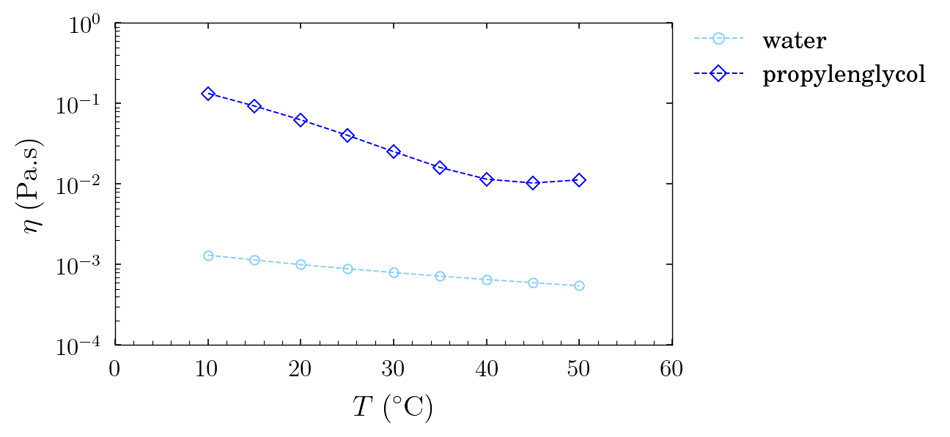
Samples presentation
1.9 wt.% of carbopol 972p
in propylenglycol
0.5 wt.% of carbopol SF2
in water
6 wt.% of pnipam
synthetized with SDS
in propylenglycol
Solvents
high dependency of viscosity
with temperature for propylenglycol,
less blatant for water

Slide 2
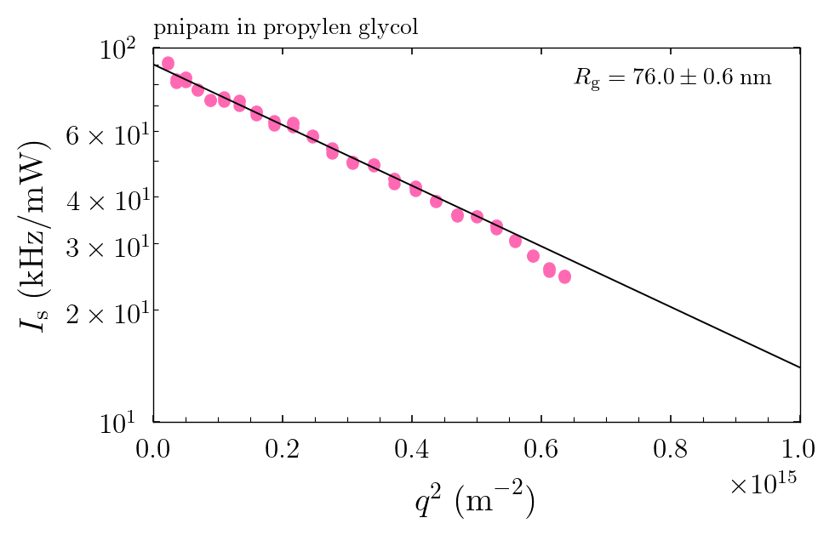
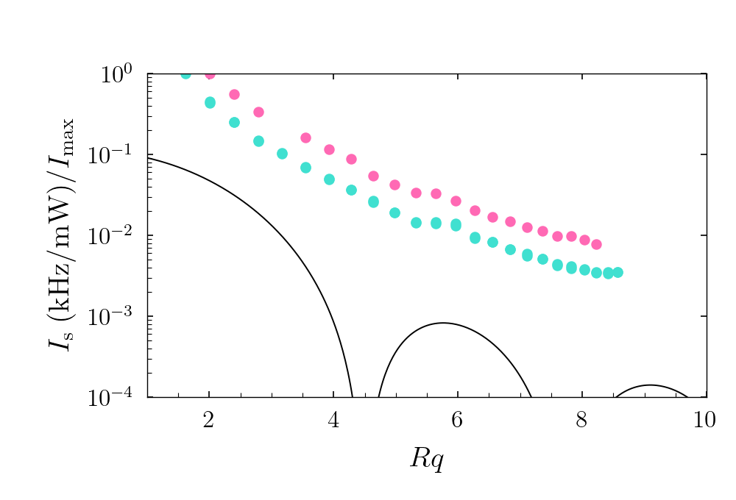
Light scattering
pnipam
synthetized with SDS
in propylenglycol
carbopol SF2
in water
Guinier fit because they are small
carbopol 972p
in propylenglycol
faint bump corresponds to
Rg ~ 340nm for both temperatures
to be done (lots of
dust in samples from
Milan)
50°C
T = 20°C
20°C
sphere form factor
(sample diluted 2x since last
measurements, same shape)

Slide 3
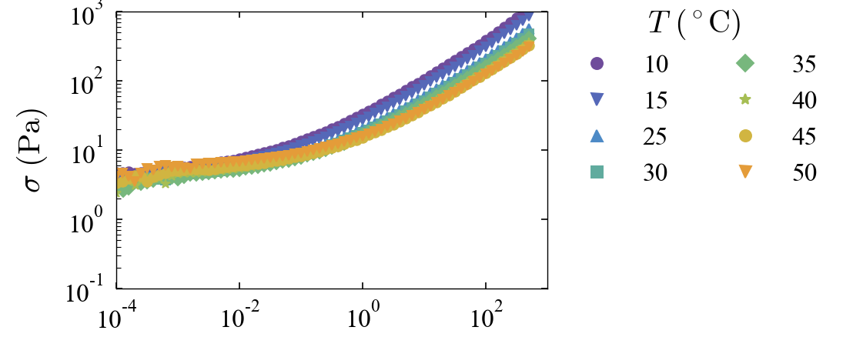
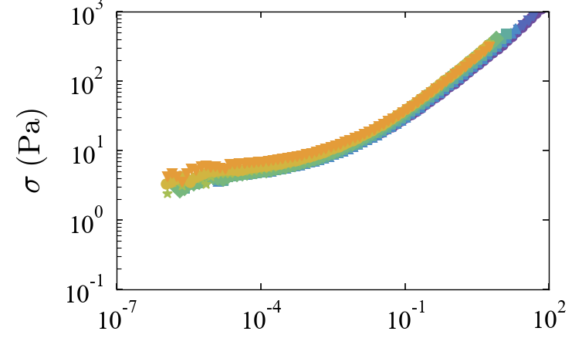
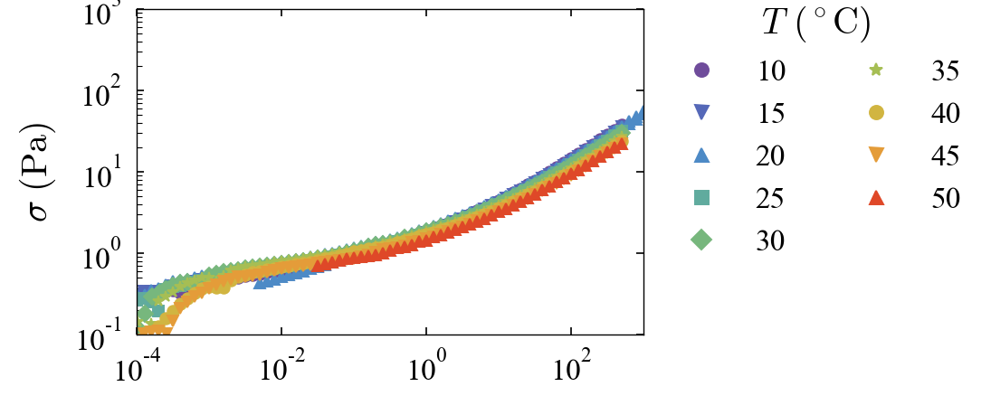
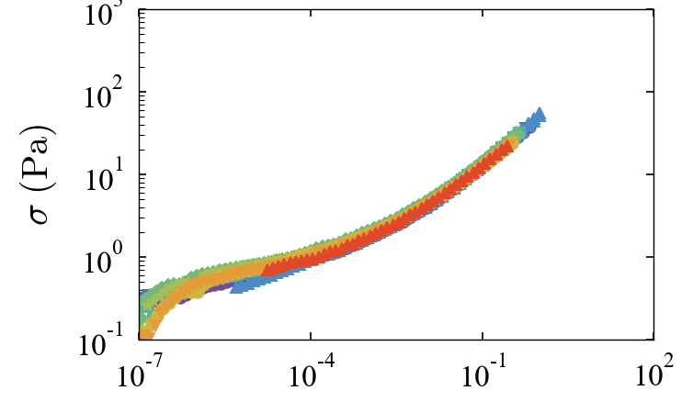
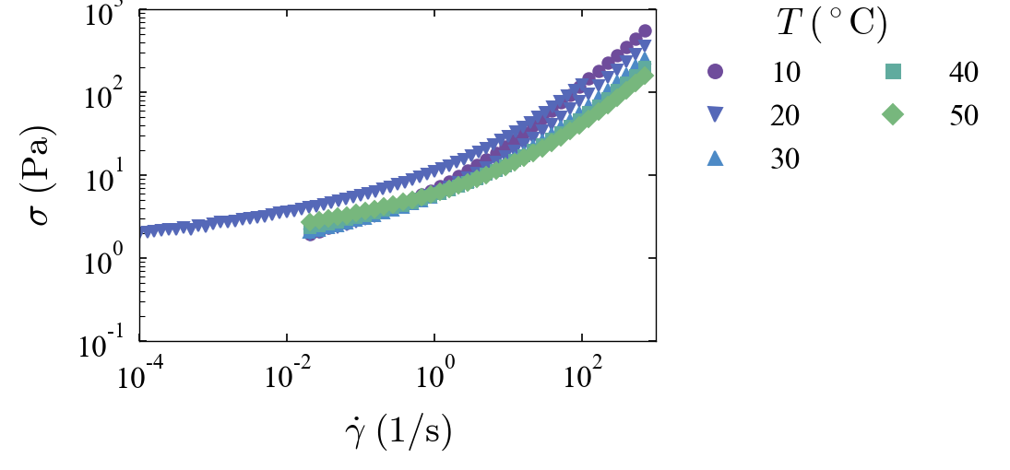
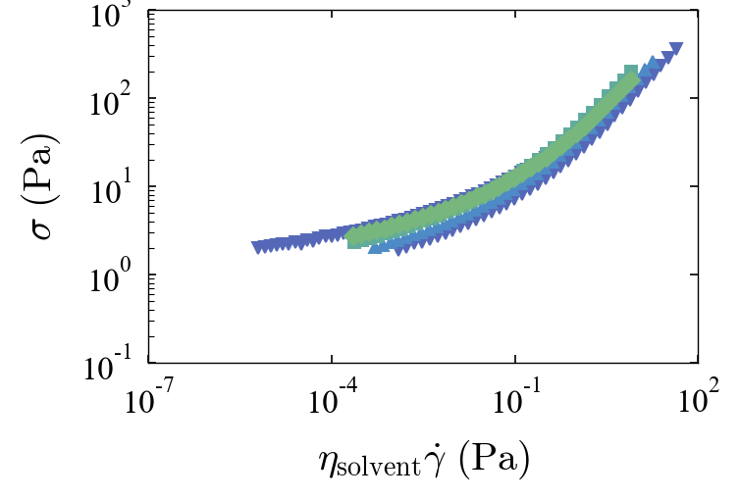
Raw data of flow curves
carbopol 972p
in propylenglycol
carbopol SF2
in water
pnipam
synthetized with SDS
in propylenglycol

Slide 4
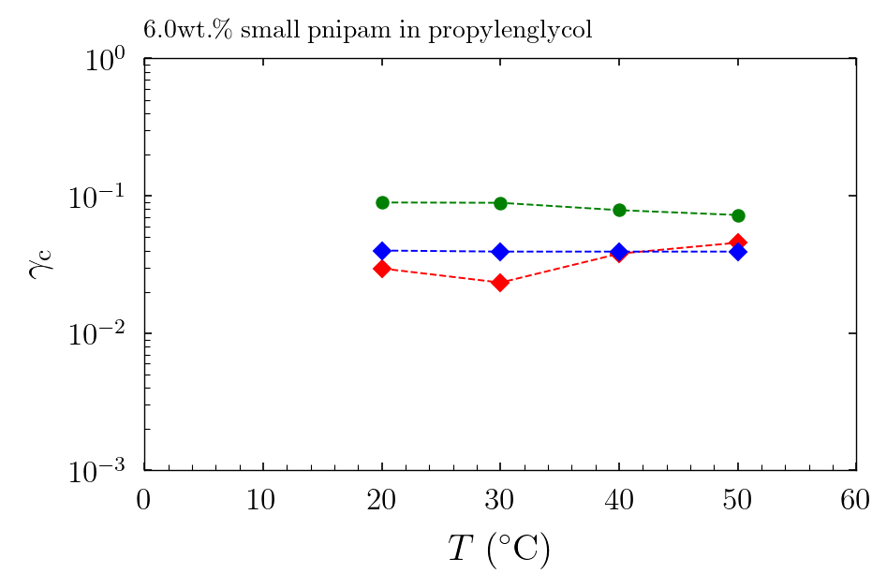
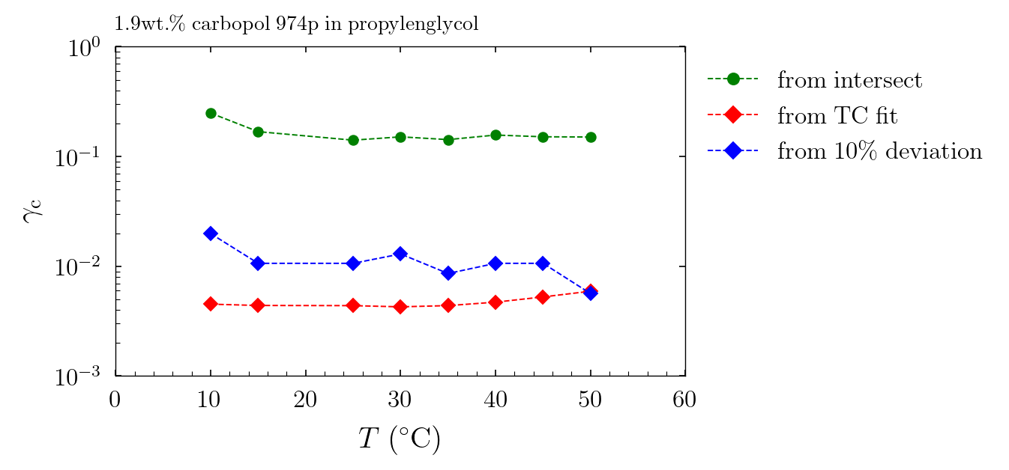
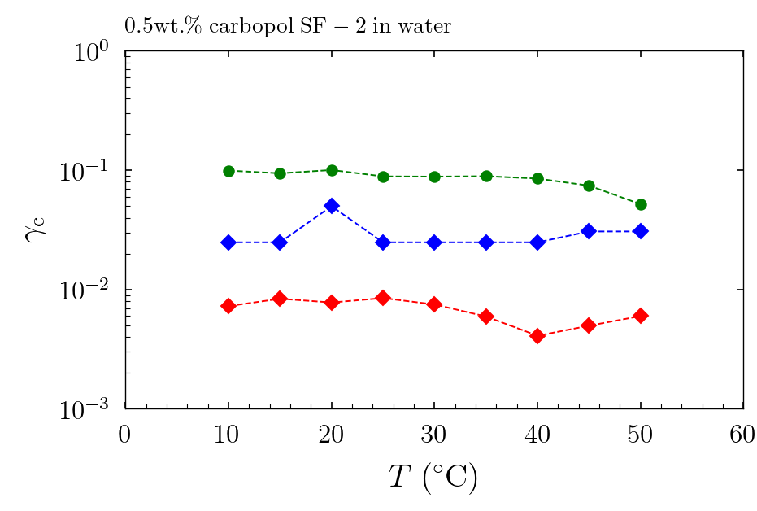
Temperature effect Critical strains from amplitude sweeps and from TC fit
3 different samples, evolution with temperature
critical strain is constant but has three different definitions that don’t seem equivalent for all microgels

Slide 5
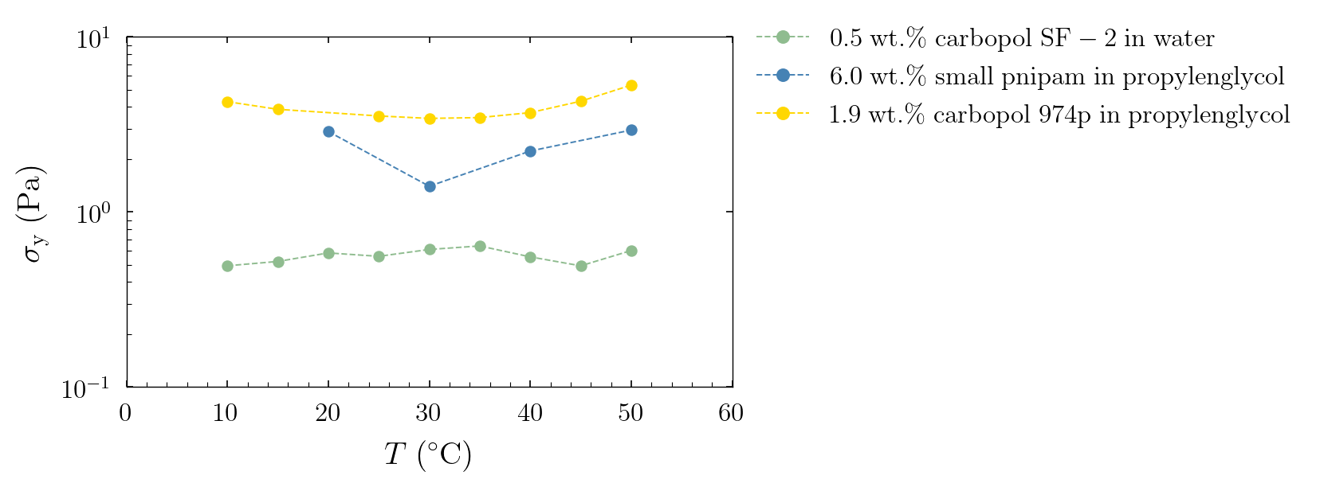
Temperature effect dynamic yield stress from TC fit
temperature does not impact yield stress

Slide 6
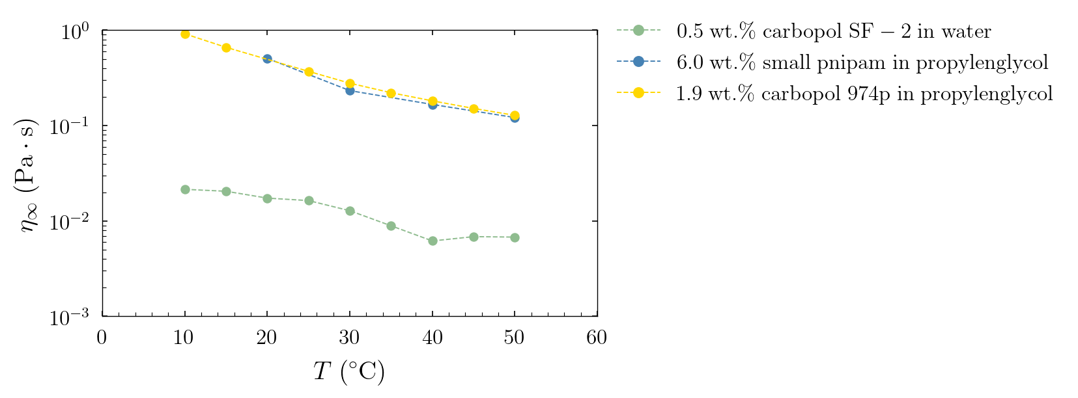
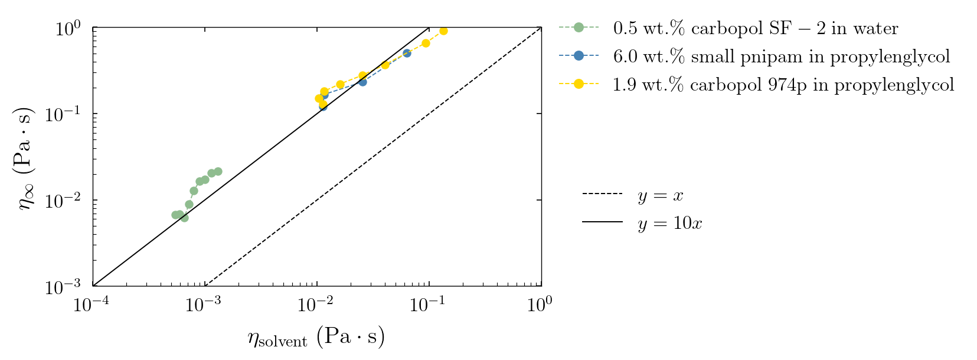
Temperature effect viscosities
on top: eta infinity extracted from TC fit
is the same for two different microgels !
at bottom: eta infinity scales linearly with
the viscosity from literature for two solvents

Slide 7
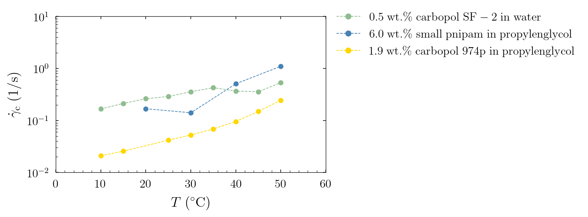
Temperature effect on caracteristic shear rate

Slide 8
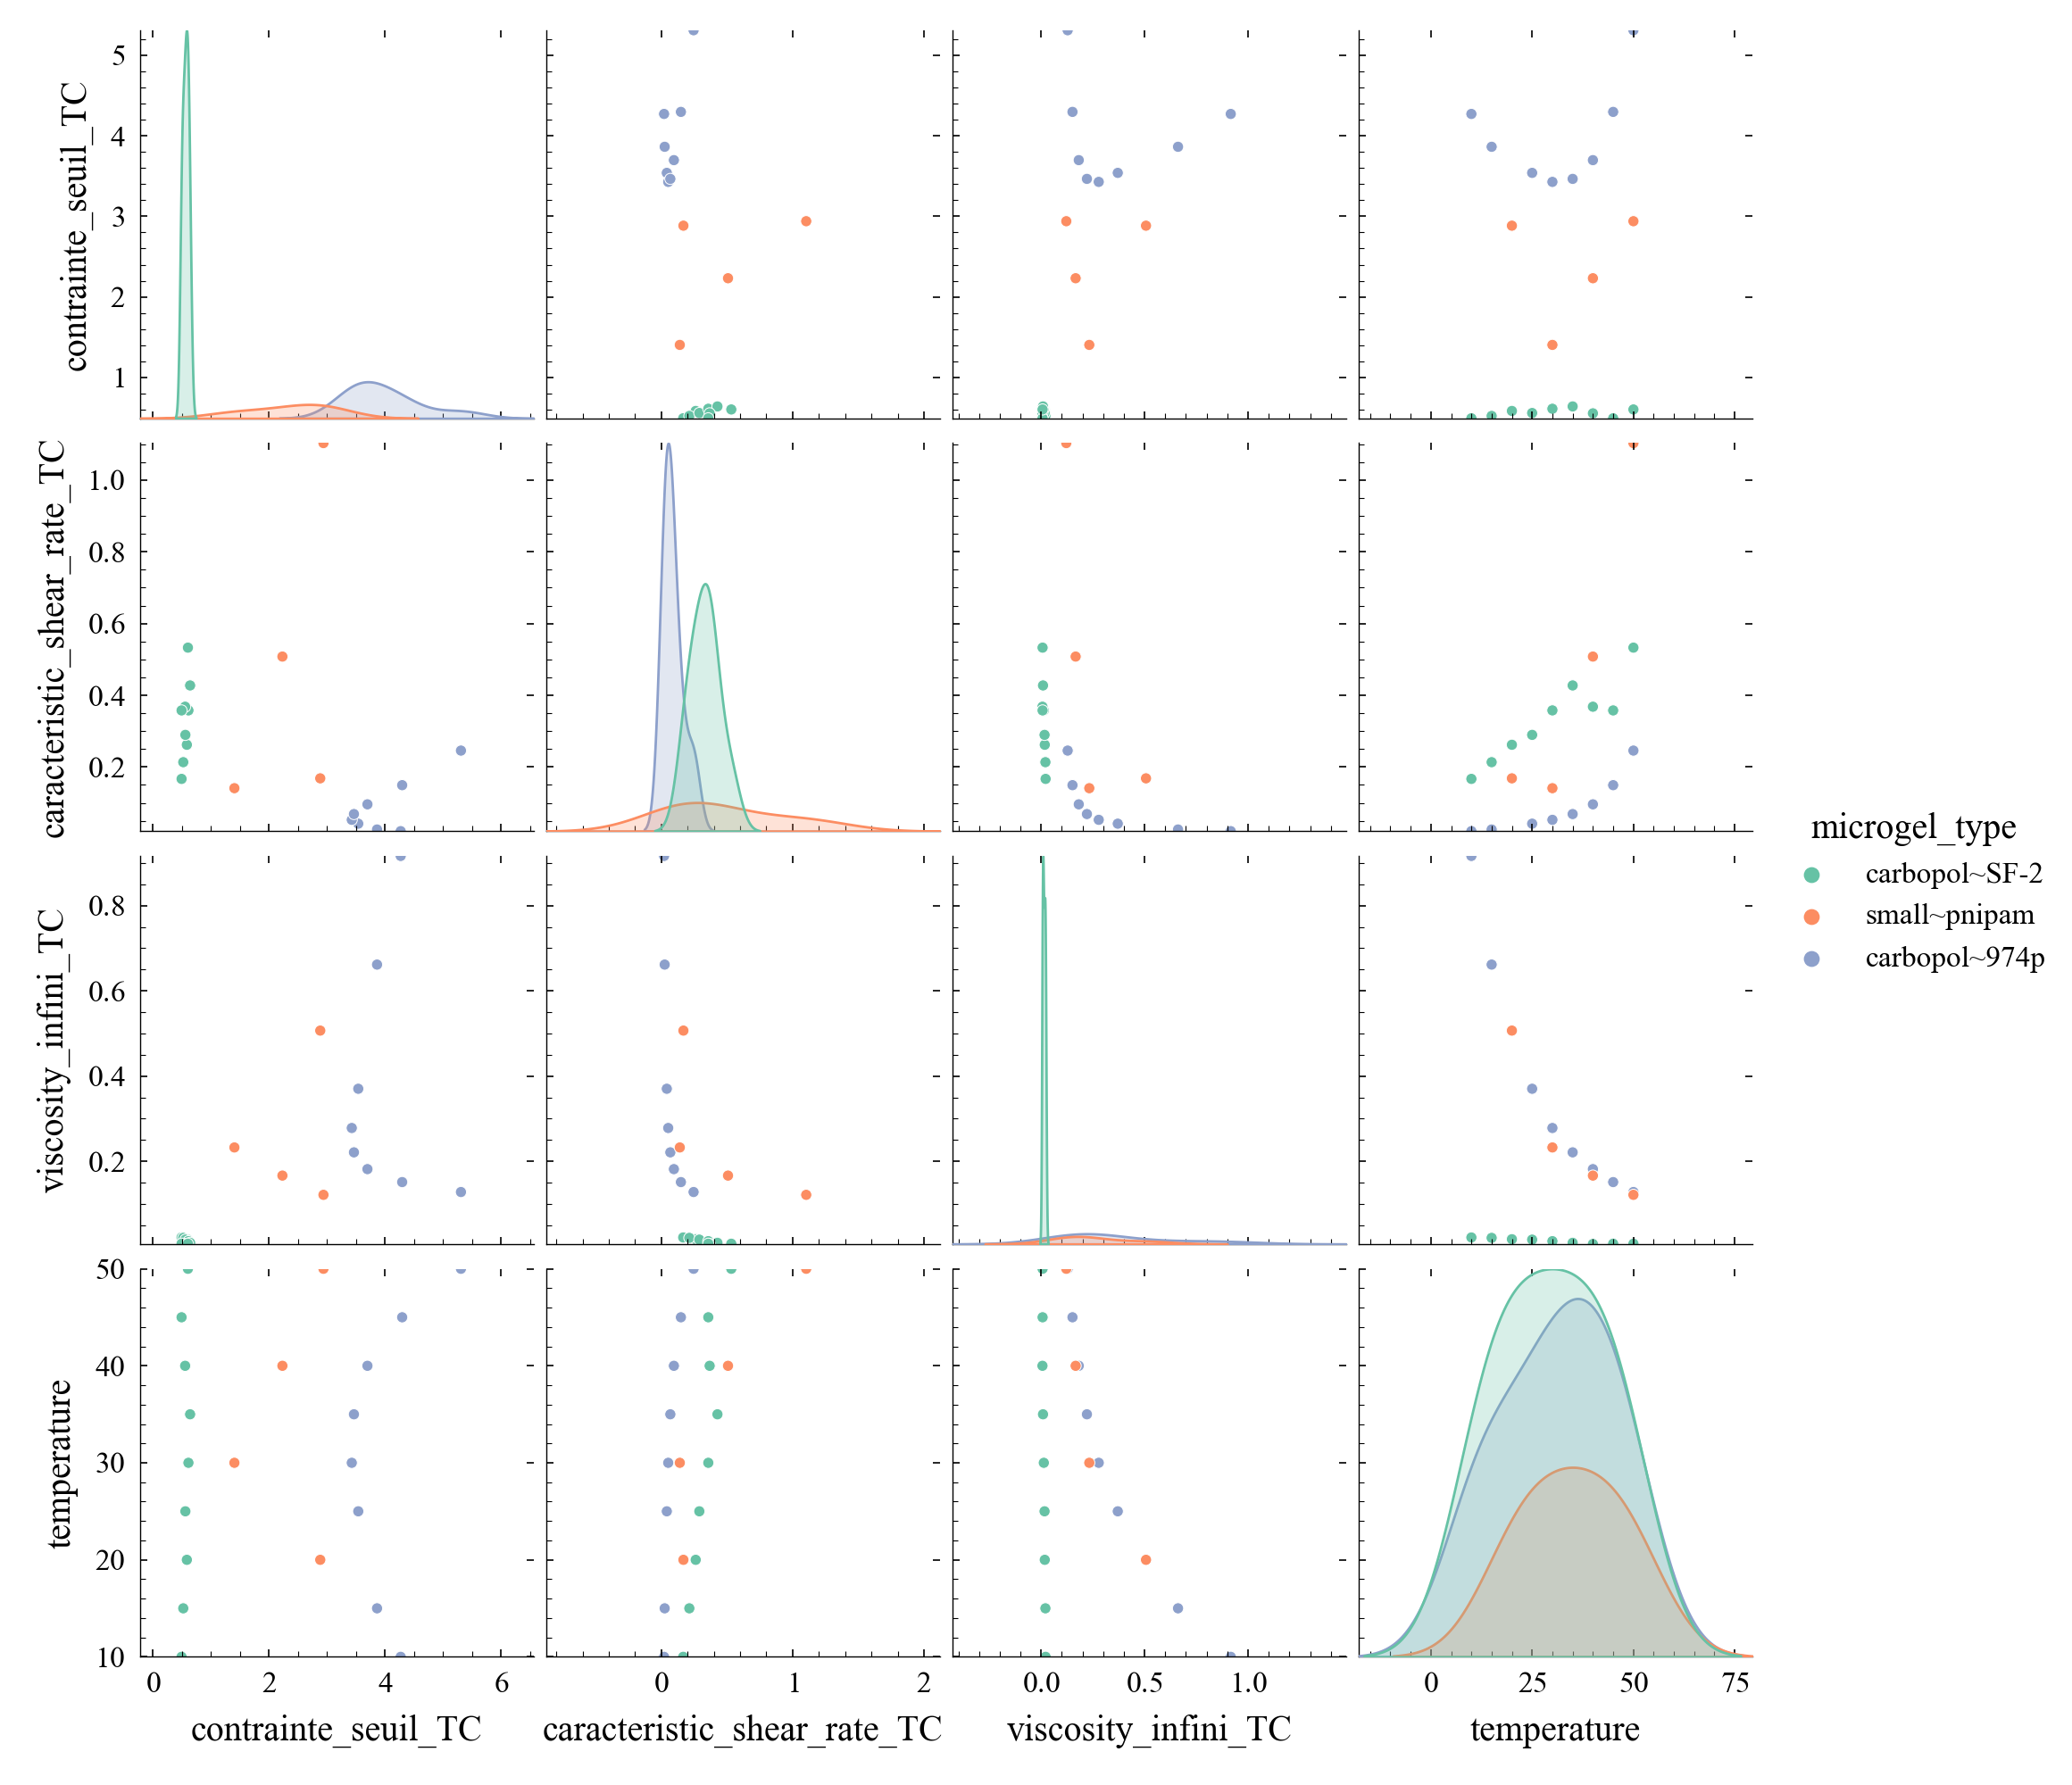
Scatter matrix for TC model
yield stress here,
sorry Marco for the french
name in my code
in water
in propylenglycol
in propylenglycol

Slide 9
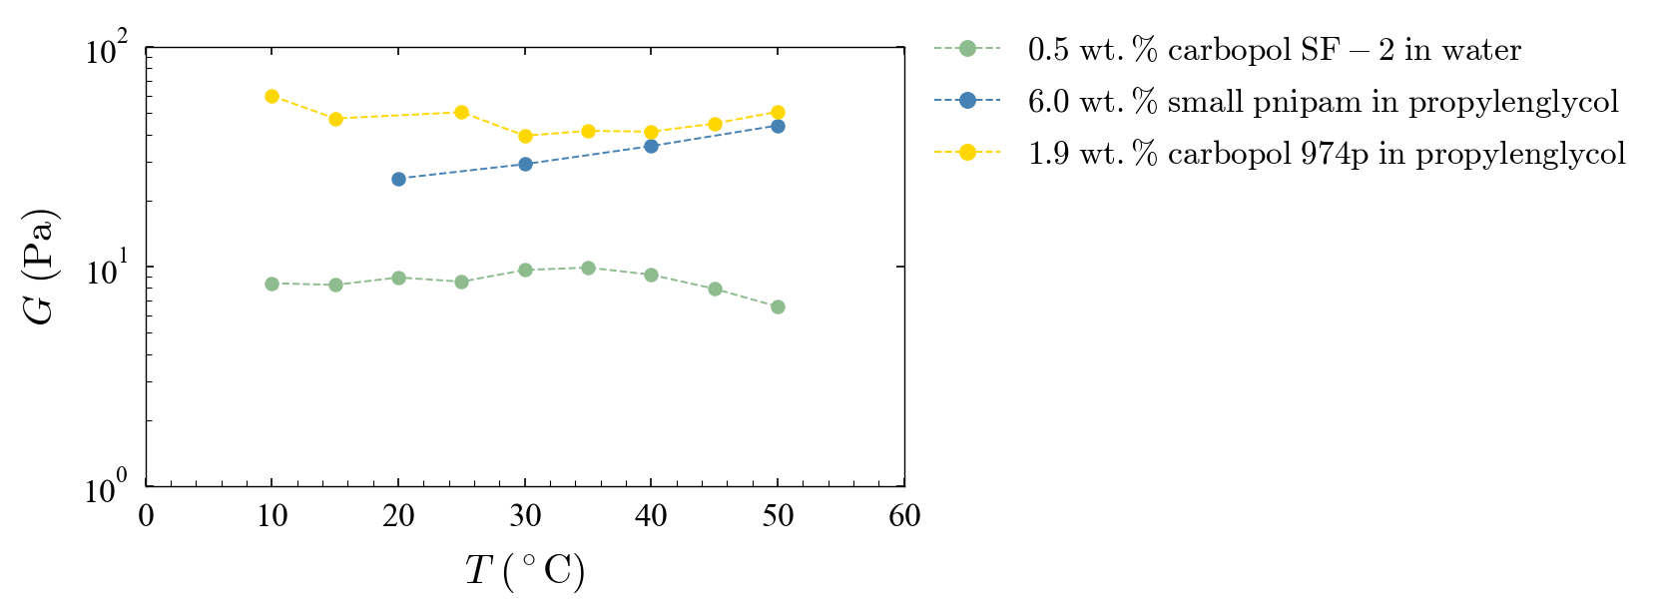
Temperature effect on elastic modulus
small effect, unclear tendency

