Slide 1
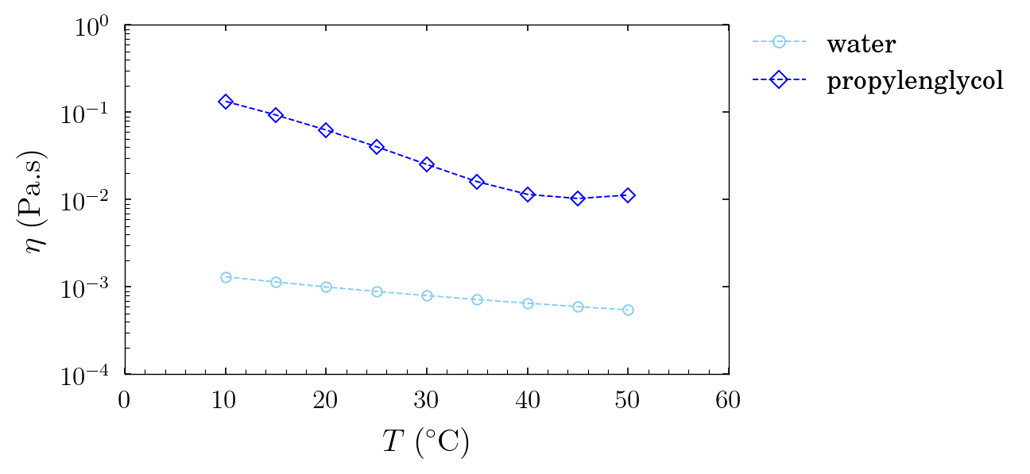
Samples presentation
1.9 wt.% of carbopol 972p
in propylenglycol
0.5 wt.% of carbopol SF2
in water
6 wt.% of pnipam
synthetized with SDS
in propylenglycol
Solvents
high dependency of viscosity
with temperature for propylenglycol,
less blatant for water

Slide 2
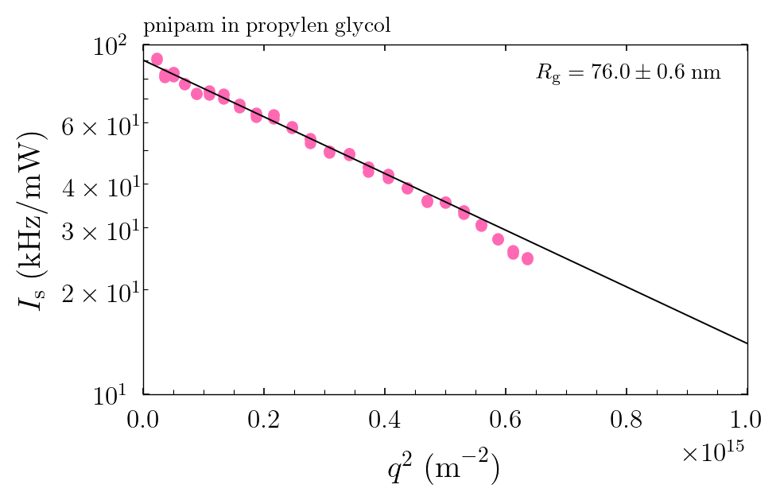
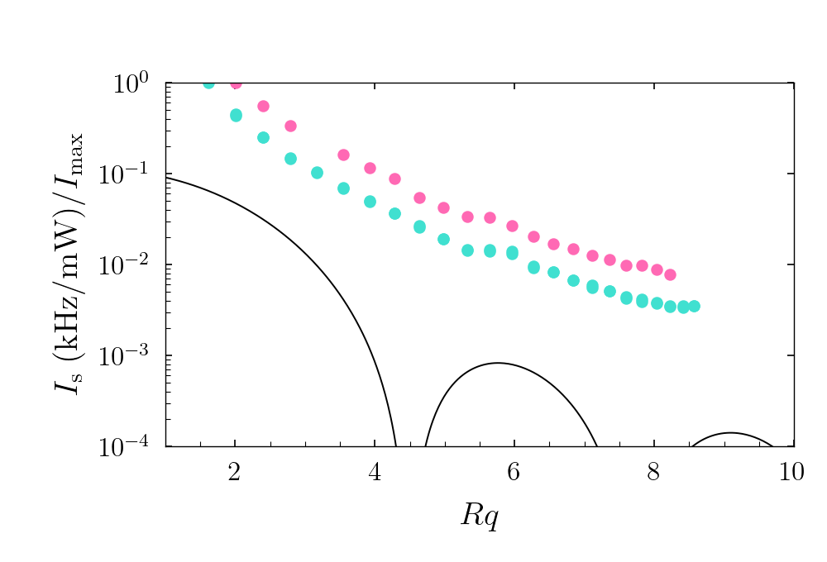
Light scattering
pnipam
synthetized with SDS
in propylenglycol
carbopol SF2
in water
Guinier fit because they are small
carbopol 972p
in propylenglycol
faint bump corresponds to
Rg ~ 340nm for both temperatures
to be done (lots of
dust in samples from
Milan)
50°C
T = 20°C
20°C
sphere form factor
(sample diluted 2x since last
measurements, same shape)

Slide 3
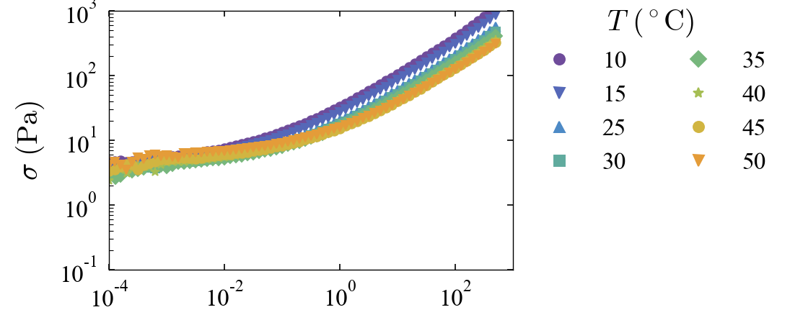
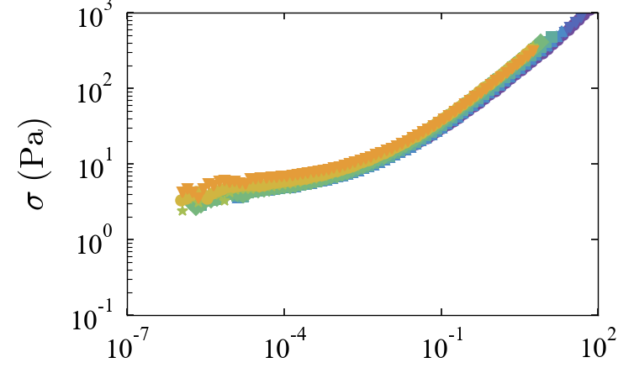
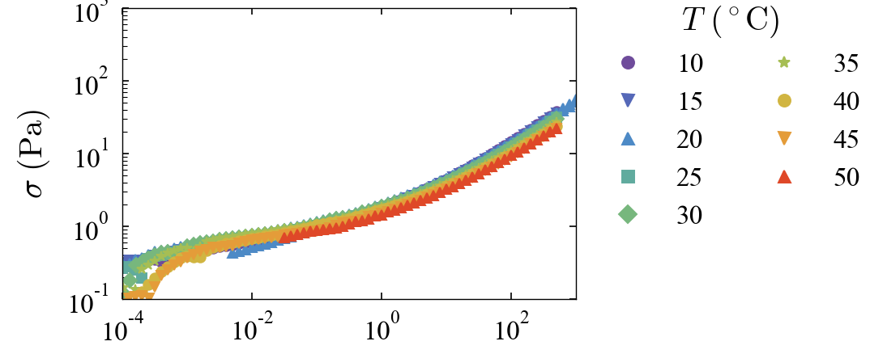
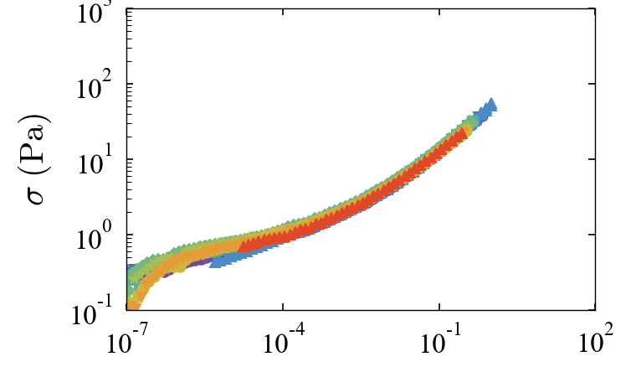
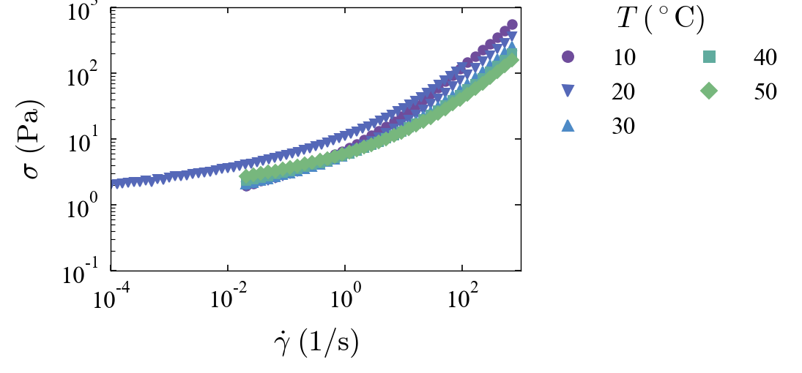
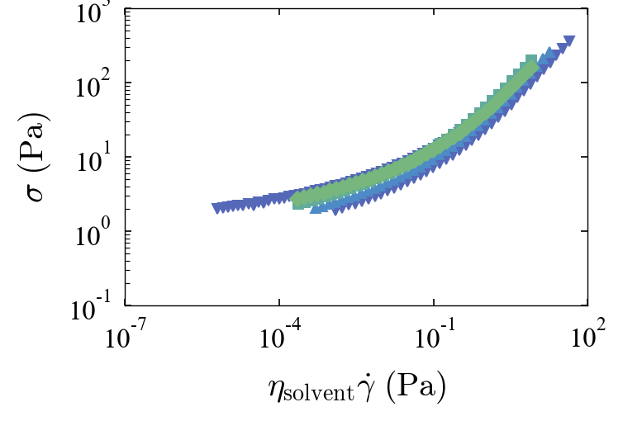
Raw data of flow curves
carbopol 972p
in propylenglycol
carbopol SF2
in water
pnipam
synthetized with SDS
in propylenglycol

Slide 4
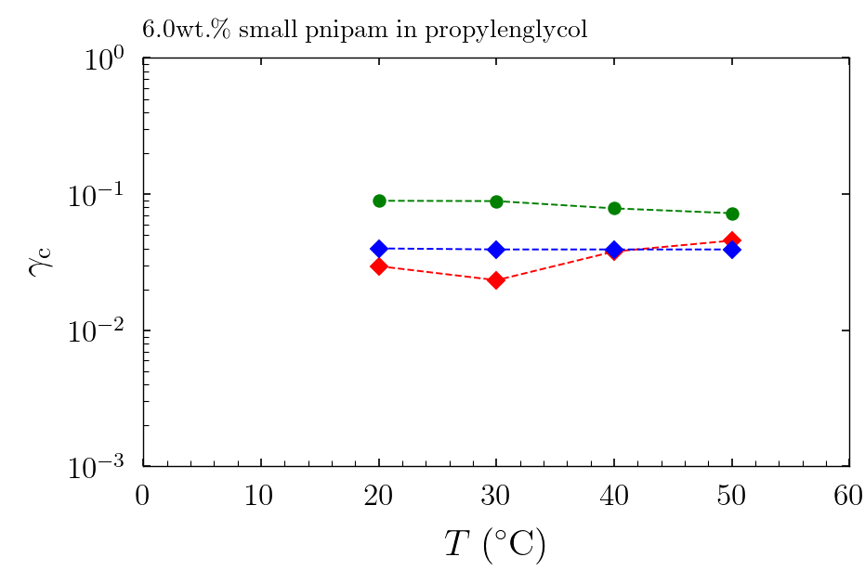
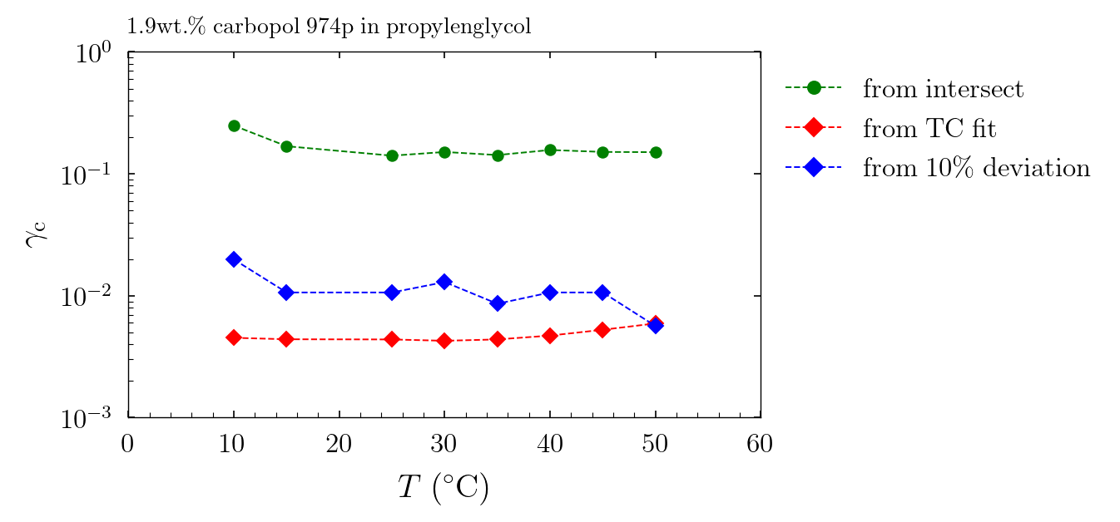
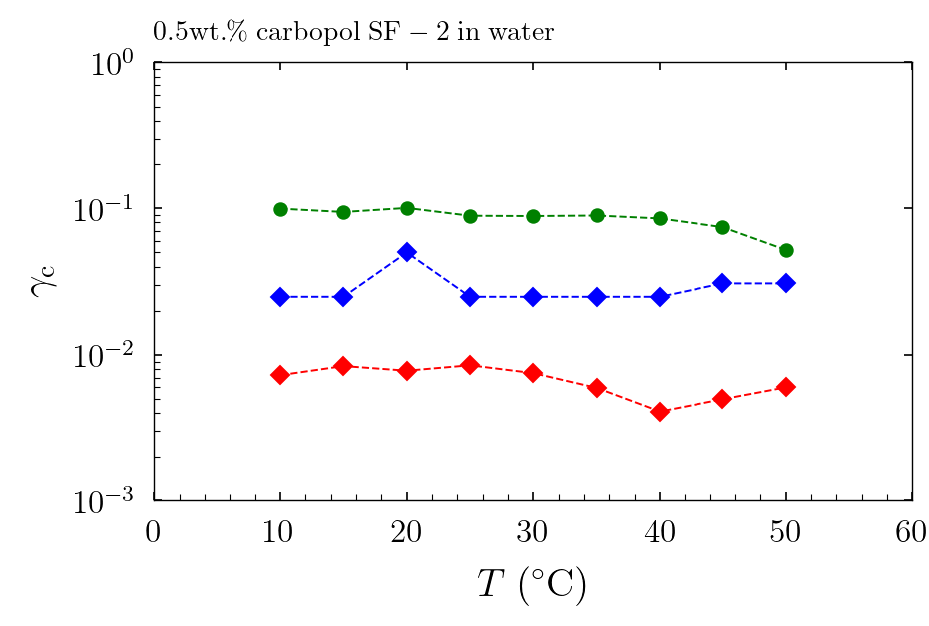
Temperature effect Critical strains from amplitude sweeps and from TC fit
3 different samples, evolution with temperature
critical strain is constant but has three different definitions that don’t seem equivalent for all microgels

Slide 5
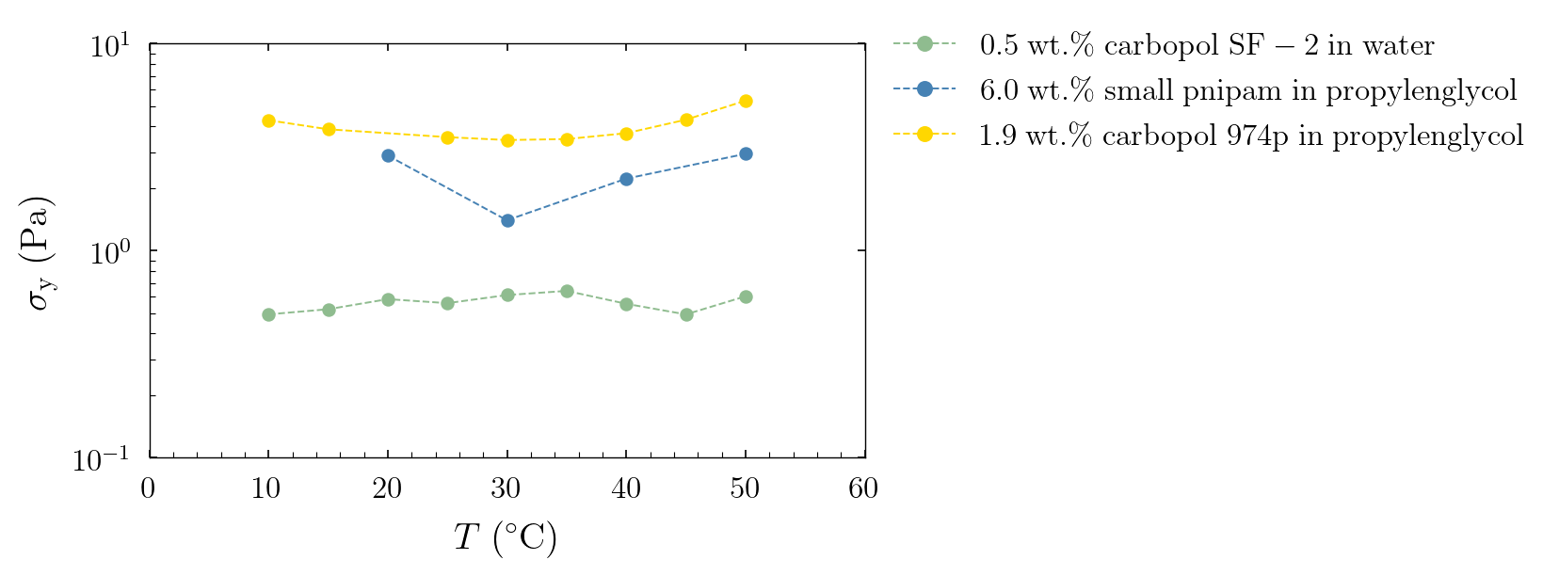
Temperature effect dynamic yield stress from TC fit
temperature does not impact yield stress

Slide 6
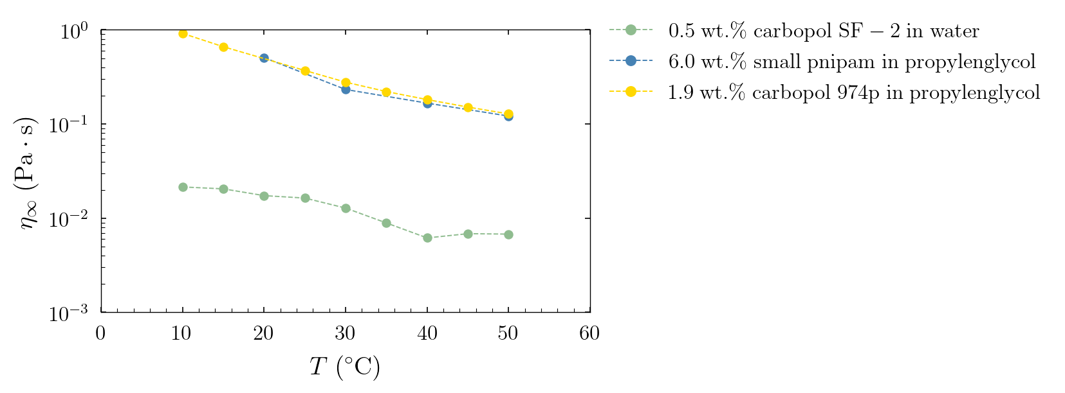
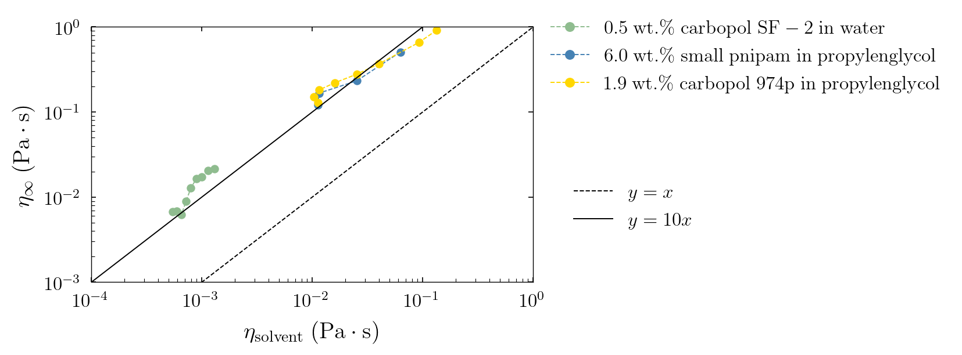
Temperature effect viscosities
on top: eta infinity extracted from TC fit
is the same for two different microgels !
at bottom: eta infinity scales linearly with
the viscosity from literature for two solvents

Slide 7
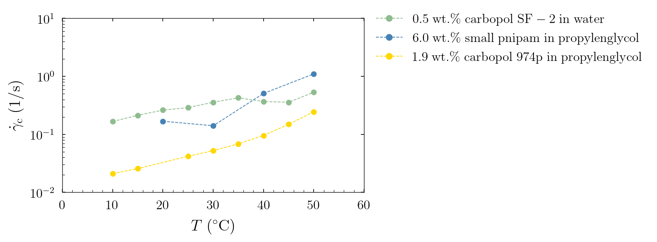
New questions:
Athermal – why par changes
What sets the terminal viscosity f(vol_frac)?
Crit shear rate – just inv prop to term visc

Slide 8
Temperature effect on caracteristic shear rate

Slide 9
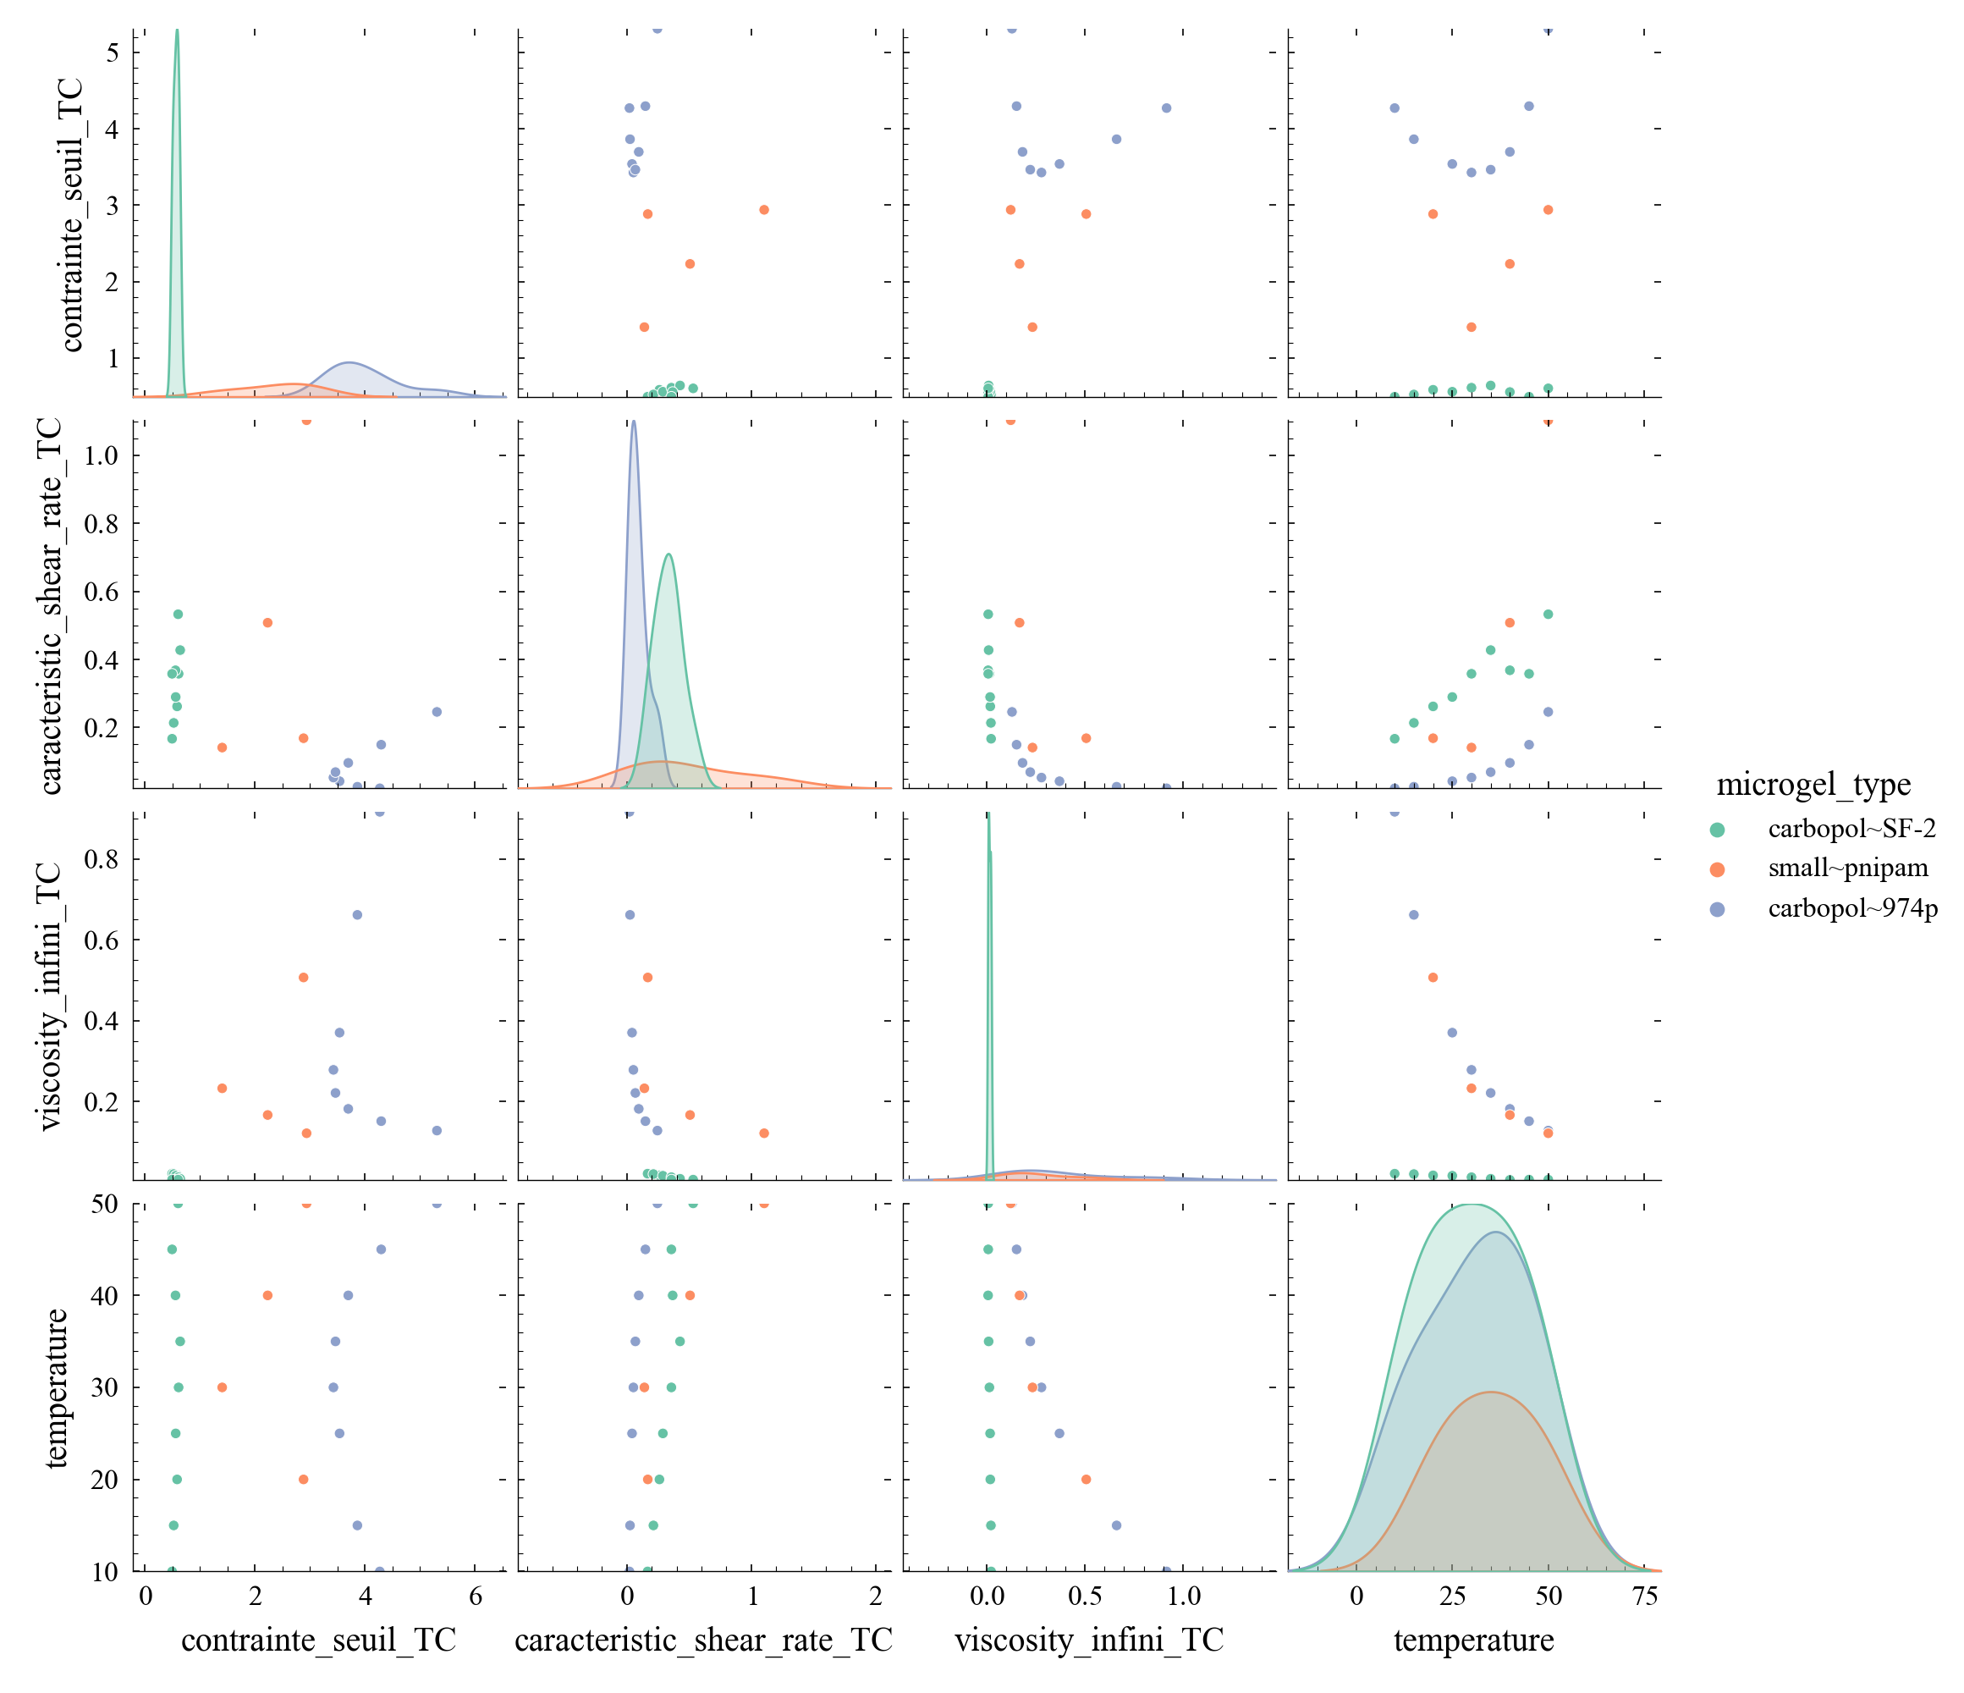
Scatter matrix for TC model
yield stress here,
sorry Marco for the french
name in my code
in water
in propylenglycol
in propylenglycol

Slide 10
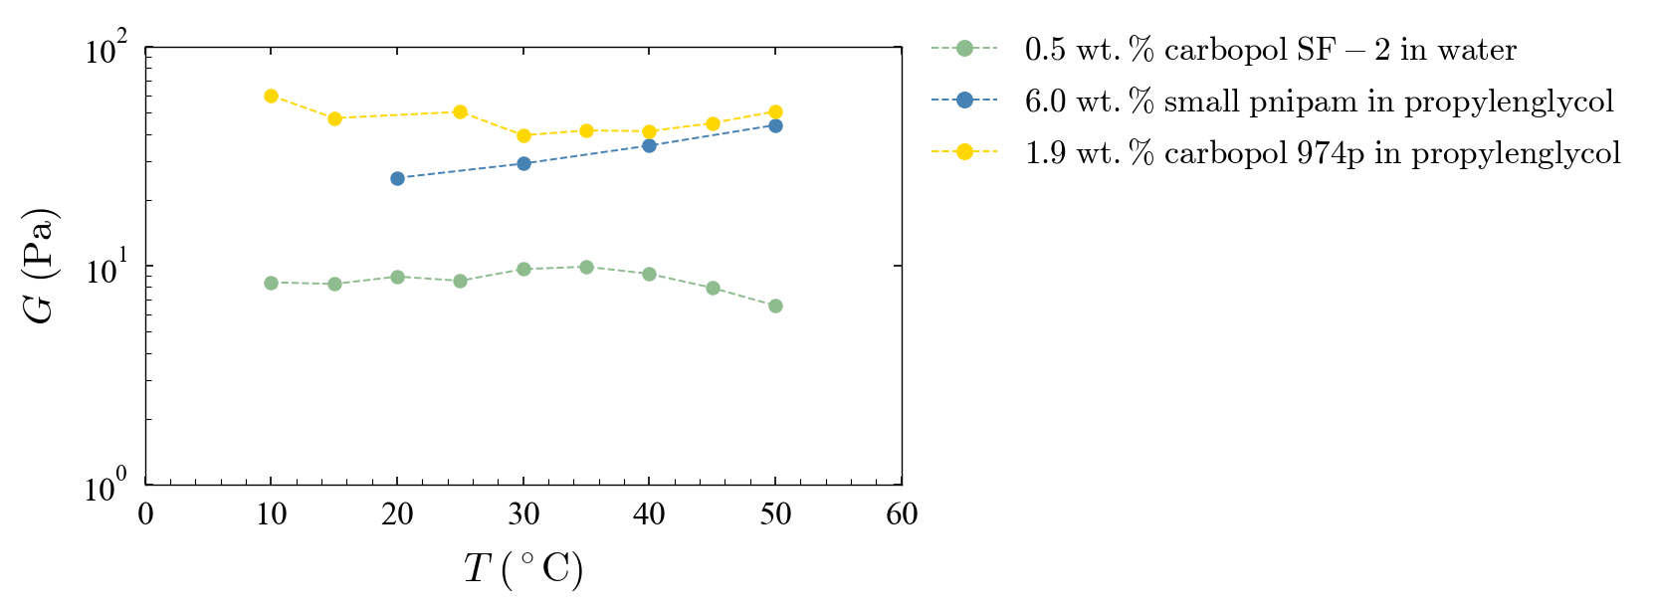
Temperature effect on elastic modulus
small effect, unclear tendency

