Slide 1
Scalable and Secure Architecture for Online Assessments and Evaluation
Prof. Chandrashekar Ramanathan
Samvaad Talk
Oct 28, 2019

Slide 2
Talk Outline
Background
Future Work
Architecture
Case Study
Modules
IIIT Bangalore Samvaad Oct 28, 2019

Slide 3
Background
IIIT Bangalore Samvaad Oct 28, 2019

Slide 4
Motivation
The Achilles Heel of MOOC
Manual Assessments and Evaluation
Need… Large-scale online exams
Access to much larger target population
Evaluation completed in a fraction of time compared to manual
But… such assessments today
Confined to multiple choice questions
Lack sound pedagogical rationale
IIIT Bangalore Samvaad Oct 28, 2019

Slide 5
Some Terminology
Assessment
Exam
Evaluation
Grading
Item / Item Bank
Question / Question Bank
Assessment Instrument
Question Paper
Response Types
Selection type and Supply type)
Assessment Pattern
IIIT Bangalore Samvaad Oct 28, 2019

Slide 6
Bloom’s Taxonomy with Knowledge Categories
* Bloom’s Taxonomy (Revised)
Factual
Remember
Understand
Apply
Analyze
Evaluate
Procedural
Create
Conceptual
IIIT Bangalore Samvaad Oct 28, 2019

Slide 7
Functional and TECHNICAL ARCHTECTURE
IIIT Bangalore Samvaad Oct 28, 2019

Slide 8
Functional Flow
Item Bank Generation
Assessment Instrument Generation
Assessment
Evaluation
MIS
Item Author
Question Paper Setter
Examination Centers
Examination Controller
Examination Controller
IIIT Bangalore Samvaad Oct 28, 2019

Slide 9
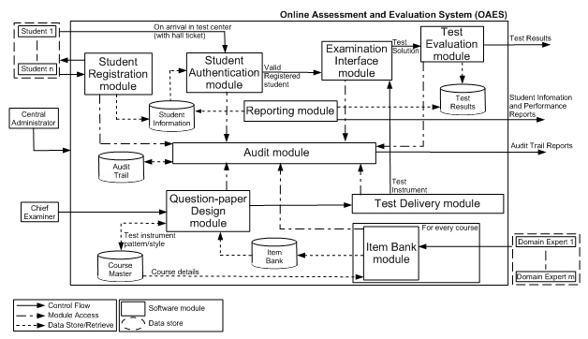
OAES Functional Modules
IIIT Bangalore Samvaad Oct 28, 2019
Notes:
<number>

Slide 10
Technical Architecture Principles
Non-centralized Operations
Centralized Monitoring
Asynchronous Data Transfer
Non-negotiable NFRs
Security
Scalability
IIIT Bangalore Samvaad Oct 28, 2019

Slide 11
Distributed and Asynchronous
Exam Admin
Module
questions
Q-paper
Q-Pack
E-Pack
marks
M-Pack
Exam
Module
Authoring
Module
Answer keys
Student Responses
A-Pack
R-Pack
Evaluation
Module
IIIT Bangalore Samvaad Oct 28, 2019

Slide 12
Security
INTRANET-ONLY
HTTPS over intranet
NO web application requires internet access
SFTP-ONLY
For Pack Transfer Over Internet
SFTP over internet
Digitally Signed
OTP-enabled
Question and answer never “travel” together
IIIT Bangalore Samvaad Oct 28, 2019

Slide 13
Scalability
Each center has its own local server for conducting online exams
Machines connected to local server over LAN (no internet required)
No need to run multi-center exams using a “central clock” (provides resilience by decoupling too)
IIIT Bangalore Samvaad Oct 28, 2019

Slide 14

Final Deployment Architecture
Intranet Zone
Secure SFTP Server in Internet Zone
Intranet Zone
Center 1
Online Evaluation
Intranet Zone
Center 2
Item bank Management
Question Paper Management
IIIT Bangalore Samvaad Oct 28, 2019

Slide 15
Authoring Module
Authoring Module
Assessment Instrument
Generator
Assessment Pattern
Generator
Assessment Pattern
Item Authoring
Item Bank
Pack Export
A-Pack
Q-Pack
IIIT Bangalore Samvaad Oct 28, 2019

Slide 16
Assessment Module
Assessment Module
Q-Pack Import
Assessment Instrument
Online Exam
Responses
R-Pack Export
E-Pack
R-Pack
Importing assessment instrument,
candidate details,
authenticator details,
exam center details
Exporting students
responses to
evaluation module
IIIT Bangalore Samvaad Oct 28, 2019

Slide 17
Exam Admin Module
M-Pack Import
Publish Grades
Q-Pack Import
Assessment Instrument
Exam
Monitor Exams
Candidates
Exam
Center
Monitor Packs
Authenticators
E-Pack Export
Importing assessment
instrument from
authoring module
Exporting assessment
instrument and exam
center details to
exam module
Importing students
grades from
evaluation module
IIIT Bangalore Samvaad Oct 28, 2019

Slide 18
Evaluation Module
R-Pack Import
Responses
Evaluation
Grades
A-Pack Import
Answer keys
M-Pack Export
Importing students
responses from
exam module
Exporting students
responses to
evaluation module
Importing expected
response from
authoring module
IIIT Bangalore Samvaad Oct 28, 2019

Slide 19
Exam Administration Module
Exam Administration Module
Exam Management
Import / Export
Remote Monitoring
Manage exam
Import Q-Pack
Packs monitoring
Manage exam center
Export E-Pack
Exam monitoring
Manage candidates
Import M-Pack
View exam results
IIIT Bangalore Samvaad Oct 28, 2019

Slide 20
Assessment items
IIIT Bangalore Samvaad Oct 28, 2019

Slide 21
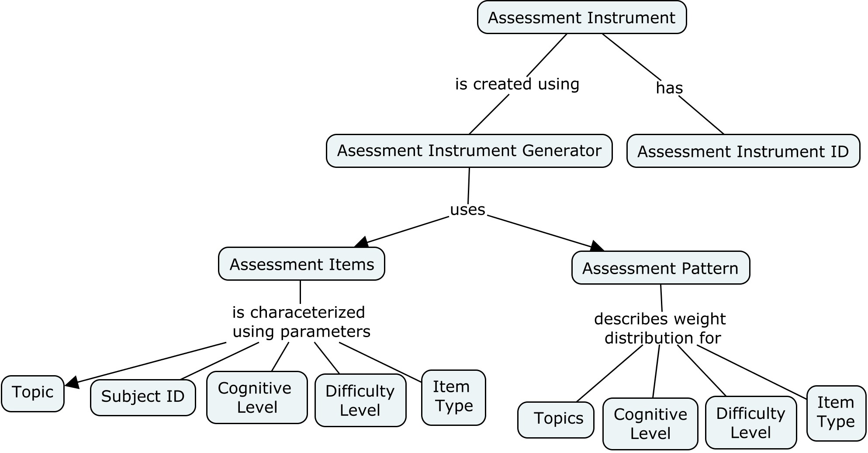
Concept Map
IIIT Bangalore Samvaad Oct 28, 2019

Slide 22
Item Types
Multiple choice
True-False
Fill in the blanks
Match the Following
Short answer*
Use feature of package
Reorder the sequence
Compute
Complete the program
Correct and complete the program
Modify code
Programming
Compare
Complete the block diagram
Complete the flow chart
Correct and complete the block diagram
Correct and complete the flow chart
Determine the output
* not what you think it is ☺
IIIT Bangalore Samvaad Oct 28, 2019

Slide 23
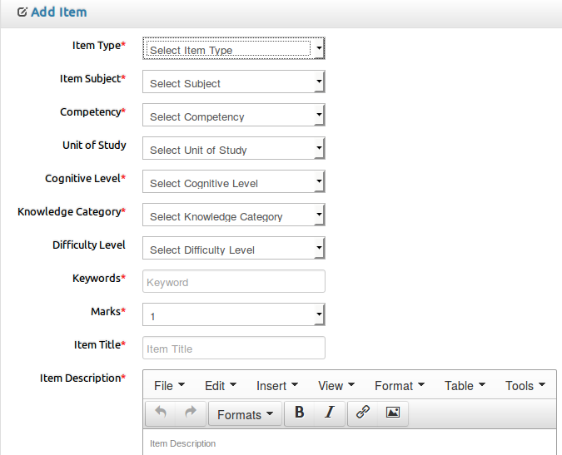
Item Meta-Data
IIIT Bangalore Samvaad Oct 28, 2019

Slide 24
CASE STUDY
IIIT Bangalore Samvaad Oct 28, 2019

Slide 25
National-level skill dev
Establish sound pedagogical rationale for assessment instruments
Develop fresh item banks using subject-matter experts
Automated assessment instrument generation from large item banks
Online assessment and automated evaluation
40 Learning Centers
Over 8 Lakh learners
75 courses
IIIT Bangalore Samvaad Oct 28, 2019

Slide 26
A Skill Dev Course in IT
Subjects
1. IT Tools and Business Systems
2. Internet Technology and Web Design
3. Programming and Problem Solving through C
4. Application of .NET Technology
5. Introduction to Multimedia
6. Introduction to ICT Resources
Item bank generation
1000 items per course covering PART A and PART B
Modules
Exam Administration
Item authoring
Instrument generation
Assessment
Evaluation
IIIT Bangalore Samvaad Oct 28, 2019

Slide 27
Status
Software Delivered
Item Bank Delivered
Independent security testing and certification done
Pilot Completed
Item Bank
SNo. | Subject | 1 Mark | 5 Marks | 10 Marks | Total
1 | IT Tools and Business Systems | 998 | 357 | 145 | 1500
2 | Internet Technology and Web Design | 1090 | 235 | 160 | 1485
3 | Programming and Problem Solving through ‘C’ language | 1072 | 384 | 111 | 1567
4 | Application of .NET Technology | 660 | 115 | 30 | 805
5 | Introduction to Multimedia | 410 | 313 | 73 | 796
6 | Introduction to ICT Resources | 740 | 307 | 98 | 1145
 | Total | 4970 | 1711 | 617 | 7298
IIIT Bangalore Samvaad Oct 28, 2019

Slide 28
FUTURE WORK
IIIT Bangalore Samvaad Oct 28, 2019

Slide 29
More can be done
Support more “supply type” items
Drawing type, essay type, lab type etc.
Add more security features
Block chain for high-stakes exams??
Incorporate feedback mechanism in evaluation
Use it for formative as well as summative assessments
And you guessed it…
Use historical data to personalize learners’ experience and also improve quality of assessment instruments and assessment items using Analytics/AI/ML
IIIT Bangalore Samvaad Oct 28, 2019

Slide 30
Thank YOU
Prof. Chandrashekar Ramanathan
IIIT Bangalore
rc@iiitb.ac.in
IIIT Bangalore Samvaad Oct 28, 2019

Slide 31
Backup SLIDES
IIIT Bangalore Samvaad Oct 28, 2019

Slide 32
IIIT Bangalore Samvaad Oct 28, 2019

Slide 33
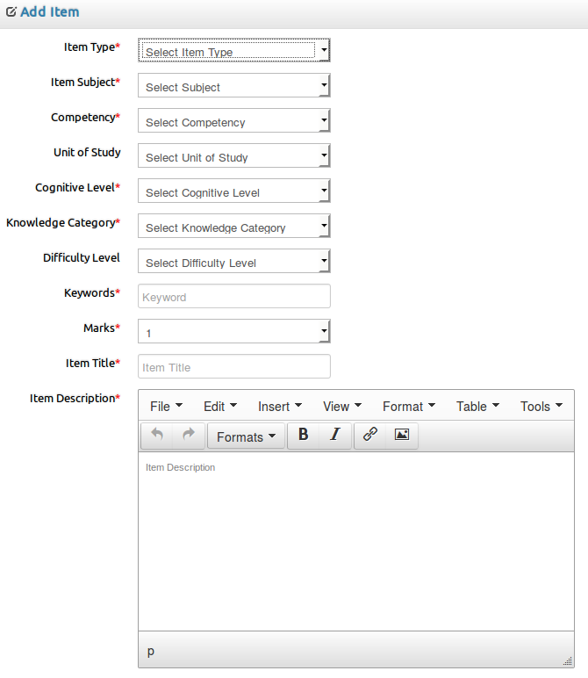
IIIT Bangalore Samvaad Oct 28, 2019

Slide 34
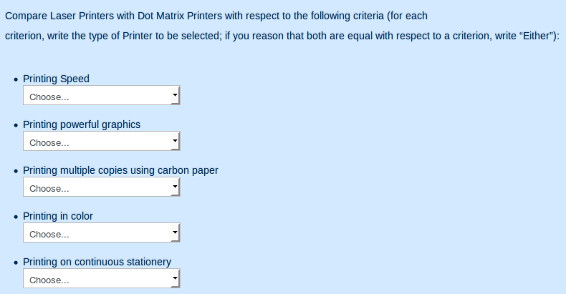
IIIT Bangalore Samvaad Oct 28, 2019

Slide 35
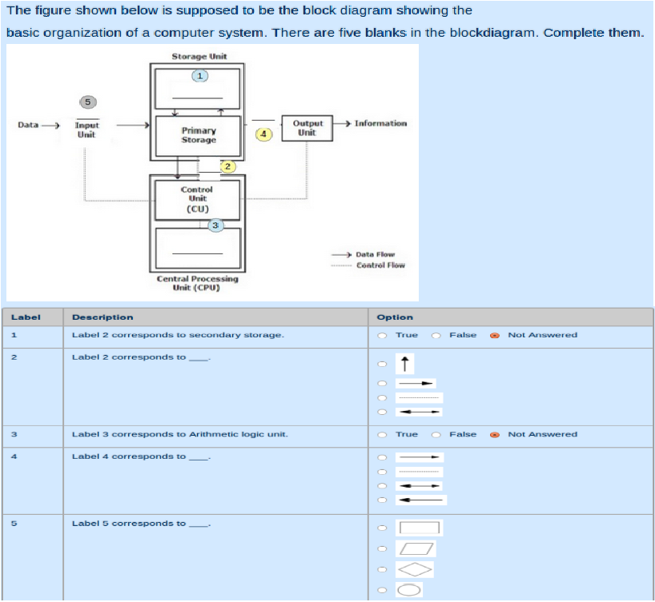
IIIT Bangalore Samvaad Oct 28, 2019

Slide 36
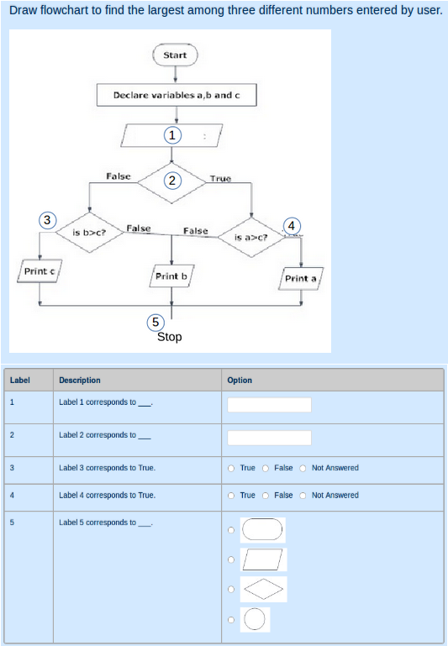
IIIT Bangalore Samvaad Oct 28, 2019

Slide 37
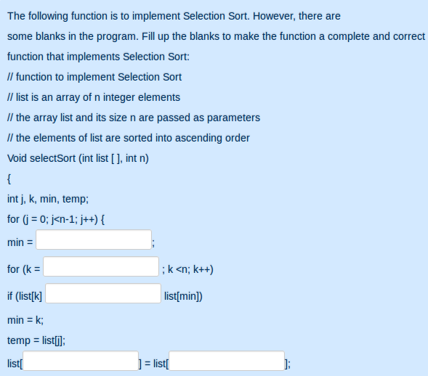
IIIT Bangalore Samvaad Oct 28, 2019

Slide 38
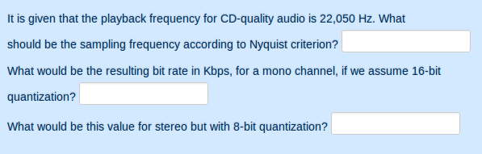
IIIT Bangalore Samvaad Oct 28, 2019

Slide 39
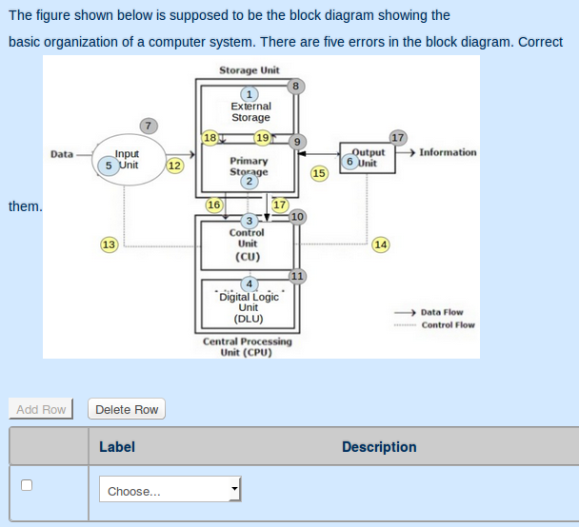
IIIT Bangalore Samvaad Oct 28, 2019

Slide 40
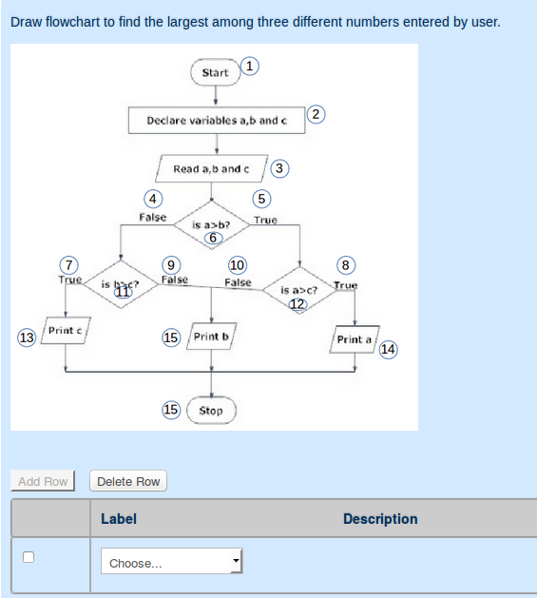
IIIT Bangalore Samvaad Oct 28, 2019

Slide 41
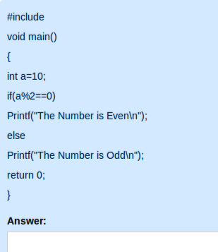
IIIT Bangalore Samvaad Oct 28, 2019

Slide 42
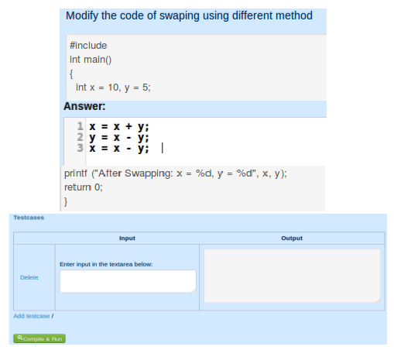
IIIT Bangalore Samvaad Oct 28, 2019

Slide 43
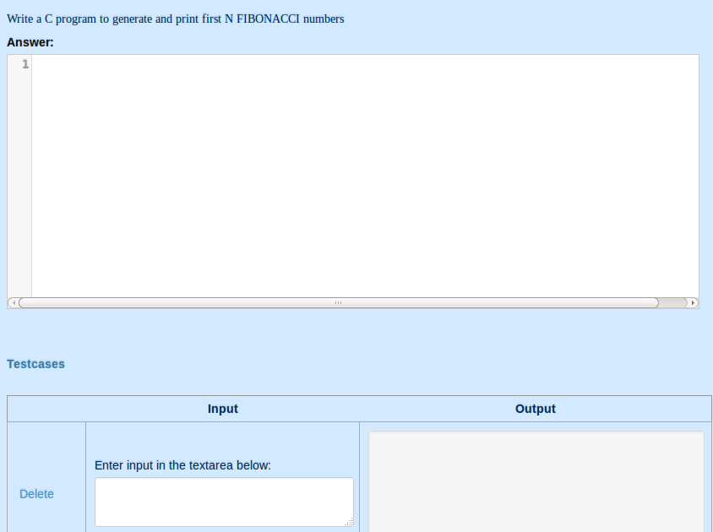
IIIT Bangalore Samvaad Oct 28, 2019

Slide 44
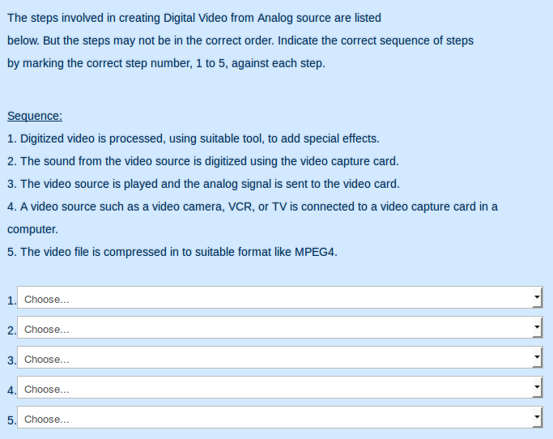
IIIT Bangalore Samvaad Oct 28, 2019

Slide 45
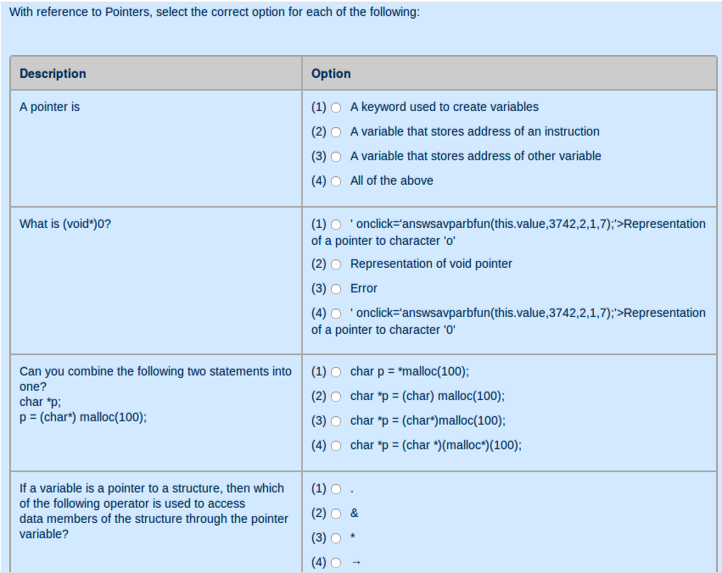
IIIT Bangalore Samvaad Oct 28, 2019

Slide 46
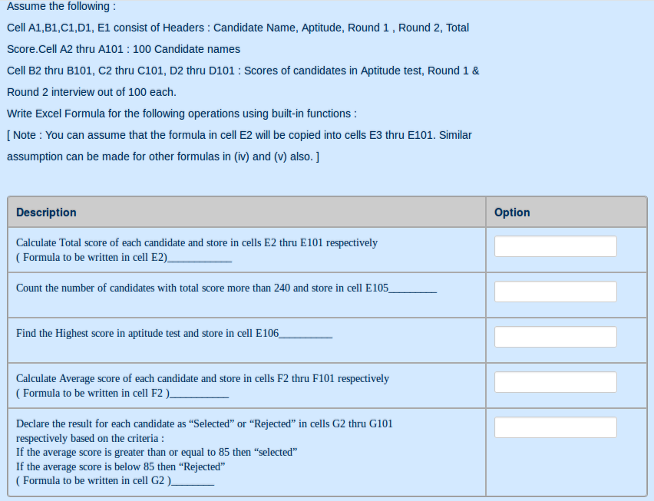
IIIT Bangalore Samvaad Oct 28, 2019

Slide 47
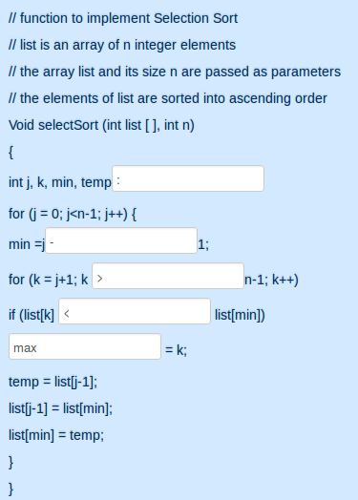
IIIT Bangalore Samvaad Oct 28, 2019

Slide 48
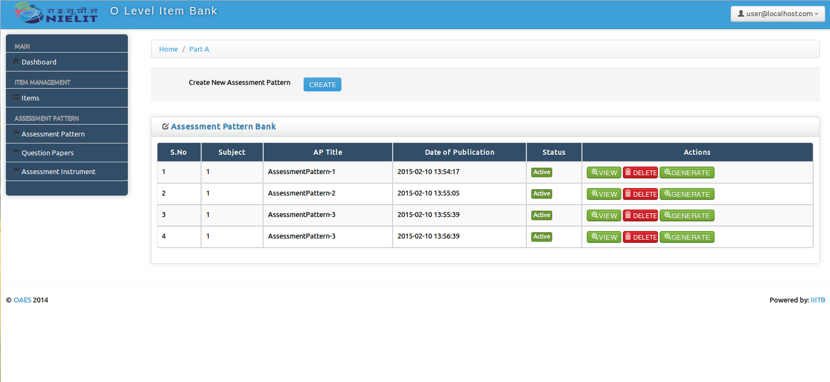
Assessment pattern

Slide 49
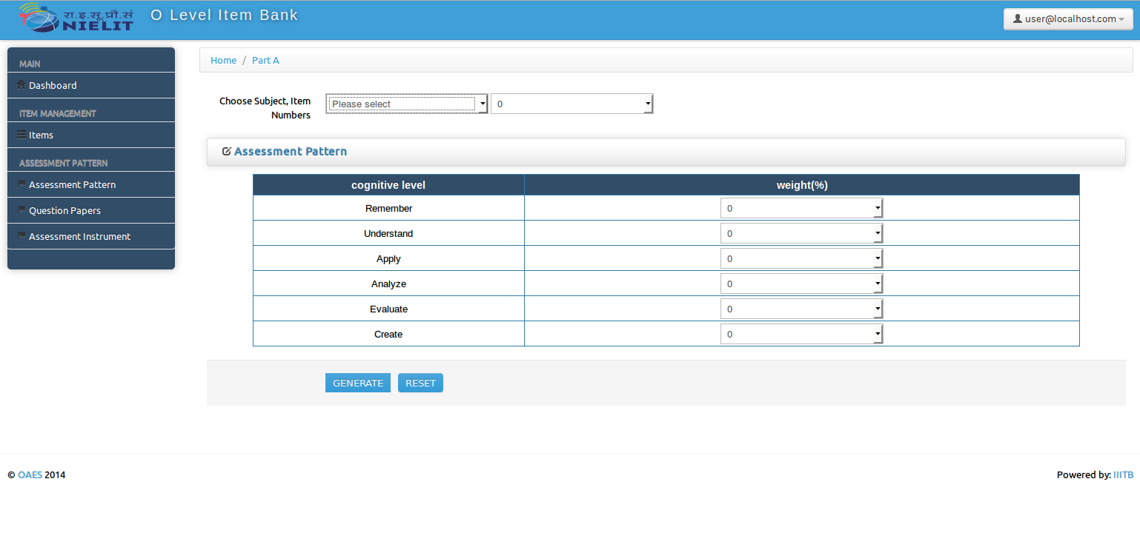
Create Assessment pattern

Slide 50
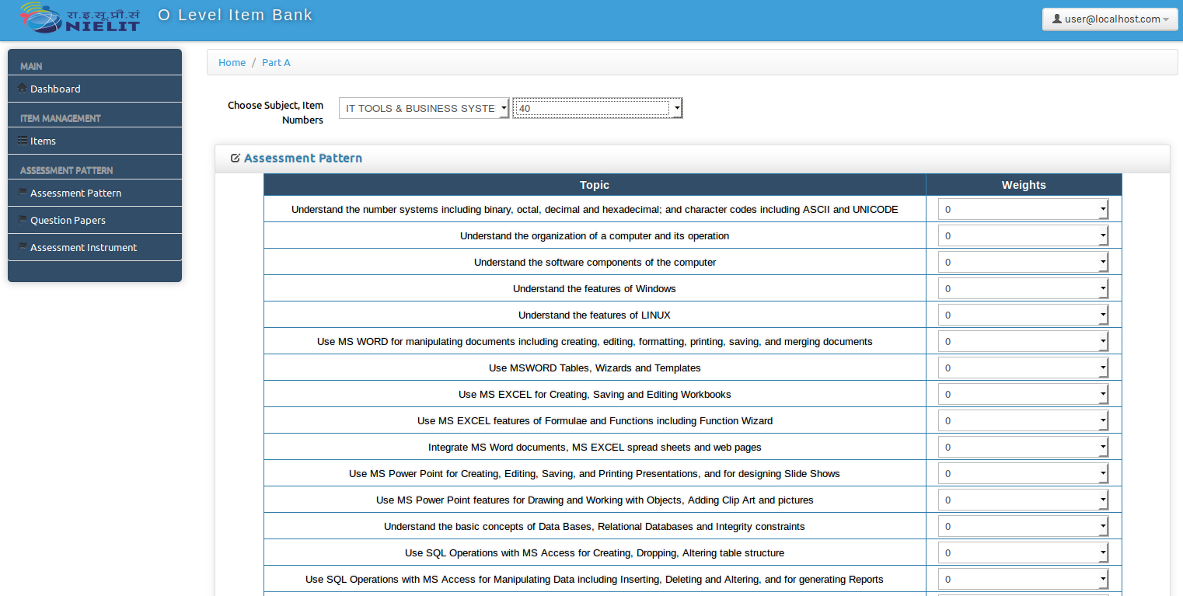

Slide 51
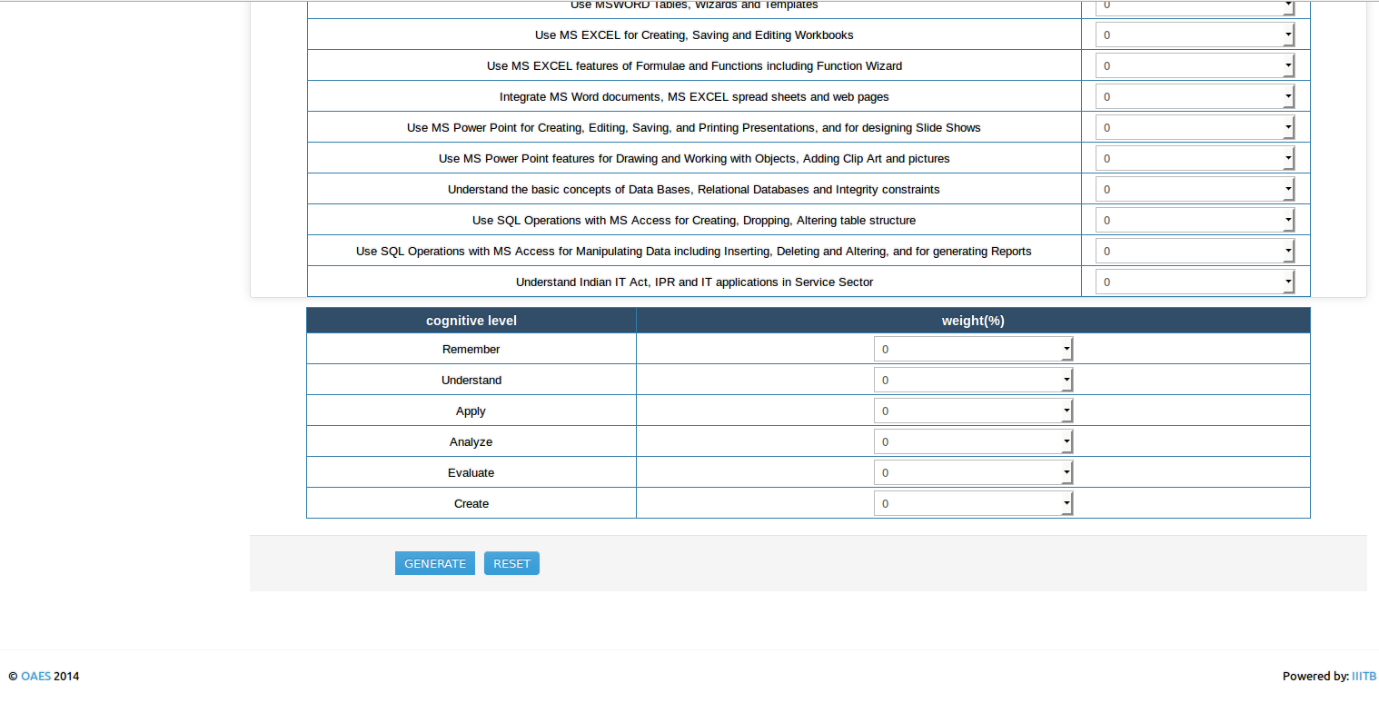

Slide 52
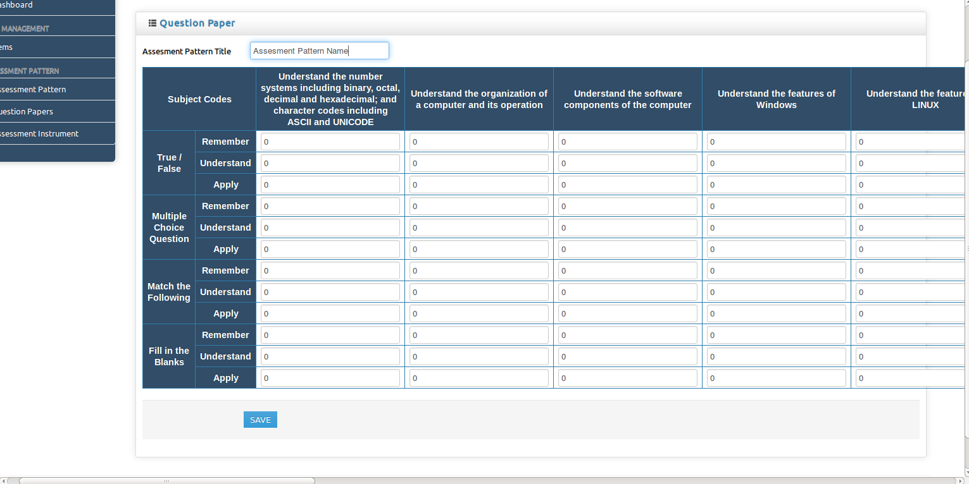
empty Assessment pattern

Slide 53
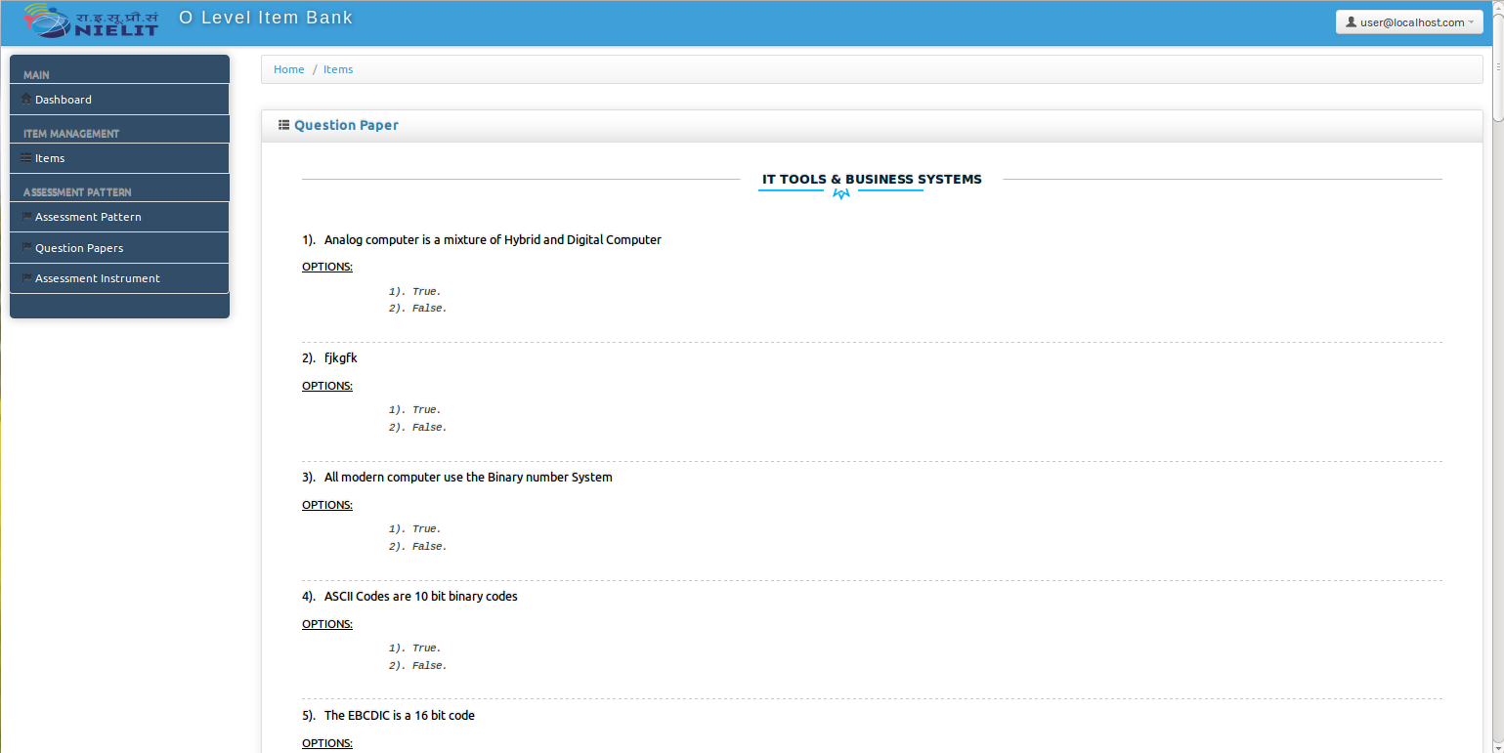
Generate Question paper Assessment pattern

Slide 54
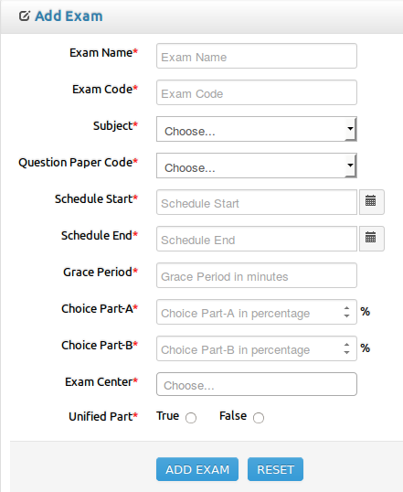
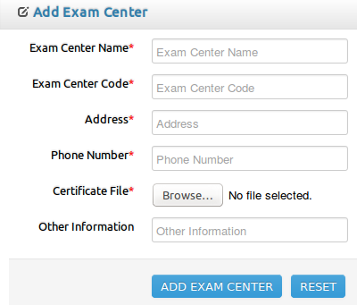
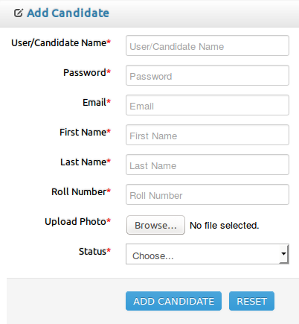
Exam Management
1. Manage exam
2. Manage exam center
3. Manage candidates
IIIT Bangalore Samvaad Oct 28, 2019

Slide 55
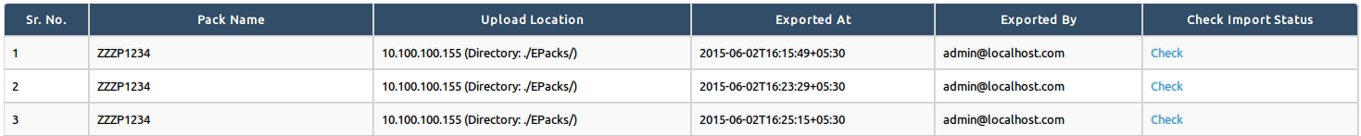
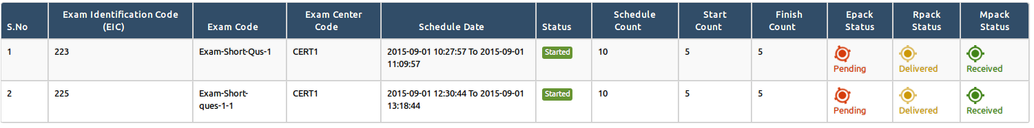
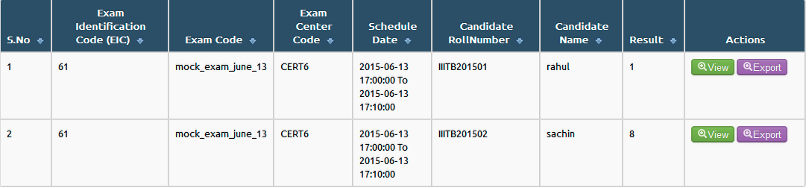
Monitoring
1. Packs monitoring
2. Exam monitoring
3. View exam results
IIIT Bangalore Samvaad Oct 28, 2019

