Slide 1
RCNN -> SPP ->Fast RCNN -> Faster RCNN

Slide 2
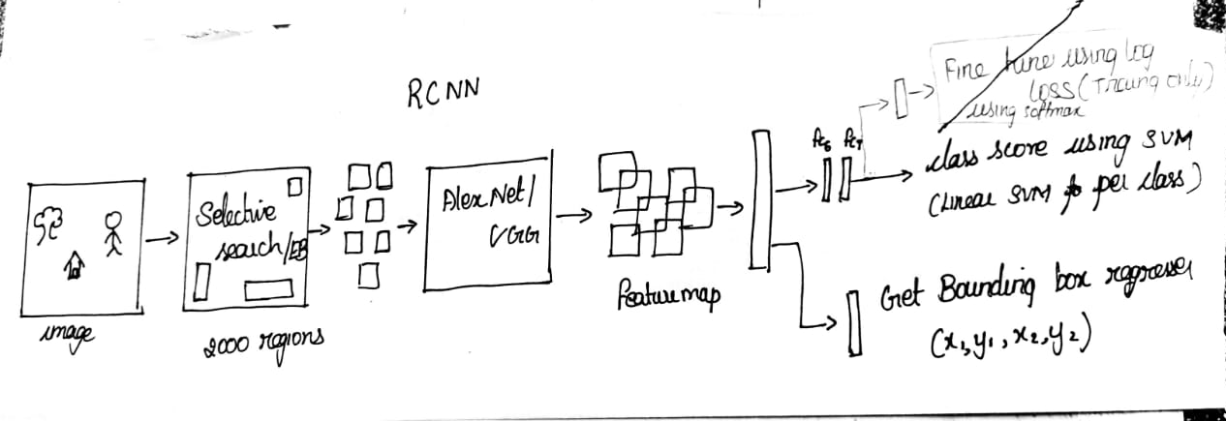
RCNN

Slide 3
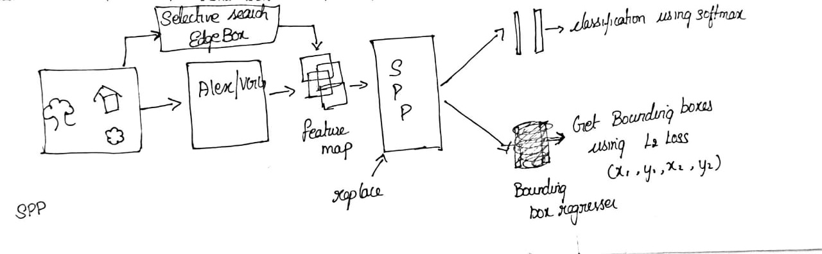
SPP

Slide 4
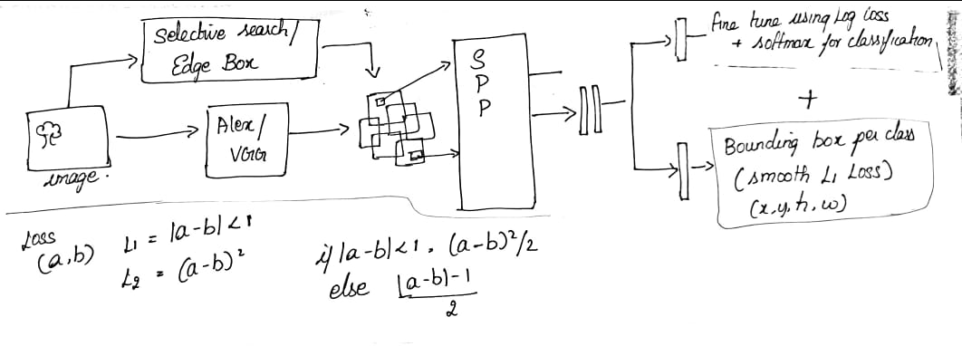
Fast RCNN

Slide 5
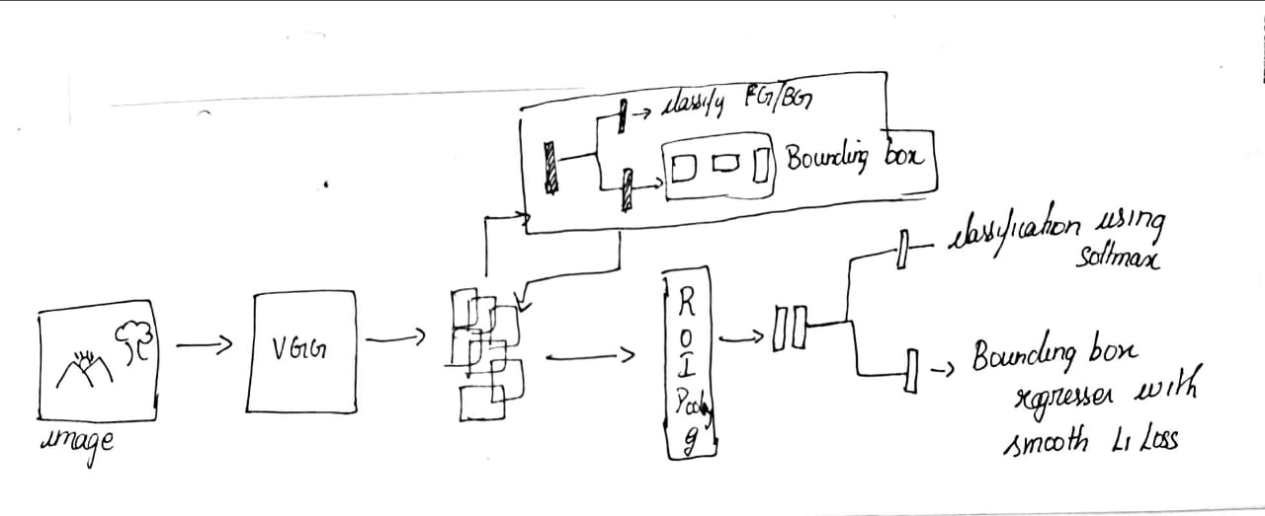
Faster RCNN

Slide 6
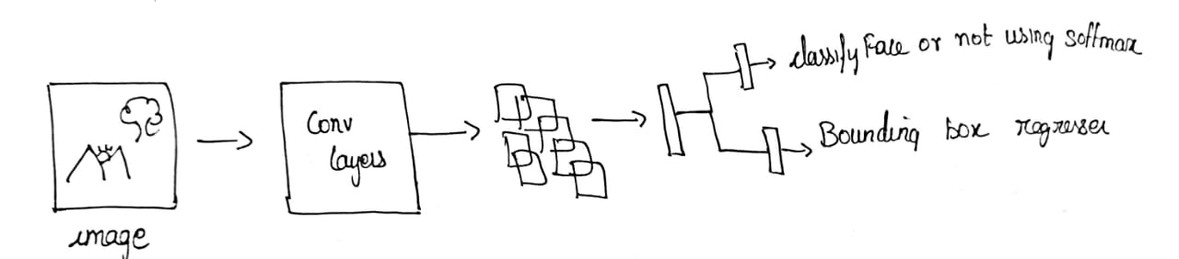
Manga Face network

Slide 7
Thank you

