Slide 1
Efficient Subwindow Search For Object Localization

Slide 2
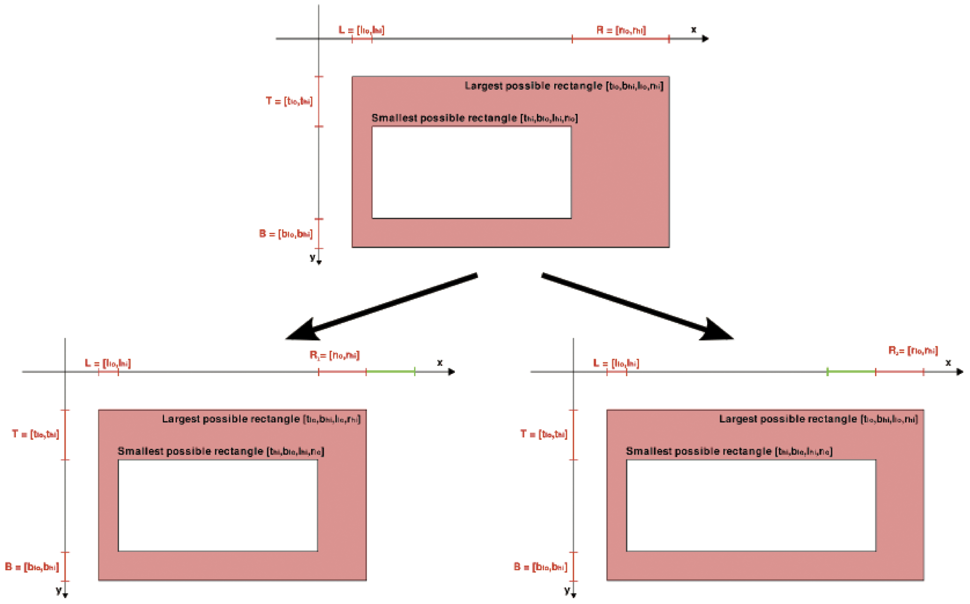


Techniques used
Branch and Bound Scheme
Quality Bound
Linear classifiers
Spatial Pyramid Features

Slide 3
Advantages
Best-suited for Bounding box on objects
Guarantees to find the globally optimal solution.
Fast and Efficient

Slide 4
Disadvantages
Computational complexity varies widely
In the worst case it takes time as Sliding window Technique
Highly related to the optimal confidence levels

Slide 5
The SHOGUN Machine Learning Toolbox

Slide 6
Advantages
Unified way for solving certain types of machine learning problem
Large scale learning
SVM can be easily combined with 35 different kernel function
Input Feature vectors can be anything and can be converted to different feature type

Slide 7
Applications
Speech and Handwritten recognition
Medical Diagnosis and Bioinformatics
Computer vision and object recognition
Stock Market Analysis
Network Security, Intrusion and detection..

Slide 8
Combining Top-down and Bottom-up Segmentation

Slide 9
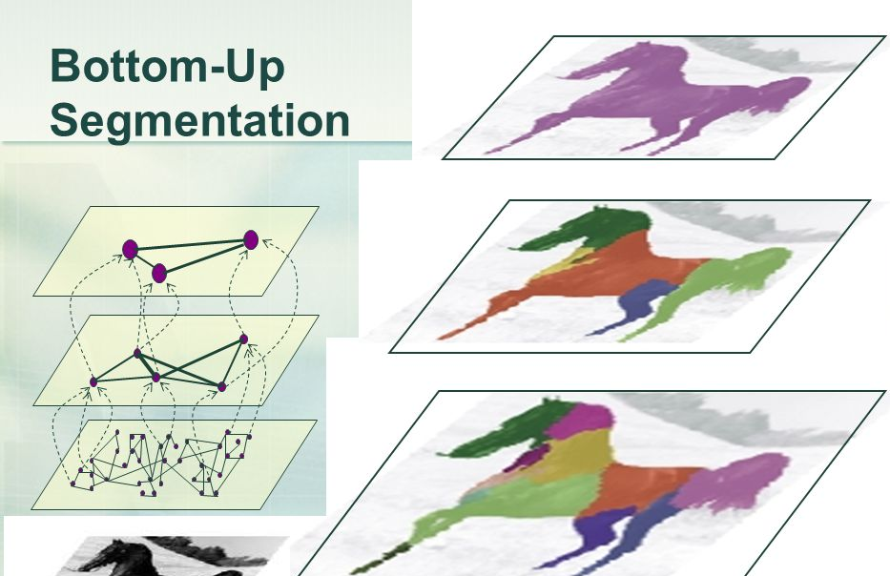
Example

Slide 10
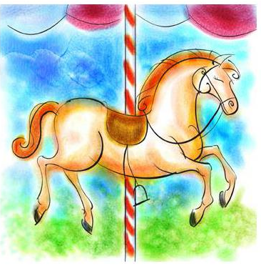
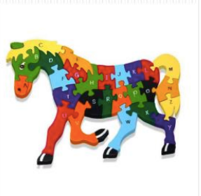
Top-down Segmentation

Slide 11
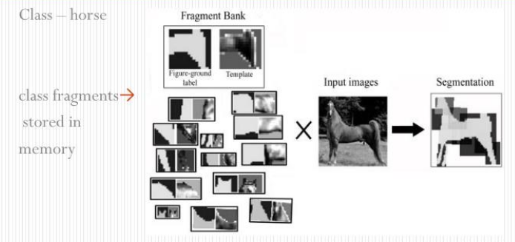
Top-down Segmentation

Slide 12
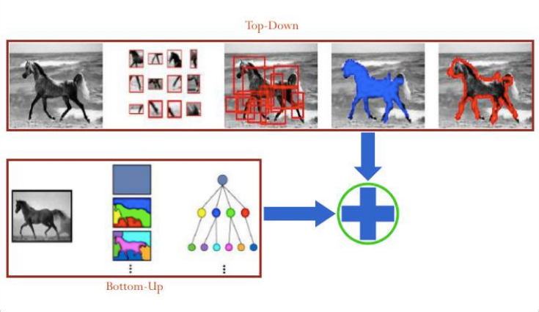
Combining

Slide 13
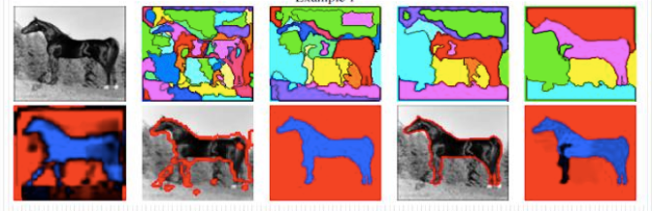
Result

Slide 14
Object Detection with Discriminatively Trained Part Based Models

Slide 15
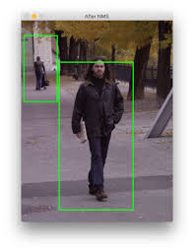
Dalal Trigg’s work
Sliding window Technique
HOG + SVM
pyramid

Slide 16
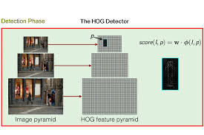
Dalal Trigg’s work
Sliding window Technique
HOG + SVM
pyramid

Slide 17
Part based model
HOG feature * SVM for the total body
Get score
Image -> doubled the resolution
SVM for individual part
Subtract penalty score
Once completed sum them up
Based on the final score! Decision taken human or not

Slide 18
Thank you

