Slide 1
Face Detection in Manga based deep neural network

Slide 2
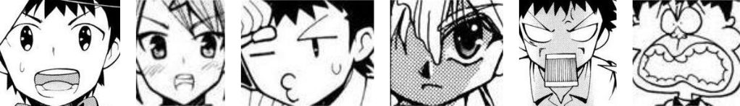
Introduction
Reason for choosing manga
Differences in natural images and manga
(a) (b) (c ) (d) (e) (f)
Related works

Slide 3
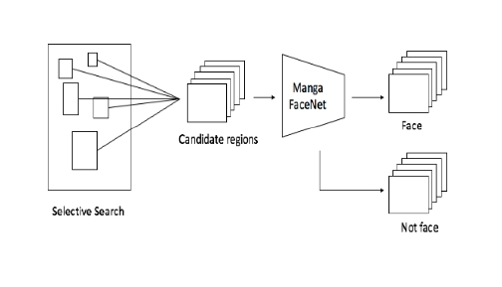
Overview of the framework

Slide 4
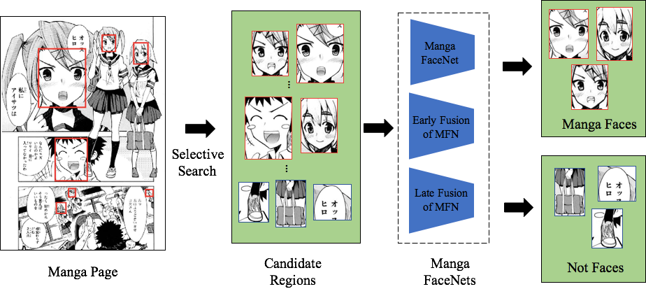
Framework
Manga Facenet

Slide 5
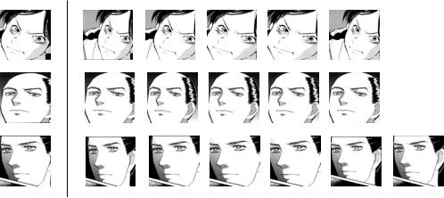
Selective search
Selective search with large overlap with the ground truth
Ground truth positive overlap

Slide 6
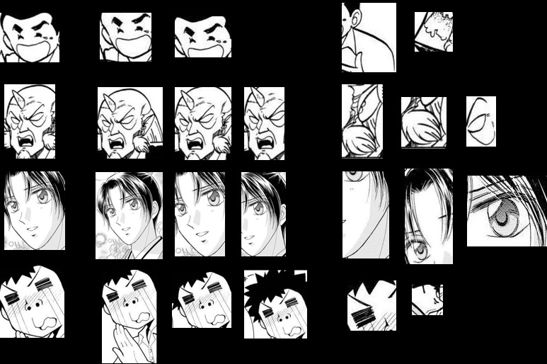
Regions found by selective search Positive and negative overlap with ground truth
Groundtruth. Positive Samples negative samples.

Slide 7
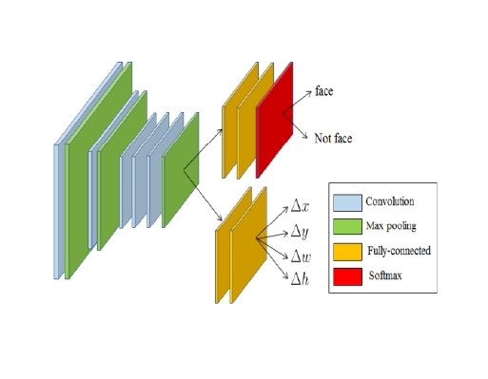
Manga FaceNet

Slide 8
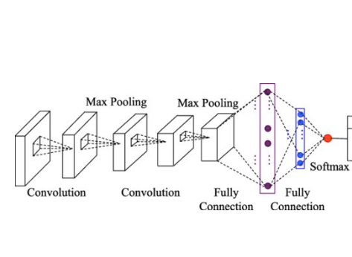
Top branch of manga facenet
Face
Not Face

Slide 9

Loss function for the Top branch:
Here
yp is the predicted probability of the given data being a manga face, and
yg is the ground truth where
yg will be 1 if the given region is really a face,
yg will be 0 if it is not

Slide 10
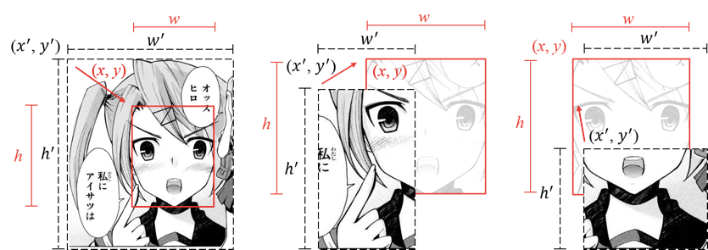
Bottom branch of manga face net

Slide 11




Horizonatal and vertical spatial displacement are calculated and normalized as
Width difference w and height difference h are calculated as
and
Predicted value of spatial displacement and aspect ratio differences are
The loss function to train the bottom branch
Where N is the number of training regions

Slide 12

Integrated loss
The top branch and bottom branch of the Manga FaceNet are jointly trained by considering the integrated loss

Slide 13
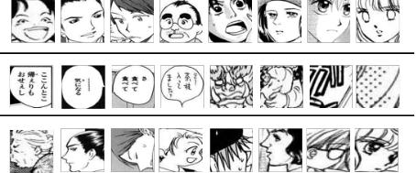
Discussion

Slide 14
Conclusion
Detect region
Detect each region is face or not by the proposed MangaNet
Spatial displacement and aspect ratio to enhance the framework
This method outperforms due to high variation

Slide 15
THANK YOU

