Slide 1
1.1 Introduction

Slide 2
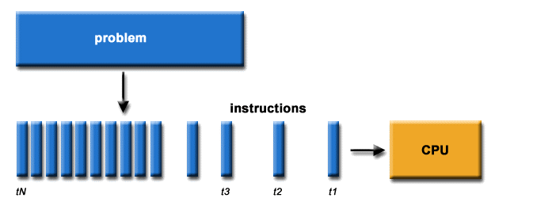
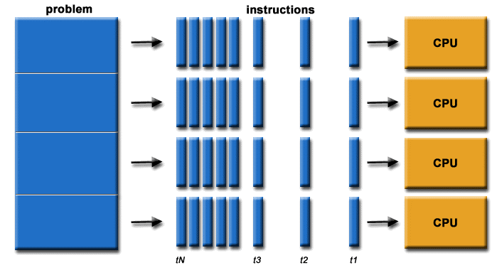
Serial vs. parallel program
One instruction at a time
Multiple instructions in parallel

Slide 3
Why parallel programming?
In general, most software will have to be written as a parallel software
Why?

Slide 4
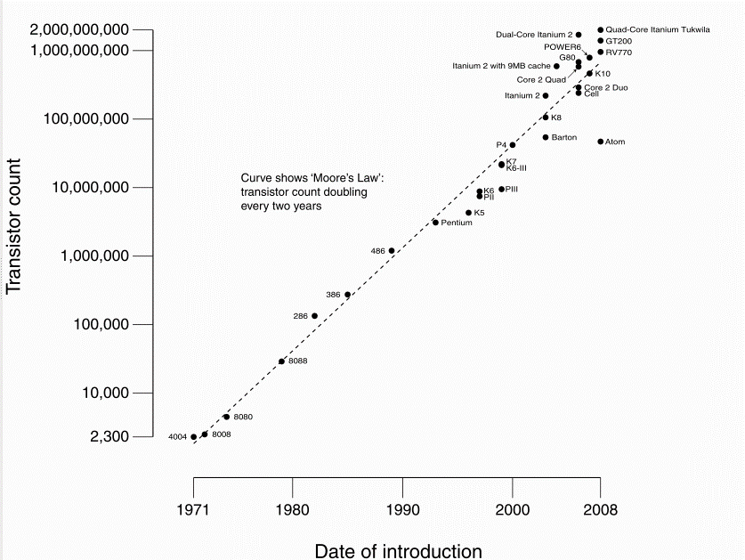
Free lunch ...
Wait 18 months – get new CPU with x2 speed
Moore's law: #transitors per chip ~ 1.8^{(years)}
Source: Wikipedia

Slide 5
is over (circa 2011)
More transistors = more execution units
BUT performance per unit does not improve
Bad news: serial programs will not run faster
Good news: parallelization has high performance potential

Slide 6
Parallel programming is hard
Need to optimize for performance
Understand management of resources
Identify bottlenecks
No one technology fits all needs
Zoo of programming models, languages, run-times
Hardware architecture is a moving target
Parallel thinking is not intuitive
Parallel debugging is not fun
But there is no alternative!!!

Slide 7
Concurrent and Distributed Programming Course
basic principles
Parallel and distributed architectures
Parallel programming techniques
Basics of programming for performance
No one book ☹
Slides are comprehensive ☺
Tons of material on the Internet ☺
This is a practical course – you will fail unless you complete all home assignments

Slide 8
Parallelizing Game of Life (Cellular automaton)
Given a 2D grid
v^{t}(i,j)=F(v^{t-1}(of all its neighbors))
j+1
i-1
i,j
i+1
j-1

Slide 9
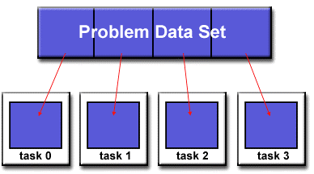
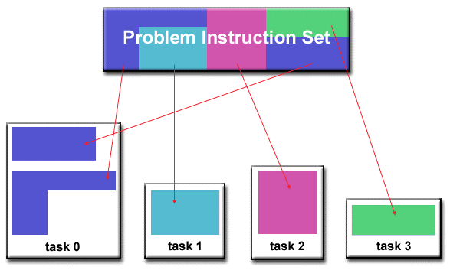
Problem partitioning
Domain decomposition
SPMD
Input domain
Output domain
Both
Functional decomposition
MPMD
Independent tasks
Pipelining

Slide 10
We choose: domain decomposition
The grid is split between processors
CPU 0
CPU 1
j+1
i-1
i,j
i+1
j-1

Slide 11
Fundamental HW-related issues

Slide 12
Issue 1. Memory
Can we access v(i+1,j) from CPU 0 as in serial program?
CPU 0
CPU 1
j+1
i-1
i,j
i+1
j-1

Slide 13
It depends...
YES: Shared memory space architecture: same memory space
CPU 0
CPU 1
Memory
NO: Distributed memory space architecture: disjoint memory space
Network
CPU 0
CPU 1
Memory
Memory

Slide 14
Someone has to pay
Easier to program, harder to build hardware
CPU 0
CPU 1
Memory
Harder to program, easier to build hardware
Network
CPU 0
CPU 1
Memory
Memory
Tradeoff: Programability vs. Scalability

Slide 15
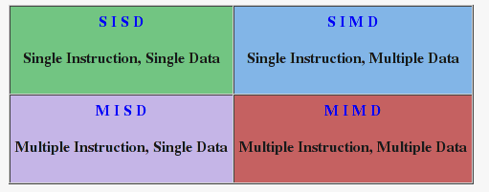
Flynn's HARDWARE Taxonomy

Slide 16
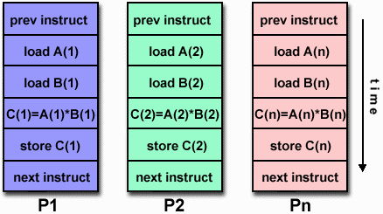
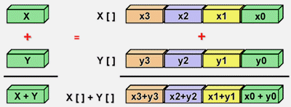
SIMD
Lock-step execution
Example: vector operations (SSE)

Slide 17
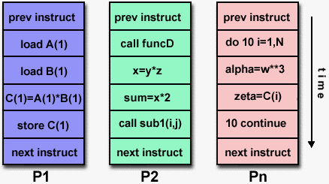
MIMD
Example: multicores
Which of SIMD/MIMD requires hw shared memory?

Slide 18
Memory architecture
CPU0: Time to access v(i+1,j) = Time to access v(i-1,j)?
CPU 0
CPU 1
j+1
i-1
i,j
i+1
j-1

Slide 19
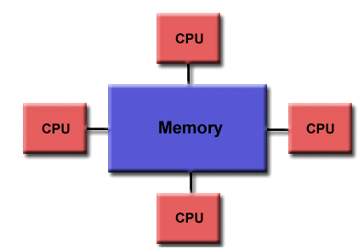
Hardware shared memory flavors 1
Uniform memory access: UMA
Same cost of accessing any data by all processors

Slide 20
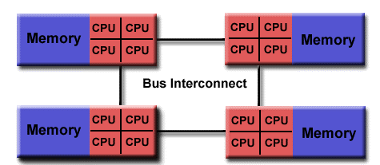
Hardware shared memory flavors 2
NON-Uniform memory access: NUMA
Tradeoff: Scalability vs. Latency

Slide 21
Memory-optimized programming
Most modern systems are NUMA or distributed
Architecture is easier to scale up by scaling out
Access time difference: local vs. remote data: x100-10000
Locality of accesses: main optimization target in parallel and distributed programs
Locality: most important parameter in program speed (either serial or parallel)

Slide 22
Software Distributed Shared Memory (SDSM)
Process 1
Process 2
CPU 0
CPU 1
Memory
Memory
Network
SDSM daemons
Software - DSM: emulation of NUMA in software over distributed memory space

Slide 23
Issue 2: Control
Can we assign one v per CPU?
Can we assign one v per process/logical task?
j+1
i-1
i,j
i+1
j-1

Slide 24
Task management overhead
Each task has a state that should be managed
More tasks – more state to manage
Who manages tasks?
How many tasks should be run by a cpu?
Does that depend on F?
Reminder: v(i,j)= F(all v's neighbors)

Slide 25
Question
Every process reads the data from its neighbors
Will it produce correct results?
j+1
i-1
i,j
i+1
j-1

Slide 26
Synchronization
The order of reads and writes in different tasks is non-deterministic
Synchronization is required to enforce the order
Locks, semaphores, barriers, conditionals….

Slide 27
Check point
Fundamental hardware-related issues affecting Programability, Correctness, Scalability, Performance
Memory accesses
Optimizing locality of accesses
Control
Overhead
Synchronization

Slide 28
1.2 Programming

Slide 29
Parallel programming issues
We decide to split this 3x3 grid like this:
CPU 0
CPU 1
j+1
i-1
i,j
i+1
CPU 2
j-1
CPU 3
Problems?

Slide 30
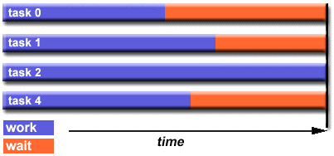
Issue 1: Load balancing
CPU 0
CPU 1
j+1
i-1
i,j
i+1
CPU 2
j-1
CPU 3
Always waiting for the slowest task
Solutions?

Slide 31
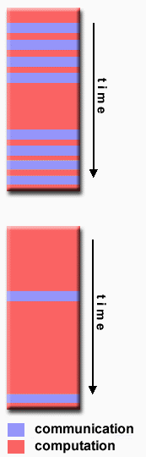
Issue 2: Granularity
G=Computation/Communication
Fine-grain parallelism:
G is small
Good load balancing
Potentially high overhead
Coarse-grain parallelism:
G is large
Potentially bad load balancing
Low overhead
What granularity works for you?

Slide 32
It depends..
For each combination of computing platform and parallel application
The goal is to minimize overheads and maximize CPU utilization
High performance requires
Enough parallelism to keep CPUs busy
Low relative overheads (communications, synchronization, task control, memory accesses versus computations)
Good load balancing

Slide 33
Summary
Parallelism and scalability do not come for free
Overhead
Memory-aware access
Synchronization
Granularity
But... let's assume for one slide we did not have these issues....

Slide 34
Can we estimate an upper bound on speedup? Amdahl's law
Sequential component limits the speedup
Split program serial time Tserial=1 into
Ideally parallelizable: A (fraction parallel): ideal load balancing, identical speed, no overheads
Cannot be parallelized: 1-A
Parallel time Tparallel= A/#CPUs+(1-A)
Speedup(#CPUs)=Tserial/Tparallel=
1 / ( A/#CPUs+(1-A) )

Slide 35
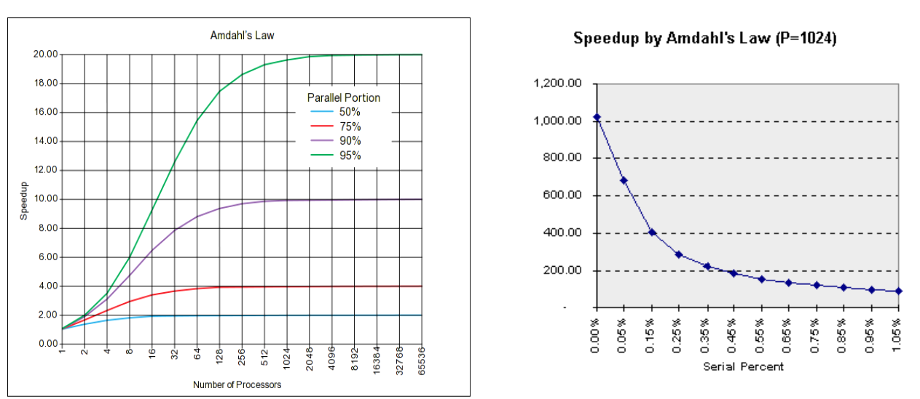
Bad news
Source: wikipedia
So - why do we need machines with 1000x CPUs?
35

Slide 36
Living with Amdahl's law: Gustafson's law
T_{parallel} = T_{parallel} *(A+ (1-A))
T_{bestserial} <= T_{simulation} = #CPUs *T_{parallel} *A + T_{parallel}*(1-A)
T_{simulation} is a serial execution of T_{parallel}, thus providing a bound on the best serial program
Speedup = T_{bestserial} / T_{parallel} <= T_{simulation} / T_{parallel} =
#CPUs *A + (1-A) = #CPUs – (1-A)*(#CPUs-1)
For larger problem sizes: 1-A ➔ 0
For a good parallel program: T_{simulation} =~ T_{bestserial}
In the limit: Speedup = #CPUs ➔linear speedup.
Crucial difference:
Gustafson - for larger problem sizes A➔1 (aka “scalability”).
Amdahl - assumes fixed problem size and fixed A.
36

Slide 37
Question
Can we achieve speedups higher than #CPUs?
“Superlinear”
37

Slide 38
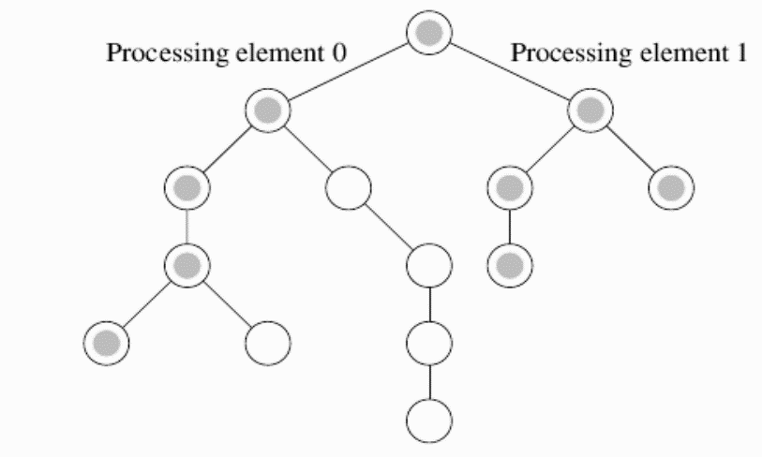
Fake superlinear speedup: Serial algorithm does more work
Searching
For this
item
Parallel algorithm is BFS
DFS is inefficient for this input
BFS can be simulated with a serial algorithm
38

Slide 39
Always use best serial algorithm as a baseline
Example: sorting an array
Efficient parallel bubble sort takes 40s, serial 150s. Speedup = 150/40?
NO. Serial quicksort runs in 30s. Speedup 0.75!
39

Slide 40
True superlinear speedup
Example: cache
Parallelization results in smaller problem size/CPU =>if fits the cache
=> non-linear performance boost!
Cannot be efficiently simulated on a serial machine
See more examples in the Graha book
40

Slide 41
Summary Amdahl Law
Parallel performance and scalability are subtle matters
Need to use a good serial program
Need to understand application scalability characteristics
Amdahl's law: understand the assumptions!!!
Too pessimistic
Assumes fixed problem size
No relation to memory hierarchy
Too optimistic
Assumes perfect load balancing, no idling, equal CPUs speed, no memory issues….
See more material: refs/ on website and book
41

Slide 42
Performance of parallel programs More details in Chapter 5 in Graha book
A parallel system is a combination of a parallel algorithm and an underlying platform
Performance measures:
Wall clock time
Speedup = Serial time / Parallel time
GFLOPs/s = how well the hardware is exploited
Scalability: Speedup as a function of #CPUs
Efficiency: Speedup / #CPUs
42

Slide 43
1.3 Memory, Locality, Cache

Slide 44

Memory
Performance characteristics
Example: which drop will reach the other side first?
44

Slide 45
Memory
Performance characteristics
CPU
Memory
DATA BUS
Latency – time between data request and receipt
Bandwidth – rate at which data is moved
45

Slide 46
Why latency is a problem
1GHz processor
Memory latency=100ns.
Memory bandwidth = Infinity
Assume 1 floating point ADD = 1 cycle (1ns)
RAW ALU performance: 1GFLOPs/s
Observed performance for adding two vectors?
46

Slide 47
Why latency is a problem
1GHz processor
Memory latency=100ns.
Memory bandwidth = Infinity
Assume 1 floating point ADD = 1 cycle (1ns)
RAW ALU performance: 1GFLOPs/s
Observed performance for adding two vectors?
We need 3 memory accesses = 300ns per 1 addition => 300 times slower
47

Slide 48
Why bandwidth is a problem - 2
1GHz processor
Memory latency = 0 ns
Memory bandwidth = 1GB/s
Assume 1 floating point ADD = 1 cycle (1ns)
RAW ALU performance: 1GFLOPs/s
Observed performance for adding two vectors?
48

Slide 49
Why bandwidth is a problem - 2
1GHz processor
Memory latency = 0 ns
Memory bandwidth = 1GB/s
Assume 1 floating point ADD = 1 cycle (1ns)
RAW ALU performance: 1GFLOPs/s
Observed performance for adding two vectors?
We need 12 bytes per one cycle: 12 GB/s. But we can do only 1GB/s => 12 times slower
49

Slide 50
Coping with memory limitations Cache ($)
Observation 1: most applications reuse data
Spatial locality: most accesses are close in space
Temporal locality: most accesses to the same data are close in time
Observation 2: small is fast
Cache can be placed ON chip
Cache has low latency
Cache has high bandwidth
CPU
$
DRAM
50

Slide 51
Cache performance
If data in cache (cache hit): latency=1 cycle, bandwidth = 100s GB/s
Otherwise – miss penalty
Hit rate= <#hits>/<#total accesses>
Miss rate?
Example: hit rate=90%, 20% instructions access memory, miss penalty 100 cycles.
Performance? What if hit rate=99%?
Cache hierarchy follows same principles
51

Slide 52
Question: Does cache help for adding two vectors?
52

Slide 53
NO!
There is no data reuse:
Cache is populated upon first access – compulsory miss - slow
If the data is not reused – no benefit from cache
Almost true
Cache line size and prefetching help
Compiler prefetching
Memory bandwidth better utilized
53

Slide 54
Question: Does cache help for matrix product?
54

Slide 55
Yes!
O(n³) computations
O(n²) memory
We read each datum O(n) times
Read more Chapter 2, Grama textbook
Remember for discussion of GPU cache
55

Slide 56
Adding more processors
Shared Memory Processors (SMPs)
Single physical memory space
CPU
CPU
$
$
Memory
56

Slide 57
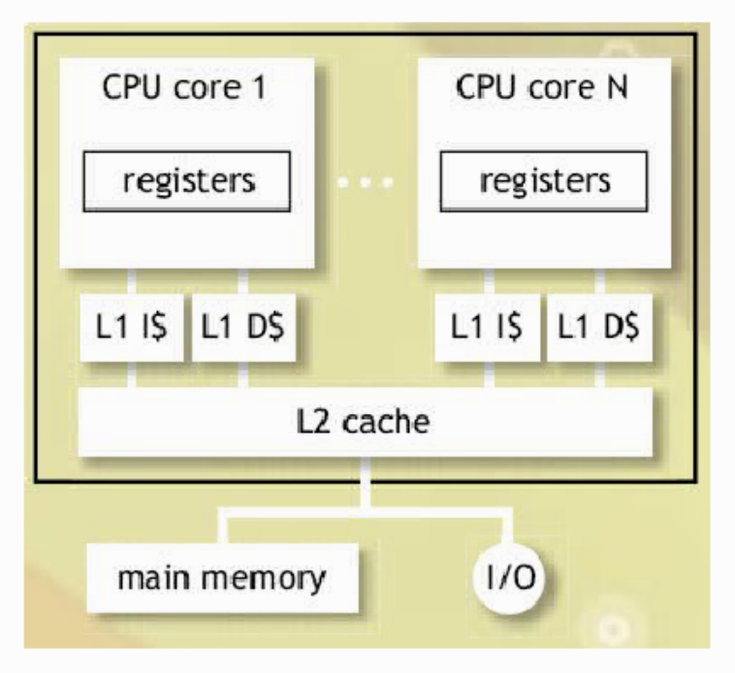
SMPs vs. Multicores
SMP – different chips
Multicores (CMP) – same chip, multiple units
Assaf Schuster, 236370, Winter 12
57

Slide 58
Cache coherence problem
Thread 1 Thread 2
A=0;
A=1;
print(A);
CPU
CPU
$
$
Memory
Which value will be printed?
58

Slide 59
Cache coherence protocol
Must ensure serializability
There must be an equivalent global order of reads and writes that respects (is consistent with) the local order of each of the threads
T1: R a,#2; W a,#3
T2: W a,#2; R a,#3
T1: R a,#2; W a,#3
T2: W a,#2; R a,#3
59

Slide 60
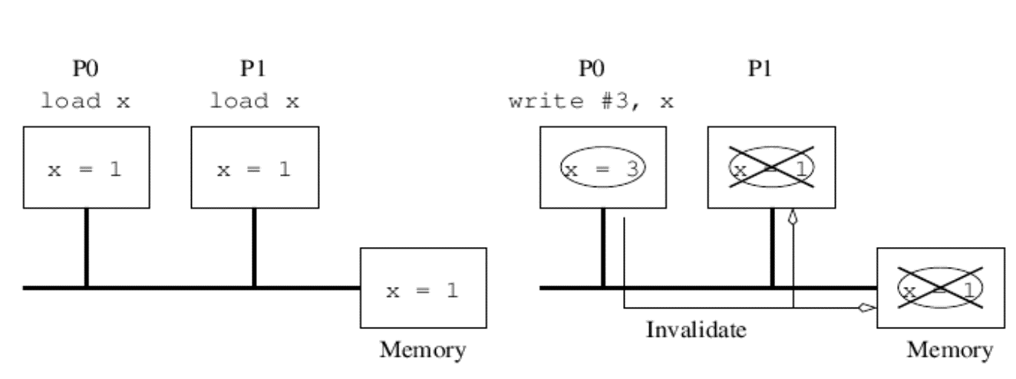
Cache coherence
Snoopy cache coherence
All caches listen for other caches' reads and writes
Write: invalidates values in others
Reads: get the latest version from other cache
60

Slide 61
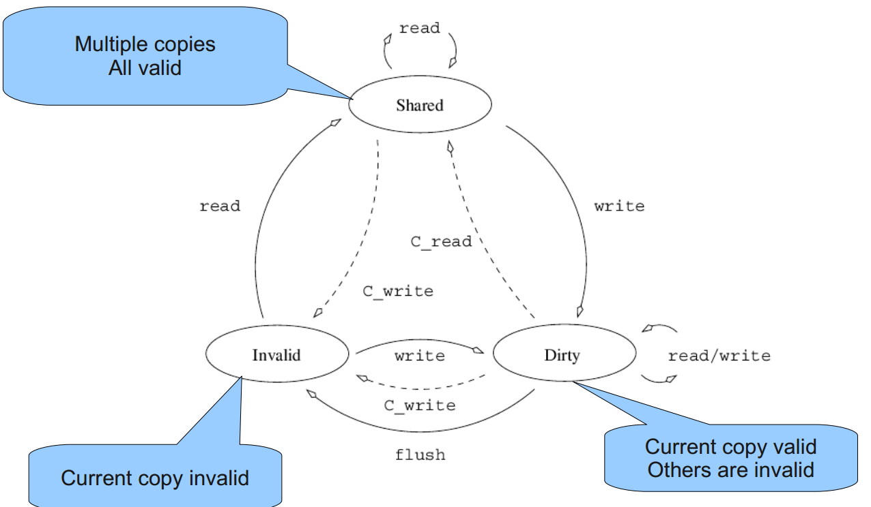
Cache coherence-2
Life cycle of a local copy of a variable V:
Operations on V by local CPU.
C_XXX operations on V by remote CPUs
(heard on bus).
Assaf Schuster, 236370, Winter 12
61

Slide 62
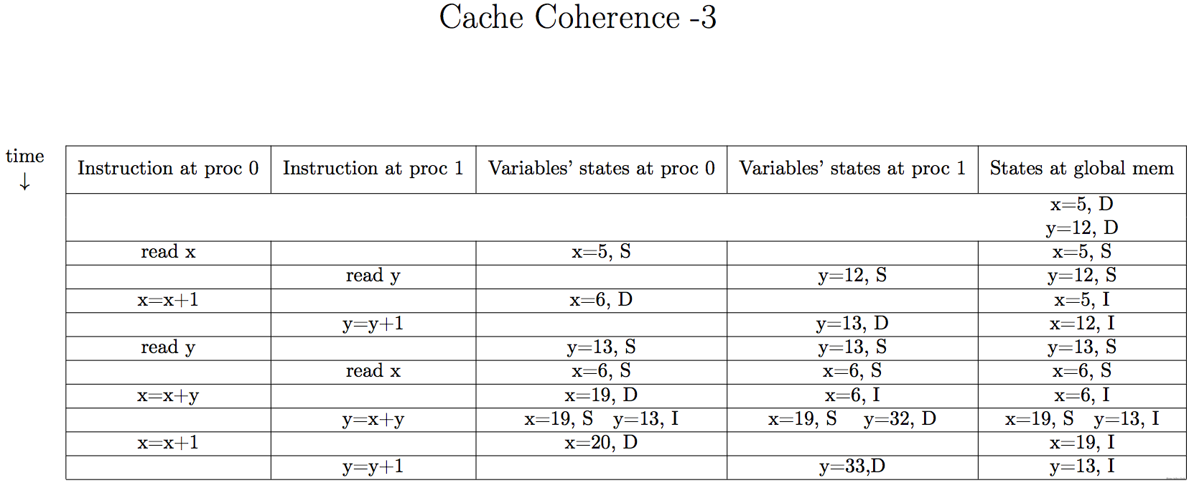
Example
Fixed by Amit Markel
62

Slide 63
False sharing
Cache coherence is managed at cache line granularity (e.g. 4 words)
Variables on the same cache line will be invalidated
May lead to unexpected coherence traffic
63

Slide 64
Summary
Snoopy cache coherence requires broadcasts
There are other approaches
False sharing: can generate unexpected load
Delays memory access, quickly grows with #processors – not scalable
64

