Slide 1
Virtual Time
“Virtual Time and Global States of Distributed Systems”
Friedmann Mattern, 1989
Notes:
Virtual Time and Global States of Distributed Systems. Friedemann Matterny, Department of Computer Science, University of Kaiserslautem.
Abstract:
“A distributed system can be characterized by the fact that the global state is distributed and that a common time base does not exist. However, the notion of time is an important concept in every day life of our decentralized real world" and helps to solve problems like getting a consistent population census or determining the potential causality between events. We argue that a linearly ordered structure of time is not (always) adequate for distributed systems and propose a generalized non-standard model of time which consists of vectors of clocks. These clock-vectors are partially ordered and form a lattice. By using timestamps and a simple clock update mechanism the structure of causality is represented in an isomorphic way. The new model of time has a close analogy to Minkowski's relativistic spacetime and leads among others to an interesting characterization of the global state problem. Finally, we present a new algorithm to compute a consistent global snapshot of a distributed system where messages may be received out of order.”

Slide 2



Rolling shutter effect
Panoramic fail

Slide 3



Panoramic Consistency (1)

Slide 4
Panoramic Consistency (2)

Slide 5
Facebook as an Example
Group discussion

Slide 6


234666 - Introduction to Hell
Closed Group

Slide 7
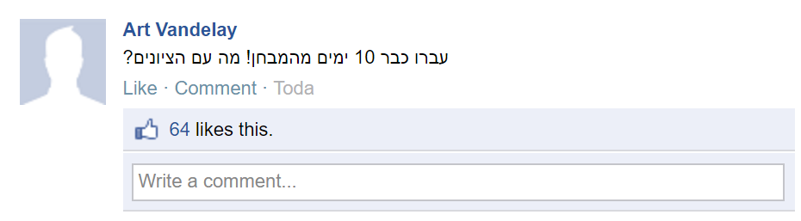


Slide 8
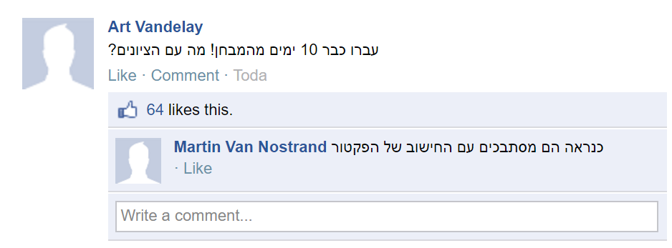


Slide 9
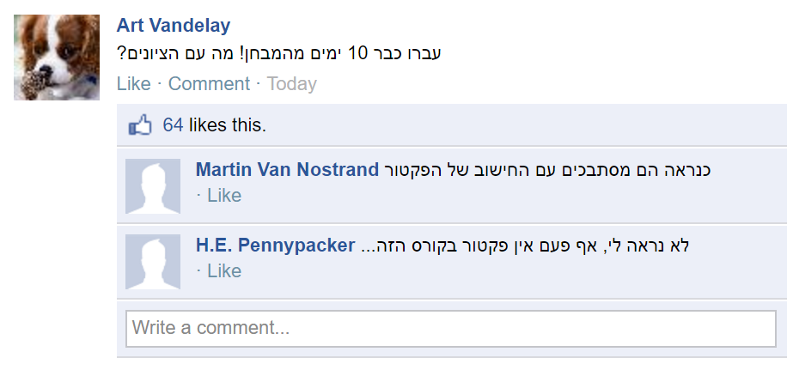


Slide 10
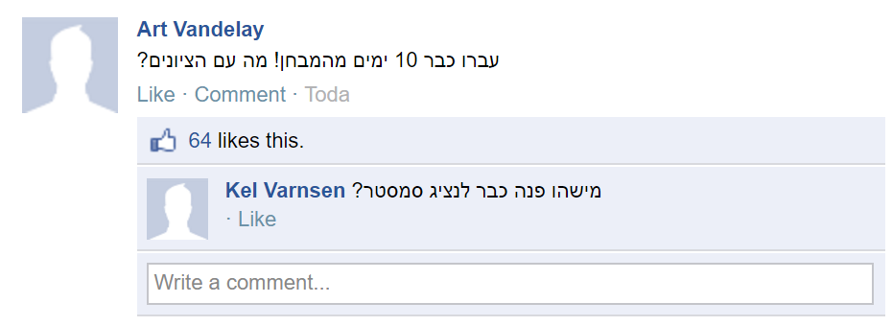


Slide 11
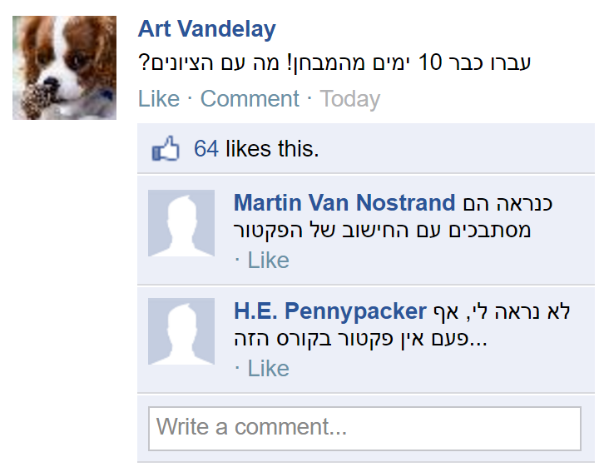
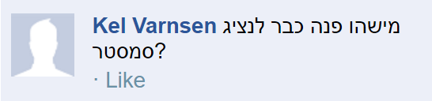
?

Slide 12
?

Slide 13
Facebook as an Example - Conclusions
A post should appear after all the posts that were already visible to the sender at the moment it was sent
This preserves Causality
Formal definition will be given later in the course
Once causality is defined:
Some posts can appear in any order and the thread will still make sense

Slide 14
Observer Types
The model: asynchronous distributed system
A set of processes having no shared memory, communicating by message transfer.
Message delay > 0, but is not known in advance.
A global observer – sees the global state at certain points in time.
It can be said to “take a snapshot” of the global state.
A local observer – (one of the processes in the system) sees the local state.
Because of the asynchrony, a local observer can only gather local views to an approximate global view.
The lack of a global observer is an obstacle for many management and control problems:
mutual exclusion, deadlock detection, distributed contracts, leader election, load sharing, checkpointing etc.
Notes:
Style change of the paper title
Added checkpointing in the examples of applications (at the bottom)

Slide 15
Events
An event is a change in the process state.
An event happens instantly, it does not “take time”.
A process is a sequence of events
There are 3 types of events:
send event – causes a message to be sent
receive event – causes a message to be received
local event – only causes an internal change of state
Events correspond to each other as follows:
All events in the same process happen sequentially, one after the other.
Each send event has a corresponding receive event
This allows us to define the happened before relation among events.
Notes:
Made changes the description of 3 types of events
Added the last sentence and
Split the slide to the current and next slides

Slide 16
The Happened Before Relation
We say that event e happened before event e’ if one of the following properties holds:
Process Order: e precedes e’ in the same process
Send-Receive: e is a send and e’ is the corresponding receive
Transitivity: exists e’’ such that e < e’’ and e’’< e’
Denoted by e → e’ or e < e’
global time
P1
e11
e12
e13
e14
Process order: e13 < e14
Send-Receive: e23 < e12
Transitivity: e21 < e32
e21
e22
e23
P2
e31
e32
P3
Notes:
This is the new slide
Addition of the example

Slide 17

Independent/Concurrent Events (1)
Two events e, e’ are said to be independent or concurrent if not e < e’ and not e’ < e.
Denoted by $e∥e’$
global time
P1
e11
e12
e13
e21
e22
e23
e24
e25
P2
e31
e32
e33
e34
P3
Notes:
A slight style change of the diagram
Slight change in the definition at the bottom; ommited the word Definition because it doesn’t appear in any of the other definitions

Slide 18
Independent/Concurrent Events (2)
Two such diagrams are called equivalent when
they have the same events and
the happened before relation is the same in both.
When global time differs for same event in two equivalent diagrams, think of process execution as if it was a rubber band.
global time
P1
e11
e12
e13
e21
e22
e23
e24
e25
P2
e31
e32
e33
e34
P3
Notes:
A slight style change of the diagram
Slight change in the definition at the bottom; ommited the word Definition because it doesn’t appear in any of the other definitions

Slide 19


Cuts
A cut C of a set of events E is the union set of the cut events $\{c_{i}\}$ and all the events $e∈E$which precede any of the $c_{i}$ in process order.
e11
c1
e12
P1
c2
e21
e22
P2
past
$c_{i}$ are events of the cut
future
c3
e31
P3
P4
c4
e41
e42

Slide 20

Consistent Cuts (1)
A cut is said to be consistent if also:
{$e∈C$and e’<e} always imply $e’∈C$.
If a receipt of a message is inside a consistent cut – then its sending is there, too.
The opposite does not necessarily hold.
e11
c1
e12
P1
c2
e21
e22
P2
past
$c_{i}$ are events of the cut
future
c3
e31
P3
P4
e41
e42
c4

Slide 21

Consistent Cuts (2)
A cut is consistent if when stretching the execution lines (a-la rubber band) so that the cut events form a vertical line, there is no send-receive arrow which crosses the cut right to left (future to past).
e11
c1
e12
P1
c2
e21
e22
P2
past
$c_{i}$ are events of the cut
c3
e31
P3
future
P4
e41
e42
c4

Slide 22
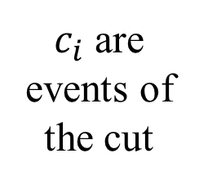
Inconsistent Cut (1)
e12
c1
P1
e11
c2
e21
e22
P2
past
$c_{i}$ are events of the cut
future
c3
P3
e31
P4
e41
e42
c4

Slide 23
Inconsistent Cut (2)
e11
e12
c1
P1
c2
e21
e22
P2
past
$c_{i}$ are events of the cut
c3
e31
P3
future
P4
e41
e42
c4

Slide 24
Global View and Consistent Cuts
A cut is consistent iff there is an execution of the diagram (including event scheduling) in which all cut events happen at the same moment
When viewed as a cut, the view of a global observer at any point in time is necessarily consistent
A message that arrived was necessarily previously sent
A global view determines a consistent cut at any point in time
P1
e11
c1
e12
c2
e21
e22
P2
past
$c_{i}$ are events of the cut
c3
e31
P3
future
P4
e41
e42
c4

Slide 25
Consistent Cuts and Global Snapshots
The consistent cut events can be viewed as a “snapshot” of what is happening in the system at a certain point in time
We already saw in the previous slide that there is an execution where this happens
The Global Snapshot problem in distributed systems:
Find an efficient protocol to compute consistent cuts.
Need to collect the local process states and the messages which are “in flight” (or, “in the communication buffers”) at the time of the cut.

Slide 26
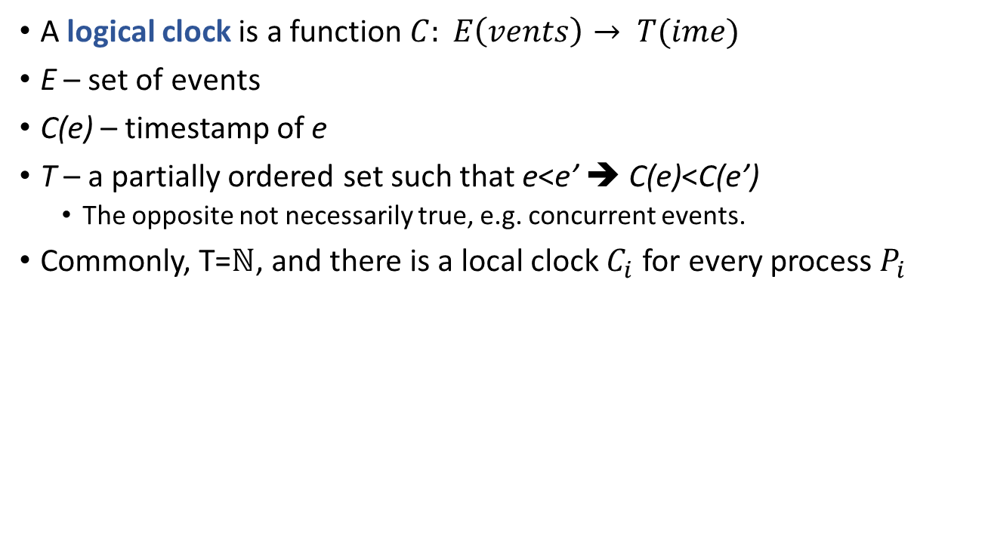
Virtual Time (Lamport, 1978. Turing Award Laureate)
A logical clock is a function $C: E\left(vents\right)→ T(ime)$
E – set of events
C(e) – timestamp of e
T – a partially ordered set such that e<e’ ➔ C(e)<C(e’)
The opposite not necessarily true, e.g. concurrent events.
Commonly, T=$ℕ$, and there is a local clock $C_{i}$ for every process $P_{i}$
Notes:
Time, Clocks, and the Ordering of Events in a Distributed System. Leslie Lamport, Massachusetts Computer Associates, Inc.
Abstract:
“The concept of one event happening before another in a distributed system is examined, and is shown to define a partial ordering of the events. A distributed algorithm is given for synchronizing a system of logical clocks which can be used to totally order the events. The use of the total ordering is illustrated with a method for solving synchronization problems. The algorithm is then specialized for synchronizing physical clocks, and a bound is derived on how far out of synchrony the clocks can become. Key Words and Phrases: distributed systems, computer networks, clock synchronization, multiprocess systems.”

Slide 27
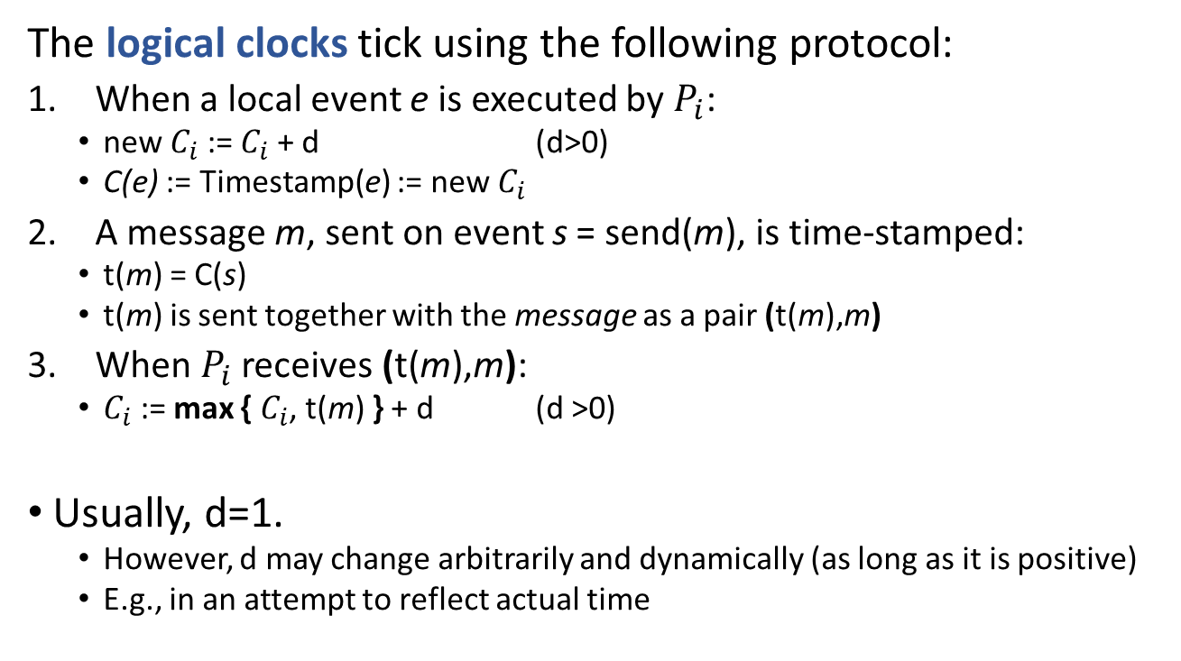
Logical Clocks Protocol
The logical clocks tick using the following protocol:
When a local event e is executed by $P_{i}$:
new $C_{i}$ := $C_{i}$ + d (d>0)
C(e) := Timestamp(e) := new $C_{i}$
A message m, sent on event s = send(m), is time-stamped:
t(m) = C(s)
t(m) is sent together with the message as a pair (t(m),m)
When$P_{i}$ receives (t(m),m):
$C_{i}$ := max { $C_{i}$, t(m) } + d (d >0)
Usually, d=1.
However, d may change arbitrarily and dynamically (as long as it is positive)
E.g., in an attempt to reflect actual time

Slide 28
Logical Clocks Protocol Example
C(e11)=1
C(e12)=2
C(e13)=3
P1
e11
e12
e13
C(e21)=1
Send(m), C(e22)=2
P2
e21
e22
(t(m)=2,m)
C(e31)=1
P3
e31
e32
Receive(m) C(e32)=3

Slide 29
Logical Clocks Protocol Example (2)
C(e12)=2
C(e11)=1
C(e13)=3
P1
e11
e12
e13
C(e21)=1
Send(m), C(e22)=2
P2
e21
e22
(t(m)=2,m)
C(e31)=1
P3
e31
e32
Receive(m) C(e32)=3
Problem?

Slide 30
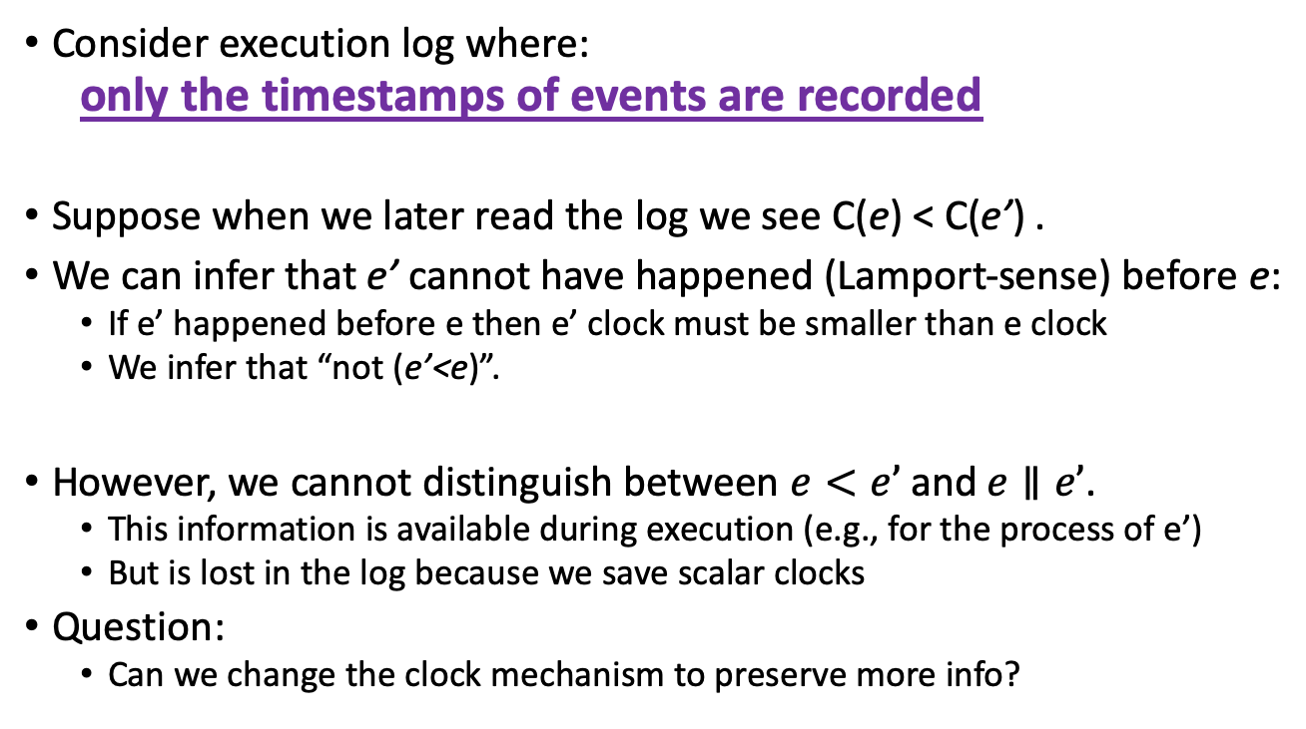
Scalar clocks lead to Loss of Execution Information
Consider execution log where:
only the timestamps of events are recorded
Suppose when we later read the log we see C(e) < C(e’) .
We can infer that e’ cannot have happened (Lamport-sense) before e:
If e’ happened before e then e’ clock must be smaller than e clock
We infer that “not (e’<e)”.
However, we cannot distinguish between $e<e’$and $e∥e’$.
This information is available during execution (e.g., for the process of e’)
But is lost in the log because we save scalar clocks
Question:
Can we change the clock mechanism to preserve more info?

Slide 31
A Vector Clock for a Global Observer
cuts
P1
1
2
P2
1
2
3
P3
1
2
P4
1
2
0 0 0 0
0 1 0 0
Vector of
times as
seen by a
global
observer
0 2 0 0
0
2
1
0
0
3
1
0
1
3
1
0
1
3
1
1
2
3
1
1
2
3
1
2
2
3
2
2
Notes:
Improved the style of arrows

Slide 32
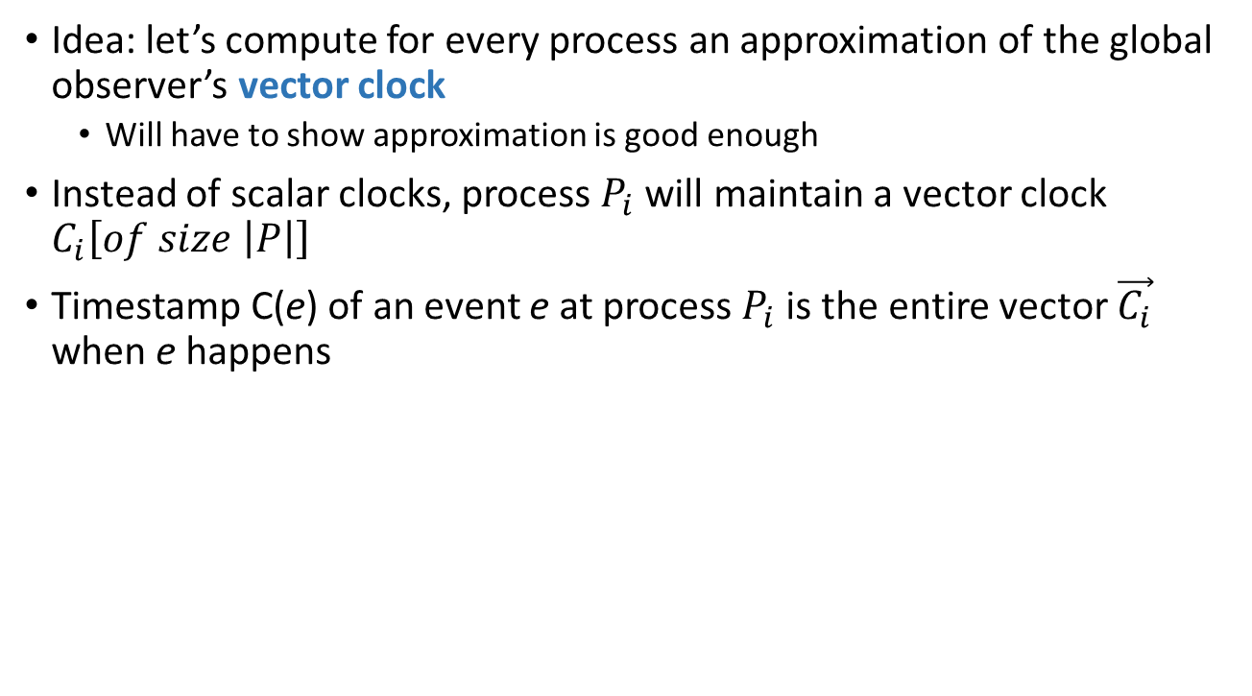
Approximating Global Vector Time
Idea: let’s compute for every process an approximation of the global observer’s vector clock
Will have to show approximation is good enough
Instead of scalar clocks, process $P_{i}$ will maintain a vector clock $C_{i}\left[of size \left|P\right|\right]$
Timestamp C(e) of an event e at process $P_{i}$ is the entire vector $\vec{C_{i}}$ when e happens

Slide 33
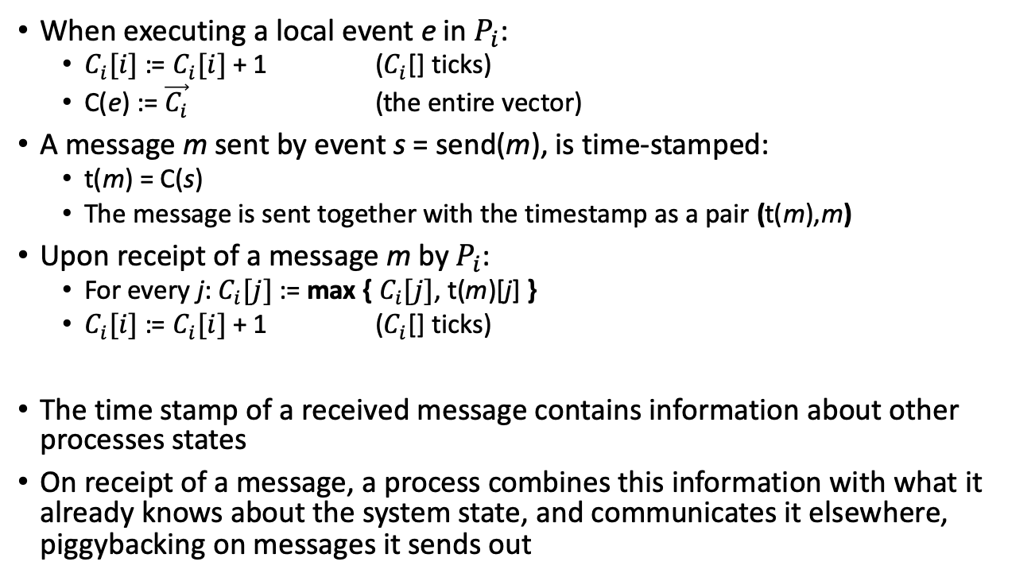
Approximating Global Vector Time Protocol
When executing a local event e in $P_{i}$:
$C_{i}[i]$ := $C_{i}[i]$ + 1 ($C_{i}$[] ticks)
C(e) := $\vec{C_{i}}$ (the entire vector)
A message m sent by event s = send(m), is time-stamped:
t(m) = C(s)
The message is sent together with the timestamp as a pair (t(m),m)
Upon receipt of a message m by $P_{i}$:
For every j: $C_{i}[j]$ := max { $C_{i}[j]$, t(m)[j] }
$C_{i}[i]$ := $C_{i}[i]$ + 1 ($C_{i}$[] ticks)
The time stamp of a received message contains information about other processes states
On receipt of a message, a process combines this information with what it already knows about the system state, and communicates it elsewhere, piggybacking on messages it sends out

Slide 34
Back to the Example
P3 receives ticking information from P2 albeit they never communicate directly
1
2
0
0
2
2
0
0
P1
0
2
0
0
1
2
0
1
0
0
0
2
0
0
0
3
0
0
P2
1
2
3
0
0
1
0
0
3
0
0
0
3
2
2
P3
1
2
0
3
0
2
0
3
0
1
0
3
0
2
P4
1
2
0 0 0 0
0 1 0 0
Vector of
times as
seen by a
global
observer
0 2 0 0
0
2
1
0
0
3
1
0
1
3
1
0
1
3
1
1
2
3
1
1
2
3
1
2
2
3
2
2
Notes:
Note: Local timestamps approximating global observer times

Slide 35
Actual Order of Independent Events not Important
1
2
0
0
2
2
0
0
P1
0
2
0
0
1
2
0
1
0
0
0
2
0
0
0
3
0
0
P2
1
2
3
0
0
1
0
0
3
0
0
0
3
2
2
P3
1
2
0
3
0
2
0
3
0
1
0
3
0
2
P4
1
2
What
is the
actual
global
order?
0
0
0
0
0
1
0
0
0
2
0
0
1
2
0
0
2
3
0
0
2
3
1
0
Really don’t Care!
Can tell e2,1 and e3,1 are concurrent (vectors independent)
Inconsistent global time is impossible
→
→
→
→
→
0
0
0
0
0
0
1
0
0
1
1
0
0
2
1
0
0
3
1
0
2
3
1
0
1
1
0
0
→
→
→
→
→
e.g.

Slide 36
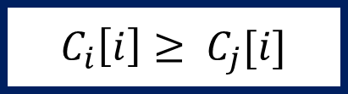

An Invariant (*)
Only $P_{i}$ can advance his clock: $C_{i}[i]$ ticks only at $P_{i}$
Thus, $P_{i}$ always knows the up-to-date time of his local time
Thus, at any point in time, for any $i,j$, it holds that:
$$C_{i}\left[i\right]≥ C_{j}[i]$$

Slide 37
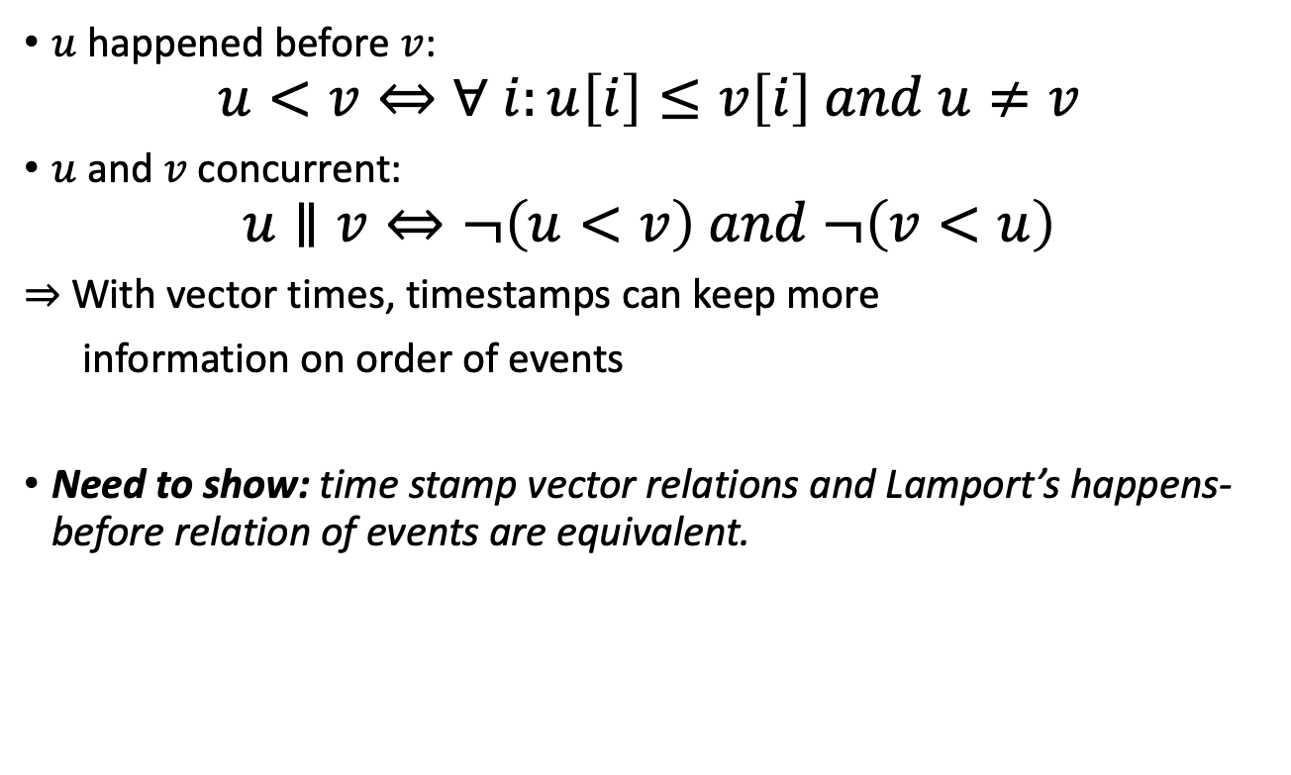
Vector Times can be Compared
$u$ happened before $v$:
$$u<v⇔∀ i:u\left[i\right]≤v\left[i\right] and u≠v$$
$u$ and $v$ concurrent:
$$u∥v⇔¬\left(u<v\right) and ¬\left(v<u\right)$$
$⇒$ With vector times, timestamps can keep more
information on order of events
Need to show: time stamp vector relations and Lamport’s happens-before relation of events are equivalent.
Notes:
Slight changes in the frame

Slide 38
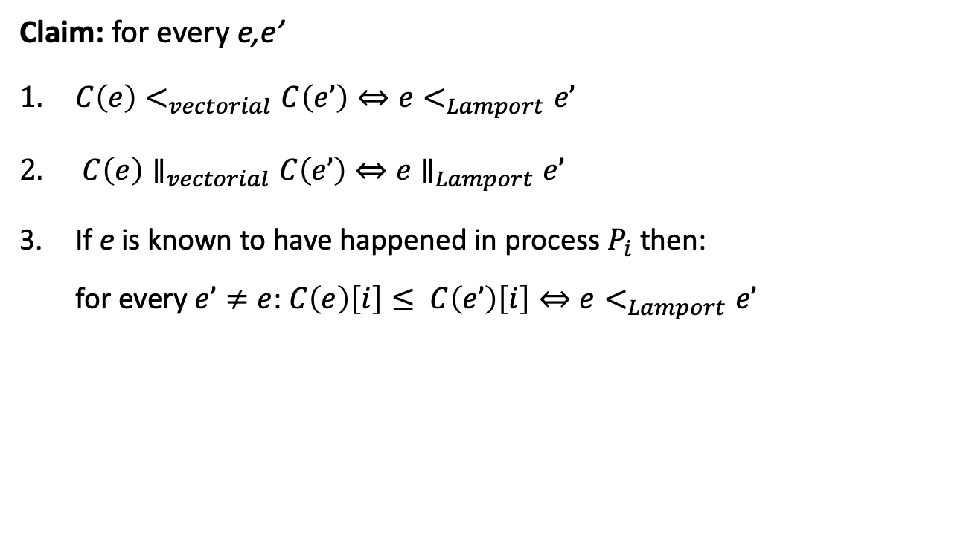
Vector Times Relations Represent Order of Events
Claim: for every e,e’
$C\left(e\right)<_{vectorial}C\left(e’\right)⇔e<_{Lamport}e’$
$C\left(e\right)∥_{vectorial}C\left(e’\right)⇔e∥_{Lamport}e’$
If e is known to have happened in process $P_{i}$ then: for every $e’≠e$: $C\left(e\right)\left[i\right]≤ C\left(e’\right)\left[i\right]⇔e<_{Lamport}e’$

Slide 39
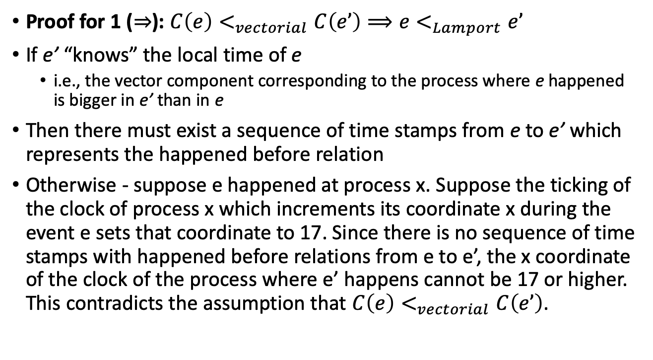
Vector Times Relations Represent Order of Events
Proof for 1 ($⇒$): $C\left(e\right)<_{vectorial}C\left(e’\right)⟹e<_{Lamport}e’$
If e’ “knows” the local time of e
i.e., the vector component corresponding to the process where e happened is bigger in e’ than in e
Then there must exist a sequence of time stamps from e to e’ which represents the happened before relation
Otherwise - suppose e happened at process x. Suppose the ticking of the clock of process x which increments its coordinate x during the event e sets that coordinate to 17. Since there is no sequence of time stamps with happened before relations from e to e’, the x coordinate of the clock of the process where e’ happens cannot be 17 or higher. This contradicts the assumption that $C\left(e\right)<_{vectorial}C\left(e’\right)$.
Notes:
FIXME: The proof is given only for the claim that “C(e) < C(e’) iff e < e’”. It should be specified in the slide.

Slide 40
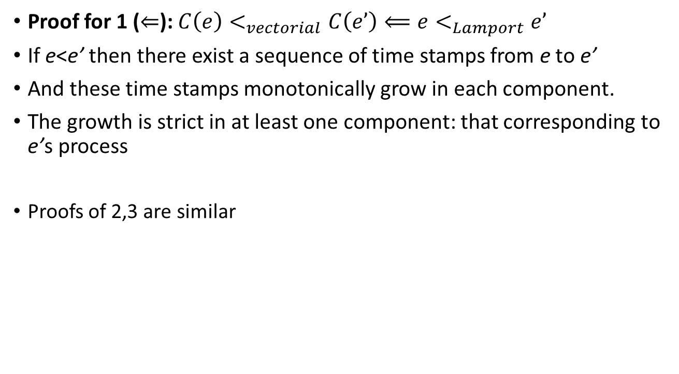
Vector Times Relations Represent Order of Events
Proof for 1 ($⇐$): $C\left(e\right)<_{vectorial}C\left(e’\right)⟸e<_{Lamport}e’$
If e<e’ then there exist a sequence of time stamps from e to e’
And these time stamps monotonically grow in each component.
The growth is strict in at least one component: that corresponding to e’s process
Proofs of 2,3 are similar

Slide 41


Cuts Revisited
Let X be a cut, $\left\{x_{i}\right\}$cut events, a system of n processes.
We say that the global time of X is (max is taken per entry)
$$t_{X}=\max_{element wise}\left\{C\left(x_{1}\right), … , C\left(x_{n}\right)\right\}$$
Different cuts have same global time (see example below)
However …
2
0
2
0
1
2
Example:
0
0
0
0
0
1
1
0
1
0
0
2
0
2 1 2 0
1
2
$$t_{X} =t_{Y}=$$
Y
X

Slide 42
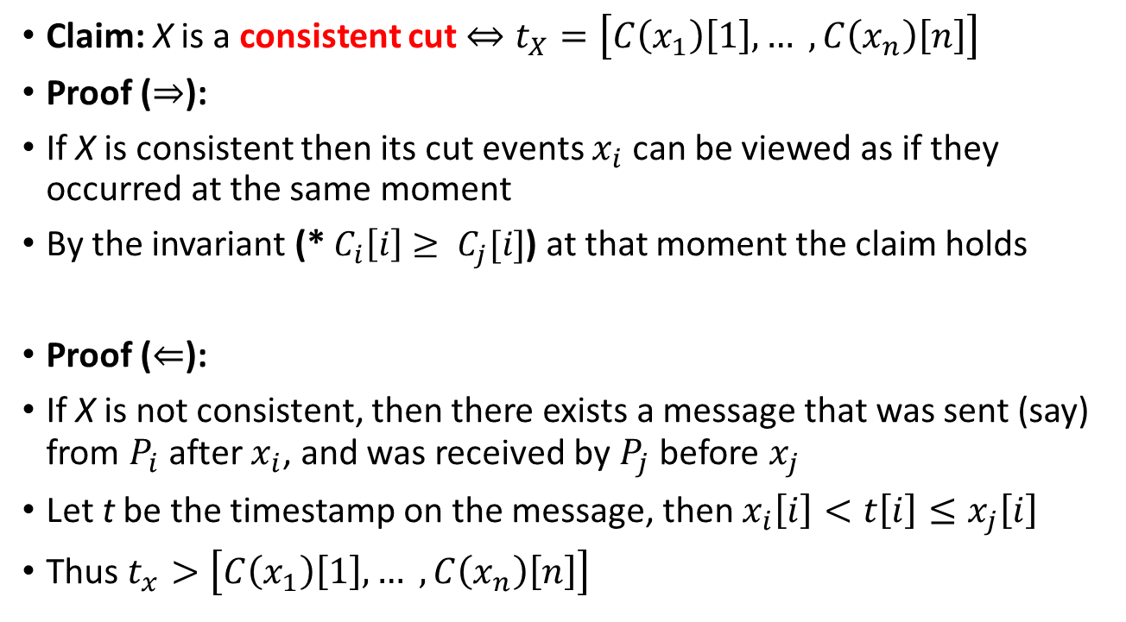
Different Consistent Cuts Have Different Global Times
Claim: X is a consistent cut $⇔t_{X}=\left[C\left(x_{1}\right)\left[1\right], … ,C\left(x_{n}\right)\left[n\right]\right]$
Proof ($⇒$):
If X is consistent then its cut events $x_{i}$ can be viewed as if they occurred at the same moment
By the invariant (* $C_{i}\left[i\right]≥ C_{j}[i]$) at that moment the claim holds
Proof ($⇐$):
If X is not consistent, then there exists a message that was sent (say) from $P_{i}$ after $x_{i}$, and was received by $P_{j}$ before $x_{j}$
Let t be the timestamp on the message, then $x_{i}\left[i\right]<t\left[i\right]≤x_{j}\left[i\right]$
Thus $t_{x}>\left[C\left(x_{1}\right)\left[1\right], … ,C\left(x_{n}\right)\left[n\right]\right]$
Notes:
An invariant: $C_{i}\left[i\right]≥ C_{j}[i]$

