Slide 1


ADI1221 – PRINCIPLES OF ARTIFICIAL INTELLIGENCE
Department of Computer Science and Engineering
(Artificial Intelligence and Machine Learning)
Academic Year: 2024 – 2025 (Odd Semester)
Register Number : 8115U23AM026
Name : MANORANJAN K
Year : 2nd YEAR
Semester : 3rd SEM
Department : CSE(AIML)

Slide 2
PRESENTATION OVERVIEW
ABSTRACT
INTRODUCTION
OBJECTIVES
LITERATURE SURVEY
EXISTING SYSTEM
LIMITATION OF EXISTING SYSTEM
PROPOSED SYSTEM
ADVANTAGES
SYSTEM ARCHITECTURE
MODULE

Slide 3
PRESENTATION OVERVIEW
MODULE EXPLANATION
IMPLEMENTATION
CONCLUSION
FUTURE ENHANCEMENT
REFERENCE

Slide 4
ABSTRACT
Nutrients and food recognition using Artificial Intelligence (AI) is an emerging field that integrates computer vision and machine learning to enhance dietary analysis and health monitoring. This technology focuses on identifying food items, estimating portion sizes, and analyzing their nutritional content using advanced algorithms trained on diverse datasets. Applications range from personalized nutrition planning to aiding healthcare professionals in managing conditions like diabetes or obesity. By leveraging convolutional neural networks (CNNs) and natural language processing (NLP), these systems improve accuracy and usability, enabling real-time feedback through mobile apps and wearable devices. The approach offers significant potential to transform the way individuals and organizations approach health and wellness through dietary insights.

Slide 5
INTRODUCTION
The integration of Artificial Intelligence (AI) in the domain of nutrients and food recognition marks a transformative step toward improving health and dietary management. AI systems leverage techniques like computer vision, machine learning, and deep learning to identify food items, estimate their portions, and analyze nutritional content with high precision. These innovations cater to a wide range of applications, from personalized meal recommendations and calorie tracking to assisting healthcare professionals in managing
chronic conditions such as obesity, diabetes, and cardiovascular diseases. By harnessing the power of advanced algorithms and large datasets, AI-driven food recognition technologies aim to make dietary assessment more accurate, efficient, and accessible for individuals and organizations alike.

Slide 6
OBJECTIVE
1. Accurate Food Identification: Develop AI systems to recognize diverse food items with precision.
2. Nutritional Analysis: Analyze and provide detailed nutritional information, including calories and macronutrient composition.
3. Portion Size Estimation: Enable accurate measurement of food portion sizes using AI techniques.
4. Real-Time Feedback: Provide instant dietary insights via mobile apps and wearable devices.
5. Personalized Diet Recommendations: Deliver tailored nutritional advice based on individual health needs and goals.
6. Healthcare Integration: Support the management of diet-related health conditions like diabetes and obesity.

Slide 7
LITERATURE SURVEY
1. Food Recognition Models: Studies demonstrate the use of convolutional neural networks (CNNs) and large datasets like Food-101 for accurate food identification.
2. Nutritional Estimation: Research integrates food recognition with calorie and nutrient estimation using techniques like 3D modeling and volume estimation.
3. Healthcare Applications: AI-powered apps support personalized meal recommendations and chronic disease management.
4. Challenges: Issues like food variability, cultural diversity, and limited annotated data for rare foods are key areas for improvement.

Slide 8
EXISTING SYSTEM
Current food recognition systems use computer vision and machine learning, like CNNs, to identify food items and analyze nutrients via mobile apps. They rely on food databases and perform well for common foods but struggle with diverse cuisines, mixed dishes, and accurate portion estimation. Limitations include reliance on high-quality images and challenges in real-time performance and cultural adaptability.

Slide 9
1. Struggles with recognizing diverse cuisines and mixed dishes due to limited dataset diversity.
2. Faces challenges in accurately estimating portion sizes for complex meals.
3. Relies heavily on high-quality images and proper lighting for accurate results.
LIMITATUON OF EXISTING SYSTEM

Slide 10
PROPOSED SYSTEM
The proposed system enhances food recognition by using deep learning models trained on diverse datasets to cover various cuisines and complex dishes. It integrates 3D modeling for better portion size estimation and AI algorithms for processing lower-resolution images. The system offers real-time feedback through mobile and wearable apps, providing personalized nutritional insights and recommendations.

Slide 11
1. Improved Accuracy: Enhanced food recognition for diverse cuisines and complex dishes through deep learning and expanded datasets.
2. Better Portion Estimation: Accurate portion size detection using 3D modeling, even for irregularly shaped foods.
3. Lower Image Requirements: Capable of processing lower-resolution images, making it more practical for everyday use.
4. Real-Time Feedback: Provides instant nutritional insights and personalized recommendations via mobile and wearable apps.
5. Personalized Nutrition: Tailors dietary recommendations based on individual health needs and preferences.
ADVANTAGES

Slide 12
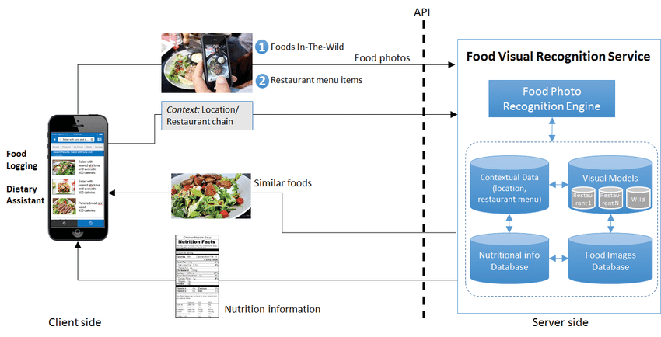
ARCHITECTURE DIAGRAM

Slide 13
MODULE HEADING
1. Food Identification and Nutritional Analysis Module
2. Portion Size Estimation Module
3. Image Processing and Quality Enhancement Module
4. Real-Time Feedback and Recommendation Module
5. User Interface and Integration Module

Slide 14
Food Identification and Nutritional Analysis Module
This module focuses on accurately identifying food items using advanced computer vision techniques, particularly convolutional neural networks (CNNs). It leverages a vast and diverse food dataset to handle various cuisines and mixed dishes. Once the food is identified, the module performs nutritional analysis by estimating calories, macronutrients (proteins, fats, carbohydrates), and micronutrients (vitamins, minerals). The data is then cross-referenced with a nutritional database to provide detailed and reliable nutritional information. This helps users track their daily intake and make informed dietary decisions.

Slide 15
Portion Size Estimation Module
The portion size estimation module uses 3D modeling and depth sensing techniques to accurately estimate the size and volume of food portions. This is crucial for ensuring that users receive accurate calorie and nutrient intake data based on portion size. The system employs AI algorithms to measure the food's spatial characteristics, even in irregularly shaped items. This module is designed to work with various food presentations, improving the system's ability to estimate portions in real-world environments, such as irregularly plated meals or home-cooked dishes

Slide 16
Image Processing and Quality Enhancement Module
This module addresses the challenges of food recognition from images with varying quality. Using advanced image processing techniques, it enhances low-resolution images by improving contrast, sharpness, and color balance. It also includes algorithms for background removal and object segmentation, ensuring the food is clearly distinguishable. The system is optimized to work with real-world images taken under different lighting conditions, making it robust and practical for everyday use. This module ensures that even with suboptimal image quality, the recognition and analysis processes remain accurate.

Slide 17
Real-Time Feedback and Recommendation Module
The real-time feedback and recommendation module provides users with instant insights into their food choices. After food recognition and analysis, the system offers nutritional feedback, including calorie content and dietary recommendations based on the user’s health goals. It adapts to the user's preferences and health conditions, offering personalized suggestions like meal modifications, portion adjustments, or healthier alternatives. This module can integrate with mobile applications and wearable devices to provide on-the-go nutrition guidance, encouraging users to make healthier dietary decisions in real-time.

Slide 18
User Interface and Integration Module
This module is responsible for creating an intuitive and user-friendly interface for seamless interaction with the system. It ensures easy navigation for food recognition, nutritional analysis, and personalized recommendations. The interface is designed to be accessible on mobile apps and integrated with wearable devices, allowing users to track their meals and health goals efficiently. The module also handles the integration of the system with external databases and platforms, such as nutrition databases and fitness tracking apps, ensuring that all relevant data is synchronized for a comprehensive user experience.

Slide 19
IMPLEMENTATION
import tensorflow as tf
from tensorflow.keras.models import load_model
from tensorflow.keras.preprocessing import image
import numpy as np
import requests
# Load the pre-trained model
model = load_model('food_recognition_model.h5')
# Preprocess input image
def preprocess_image(img_path):
img = image.load_img(img_path, target_size=(224, 224))
img_array = image.img_to_array(img) / 255.0
img_array = np.expand_dims(img_array, axis=0)
return img_array

Slide 20
IMPLEMENTATION
# Predict food item
def predict_food(img_path):
img_array = preprocess_image(img_path)
predictions = model.predict(img_array)
class_names = ['apple', 'banana', 'burger', 'pizza'] # Example classes
predicted_class = class_names[np.argmax(predictions)]
return predicted_class
# Example usage
food_item = predict_food('example_food_image.jpg')
print("Predicted Food Item:", food_item)

Slide 21
IMPLEMENTATION
import requests
# Get nutritional data from API
def get_nutrition(food_item):
api_key = 'YOUR_API_KEY'
base_url = 'https://api.nal.usda.gov/fdc/v1/foods/search'
params = {'query': food_item, 'api_key': api_key}
response = requests.get(base_url, params=params)
data = response.json()
return data['foods'][0]['foodNutrients'] # Example extraction
# Display nutritional data
nutrients = get_nutrition(food_item)
for nutrient in nutrients:
print(f"{nutrient['name']}: {nutrient['amount']} {nutrient['unitName']}")

Slide 22
IMPLEMENTATION
def dietary_recommendations(nutrients, goal='weight loss'):
if goal == 'weight loss':
if 'Calories' in nutrients:
print("Consider reducing high-calorie foods.")
elif goal == 'muscle gain':
if 'Protein' in nutrients:
print("Increase protein intake from sources like eggs or beans.")
else:
print("Maintain a balanced diet.")

Slide 23
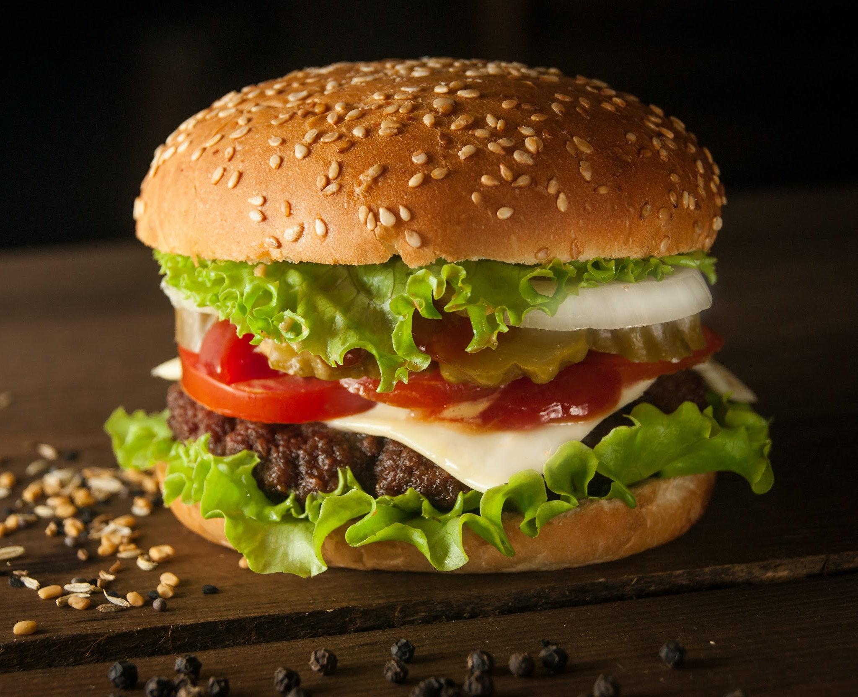
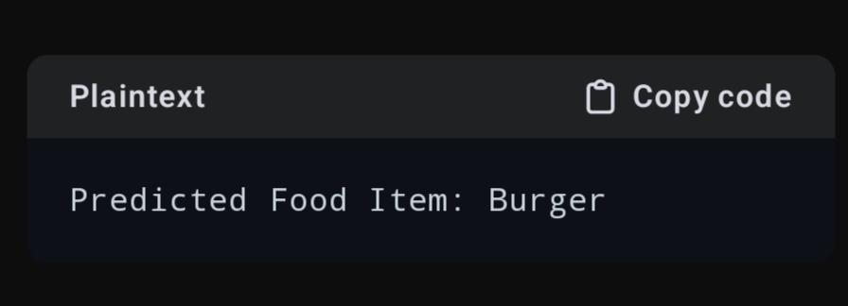
IMPLEMENTATION SCREENSHOT

Slide 24
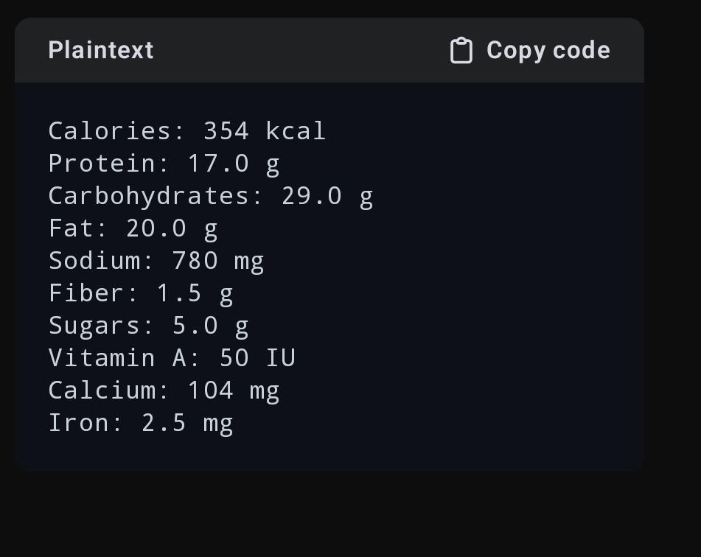
IMPLEMENTATION SCREENSHOT

Slide 25
CONCLUSION
The integration of Artificial Intelligence in nutrients and food recognition presents a revolutionary approach to dietary management and health monitoring. By leveraging advanced technologies such as deep learning, 3D modeling, and real-time feedback systems, this solution addresses the limitations of existing systems, providing more accurate, accessible, and personalized nutritional insights. It empowers individuals to make informed dietary choices, supports healthcare professionals in managing diet-related conditions, and promotes overall well-being. As AI continues to evolve, the potential for further innovation in this field remains vast, paving the way for smarter and more efficient dietary solutions in the future.

Slide 26
FUTURE ENHANCEMENT
1. Enhanced Dataset Diversity: Expanding datasets to include more regional cuisines, rare food items, and complex dishes for improved recognition accuracy.
2. Integration with IoT Devices: Incorporating AI capabilities into smart kitchen appliances and wearable devices for seamless dietary tracking.
3. Voice and AR Assistance: Adding voice commands and augmented reality (AR) features to enhance user interaction and food visualization

Slide 27
REFERENCES
1. Research papers and articles on food recognition systems using AI, such as those leveraging convolutional neural networks (CNNs) for image-based food identification.
2. Studies on integrating nutritional analysis with mobile and wearable applications, focusing on real-time feedback and user personalization.

Slide 28
THANK YOU
ANY QUERIES?

