Slide 1
IPL Data Analysis (2008 – 2017)
Power BI Project Presentation

Slide 2
Project Overview
Analyzed IPL data from 2008–2017 using Power BI.
Created interactive dashboards and KPIs.
Generated insights about teams, players, toss decisions, and stadium performance.

Slide 3
Project Objectives
Identify successful IPL teams and players.
Analyze batting, bowling, and fielding statistics.
Study toss decision impact on matches.
Generate insights for strategy and engagement.

Slide 4
Dataset Used
Matches dataset with match details and results.
Deliveries dataset with ball-by-ball information.

Slide 5
Data Cleaning & Preparation
Handled null values in city column using venue information.
Remove umpire3 column because it contained 100% null values.
Corrected Teams name using replace values.

Slide 6
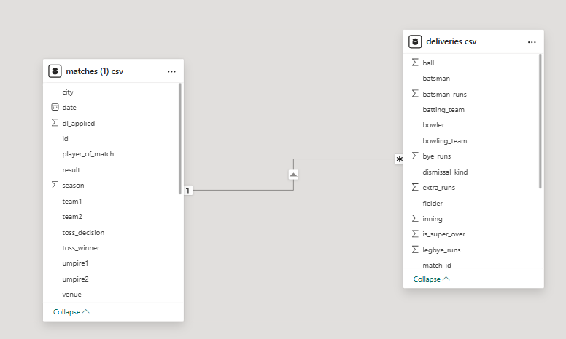
Data Modelling

Slide 7
KPIs Created
Total Matches
Total Runs
Total Wickets
Total Sixes and Fours
Most Successful Team
Most Player of the Match Awards

Slide 8
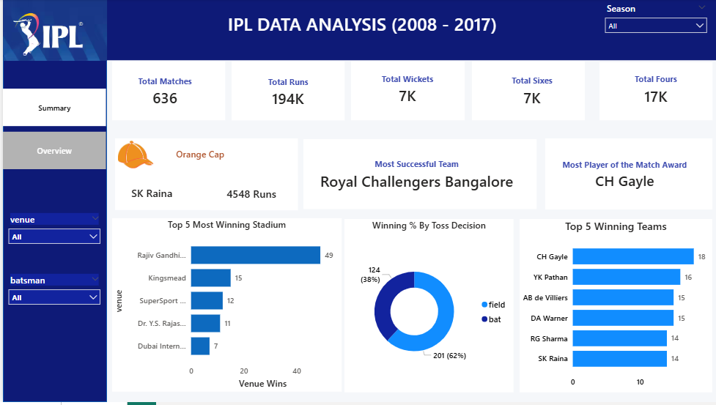
Summary Dashboard

Slide 9
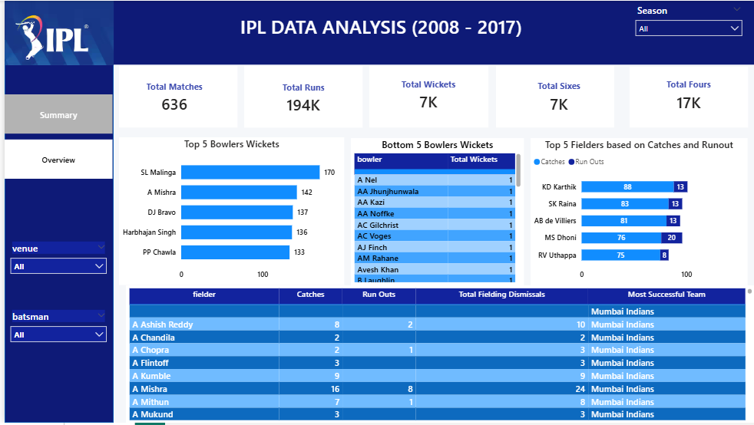
Overview Dashboard

Slide 10
Key Insights
Royal Challengers Bangoalore emerged as one of the most successful teams.
CH Gayle received the most Player of the Match awards.
Teams choosing to field after toss had better success rates.
SL Malinga was among the top wicket takers.

Slide 11
Tools & Technologies
Power BI
Power Query
DAX
Excel / CSV datasets

Slide 12
Conclusion
Successfully transformed IPL datasets into interactive dashboards.
Generated insights for team and player performance.
Demonstrated Power BI, DAX, and data visualization skills.

