Slide 1
Advanced Data Analytics Topics
Semester Project
Sentiment Analysis on IMDB reviews
EMMANOUIL GIANNAKIS E21022

Slide 2
01
Data Pre-Preprocessing

Slide 3
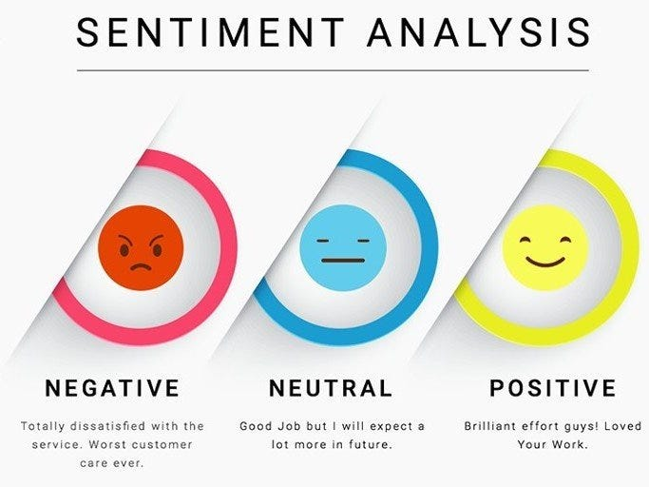
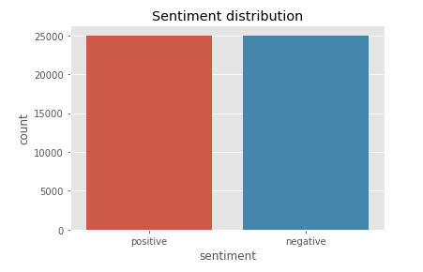

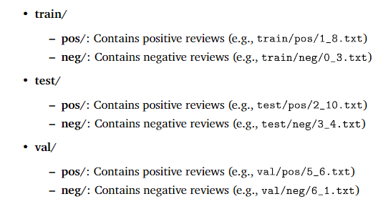
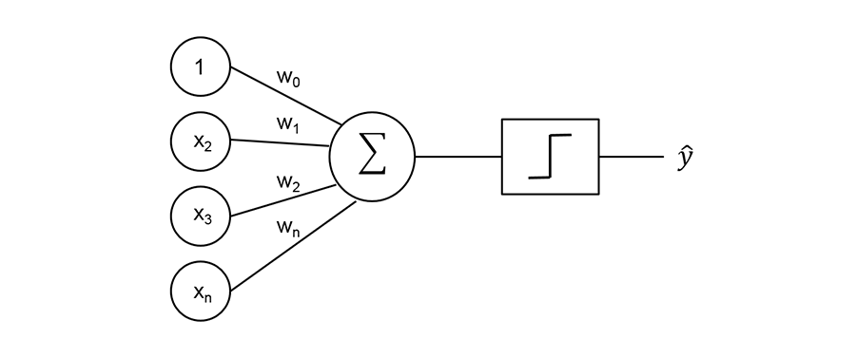

Dataset Format
Model Training
Remove Punctuation
Lowercasing
A
a
A

Slide 4
02
Data Preprocessing

Slide 5

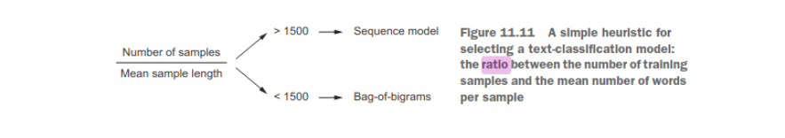
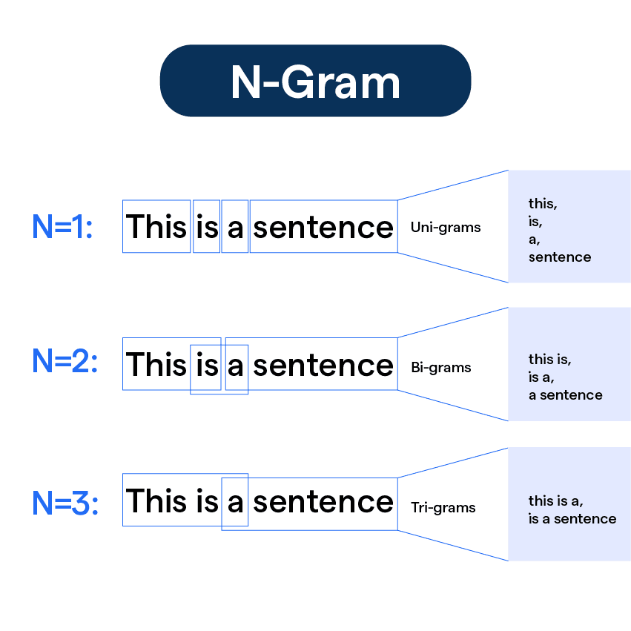
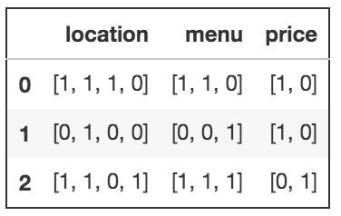
Based on the analysis of the ratio :
number per training samples / mean words per samples =
*Bag of Words Tokenization is going to perform better on the dataset.
This heuristic rule is based on a systematic analysis of the performance of various text classification techniques across many different types of text datasets by Francois Chollet in 2017.
Creation of a vocabulary of 20,000 most frequent words and maximum of 600 tokens per sequence.
After tokenizing the text, we apply multi-hot encoding, representing each review as a binary vector. In this matrix, each word corresponds to a unique position, with multiple 1 indicating the presence of specific words across the document.

Slide 6
02
Machine Learning

Slide 7

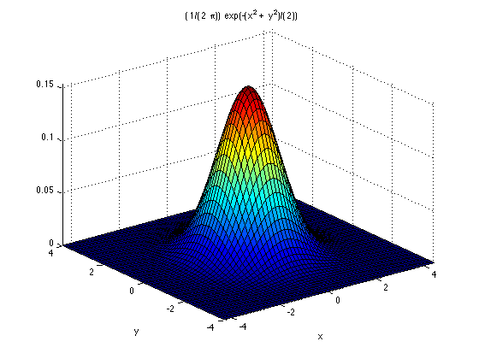


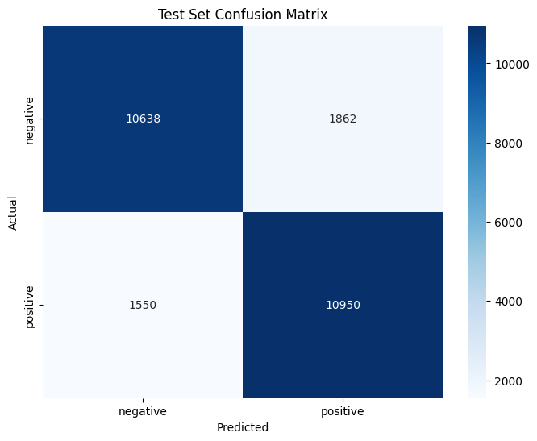
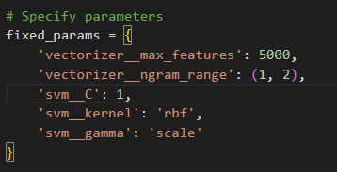
Support Vector Machine(SVM) with RBF Kernel
Data Conversion from Folders to CSV
Results
Hyperparameters

Slide 8
03
Deep Learning

Slide 9
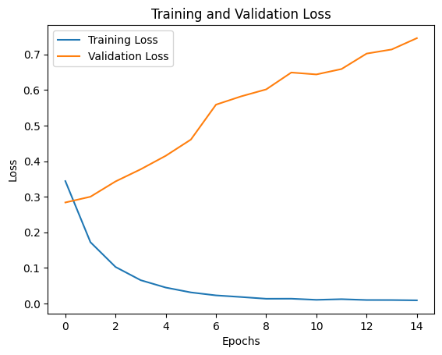
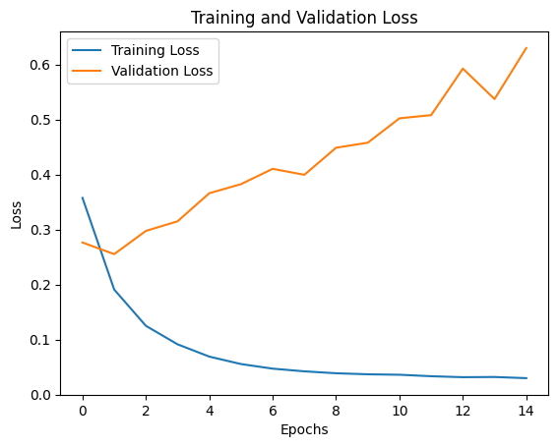
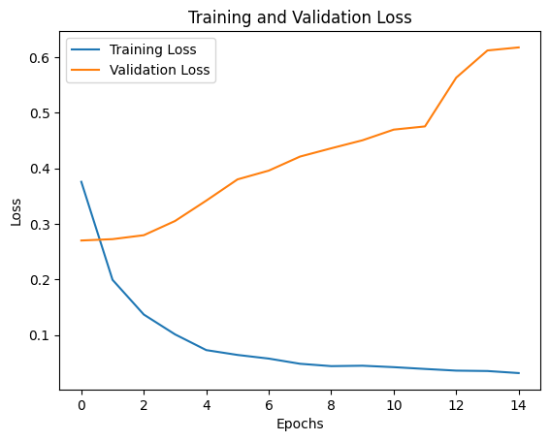
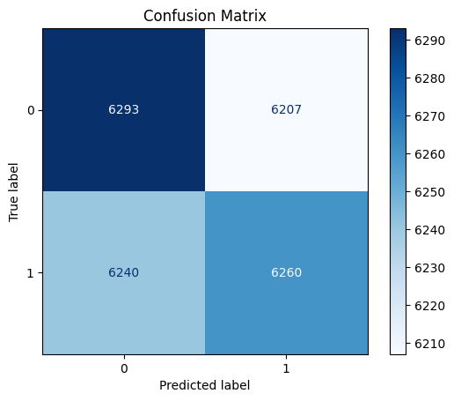
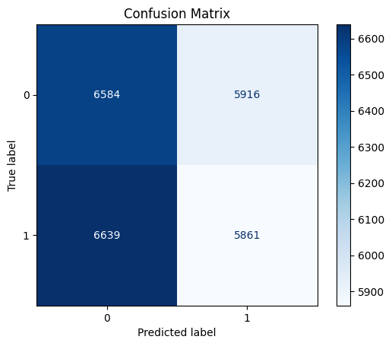
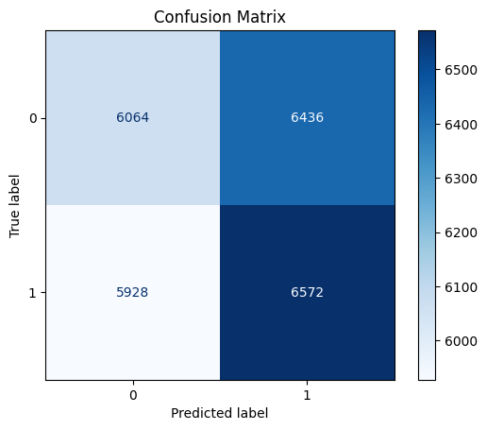
Bag of Words Models
N-Gram approach
Unigram
Bigram
Trigram
Overfitting!!!

Slide 10
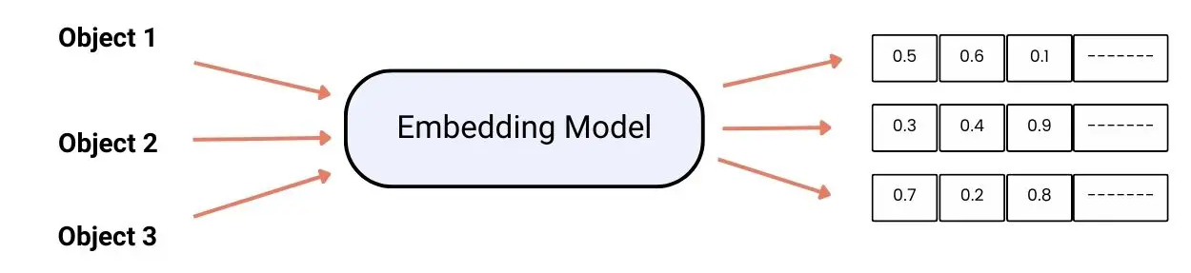
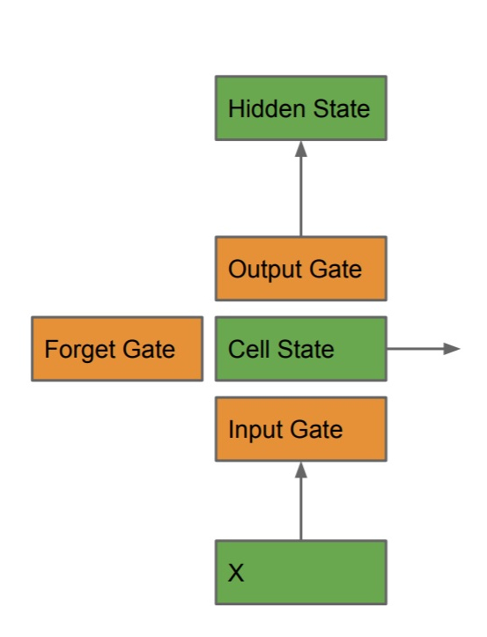
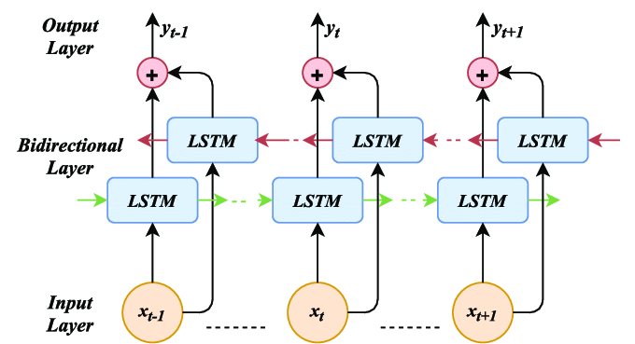
Sequence Models
LSTM architecture
Embedding Layer for word vectorization
Gating mechanism to manage information flow:
Input Gate:
Output Gate:
Forget Gate:
Cell State: Memory pipeline that allows model to retrieve long-term information
Vectors are input to Bidirectional LSTM block
Bidirectional : process sequence
forward
backward

Slide 11
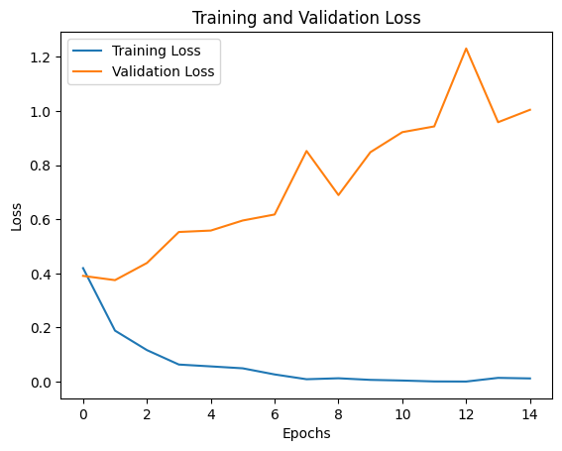
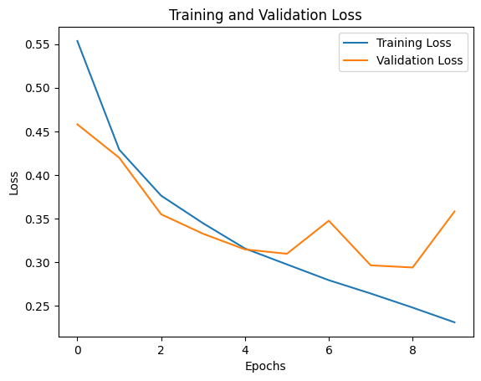
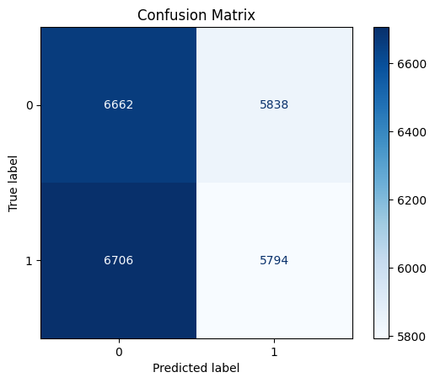
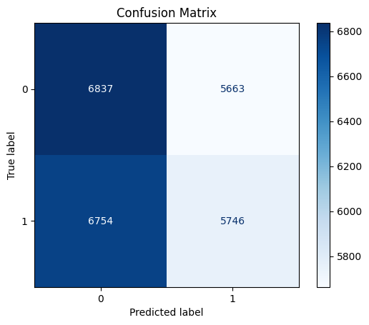
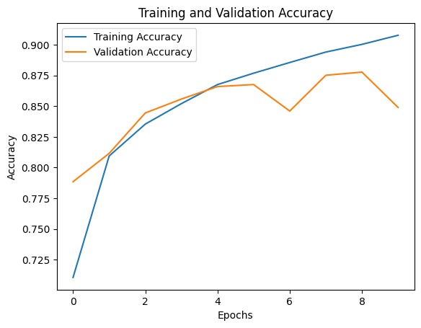
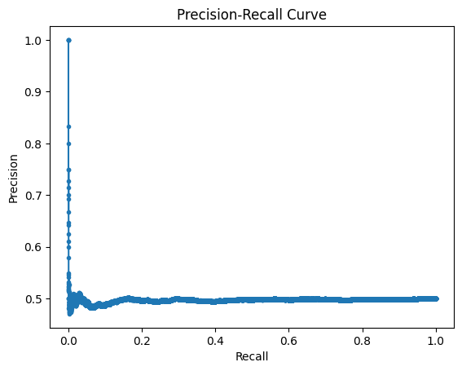
Sequence Models
Results
Trainable Embeddings
Pretrained GloVe Embeddings

Slide 12
04
Results

Slide 13
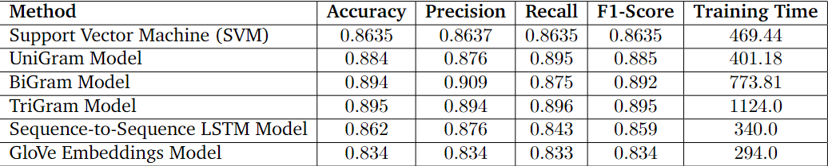
The training was done using a NVIDIA A100 GPU available through Google Colab.
SVM showed a robust Confusion Matrix correctly classifying most test cases. Also the prediction time was much faster than the rest of the models due to its computationally efficient architecture

Slide 14
05
App

Slide 15


Home Page
Hover Mouse

Slide 16
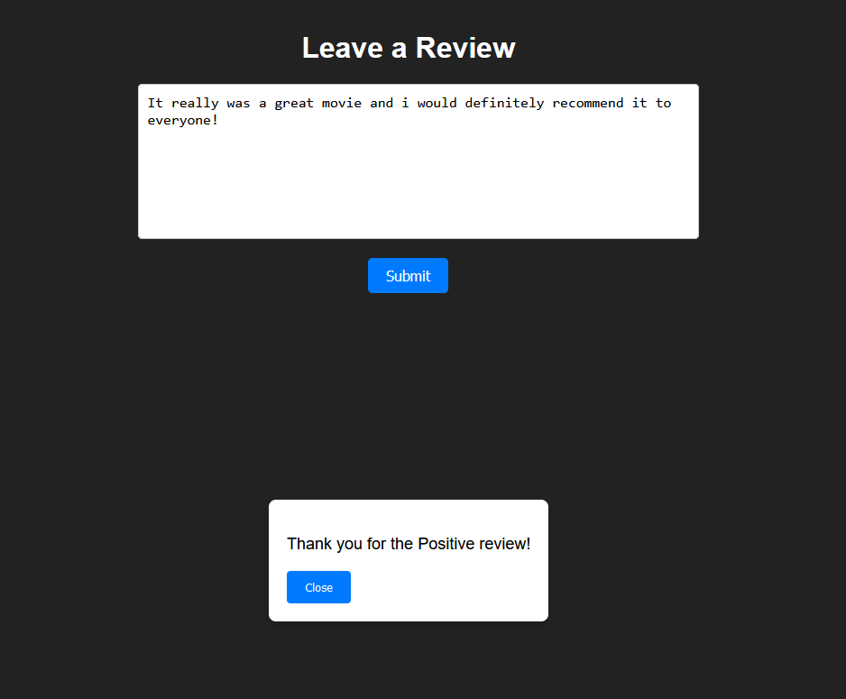
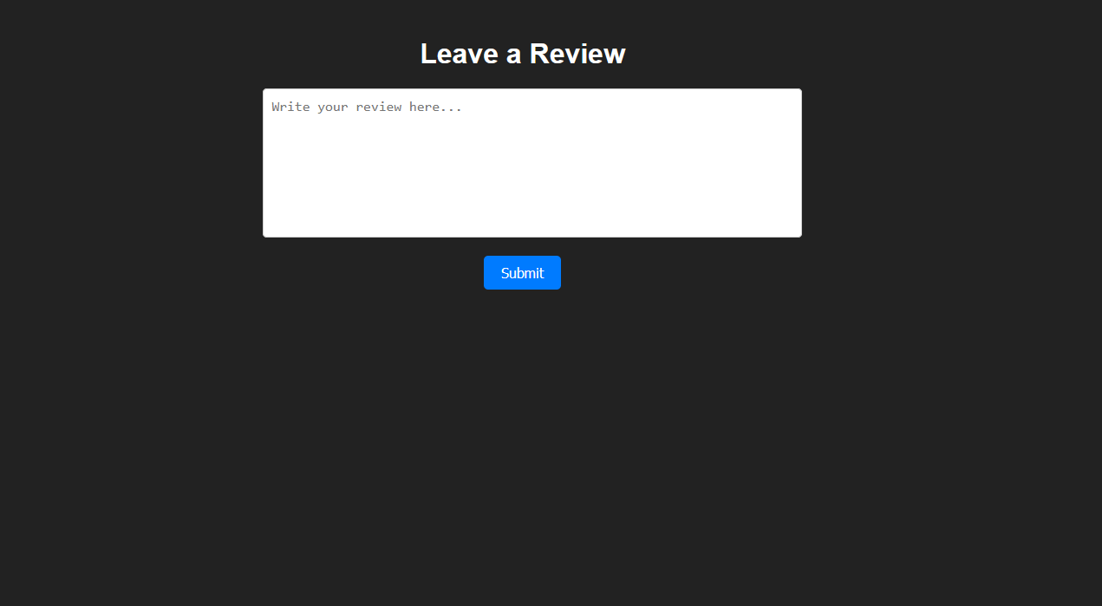
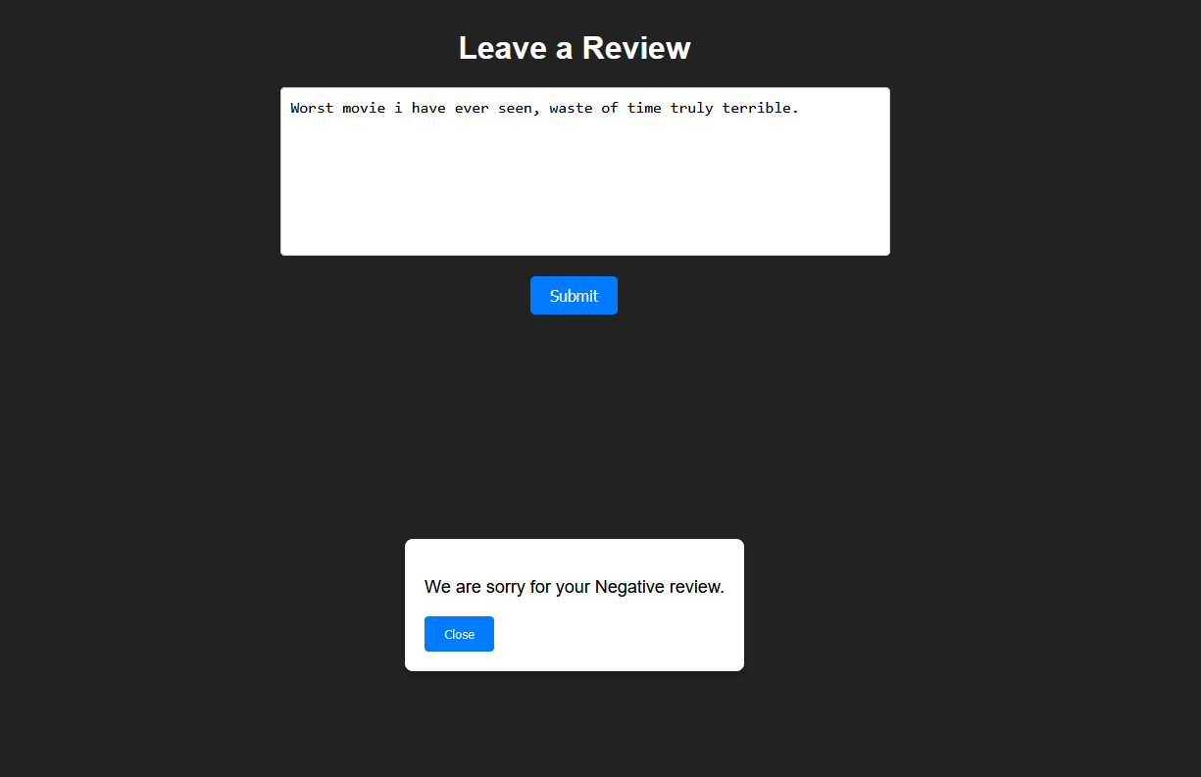
Review Page

Slide 17
Bibliography
Sentiment Analysis for IMDb Movie Review Using Support Vector Machine (SVM) Method
https://rb.gy/ofdnmr
Analysis Sentiment based on IMDB aspects from movie reviews using SVM
https://rb.gy/8oehvg
Performance Study of N-grams in the Analysis of Sentiments
https://rb.gy/33g01a
Deep Learning with Python by François Chollet
https://rb.gy/skvk2a

