Slide 1
Array Encoding for Symbolic Execution of JavaScript with ExpoSE
JavaScript
Existing Solutions to JS Correctness
Symbolic Execution
JavaScript Arrays
Project Goals
Encoding Simple JS Arrays
A Solution to Complex JS Arrays?
Supervised by Johannes Kinder
ExpoSE by Johannes Kinder, Blake Loring, Duncan Mitchell

Slide 2
JavaScript is Ubiquitous and Problematic
JavaScript has been the most commonly used programming language according to the StackOverflow developer survey for five years ^{[1]}
Dynamic Types : ‘6’ * 3.0 - true === 17
‘’ == false
‘3’ == 3.0
Alter Behaviour of the Standard Library : Array.prototype.toString = () => ‘Fred’ [].toString() === ‘Fred’
Dynamic Procedures and Property Access:
function do_b (func, b){ func(b) } let bar = ‘foo’ let baz = obj[bar]
[1] https://insights.stackoverflow.com/survey/2017
Notes:
POPULAR Web, server (Node Express), Electron (Slack / Atom), and mobile (React Native)
BROKEN
Quickly prototyped in 10 days at Netscape it borrows language features from a lot of obscure places leading to a lot of idiosyncratic behaviour and this combined with a dynamic type system, loose script syntax, and a ‘fail silently approach, creates a lot of opportunities for subtle bugs
JavaScript often

Slide 3
Existing Solutions Aren’t Great
Eslint and other similar tools provide a limited set of ‘rules’ that code can be tested against
Flow and Typescript require developers to annotate or compile to JavaScript
Tools like KJS ^{[2]} and JaVerT ^{[3]} only operate on a subset of ES5 and its standard library
Few solutions analyse dependencies but JavaScript has a rich library ecosystem ^{[4]}
[2] Park, D., Stefănescu, A., & Roşu, G. (2015, June). KJS: A complete formal semantics of JavaScript. In ACM SIGPLAN Notices (Vol. 50, No. 6, pp. 346-356). ACM.
[3] Santos, J. F., Gardner, P., Maksimović, P., & Naudžiūnienė, D. (2017, August). Towards Logic-Based Verification of JavaScript Programs. In International Conference on Automated Deduction (pp. 8-25). Springer, Cham.
[4] http://www.modulecounts.com/
Most solutions struggle to reason about the JS execution environment (DOM APIs, etc.)
Notes:
POPULAR Web, server (Node Express), Electron (Slack / Atom), and mobile (React Native)
BROKEN
Quickly prototyped in 10 days at Netscape it borrows language features from a lot of obscure places leading to a lot of idiosyncratic behaviour and this combined with a dynamic type system, loose script syntax, and a ‘fail silently approach, creates a lot of opportunities for subtle bugs
JavaScript often

Slide 4
Symbolic Execution to the Rescue
Goal: Execute every possible path of the program once to identify all possible errors
function (x, y) {
if (x > 14 ) {
if (x === 14) {
return;
}
throw new Error()
}
if ( y < 1) {
y --
}
}
function (x) {
if (x > 1 ) {
…
} else {
…
}
}
Notes:
Symbolic execution is a technique that can be used for program testing.
A program is executed both normally, with actual values for variables (we call this concrete execution) and symbolically, in which we store an additional representation of the values as a set of all the possible values that a variable could represent in the current execution. When we reach a branching statement we constrain this value by evaluating the branch condition. (Describe the simple case in slide)
The conjunction of branch conditions (of the branches that were taken) represents an equivalence class in the set of paths taken through a program and so if we continue to do this, by generating new paths through the program then we can exhaustively test all paths of the program.

Slide 5
Random initial input: x: 0.5, y: -30 pc: true
pc: x <= 14
pc: (x <= 14) ^ (y < 1)
No error was found
Generate new inputs
newPath: ¬(x <= 14) ^ (y < 1)
Call constraintSolver.Solve(newPath)
x: 5947, y: -30
pc: true
pc: x > 14
constraintSolver.solve(pc ^ x = 14) unsat
Error, found with concrete inputs x: 5947, y: -30
function (x, y) {
if (x > 14 ) {
if (x === 14) {
return;
}
throw new Error()
}
if ( y < 1) {
y --
}
}
Notes:
It executes the program, so every bug that is found is guaranteed to be a real bug (severity aside)
It can run in multiple environments
It tests not just your code but all underlying library code
It’s very effective at identifying corner cases
It is able to support the full set of the language concretely
ExpoSE is a tool developed in this department for the symbolic

Slide 6

Symbolic Execution to the Rescue
Symbolic execution actually executes the program – no false positives
Can run in multiple environments seamlessly* V8, SpiderMonkey, Chakra
Tests underlying library code★
Able to support the full set of language features – falling back to concrete execution on parts of the standard library we can’t model symbolically
[*] As long as we can run our constraint solver (Z3) there
[★] As long as the code is JavaScript
Notes:
It executes the program, so every bug that is found is guaranteed to be a real bug (severity aside)
It can run in multiple environments
It tests not just your code but all underlying library code
It’s very effective at identifying corner cases
It is able to support the full set of the language concretely
ExpoSE is a tool developed in this department for the symbolic

Slide 7
JavaScript Arrays
JavaScript arrays are a special form of object where the property name when coerced to an unsigned integer is between 0 and 2⁵³ -1
Has a rich assortment of array prototype functions: pop(), map(), filter(), every()
JavaScript arrays are non-homogenous let arr = [‘1’, 42.0, false, new Foo()]
JavaScript arrays can have ‘holes’ let arr = [‘a’ , , ‘c’]

Slide 8
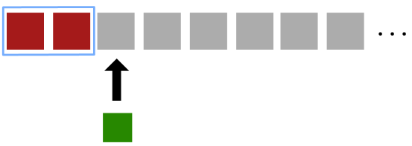
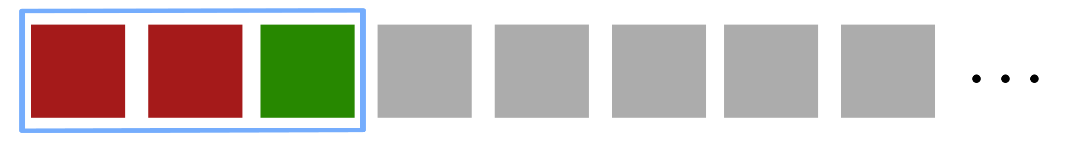
Representing ‘Simple’ JavaScript Arrays in ExpoSE
Decide whether to represent arrays as Z3 arrays or Z3 sequences
Turns out arrays are better but a lot more work
Supporting the simple homogenous case: implement .length, put index, and get index
Have two constraints per array: one for the array and one for the length of the array

Slide 9
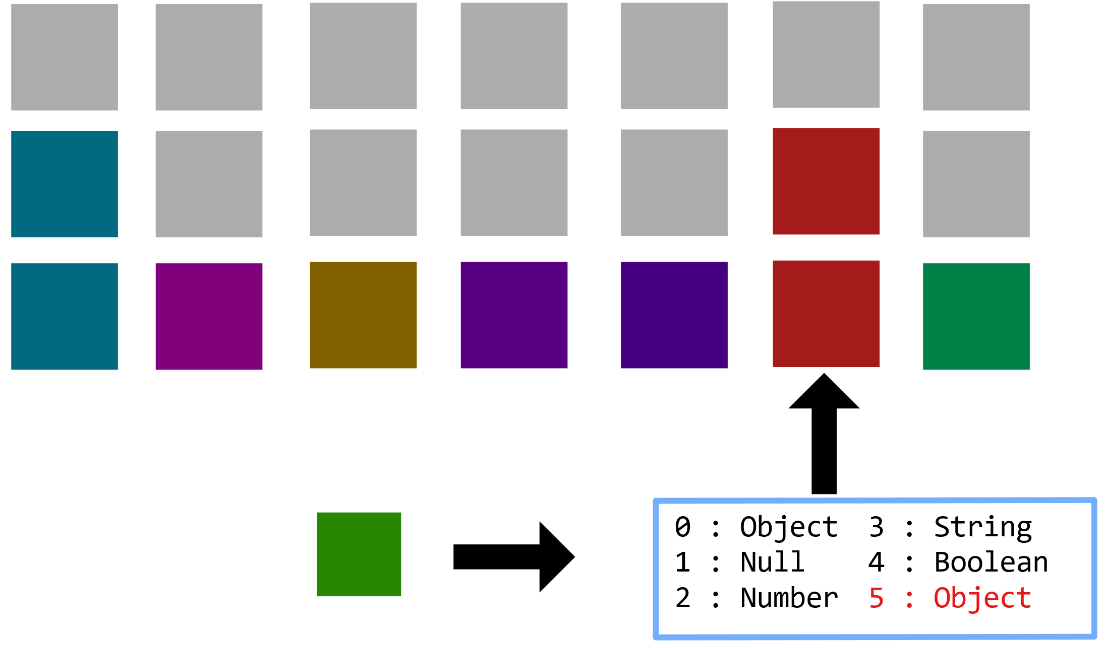
Representing ‘Complex’ JavaScript Arrays in ExpoSE
An array of arrays: one for each primitive JS type (and one for holes!) with a hash map that maps index to array
Length would be the number of keys in the hash map

