Slide 1
Testing Data (20%)
Obtain test metrics and confusion matrix
Get 512 descriptor/image using Resnet
Data Preprocessing
Data Augmentation (balancing)
Original Dataset
Split Data
Training Data (80%)
KNN Classifier

Slide 2
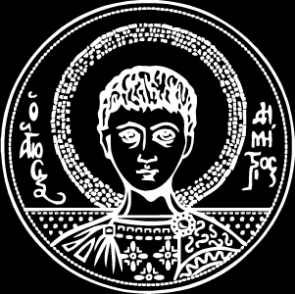
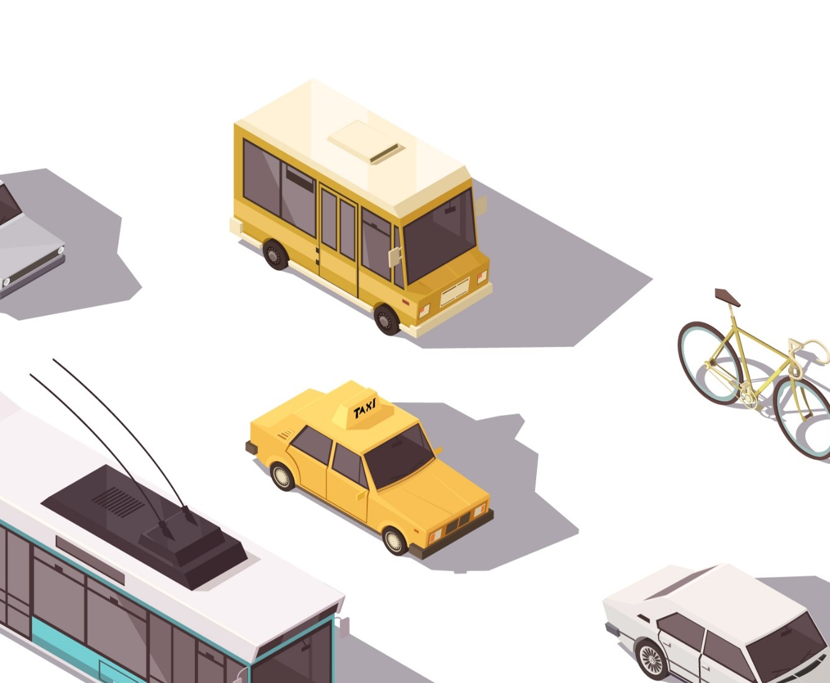

Classification of incident-related images using machine learning Panteleimon Manouselis Bishoy Essam Samir Yassa Gerges
Topic Teachers: Estefania Talavera (CV&IC)
Faizan Ahmed (TS)
Notes:
Hi. My name is Pantelis and this is my colleague Bishoy and today we will present to you our project on the classification of incident-related images using machine learning.

Slide 3
Problem Statement
Automatic recognition of incident-related images that require human intervention
Notes:
Before we dive into the details of our project, let's start with the problem statement. Incidents such as accidents or disasters can happen anywhere and anytime. In many cases, the first responders who arrive at the scene are police officers, firefighters, or medical staff and they often need to make quick decisions based on the situation they are facing. In some cases, incident-related images can provide valuable information that can help these responders take appropriate actions. However, manually analyzing and classifying these images can be time-consuming and error-prone. Therefore, our project aims to develop a system that can automatically recognize incident-related images that require human intervention. This system can potentially save valuable time and improve the accuracy of decision-making in emergency situations."

Slide 4
Proposed Approach
Leveraging Computer Vision with ResNet and KNN Classifiers
Notes:
To achieve our goal of automatically recognizing incident-related images, we proposed a two-step approach leveraging computer vision with ResNet and KNN classifiers. Firstly, we used the ResNet-18 convolutional neural network to extract features from the images. ResNet is a deep learning model that has achieved state-of-the-art performance on various image recognition tasks. By using ResNet, we were able to extract high-level features from the images, which can be used to represent the images in a lower-dimensional space. Secondly, we used the K-nearest neighbor (KNN) classifier to classify the images based on their extracted features. KNN is a simple and effective classification algorithm that assigns a new sample to the class of its nearest neighbors in the feature space. By using KNN, we were able to classify the incident-related images with high accuracy. In the following slides, we'll go into more details on how we implemented these steps and how we evaluated the performance of our approach."

Slide 5
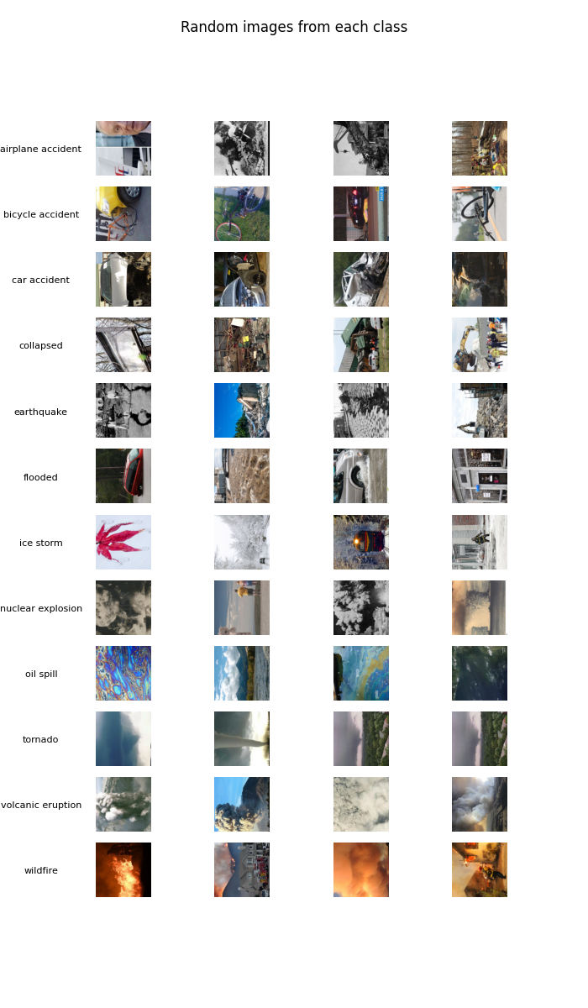
Dataset:

Slide 6
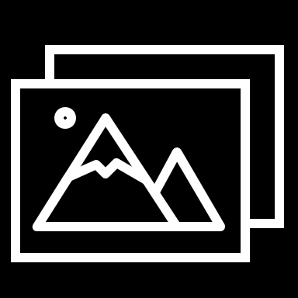
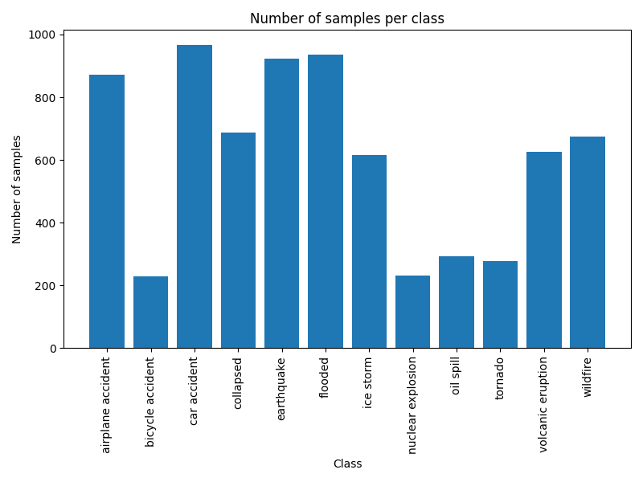
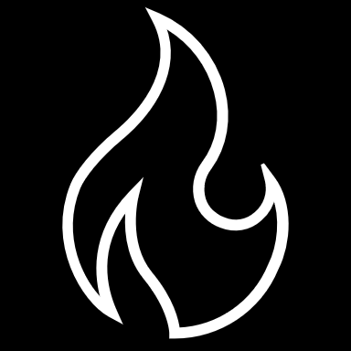
Dataset Description
Images describing natural disasters
Incidents at different Locations
Twelve classes
http://incidentsdataset.csail.mit.edu
Notes:
Our dataset consists of images depicting various incidents. The images are divided into twelve classes, each representing a different type of incident. The given dataset is unbalanced, meaning that each class does not contains an equal number of images and therefore if we trained the classifier in the provided dataset, it would be biased towards the “larger” classes.

Slide 7
Data Preprocessing
Delete
corrupted
images
Remove
low-quality
Images
Data
Augmentation
Notes:
Before we could use the images in our dataset for training and testing our classifiers, we had to preprocess them to ensure that they were in a consistent format and size. One of the first steps we took was to delete any corrupted images from the dataset.

Slide 8
Data Preprocessing
Delete
corrupted
images
Remove
low-quality
Images
Data
Augmentation
Notes:
The next step was the removal of any low-quality images from the dataset using Laplacian filtering. The Laplacian filter is a technique that can help detect edges and details in an image. By applying Laplacian filtering to our images, we were able to identify and remove low-quality images that lacked sharp edges and details. This step helped improve the quality of our dataset.

Slide 9
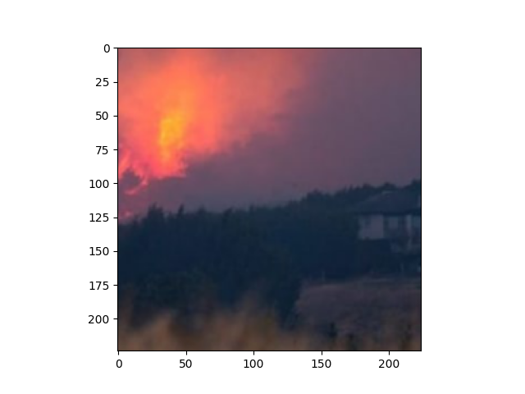
Low-Quality Image Removal
Notes:
Low quality Image detected using Laplacian (i.e., check how strong the edges are in an image)

Slide 10
Data Preprocessing
Delete
corrupted
images
Remove
low-quality
Images
Data
Augmentation
Notes:
The last step of data preprocessing was to apply data augmentation techniques to balance our dataset. Specifically, we randomly undersampled classes with many images and oversampled classes with few images. This step helped ensure that our dataset was balanced and prevented our classifiers from being biased towards any particular class.

Slide 11
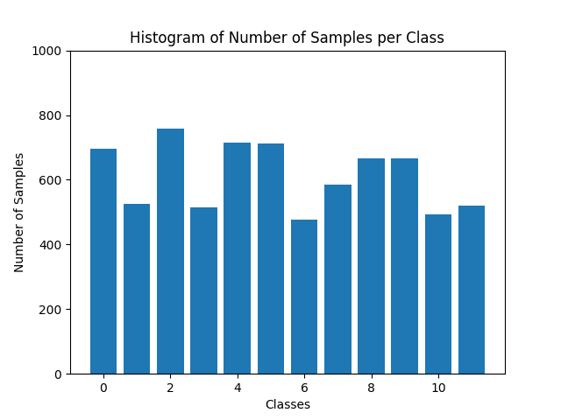
Data Augmentation
Initial Unbalanced Dataset
Balanced Dataset after Augmentation
Notes:
We did augmentation using random undersampling of the samples in the large classes and random oversampling of the samples in the small classes.

Slide 12
Experiments and results

Slide 13
KNN Classifier – No preprocessing
No Data preprocessing: No Laplacian threshold, No Data Augmentaion
Descriptors: 512 descriptors using ResNet18
Data Normalization
10-fold cross validation Average accuracy | Precison
0.59473 +- 0.01764 | 0.67
Notes:
The precision is the ratio tp / (tp + fp) where tp is the number of true positives and fp the number of false positives. The precision is intuitively the ability of the classifier not to label a negative sample as positive.
The recall is the ratio tp / (tp + fn) where tp is the number of true positives and fn the number of false negatives. The recall is intuitively the ability of the classifier to find all the positive samples.

Slide 14
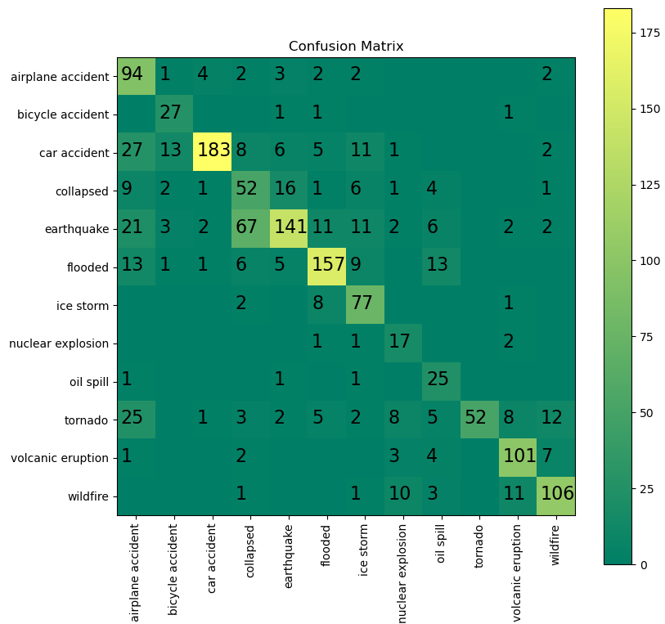
KNN Classifier – No preprocessing
Predicted
Unbalanced Dataset
True
Notes:
Poor:
Bicycle accident, nuclear explosion: more than half are misclassified
Compared to
Rich:
Flooded, car accident: classified correctly

Slide 15
KNN Classifier – After preprocessing
Data preprocessing: Laplacian threshold = 150, Data Augmentaion
Descriptors: 512 descriptors using ResNet18
Data Normalization
10-fold cross validation Average accuracy | Precison
0.81523 +- 0.01279 | 0.79
Notes:
The precision is the ratio tp / (tp + fp) where tp is the number of true positives and fp the number of false positives. The precision is intuitively the ability of the classifier not to label a negative sample as positive.
The recall is the ratio tp / (tp + fn) where tp is the number of true positives and fn the number of false negatives. The recall is intuitively the ability of the classifier to find all the positive samples.

Slide 16
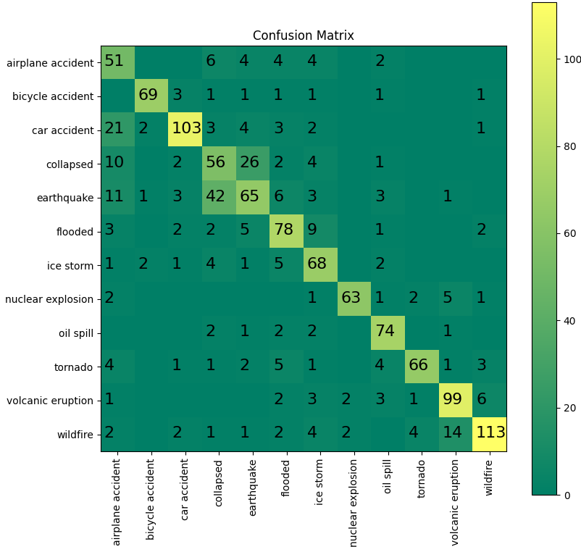
KNN Classifier – After preprocessing
Predicted
Balanced Dataset after Augmentation
True

Slide 17
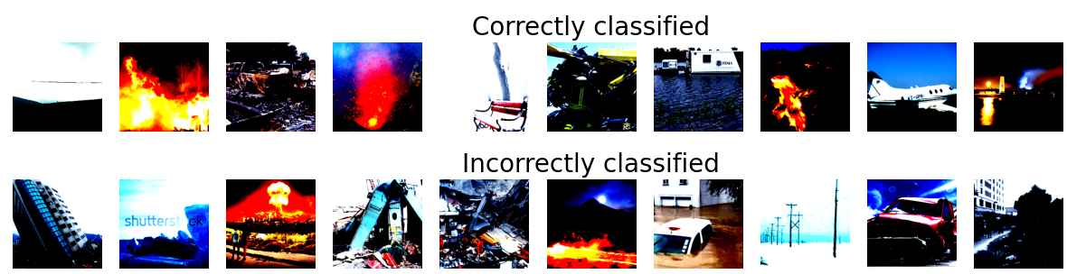
KNN Classifier

Slide 18
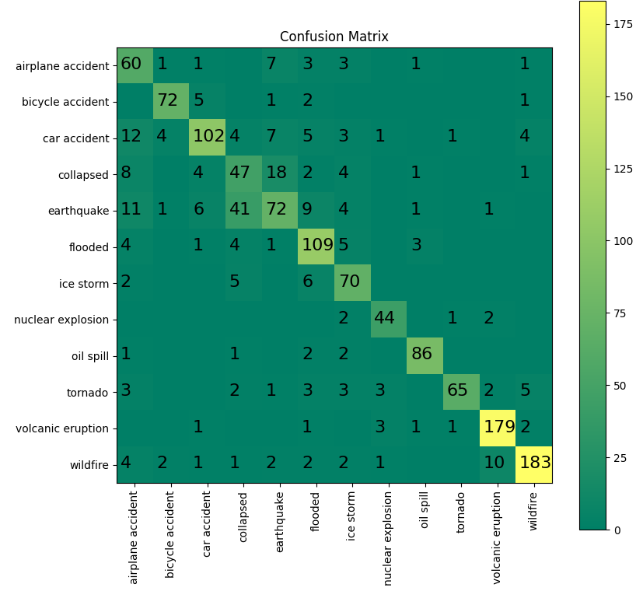
KNN Classifier - Comparison
Without preprocessing
With preprocessing
10-fold cross validation Average accuracy | Precision
0.59473 +- 0.01764 | 0.67
10-fold cross validation Average accuracy | Precision
0.81523 +- 0.01279 | 0.79
Notes:
Compare 10-fold cross validation average accuracy
Compare poor classes before and after preprocessing: (2) Bicycle accident, (8) nuclear explosion
You may think resampling introduced the same picture multiple times so, it gets classified multiple times. But actually, resampling also decreased the number of misclassification, thus shown to be effective!

Slide 19
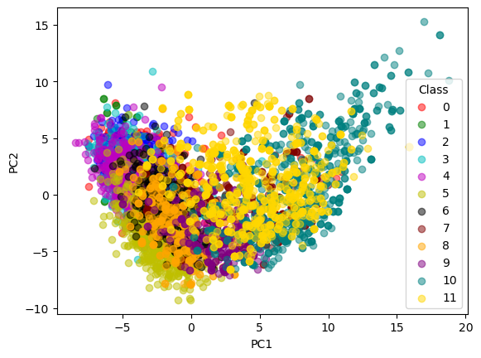
PCA Visualization: Dimensionality reduction

Slide 20
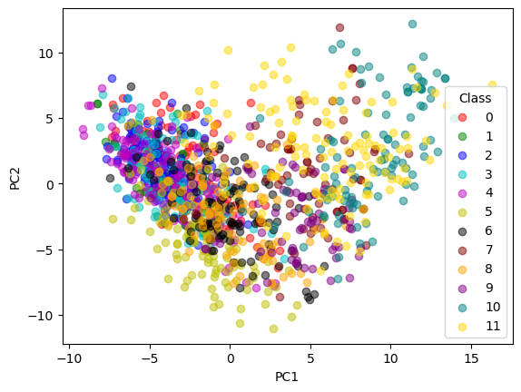
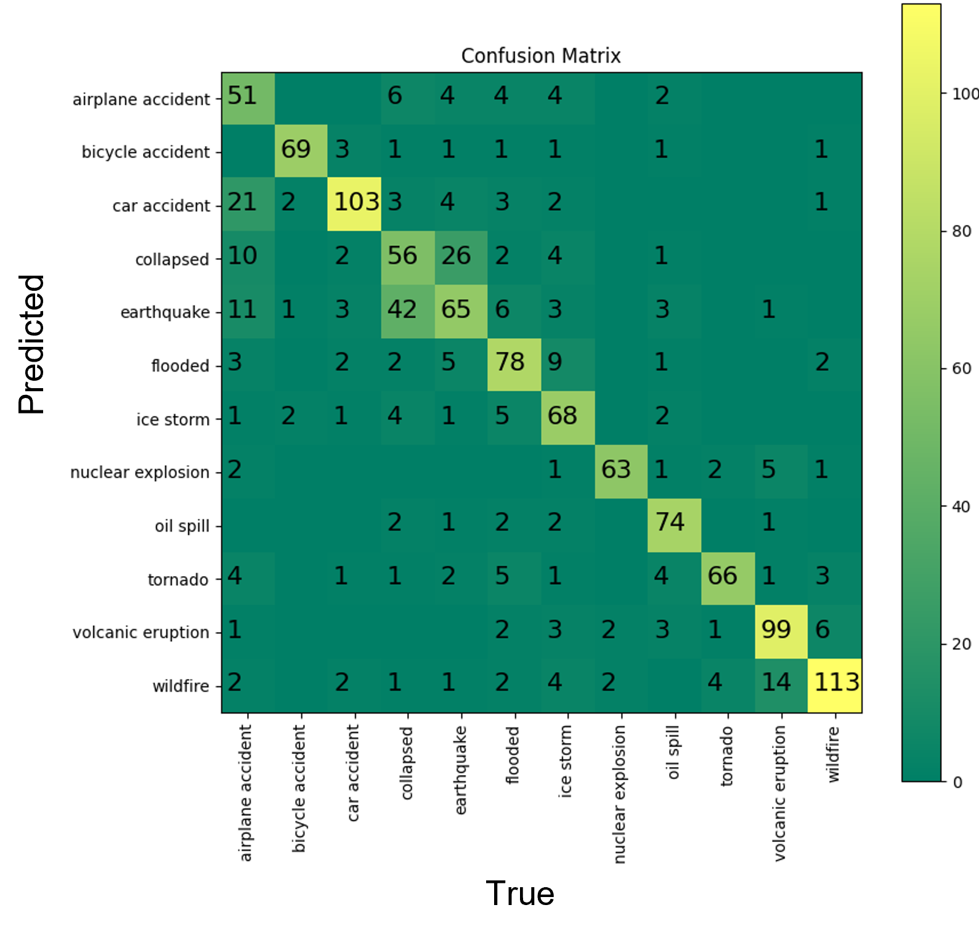
PCA Visualization: Dimensionality reduction
Notes:
Although the feature space is extremely low and does not provide a reliable visualization, one can still make some interesting observations. Here for example, the class with the best confusion performance looks more separated than the other classes.

Slide 21
Conclusion
ResNet provided a means to effectively describe the dataset using low number of descriptors compared to the total number of image pixels.
KNN is a machine learning algorithm that has demonstrated satisfactory classification performance in our case.
Data cleaning and preprocessing enhances the performance and reliability of the classification.
PCA visualization in feature space can give some visualization insights, yet not reliable.

