Slide 1


Title: Plant Disease Detection System for Sustainable Agriculture
Name : Melupaka Manozgna
AICTE Student ID: STU67d0270cc2dc41741694732

Slide 2

Learning Objectives
To understand the implementation of Convolutional Neural Networks (CNN) for image classification.
To classify plant leaf images into 38 disease categories using deep learning.
To explore deep learning tools and training techniques in real-world datasets.
To evaluate performance using accuracy, precision, recall, and loss metrics.
To identify real-world use cases of AI in agriculture for disease detection and prevention.
GOAL
Source :
https://github.com/Manozgna19/plant-disease-detection-system-for-sustainable-agriculture

Slide 3
Tools and Technology used
Programming Language: Python
Frameworks/Libraries: TensorFlow, Keras
Environment: Google Colab
Dataset Source: Kaggle - PlantVillage Dataset
Model: Custom CNN (trained from scratch)
Note: No pre-trained models were used

Slide 4
Methodology
Data Collection:
Acquired dataset from Kaggle containing 38 classes of healthy and diseased leaf images.
2. Data Preprocessing:
Resizing, normalization, data augmentation
Label encoding for class names
3. Model Building:
CNN with 4 Conv2D layers + MaxPooling + Dense layers
Dropout used to prevent overfitting
EarlyStopping and ModelCheckpoint for optimal training
4. Model Training & Evaluation:
Trained on Google Colab using GPU
Evaluation using accuracy, loss, precision, recall, and test predictions

Slide 5
Problem Statement:
Manual plant disease detection is time-consuming and lacks accuracy.
Delay in identification results in crop failure and economic loss.
There is a need for an automated, efficient, and scalable solution.
Objective: Build a deep learning system using CNN to detect plant diseases from leaf images.

Slide 6
Solution:
Developed a CNN model to classify 38 plant diseases based on leaf images.
Achieved an accuracy of ~89% on test data
Applied Dropout and EarlyStopping to improve model generalization
Built entirely from scratch using Keras with TensorFlow backend
GitHub Link: https://github.com/Manozgna19/plant-disease-detection-system-for-sustainable-agriculture

Slide 7
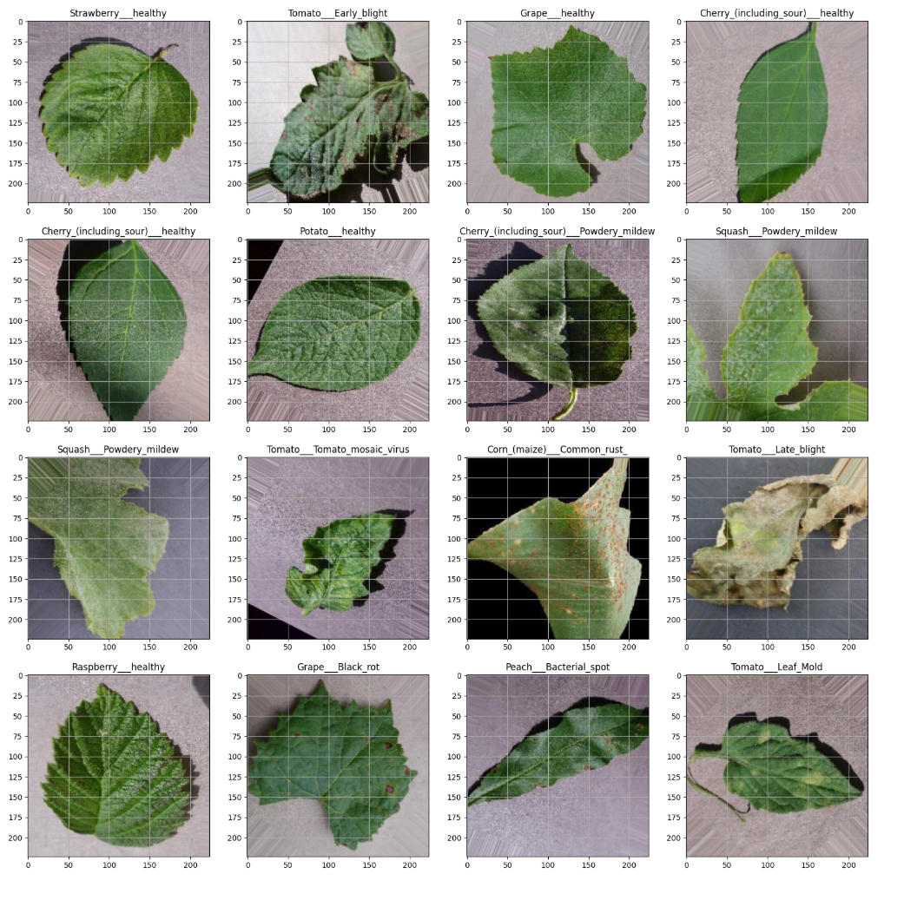
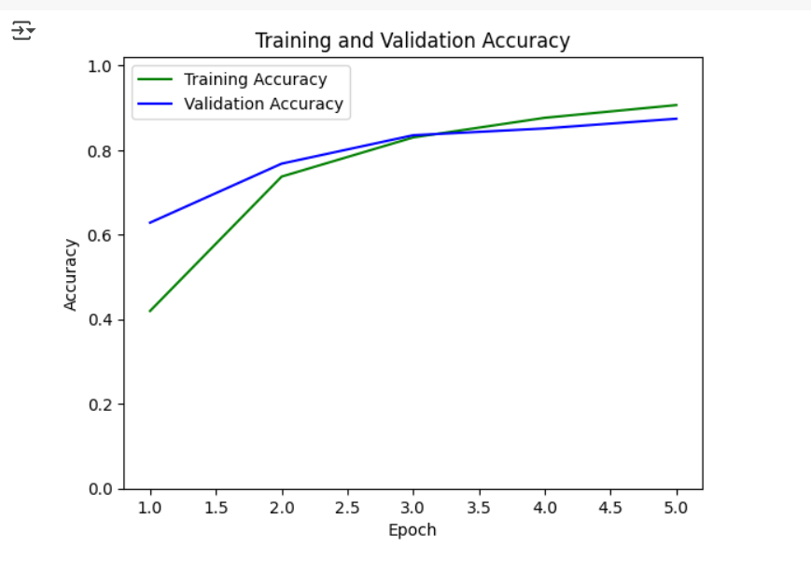
Screenshot of Output:
Model training and validation accuracy over 5 epochs
Sample images from 38 plant disease classes

Slide 8
Conclusion:
Conclusion:
Successfully built a CNN-based model for classifying 38 plant diseases
Achieved high accuracy with proper use of deep learning techniques
Model performance was validated using standard evaluation metrics
Future Scope:
Expand model to detect 100+ plant diseases
Use advanced optimizers like RMSprop for hyperparameter tuning
Deploy the model using Streamlit, Gradio, or Flask for real-time usage
Integrate with mobile cameras to assist farmers in real-time diagnosis
Contribute to the conservation of rare plant species through early detection

