Slide 1

PGPDS Fall 2021 : BDSN
End Term Assignment
Manpreet Singh – A21017

Slide 2

Machine Learning with PySpark and MLlib - Solving a Binary Classification Problem
Apache Spark, once a component of the Hadoop ecosystem, is now becoming the big-data platform of choice for enterprises. It is a powerful open source engine that provides real-time stream processing, interactive processing, graph processing, in-memory processing as well as batch processing with very fast speed, ease of use and standard interface.
In the industry, there is a big demand for a powerful engine that can do all of above activities.
Most companies and many clients are using Spark to develop sophisticated models
that would enable us to discover new opportunities or avoid risk.

Slide 3
description of the problem
We will use the data set to built a ML model, and it is related to one of the direct marketing campaigns of a Foreign banking institution. The goal is to predict whether the clients will subscribe (Yes/No) to a term deposit.
This data can be used to anticipate customers behaviours w.r.t to making investments in the bank and banks can plan to cross sell and upsell its services to those customer's making them more profitable.

Slide 4
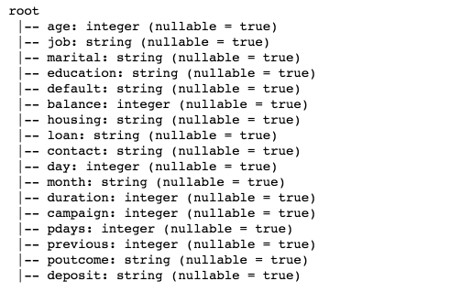
Identifying a data set with which WE can solve the problem
Input variables: age, job, marital, education, default, balance, housing, loan, contact, day, month, duration, campaign, pdays, previous, poutcome.
Output variable: deposit
Classification goal is to predict whether the client will subscribe (Yes/No) to a term deposit.

Slide 5
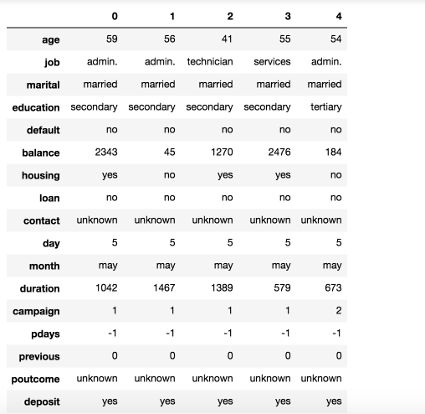
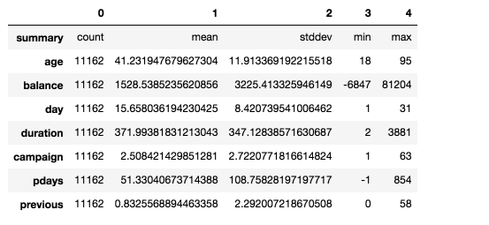
DATA Set snap & Statistics of the data

Slide 6
why it is important to solve the problem
The data mining techniques can be used to determine that how customers will react to adjustments in interest rates, the risk profile of a customer segment for defaulting on loans.
Bank executives need to know whether the customers they are dealing with are reliable or not. Offering new customers credit cards, extending existing customers lines of credit, and approving loans can be risky decisions for banks if they do not know anything about their customers.
Bank can then cross-reference those patterns with its own database for signs of internal trouble for customers.
Data mining techniques helps to analyze the customers who are loyal from those who shift to other banks for better services.

Slide 7
Approach followed in terms of tools and techniques
Exploring The Data
Preparing Data for Machine Learning
Building Pipeline
Modelling
Deployment

Slide 8
Exploring The Data
Summarizing the data.
Checking relationships between different variables.
Checking if data is perfectly balanced.
Preparing it for next steps.
Deciding Input and Output variables.

Slide 9
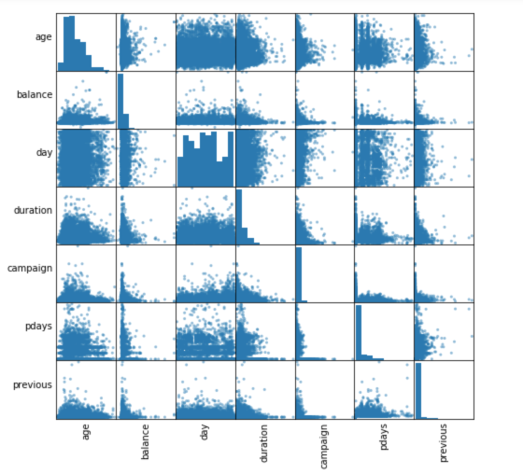
Correlations between independent variables

Slide 10
Preparing Data for Machine Learning
One-Hot Encoding.
Vector Assembler –a feature transformer that merges multiple columns into a vector column.Preparing it for next steps.
Category Indexing.
Note : Reference has been taken from data bricks website for codes.

Slide 11
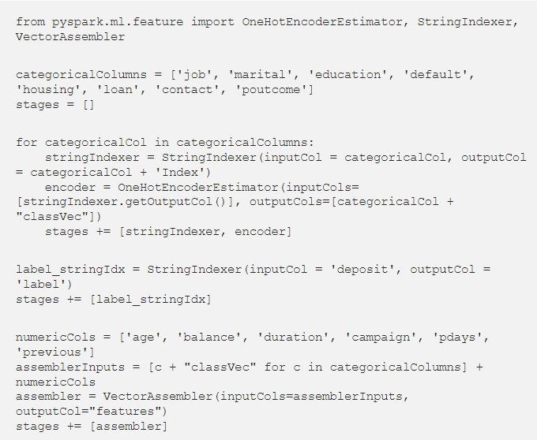
Code Block for Preprocessing
Resulting output has the binary vectors appended to the end of each row. We use the String Indexer again to encode our labels to label indices. Next, Vector Assembler is used to combine all the feature columns into a single vector column.

Slide 12
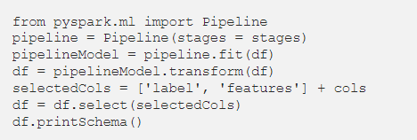
Building Pipeline
Pipeline is used to chain multiple Transformers and Estimators together to specify our machine learning workflow.

Slide 13

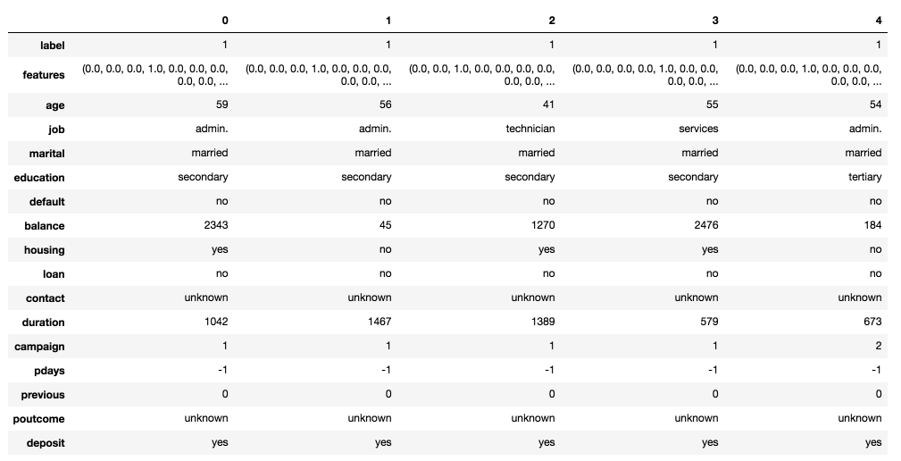
A Pipeline’s stages are specified as an ordered array.
Randomly split data into train and test sets, and set seed for reproducibility
features column and label column After Prepressing

Slide 14
Modelling
Data has been set and seeded for the models to be trained and evaluated.
Models used are :
Logistic Regression
Decision Tree Classifier
Random Forest Classifier
Gradient-Boosted Tree Classifier
Each model is evaluated and Gradient-Boosted Tree Classifier performs better.

Slide 15
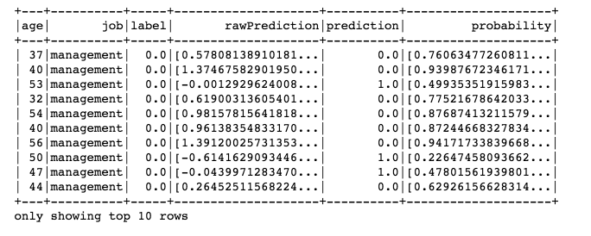
Sample Prediction's for Gradient Boosting

Slide 16
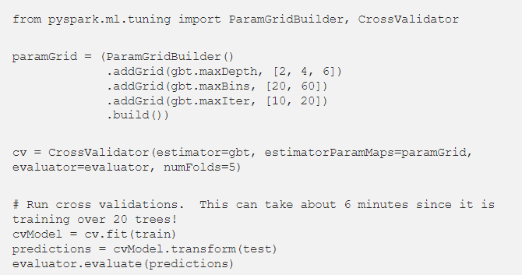
Code BLOCK for PARAMETERS Optimization

Slide 17
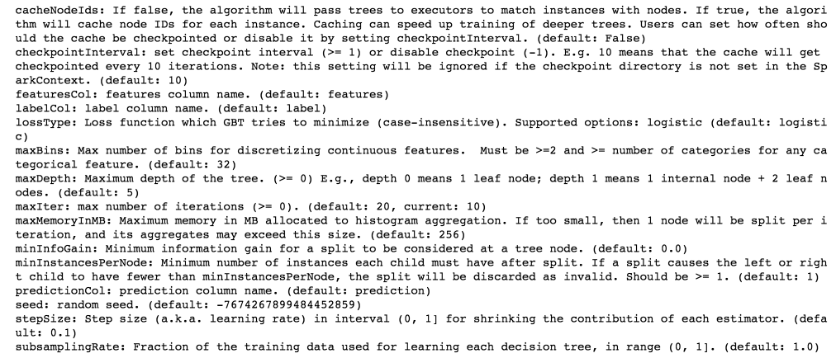
results achieved with techniques
Once the model is ready and tested on the data we optimize and tune the parameters using Grid Builder and cross validator.
The optimized parameters achieved for Gradient Boosted tree are :

Slide 18
tools and techniques
Techniques such as logistic regression and decision tree perform poorly because they are too weak for the given range of different features.
For Making the prediction we resorted to ensemble techniques like Random Forest and Gradient-Boosted Tree.
Tools like PySpark are being used to make it more scalable for deployment.
Python and SQL helps us to easily build ready to use model for use.

Slide 19

usage of a NoSQL database IN ADDITION to Spark
Extension for this Project
If NOSQL is being used for extraction of the data being used to train the model it will provide us with less latency reads and if further results are to published on web source it can be done also.
It proves to be better performing in production environment if its needs to trained readily on new data.

Slide 20
repository for this project
GitHub Link : https://github.com/Manpreet-SB/project_space/upload/project_space_MLcodes/Projects/BDSN_Assignment

