Slide 1
Arduino
Arduino is an open-source electronics platform based on easy-to-use hardware and software.
Arduino boards are able to read inputs - light on a sensor, a finger on a button, or a Twitter message - and turn it into an output - activating a motor, turning on an LED, publishing something online.
You can tell your board what to do by sending a set of instructions to the microcontroller on the board.

Slide 2
Arduino Features
Open Source Hardware Platform
Open Source Development Environment/IDE
Arduino platform is based on easy to use hardware and software
Arduino boards can read inputs i.e light on a sensor, a finger on a button, or a Twitter message
Arduino boards can convert input response into an output i.e activating a motor, turning on an LED, publishing something online.
It can be trained with set of instructions to the microcontroller on the board to perform specific task.
To do so you use the Arduino programming language (based on Wiring), and the Arduino Software (IDE), based on Processing.

Slide 3
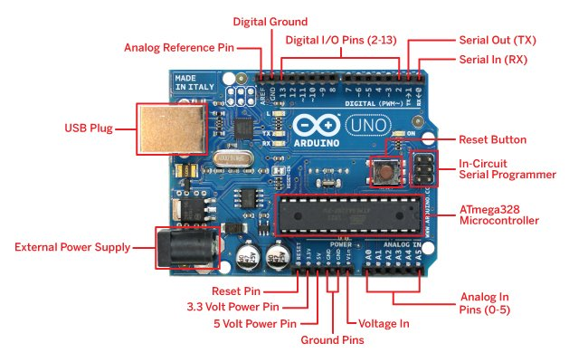
Components of Arduino Board
USB Connector
Power Port
Voltage Regulator
Power LED Indicator
Microcontroller
Analog Pins
Digital Pins
Reset Switch
Crystal Oscillator
TX RX LEDs
Power Pins: Pins(
3.3V, 5V, GND, Vin)

Slide 4
What is Arduino IDE
IDE stands for Integrated Development Environment
It is a text editor and used to upload code on to the Arduino board
Program files in IDE is called Sketch
A sketch contain all the code that you write for your projects
File is saved with the extension of .ino
The code is written in Arduino IDE as that of C++ format and it is human readable
Arduino IDE is responsible to convert the code written (in C++) to machine language compatible with microcontroller

Slide 5
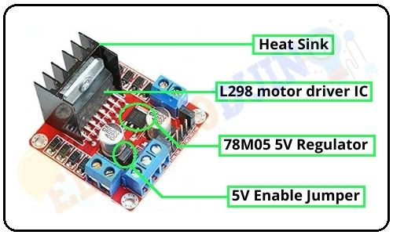
L298N Motor Driver
Introduction:
L298N module is a high voltage, high current dual full-bridge motor driver module for controlling DC motor and stepper motor. It can control both the speed and rotation direction of two DC motors. This module consists of an L298 dual-channel H-Bridge motor driver IC. This module uses two techniques for the control speed and rotation direction of the DC motors. These are PWM – For controlling the speed and H-Bridge – For controlling rotation direction. These modules can control two DC motor or one stepper motor at the same time.

Slide 6
L298 motor driver IC:
L298 is a high voltage, high current dual full-bridge motor driver IC. It accepts standard TTL logic levels (Control Logic) and controls inductive loads such as relays, solenoids, DC and Stepper motors. This is a 15 pin IC. According to the L298 datasheet, its operating voltage is +5 to +46V, and the maximum current allowed to draw through each output 3A. This IC has two enable inputs, these are provided to enable or disable the device independently of the input signals.
A black color heat sink is attached to the L298 IC of the module. A heat sink is a passive heat exchanger that transfers the heat generated by an electronic or a mechanical device to a fluid medium, often air or a liquid coolant.
78M05 5V Regulator:
The module has an on-board 78M05 5V Voltage regulator. This Voltage regulator will be performed only when the 5V Enable jumper is placed. When the power supply is less than or equal to 12V, then the internal circuitry will be powered by the voltage regulator, and the 5V pin can be used as an output pin to power the microcontroller or other circuitry (sensor).
The jumper should not be placed when the power supply is greater than 12V and separate 5V should be given through 5V terminal to power the internal circuitry.

Slide 7
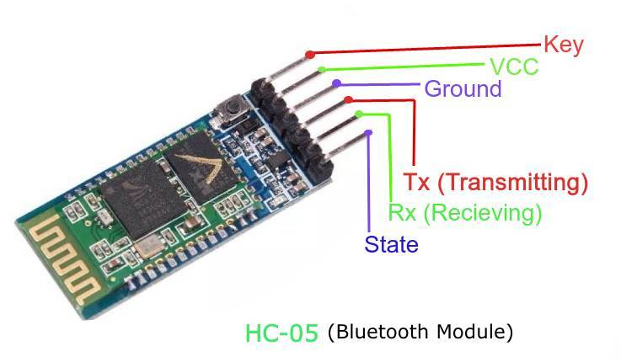
HC-05 Bluetooth
The HC-05 is a class 2 Bluetooth module designed for transparent wireless serial communication. It is pre-configured as a slave Bluetooth device. Once it is paired to a master Bluetooth device such as PC, smart phones and tablet, its operation becomes transparent to the user. All data received through the serial input is immediately transmitted over the air. When the module receives wireless data, it is sent out through the serial interface exactly at it is received. No user code specific to the Bluetooth module is needed at all in the user microcontroller program.

