Slide 1
Memcached

Slide 2
Overview
Memcached is an open source, high-performance, distributed memory caching system intended to speed up dynamic web applications by caching data and objects in RAM to reduce the number of times an external data source (such as a database or API) must be read.
Memcached runs on Unix-like operating systems (at least Linux and OS X) and on Microsoft Windows.
Memcached's APIs provide a very large hash table distributed across multiple machines. When the table is full, subsequent inserts cause older data to be purged in least recently used (LRU) order
It is distributed under Berkeley Software Distribution (BSD) license.

Slide 3
The servers maintain a key–value associative array; the clients populate this array and query it by key. Keys are up to 250 bytes long and values can be at most 1 megabyte in size.
Clients use client-side libraries to contact the servers, which expose their service at port 11211 by default. Both TCP and UDP are supported.
Each client knows all servers; the servers do not communicate with each other. If a client wishes to set or read the value corresponding to a certain key, the client's library first computes a hash of the key to determine which server to use.
Memcached has no internal mechanism to track misses which may happen.

Slide 4
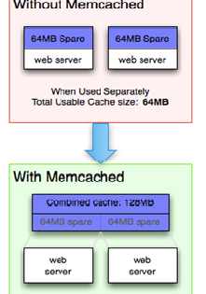
What Memcached does:
Without Memcached - Each node is completely independent (top). This is a classic deployment strategy, however it is both wasteful in the sense that the total cache size is a fraction of the actual capacity of your web farm, but also amount of effort required to keep the cache consistent across all of those nodes is more.
With Memcached - Each node can make use of memory from other nodes (bottom). All of the servers are looking into the same virtual pool of memory. This means that a given item is always stored and always retrieved from the same location in your entire web cluster. In addition, as the demand for your application grows to the point where you need to have more servers, it generally also grows in terms of the data that is required be regularly accessed.

Slide 5
Important Links
Official Website: https://memcached.org/
Memcached Tutorial: https://www.tutorialspoint.com/memcached/index.htm
Youtube: https://youtu.be/7MLXuG83Fsw

