Slide 1

Book Recommendation Engine
for New Users
Manqiong Chen & Yifei Wang
Notes:
Book recommendation engine for new users.

Slide 2

How does Goodreads suggest books to
new users
without historical data?
Notes:
There are so many Ecommerce or cataloging platform. Goodreads is one of them. It helps the book lovers to find their favorite books.
Once user start viewing content there, goodreads will be able to suggest future content Based on the users taste and trait.
But how about if we dont have enough user historial data? How do we suggest content if, the user comes for the first time and have made its first click, how do we suggest more content based on this single click?
Find the users favorite book without much user historical data.
How do you give book recommendation to users without any historical data.
Mimic the process
With very limit information
--
Story -
A recommendation system recommends books to customers best suited to their tastes and traits — method to increase company sales.
We know that, based on user historical data, we can pred
User histriacal data can help us precidat what the user wan in the future
However, how about if we dont

Slide 3
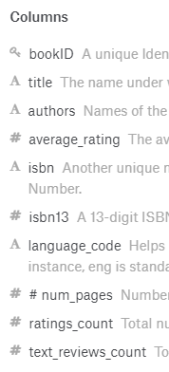
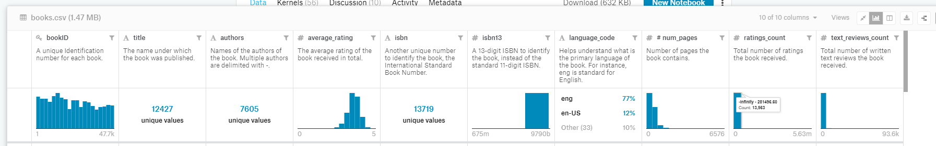
Data source
Columns
Source : kaggle https://www.kaggle.com/jealousleopard/goodreadsbooks - collect from Goodreads API
Columns : authors, average_rating, langauge_code, rating_count, text_reviews_count
Unique values: 12000+
Unique values
Notes:
We download data from kaggle. Which is originally from goodreads api
Many columns in this csv file, authors, language, average rating, rating count, text review count, those could be relavanta to our project
Book id numbers, isbn number
In total there are more than 12 thousands unique records of books.

Slide 4
Data Cleansing
Drop bad lines
Remove outliers
Replace missing data with means
Notes:
In encounter some problem when trying to import the file. Then it came out that, for some of the lines, there are extra commas, there are 20ish those kind of lines .very few comparing the total number of 12 thousand lines. so we simply drop them, and continue to the next step - identify and remove outliers.

Slide 5
Badlines
Lack fields, extra commas ...

Slide 6
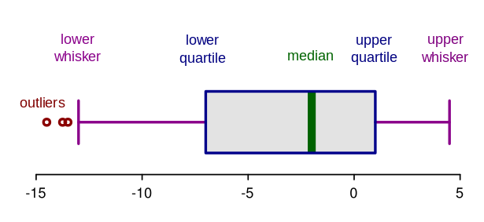
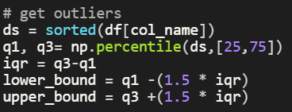
Remove Outliers
Identify method - interquartile range (IQR)
Remove from data frame
Notes:
The way we use is a very common approach - interquatile range
Box plots , see out liers , and we use this method indentify and remove

Slide 7
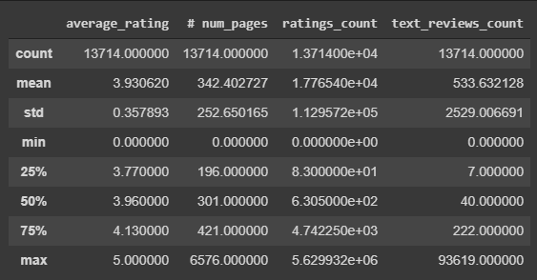
Missing data -> Mean values
Find missing data and replace with mean values
Notes:
Populate 0 to mean
Summry of this data, minimal is 0, suppose to be 0, we consider it as missing data, we replace it to mean
You can mean the mean is … name the columns

Slide 8
Basic Statistics
Histogram
Barcharts
Boxplots
Scatter plots
Notes:
Apply some basisc statistic and plot graph to reveal potential corelation of the varviables

Slide 9
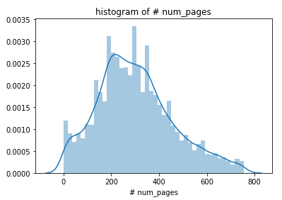
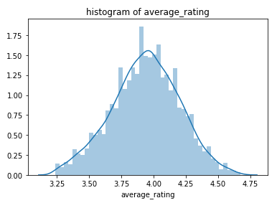

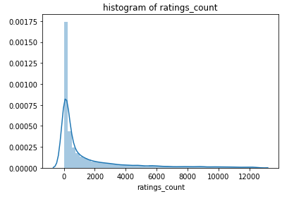
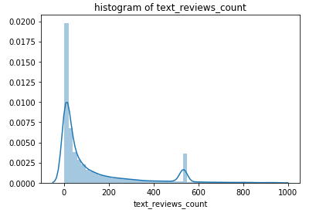
distribution
name
Notes:
Histograms
pages “ scale to right
Symmetric
Scale to right - long tails

Slide 10
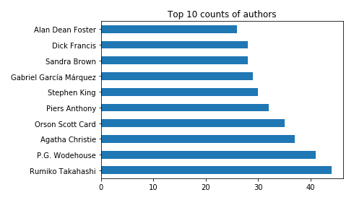
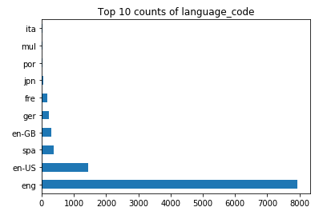
Barcharts for text counts

Slide 11
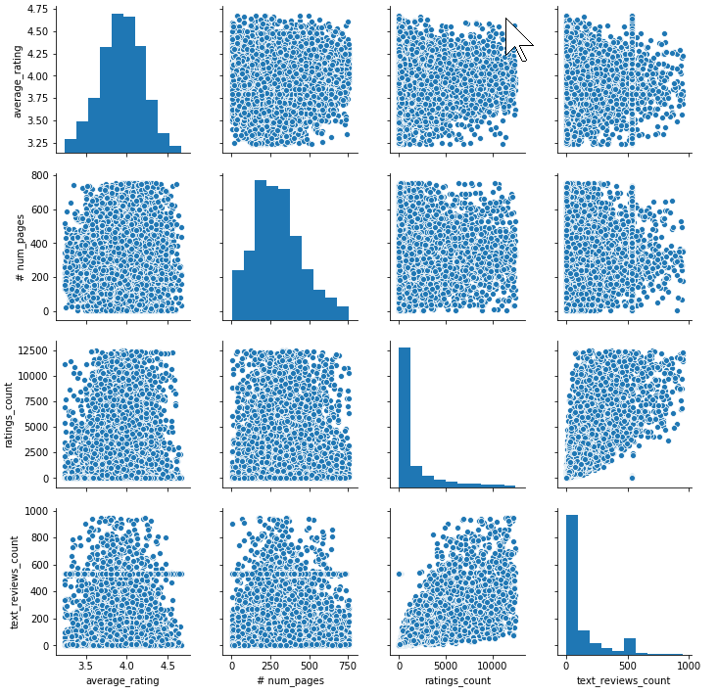

Barcharts variable distribution and relationship
Notes:
Pair wise scatter plot - reveal
No pattern for most
Slight relationship between ...

Slide 12
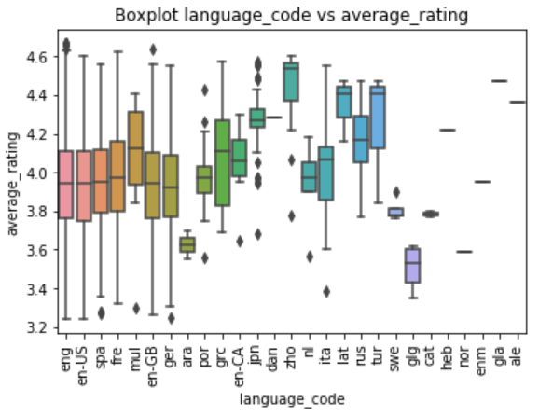
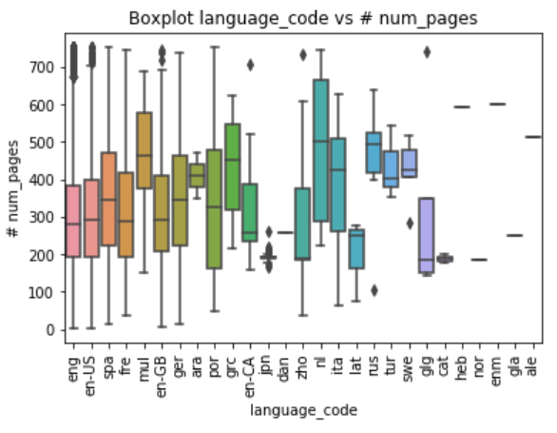
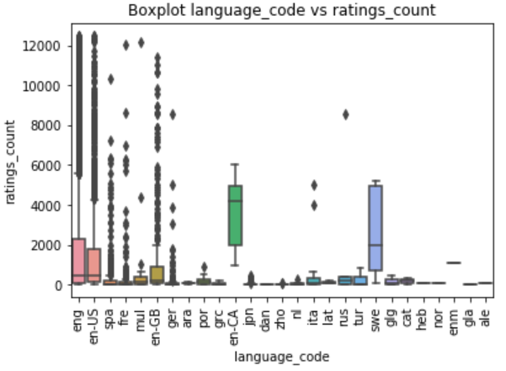
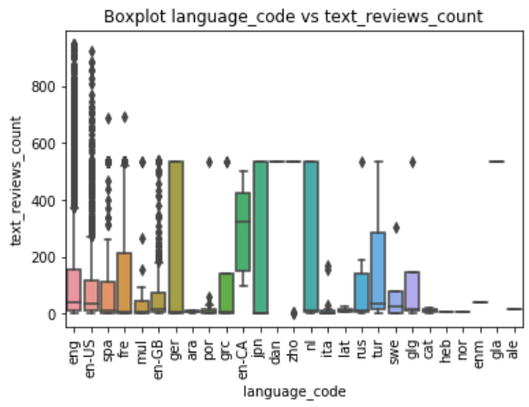
Boxplots
Notes:
Data distribution
Anova - search it

Slide 13
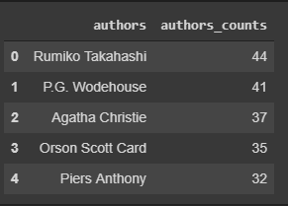
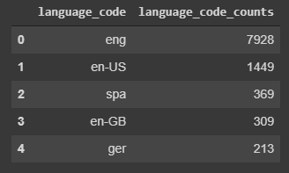
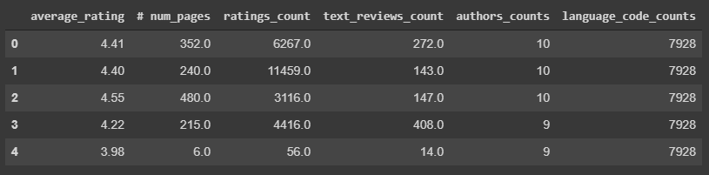
Clustering
Feature Engineering
Before do any clustering, we need to do some feature engineering.
To do this we need change authors and language code into integiner, so that we can plug data into clustering model.

Slide 14
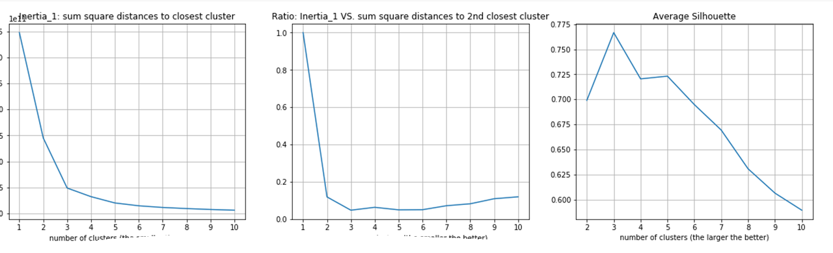

K-Means Clustering
Inertia
Authors and language_code have been converted to number counts
Elbow method to find K value
Divide into 3 categories

Slide 15
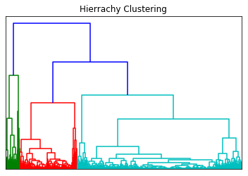

Hierarchical

Slide 16

Classification
Methods we tried
Notes:
Normalize data,
Pca, pipeline
Remove voting

Slide 17
Steps
minimax scaler - normalize data
Put in model together . combine 1 and 2 in models with the pipeline
Cross validation run the model - find best parameter.
Evaluate model - accurate score and f1 score.
Find the best model - random forest and decide tree. Pipeline give best param for each model

Slide 18
Results
 |  | RandomForest | SVM | DecisionTree | AdaBoost
train | CV Score | 0.987 | 0.972 | 0.982 | 0.977
test | accuracy score | 0.986471251 | 0.974821496 | 0.985719654 | 0.967305524
 | f1 score | 0.986471251 | 0.974821496 | 0.985719654 | 0.967305524

Slide 19
How do we recommend the best books for a new user?
Top 10 books with the highest average rating in the specific category.

Slide 20
Thank you!
Code: https://github.com/Manqiong/Project

