Slide 1
Job Offers Data Processing and Analysis System (Muse API)
ETL, job skills extraction from text, search and visualization using FastAPI, Airflow, MongoDB, Elasticsearch, PostgreSQL, Dash

Slide 2
Objectives
Collect data with job offers and skills
Data lake / staging
Analyze offers – skills extraction from job descriptions (hard and soft skills)
Identyfication of top recruiting sectors
Identyfication of top recruiting companies
Search for dream job – location, skill, company, sector, title

Slide 3
Component Communication Architecture
7 Docker containers: FastAPI, Airflow, Airflow PostgreSQL, MongoDB, PostgreSQL, Elasticsearch, Dash
FastAPI as the main orchestrator
Airflow triggers pipelines via API
Dash fetches data from PostgreSQL and Elasticsearch via FastAPI

Slide 4
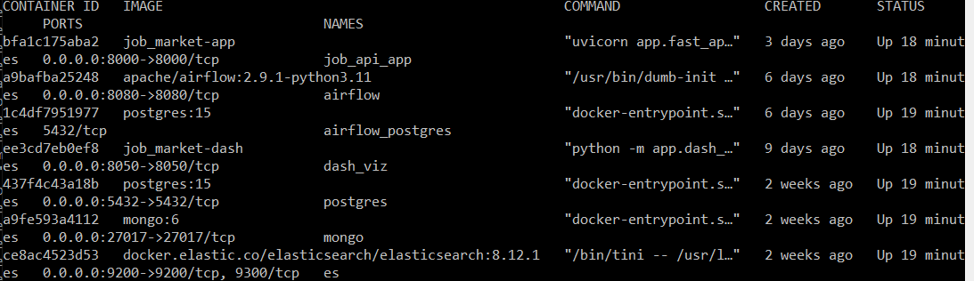

Slide 5
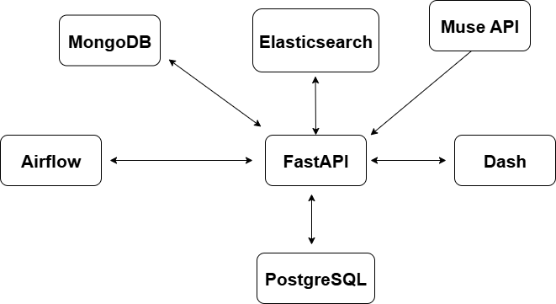
Communication between components

Slide 6
Data Flow in the System
Fetch job offers from Muse API
Store raw data in MongoDB (JSON)
Clean descriptions, shell out skills from job descriptions, enrich data
Use Elasticsearch for advanced enrichment
Store final data in PostgreSQL and Elasticsearch
Data accessed via Dash dashboard

Slide 7
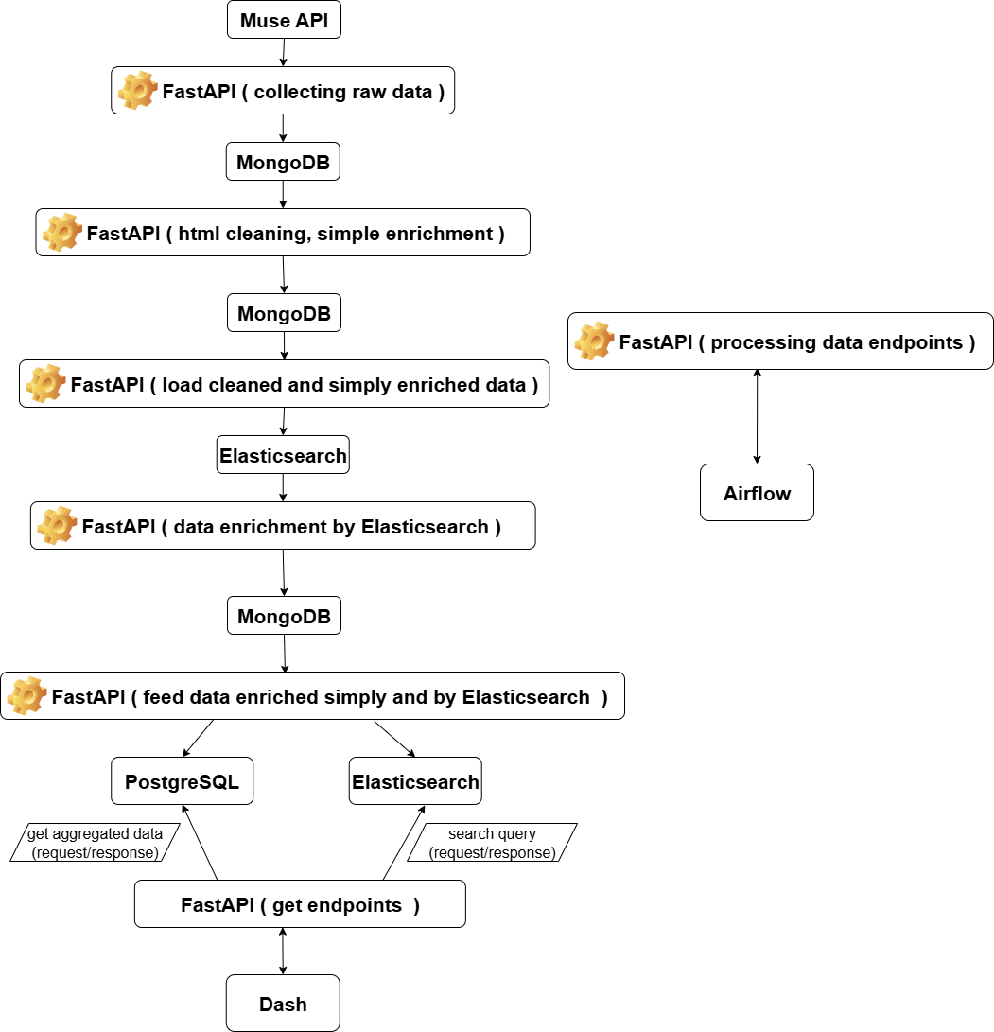

Slide 8
Job Data Enrichment Process
• Skills files per category
• HTML cleaning + basic enrichment (regex – pure Python)
• Elasticsearch to find missing skills (fuzzy search, stemming, multimatch, batching)
• Enrich job documents with search results (ES + regex)
• Store enriched data in PostgreSQL and Elasticsearch (search index)

Slide 9
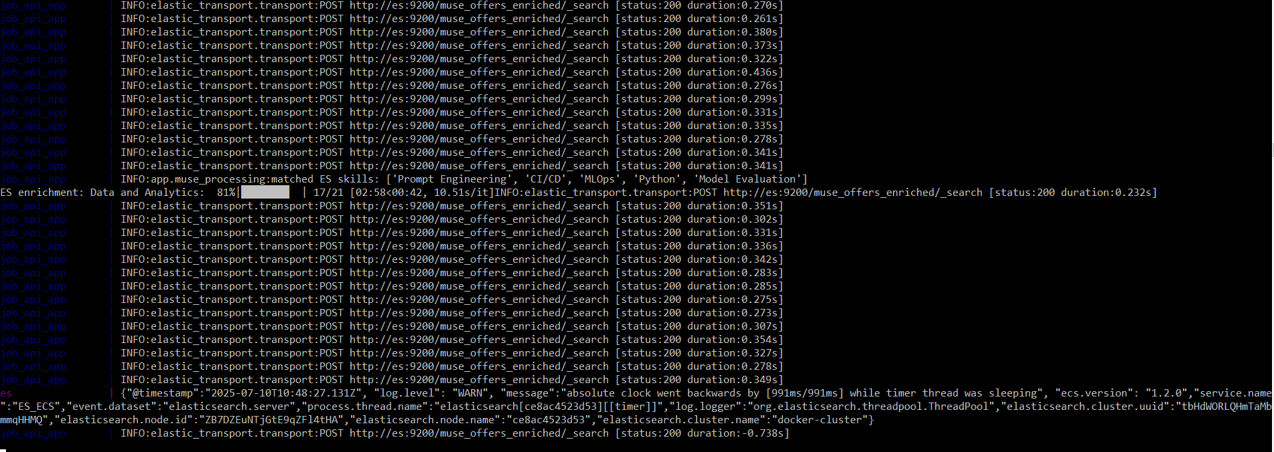
Elasticsearch enrichment process

Slide 10
Automation with Airflow
Airflow manages task execution order (FastAPI endpoints)
Pipeline handles full flow: fetch → clean → enrich → load
Implemented as DAG with 8 tasks

Slide 11
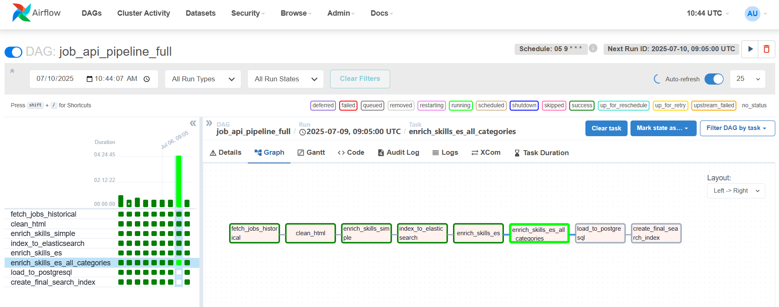

Slide 12
Dash – Interactive Visualization
Dash displays charts and statistics from PostgreSQL – job offers aggregations
Search field powered by Elasticsearch – search through title, skills (soft and hard), locations, descriptions, company name, job title
FastAPI provides endpoints for daily data access
Airflow ensures daily job offers ingestion

Slide 13
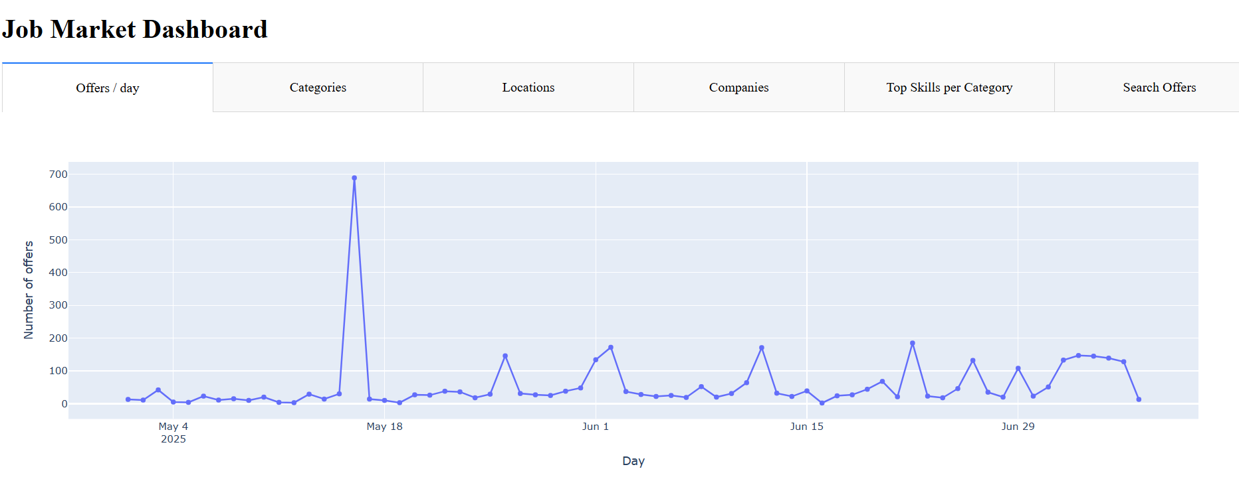
Job ofers - daily

Slide 14
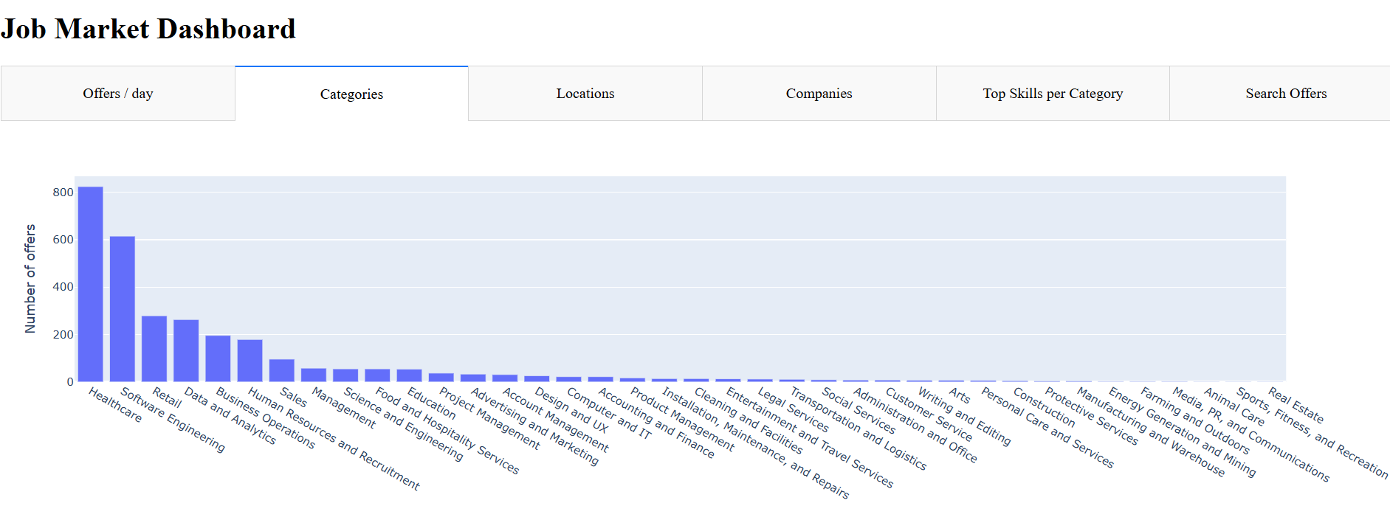
Job sectors

Slide 15
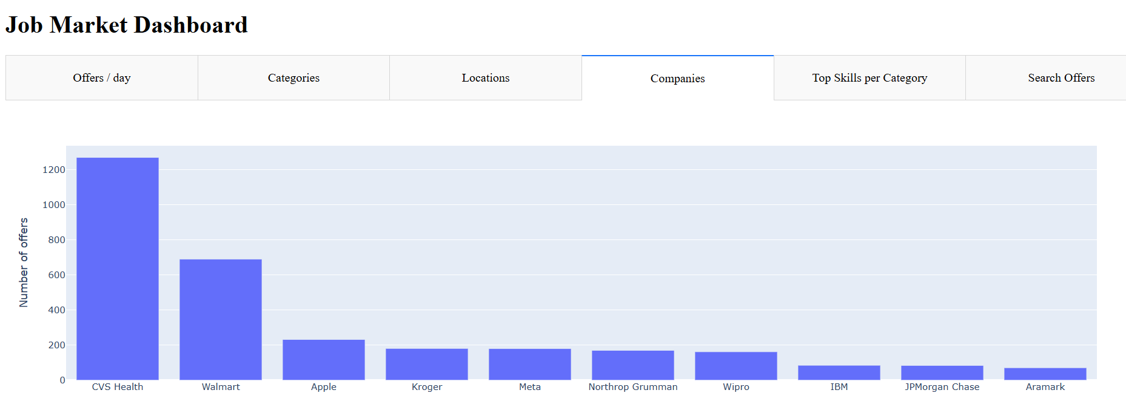
Top 10 companies

Slide 16
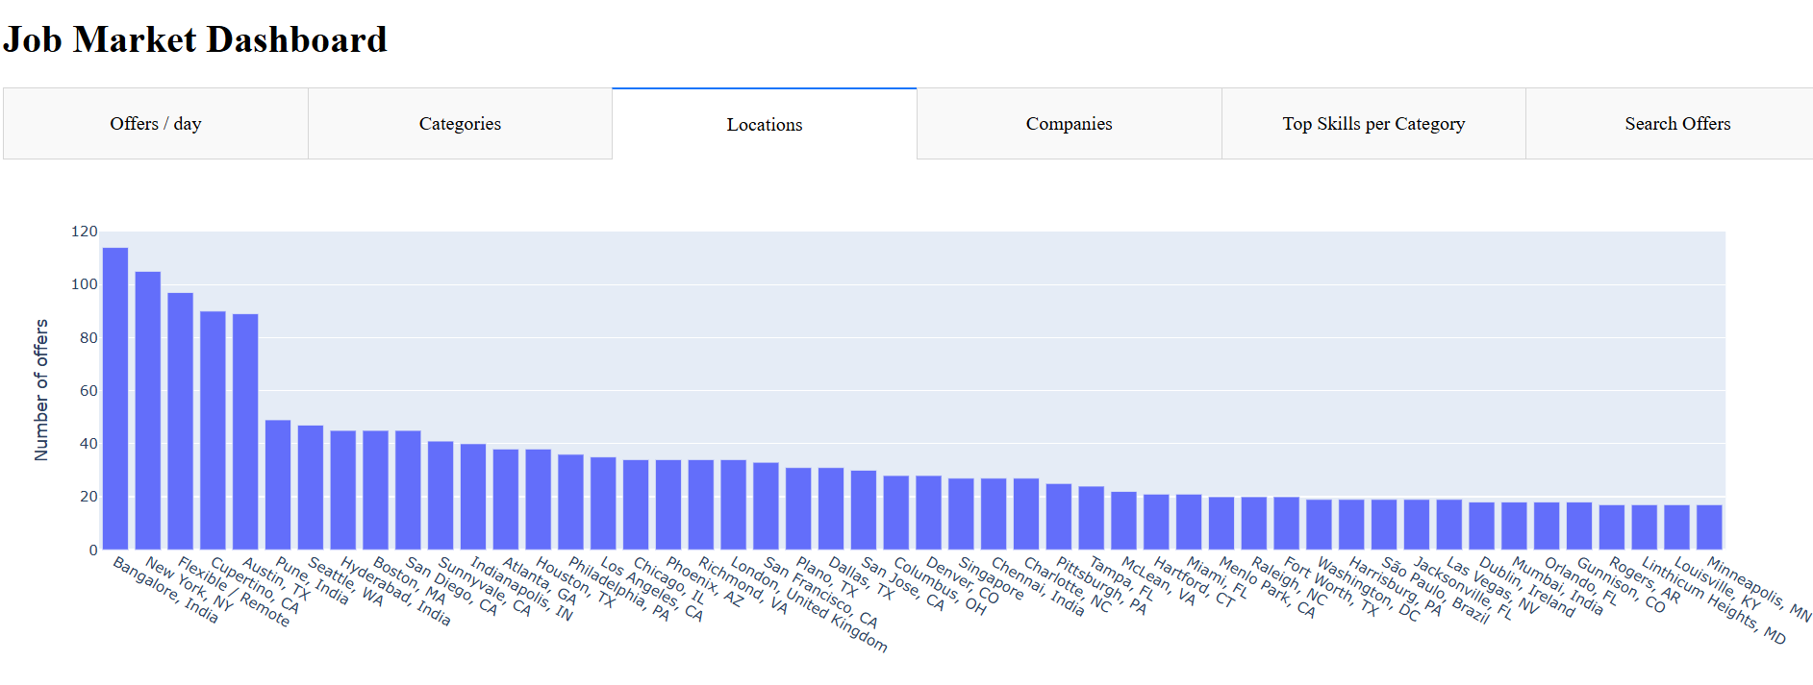
Job offer locations

Slide 17
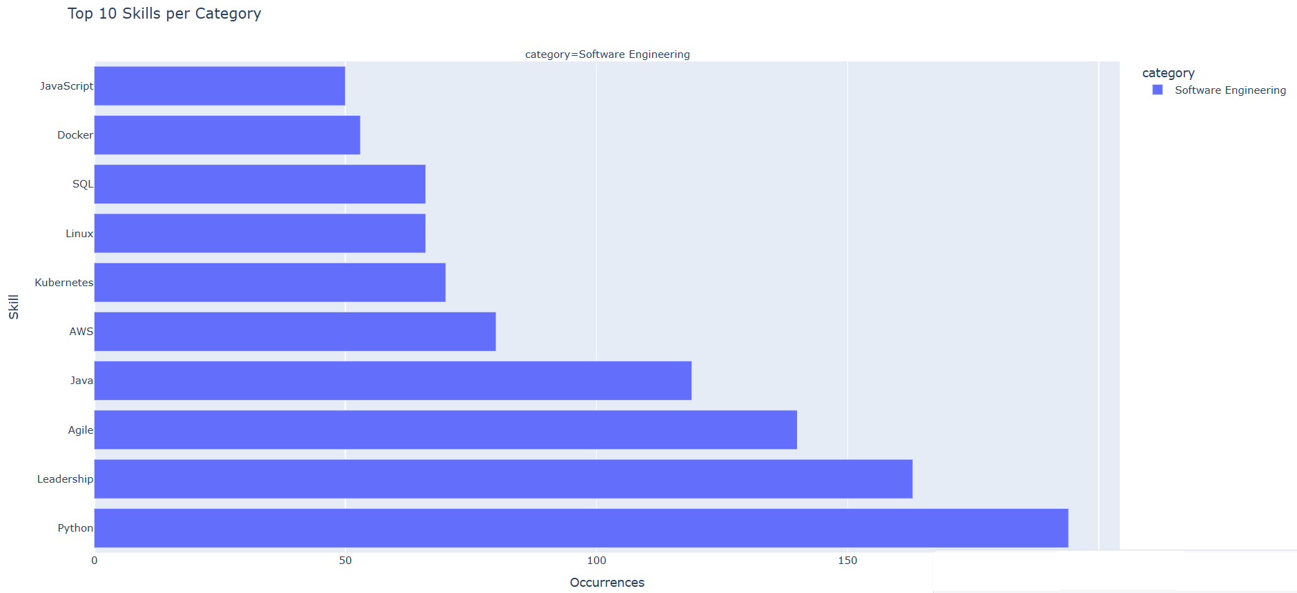
Top 10 sector skills

Slide 18
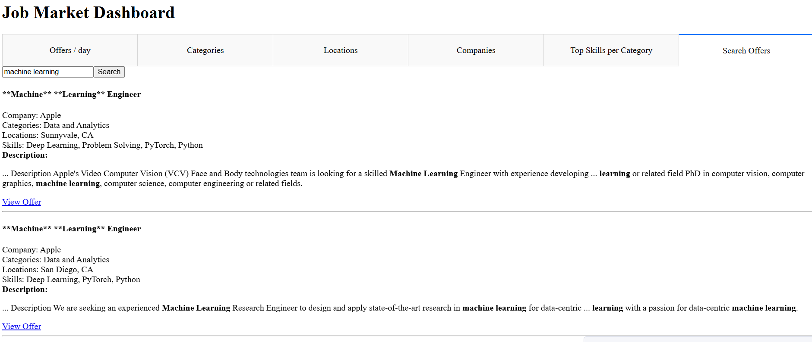
Search for dream job

Slide 19
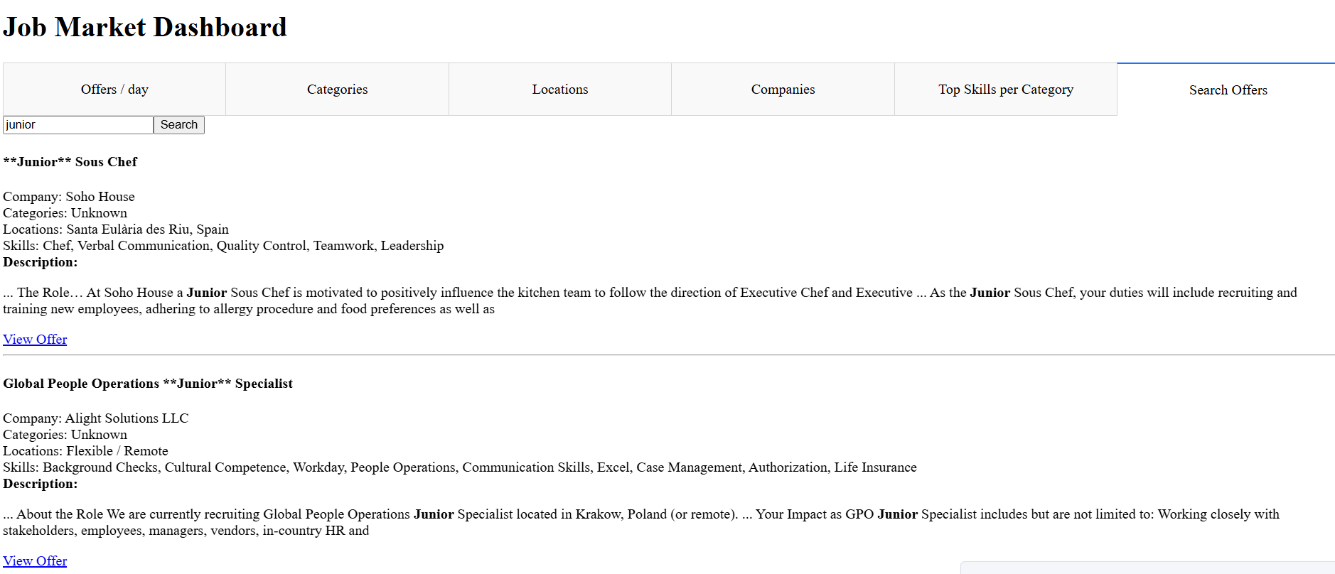

Slide 20
What’s Next?
skills for all sectors/categories
NLP-based enrichment (e.g., embeddings for jobs/skills)
Integration of other APIs
Other data sets eg. average salaries, living costs, seniority etc.
Other languages offers (not only EN)
Going to cloud

