Slide 1

Telecom Customer Churn prediction
By: Andre Johnson

Slide 2
Executive Summary
"In this project, my primary goal was to develop an effective machine learning model to empower the telecommunications company to enhance customer retention in a highly competitive market. By accurately pinpointing customers at risk of churning, the company can implement targeted interventions, resulting in improved customer satisfaction and increased revenue."

Slide 3
Selected Model: Random Forest
Random Forest was chosen as the primary model due to its ability to handle complex relationships between features and its robust performance. The model delivered favorable results during evaluation, particularly in terms of recall for the 'Yes' class, indicating its effectiveness in identifying customers likely to churn, which aligns with our core objective.

Slide 4
Data Preparation and Model Training Process
I utilized a comprehensive dataset containing various features, including customer demographics, services used, and contract details. The process commenced with encoding categorical variables, checking for missing values, checking for duplicate rows and scaling the features. Once the data was properly preprocessed, I partitioned it into training and testing sets, laying the foundation for a robust evaluation of the two machine learning models.

Slide 5
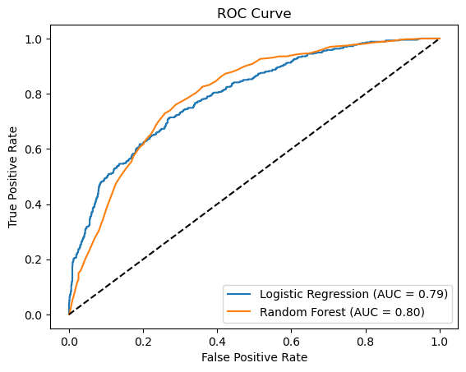
Approach to Achieve Project Goals
To accomplish the project objectives, I employed the Logistic Regression model using Python and scikit-learn, contrasting its performance against the Random Forest model. Throughout the evaluation, I emphasized metrics like precision, recall, and F1 score to gauge each model's efficacy. Recognizing data imbalances, I implemented the under-sampling technique to enhance the models' performance significantly, ensuring a more accurate and reliable prediction of customer churn.
In the accompanying ROC curve visualization, we can see that both models perform significantly better than a random classifier, with AUC scores of 0.79 for Logistic Regression and 0.80 for Random Forest. The ROC curve plots the true positive rate against the false positive rate at various threshold levels, providing a graphical representation of the binary classification model's performance. Although the models have similar performances, the slightly higher AUC score for the Random Forest model suggests it might be better at predicting customer churn.

Slide 6
Results and Conclusions
The Random Forest model demonstrated a stronger performance than the Logistic Regression model in terms of recall for the 'Yes' class, indicating its superior ability to identify customers at risk of churning. My analysis revealed that factors such as contract type and payment method played significant roles in determining customer churn. Potential future work could involve further refinement of the model and exploration of additional factors that may contribute to customer churn.

Slide 7
Next Steps
To expand on this project, I would consider exploring additional data sources, applying more sophisticated techniques to refine the model, or even integrating the model into a real-time customer retention system. With additional time, I would also assess the impact of targeted interventions on customer churn rates to optimize the retention strategy further.

Slide 8
Investment/Project Costs
Transitioning this project to production would entail expenses such as salaries, data acquisition, and infrastructure. As a Data Scientist, my estimated salary for a 6-month project would be $60,000. Including operational expenses, the total cost of scaling this project would range from $150,000 to $200,000.

