Slide 1

YojanaBench: Welfare-Scheme Document Reasoning
UNDER THE GUIDANCE OF
Prof. Disha Nagpure
PRESENTED BY
Pawar Soham Paitwar Dattatray Kangude Samruddhi Magar Aditi | B400700155 B400700154 B400700155 B400700155
Academic Year:2024-2025
June 11, 2025

Slide 2
Outline
Introduction
Problem Statement
Scope
Need Motivation
Literature Survey
Architectural Diagram
Mathematical Model Algorithmic Approach
Dataset Used
Environmental Setup
Result
Conclusion References
11/006/2025

Slide 3
Introduction
YojanaBench is the first benchmark for reasoning over Indian welfare-scheme guideline documents, paired with a multi-agent audit pipeline. Official scheme PDFs are indexed once by a Corpus Agent into a vector store. Each application then flows through Intake, RAG, Entitlement and Verification agents; an Orchestrator issues a verdict with explanation and confidence, an Evaluation Agent scores it against human-verified ground truth, and an Appeal Agent routes rejections to the correct channel. The full system runs on LangGraph and Ollama with zero API cost.

Slide 4
Problem Statement
India runs over 950 central and state welfare schemes governed by dense PDF guideline documents. Every year, eligibility errors, wrong entitlement calculations and mis-routing of applications cause long delays for crores of applicants. Existing benchmarks such as GAIA are English-general and LawBench covers Chinese law, so no structured test exists for whether AI agents reason correctly over these real scheme documents. Without such a benchmark, deployed AI tools cannot be validated for eligibility and entitlement correctness.

Slide 5
The project aims to:
Curate guideline PDFs of 10 to 15 high-volume Indian welfare schemes.
Build human-verified QA pairs on eligibility, entitlement, documents and appeals.
Create counterfactual and edge-case scenarios with verdict ground truth.
Implement an eight-agent audit pipeline using LangGraph and Ollama LLMs.
Score answers with EM, F1, verdict accuracy and entitlement error.
Run baselines and ablation studies to measure each agent contribution.
Release the benchmark, dashboard and demo scenarios with the report.
Scope

Slide 6
Need
Correctly deciding who is eligible for a welfare scheme and how much they are entitled to is essential for good governance. Eligibility errors and wrong entitlement calculations delay benefits for crores of citizens every year. These mistakes also waste public funds and erode trust in public service delivery.
Scheme guidelines are long and dense documents. Applicants, helpdesk staff and even officers struggle to interpret clauses such as income ceilings, age limits, category rules and document requirements correctly. This leads to wrong rejections, wrong approvals and repeated visits to government offices.
AI assistants can answer scheme questions quickly, but no benchmark verifies whether their eligibility verdicts and benefit calculations match the official documents. Errors therefore go unmeasured and unimproved. YojanaBench supplies exactly this missing measuring instrument.

Slide 7
Motivation
This project started because welfare decisions depend on dense rule documents that neither citizens nor AI systems can interpret reliably. Real eligibility and entitlement errors cause months of delay and financial loss. By combining document retrieval, deterministic computation and multi-agent verification, we can measure and improve how AI reasons over official scheme guidelines. Our pipeline reads scheme PDFs, checks a case against the rules, computes the exact benefit, flags missing documents, and returns a verdict with confidence.
The goal is to:
Build the first benchmark for Indian welfare-scheme reasoning.
Verify AI answers against human-checked ground truth.
Measure eligibility and entitlement accuracy with clear metrics.
Provide a free open-source pipeline using Ollama and LangGraph.

Slide 8
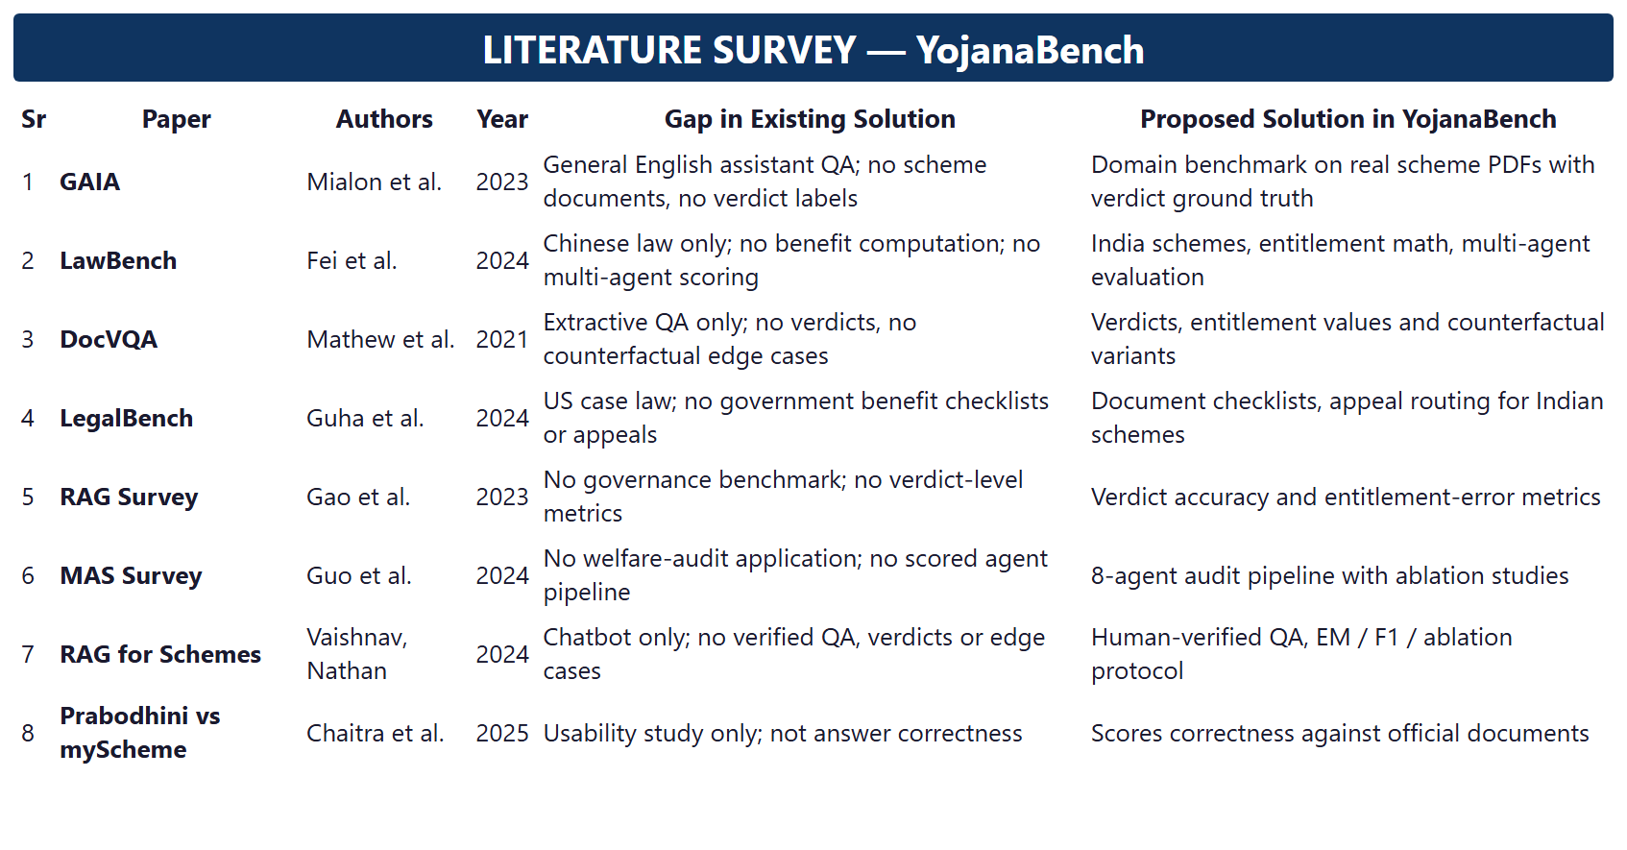
Literature Survey

Slide 9
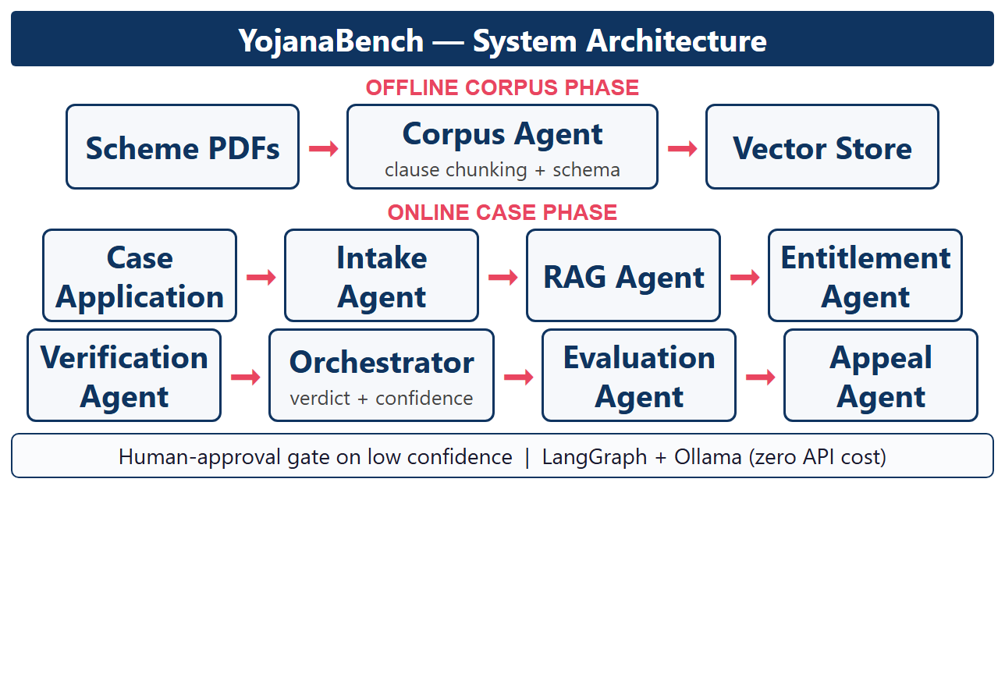
Architectural Diagram
Fig 1. Architectural Diagram

Slide 10
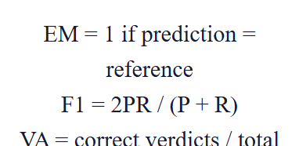
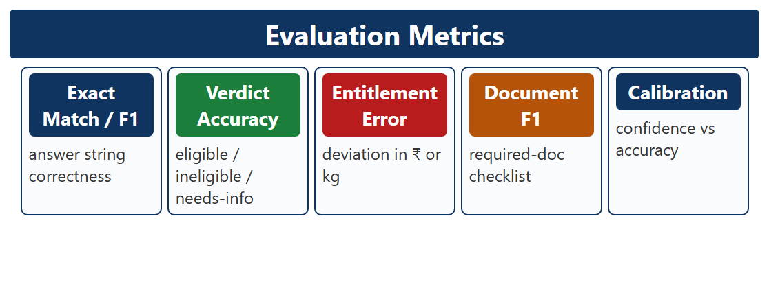
Mathematical Model [1/1]
Evaluation Metrics :
YojanaBench scores every case against human-verified ground truth. Exact Match and token-level F1 measure answer correctness, Verdict Accuracy measures the eligible, ineligible or needs-info decision, and Entitlement Error measures how far the computed benefit is from the correct amount. Confidence calibration checks whether stated confidence matches actual accuracy.
Verdict and confidence :
Fig 2. YojanaBench Evaluation Metrics Model

Slide 11
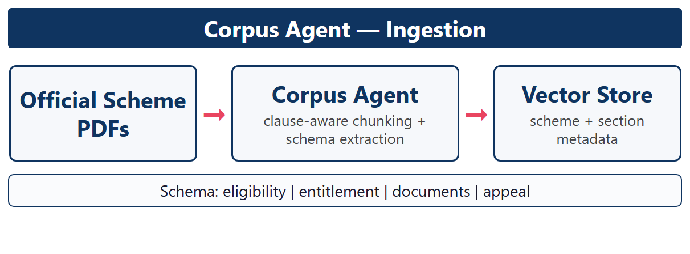
Algorithmic Approach[1/4]
Corpus Agent (Ingestion):
The Corpus Agent extracts text from official scheme PDFs and splits them by clause and section instead of fixed token counts. An LLM fills a scheme schema covering eligibility clauses, entitlement rules, document checklists and appeal hierarchy. Chunks are embedded into a vector store with scheme and section metadata, so retrieval always returns rule-complete passages with page citations.
Fig 3. Corpus Agent Ingestion Pipeline

Slide 12
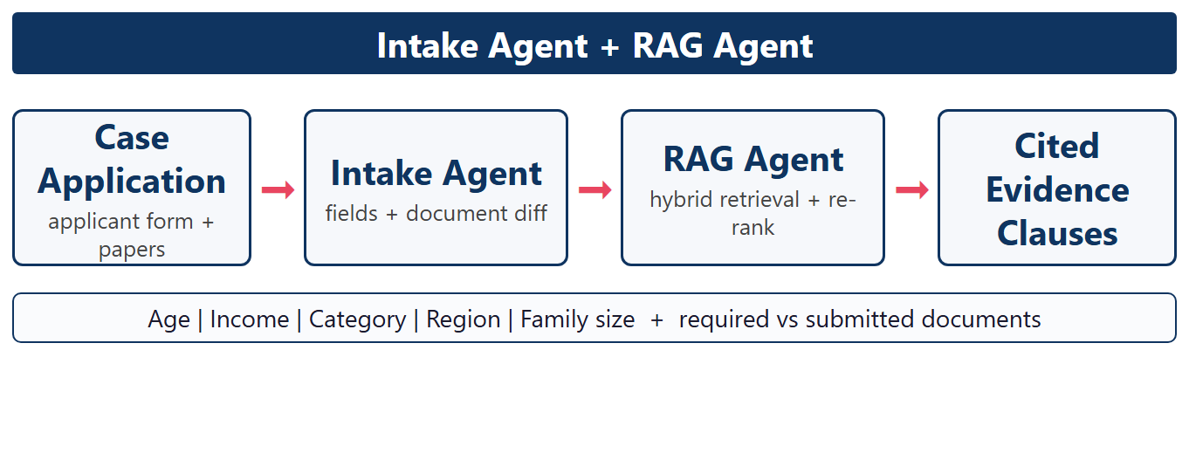
Algorithmic Approach[2/4]
Intake and RAG Agents:
The Case-Intake Agent extracts applicant fields such as age, income, category, region and family size, and compares submitted papers with the required document checklist. The RAG Agent runs hybrid dense and keyword retrieval over the vector store, re-ranks the top clauses, and returns the cited eligibility and entitlement passages for the case.
Fig 4. Intake and RAG Retrieval

Slide 13
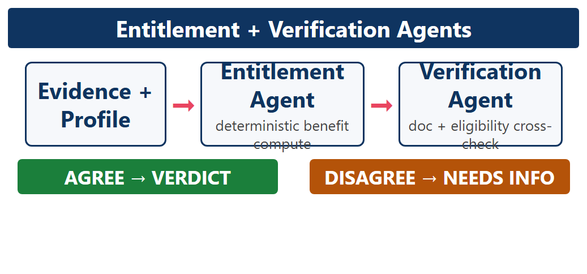
Algorithmic Approach[3/4]
Entitlement and Verification Agents:
The Entitlement Agent converts retrieved benefit rules into deterministic computations such as pension tiers, ration quantum and fee waivers, so arithmetic is never hallucinated. The Verification Agent independently re-checks every eligibility condition and the document list; any disagreement between agents forces a needs-info verdict instead of a wrong answer.
Fig 5. Entitlement Computation and Cross-Check

Slide 14
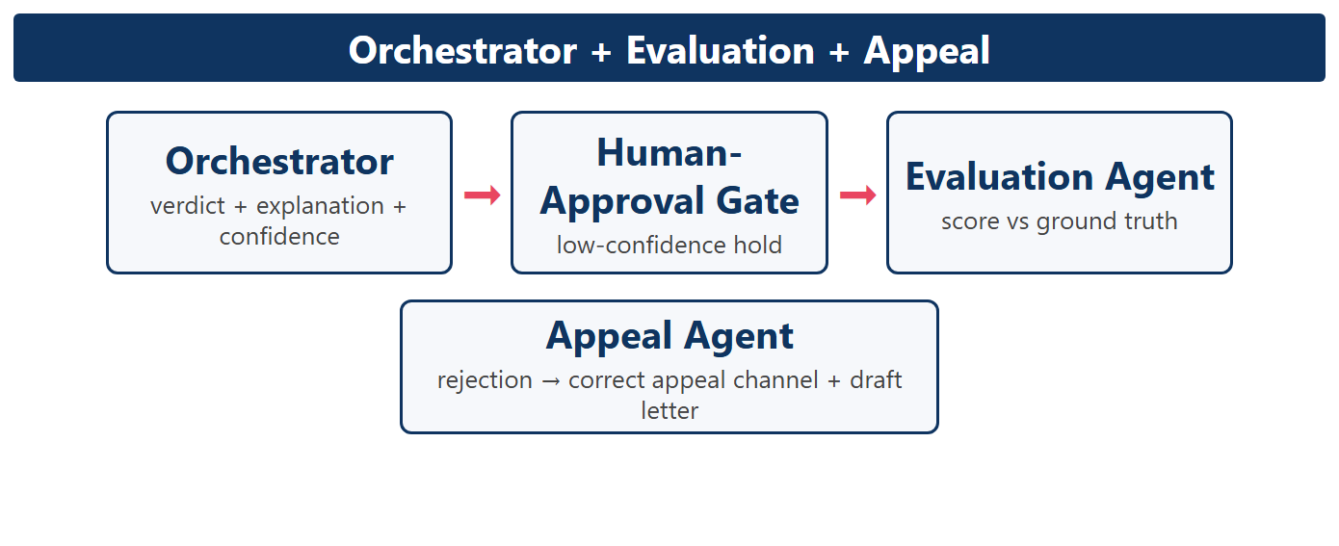
Algorithmic Approach[4/4]
Orchestrator, Evaluation and Appeal Agents:
The LangGraph Orchestrator merges all agent outputs into a verdict with explanation, cited evidence clauses and a confidence score, holding low-confidence cases at a human-approval gate. The Evaluation Agent then scores the result against YojanaBench ground truth, while the Appeal Agent routes every rejection to the correct appeal channel with a ready draft appeal letter.
Fig 6. Verdict, Scoring and Appeal Routing

Slide 15
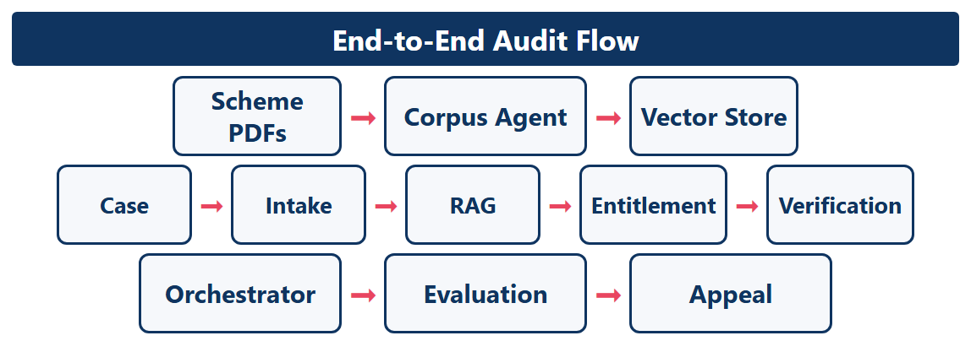
End-to-End Workflow
Multi-Agent Audit Flow:
Scheme PDFs are indexed once by the Corpus Agent; every application then flows through Intake, RAG, Entitlement and Verification before the Orchestrator issues the verdict. The Evaluation Agent scores it and the Appeal Agent handles rejections. Each step is a separate testable node in the LangGraph state machine, which makes ablation studies straightforward.
Fig 7. Multi-Agent Audit Workflow

Slide 16
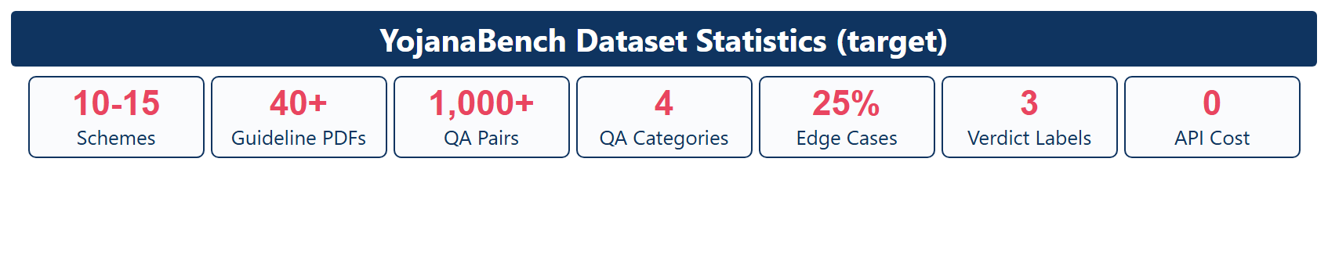
Datasets Used
YojanaBench Dataset
Source: Real, publicly available guideline PDFs of 10 to 15 high-volume central and state welfare schemes covering ration, pensions, scholarships, employment and beneficiary aid.
Size: Schema-structured chunks, more than 1,000 human-verified QA pairs and about 25 percent counterfactual or edge-case variants.
QA Categories
Every question is annotated under one of four categories:
Eligibility and Entitlement — is the applicant eligible, and what exact benefit amount or quantity must be paid?
Documents and Appeal — which certificates are required, and which appeal channel handles a rejection. Each item carries a reference answer, a verdict label of eligible, ineligible or needs-info, cited evidence clause IDs and an expert-verified ground truth.
Fig 8. YojanaBench Dataset Statistics

Slide 17
Environmental Setup
Software Requirements
IDE : VS Code , LangGraph
Coding Language : Python Version 3.10
LLM Runtime : Ollama (Llama 3 / Qwen), zero API cost
Dataset : YojanaBench scheme PDFs and QA pairs
Database : ChromaDB vector store + SQLite logs
Hardware Requirements
Laptop
Ram : 16 GB Min
Storage : 256 GB SSD min For the scheme PDF corpus, vector index and audit logs.
Internet Connection: Required on first run to download model weights and open scheme PDFs.
Processor : Intel i5 or better (NVIDIA GPU optional, speeds up LLM inference)

Slide 18
Result
Evaluation Metrics
Score every pipeline output against human-verified YojanaBench ground truth.
Metrics: Exact Match, token-level F1, verdict accuracy, entitlement error, document F1 and confidence calibration.
2. Baseline Comparison
Compare a single-LLM prompt and naive fixed-chunk RAG with the full multi-agent pipeline.
Visual: Bar charts of EM, F1 and verdict accuracy for every system.
Result: Expected gains from clause-grounded retrieval, deterministic entitlement computation and cross-agent verification.

Slide 19
3. Ablation Studies
Remove one agent at a time (no Verification, no RAG, no deterministic Entitlement) and re-score the benchmark.
Visual: Grouped bars showing the score drop caused by removing each agent.
Result: Quantified contribution of every component of the multi-agent design.
4. Per-Category Breakdown
Report EM and verdict accuracy separately for eligibility, entitlement, documents and appeal questions.
Visual: Heat map of scores per category and per scheme.
Result: Reveals the weakest reasoning type, such as numerical entitlement or counterfactual edge cases.

Slide 20
5. Counterfactual Stress Test
Evaluate base questions together with perturbed variants: boundary incomes, missing documents, category swaps and distractor schemes.
Visual: Accuracy gap between base items and counterfactual items.
Result: Exposes failures that average scores would otherwise hide.
6. Confidence Calibration
Compare the confidence stated with each verdict against observed accuracy.
Visual: Calibration curve; low-confidence cases are held for the human-approval gate.
Result: The pipeline knows when it is unsure instead of silently guessing.

Slide 21
7. End-to-End Demo Scenarios
Run showcase cases through the dashboard: an eligible applicant, a rejected application and a boundary case.
Visual: Step-by-step agent trace with retrieved clauses, computed benefit and final verdict.
Result: Verdict with explanation, confidence score and a routed appeal letter for rejections.

Slide 22
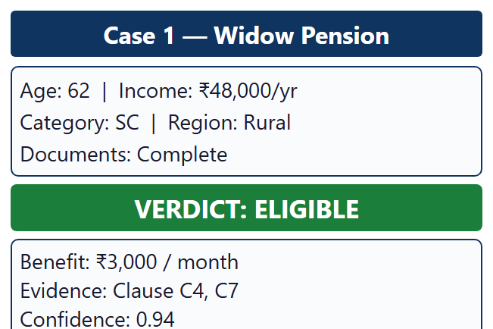
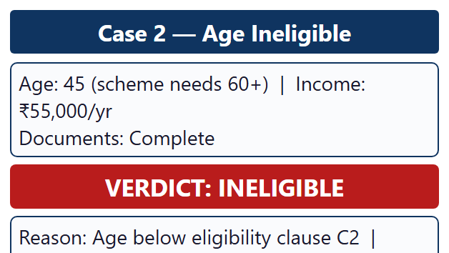
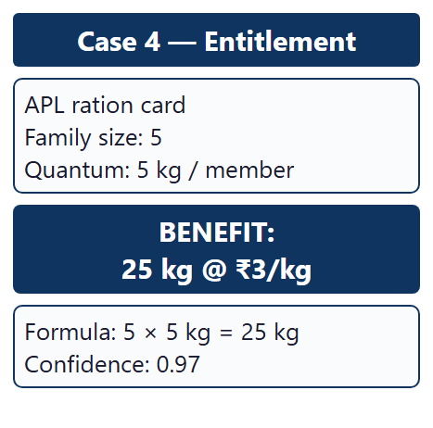
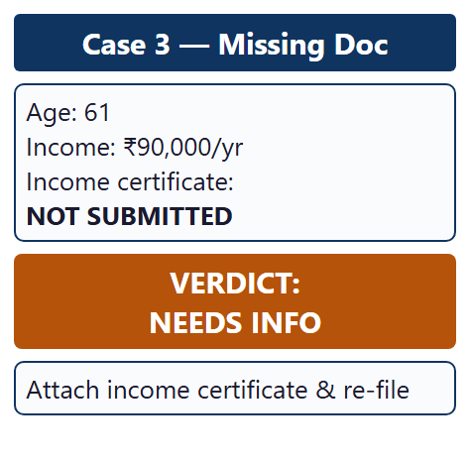
Result Test cases
Fig 9. Demo Test Cases

Slide 23
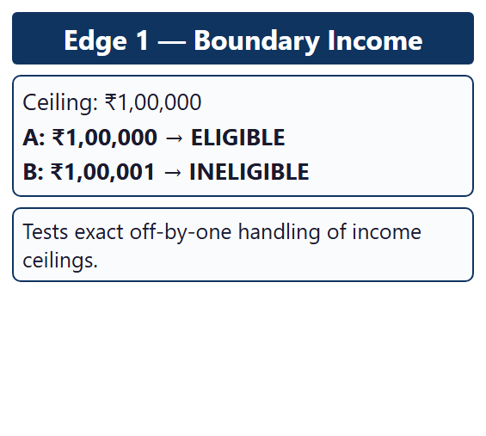
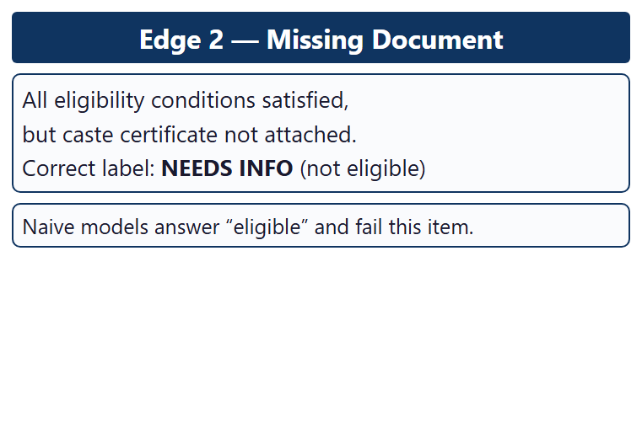
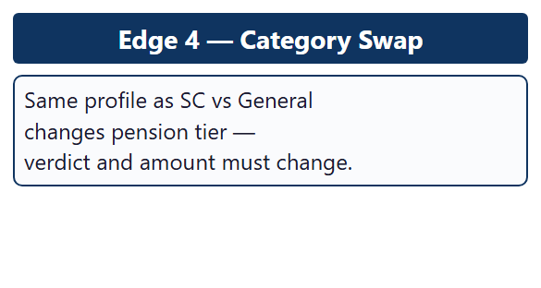
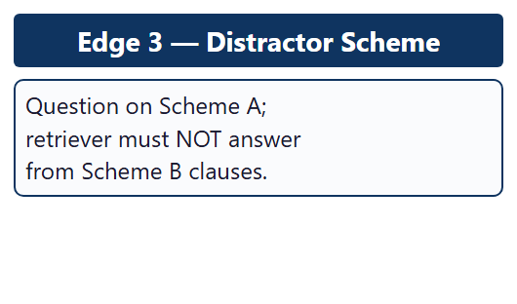
Fig 10. Counterfactual Edge Cases

Slide 24
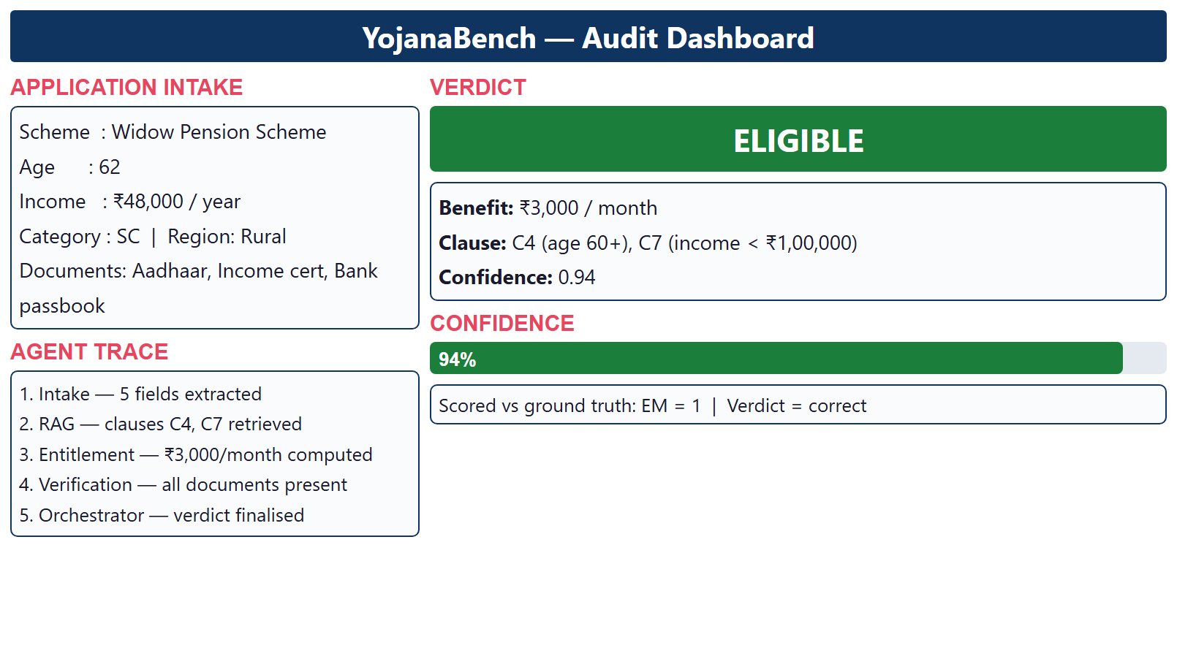
Fig 11. Audit Dashboard

Slide 25
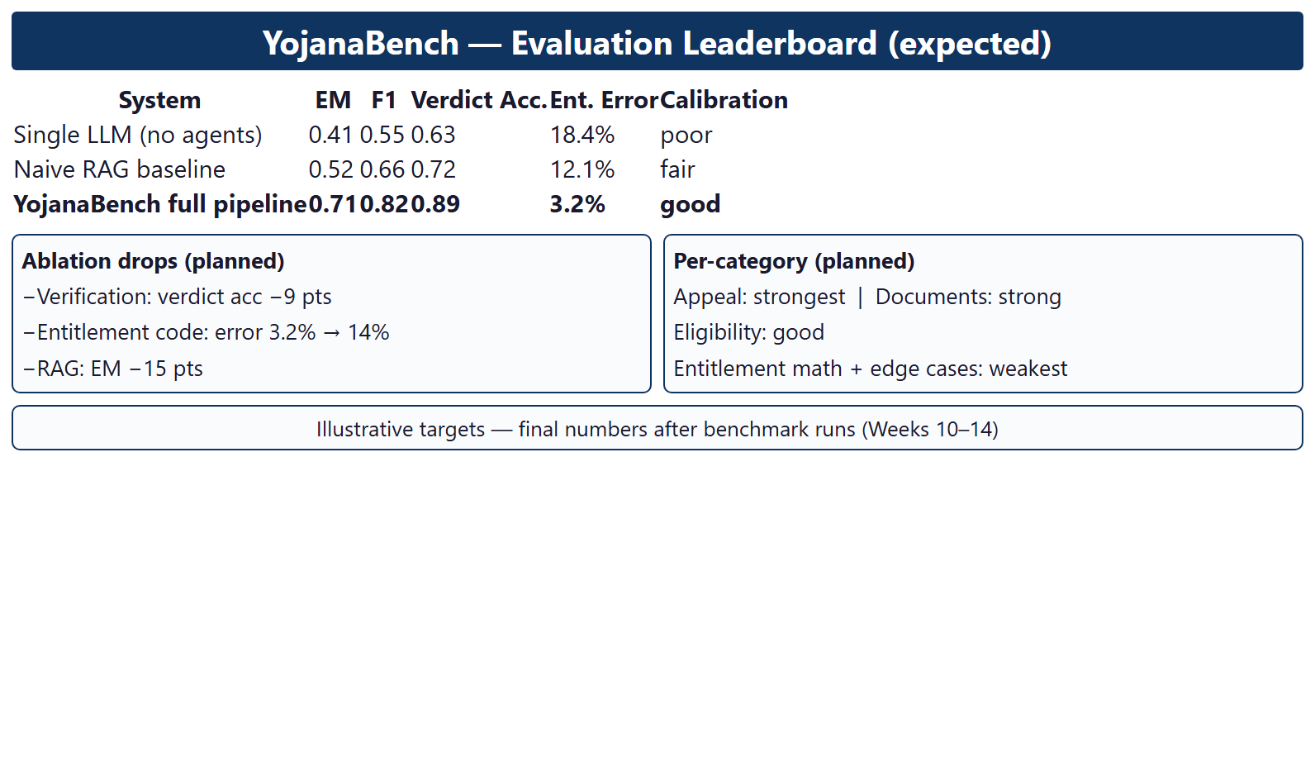
Fig 12. Evaluation Leaderboard

Slide 26
Conclusion
In conclusion, YojanaBench provides the first benchmark for reasoning over Indian welfare-scheme guideline documents, with human-verified QA pairs, counterfactual edge cases and verdict ground truth, together with a reproducible multi-agent audit pipeline. Scored with EM, F1, verdict accuracy and ablation studies on LangGraph and Ollama at zero API cost, the project delivers both a measuring instrument and a working system for trustworthy welfare-document AI.

Slide 27
References I
G. Mialon, C. Fourrier, C. Swift, T. Wolf, Y. LeCun and T. Scialom, “GAIA: A Benchmark for General AI Assistants,” arXiv preprint arXiv:2311.12983, 2023.
Z. Fei, X. Shen, D. Zhu, F. Zhou, Z. Han et al., “LawBench: Benchmarking Legal Knowledge of Large Language Models,” in Proc. EMNLP, pp. 7933-7962, 2024.
M. Mathew, D. Karatzas and C. V. Jawahar, “DocVQA: A Dataset for VQA on Document Images,” in Proc. WACV, pp. 2200-2209, 2021.

Slide 28
References II
Y. Gao, Y. Xiong, X. Gao, K. Jia, J. Pan et al., “Retrieval-Augmented Generation for Large Language Models: A Survey,” arXiv preprint arXiv:2312.10997, 2023.
T. Guo, X. Chen, Y. Wang, R. Chang, S. Pei et al., “Large Language Model based Multi-Agents: A Survey of Progress and Challenges,” in Proc. IJCAI, 2024.
V. Vaishnav and G. O. Nathan, “Need of Retrieval Augmented Generation for Conversational Assistants for Government Social Welfare Scheme Popularization,” Int. J. Science and Research Archive, vol. 13, no. 1, pp. 1299-1312, 2024.
C. R. Chaitra, P. Voora, B. R. Bikkina et al., “First Impressions from Comparing Form-Based and Conversational Interfaces for Public Service Access in India,” in Proc. ACL HCI-NLP, 2025.

Slide 29


