Slide 1
Cyclistics bike-share
Case Study

Slide 2
Project Purpose
Support the decision – making process for making a marketing strategy to convert casuals to members
Single Pass Purchasers
Annual Subscribers

Slide 3
Goal
How do members and casual riders use Cyclistics Bikes differently?

Slide 4
Executive summary
Casuals - Prioritize cyclistics Bikes for leisure
Members – prioritize cyclistics bikes for commuting
More data collection and analysis is required to test the hypothesis and get key marketing opportunities

Slide 5
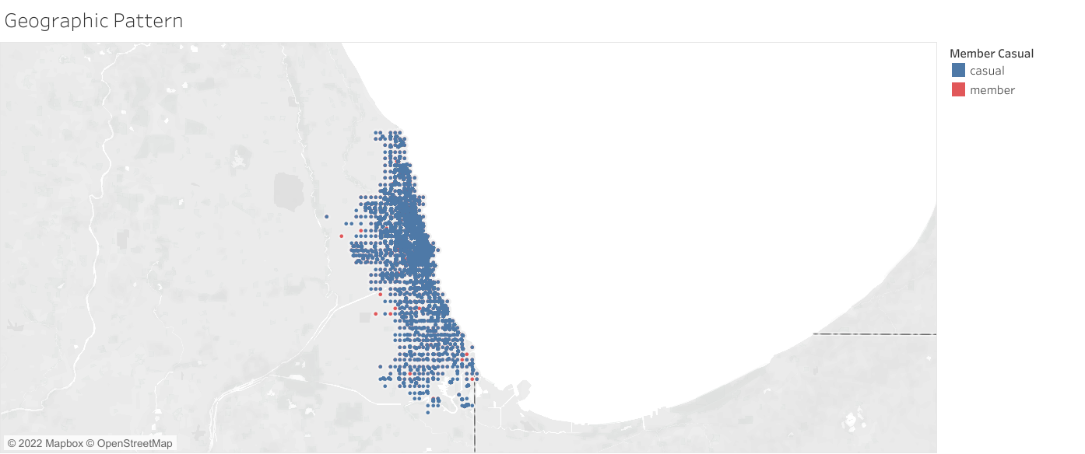
Geographic pattern of riders
Density of casuals increase towards the coastline, but still not enough information for a conclusion

Slide 6
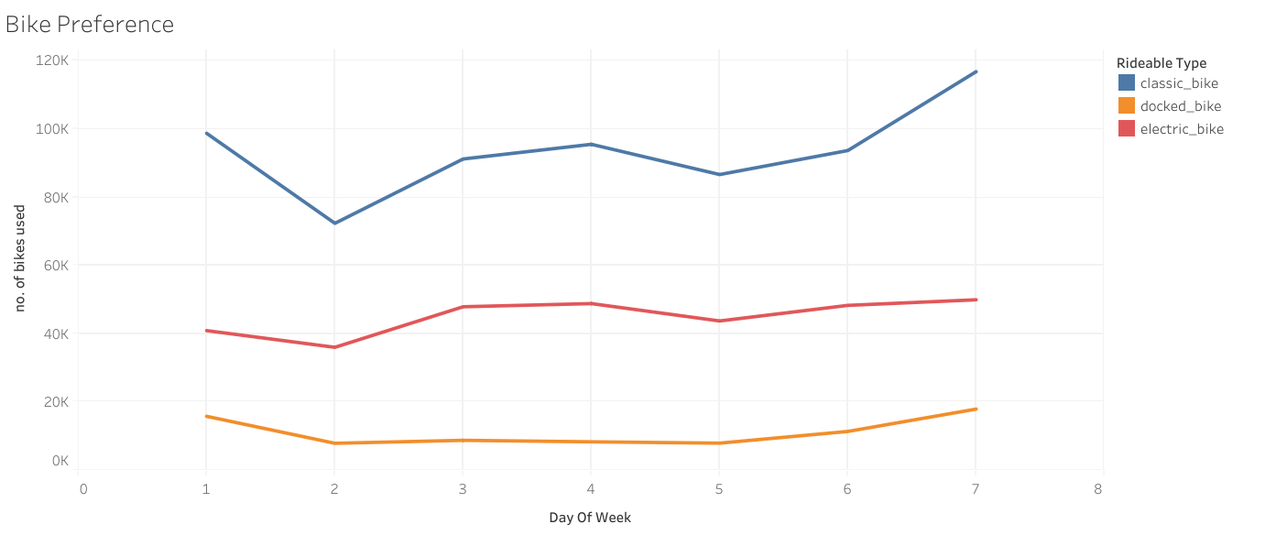
Bike preference / popularity

Slide 7
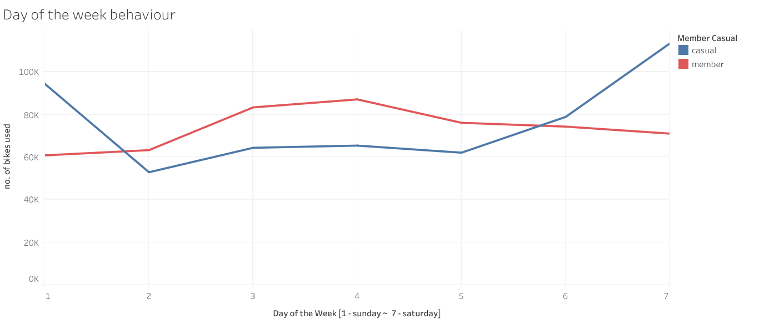
Day of the week behaviour
Casuals usage of bikes spikes during weekends.
Whereas, members usage of bikes decreases during weekends.

Slide 8
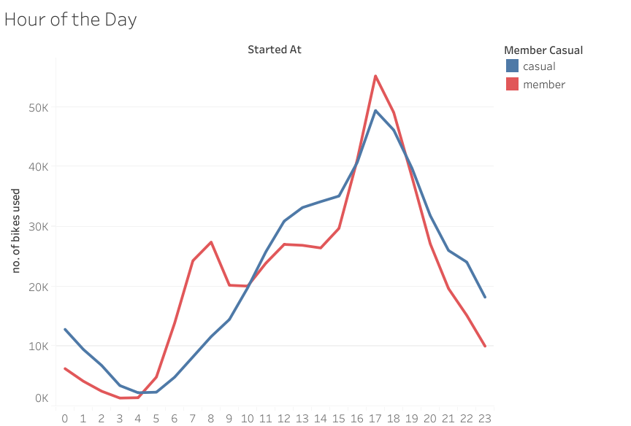
Hour of the day behaviour
We see spike in bike usage during evening from both casuals and members.
However, the members have a pattern of increased bike usage at the rush hours (time when people usually go to work or back to home)
RUSH HOUR

Slide 9
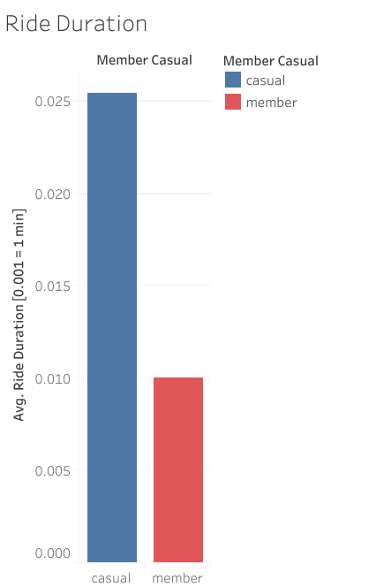
Average ride Duration
Casuals ride 2.52 Times longer than Members
0.02540
i.e: They spend more time riding the bike
0.01007

Slide 10
Key findings
The evidence is inconclusive
There may be more than we are able to see here
we don’t know about individual life
Moving forward with conversion marketing strategy is risky.

Slide 11
Next possible steps
(A) re - iteration
(B) Forging ahead
Acquire more meaningful data collection and analysis to test our hypothesis and uncover any relevant marketing opportunities.
Apply what we know from our initial findings to kick-start and form the marketing conversion strategies.

Slide 12
Recommendations for (A) re-iteration
redefine the problem:
What drives casuals and members to be different?
What values are closely associated with each user group?
What experience they are after from cyclistics?
What each user group need?

Slide 13
Recommendations for (A) re-iteration
Sample and collect relevant data through unbiased survey:
Qualitative data about user motivation
Data about user demographics

Slide 14
Recommendations for (A) re-iteration
Collect data about:
Annual income - $20,000
Location – outer Chicago
Age - 20
Bmi - overweight
Bike trips – summer months
Disposable income’
Relevance
Biking capacity
Tendencies (summer season usually have more riders)

Slide 15
RECOMMENDATION FOR (B) Forging ahead
Consider alternatives toconversion, such as new service and pricing models
Optimize by focusing on factors affecting casual’s willingness to pay
Look at opportunity costs like shortage of bikes when casual needs.

Slide 16
RECOMMENDATION FOR (B) Forging ahead
Yearly subscription to week end passes:
As casuals usages is more on week ends a service like annual subscription to weekend only passes can be appealing to them.
introducing a middle pricing for that and incremental discount for full annual subscription

Slide 17
RECOMMENDATION FOR (B) Forging ahead
Convey benefits of using cyclistics bikes and frequent biking:
You saved $105.50 otherwise used on gas
You burned 10,000 calories
You increased your life expectancy by 7 years
You saved the planet from the equivalent of 3 gas tanks of CO2

Slide 18
RECOMMENDATION FOR (B) Forging ahead
Additional benefits to those who purchase the membership:
Bike reservation during peak biking season
Remove any pain points in their experience
Pre booking your bike through your phone

Slide 19
Our proposal
We know how casuals and members uses bikes differently but not conclusively.
There is need of doing more qualitative survey to find reasons behind this and so that we can make more effective conversion strategy.
Forging ahead is risky with vital miss information.

