Slide 1

Automatic Data Flow Diagram Creator
Akansha Agarwal (UIN : 430000781)
Manseerat Kaur Batra (UIN : 529005632)
Department of Computer Science and Engineering
Texas A&M University
Course Instructor : Dr. Tracy Anne Hammond

Slide 2
Outline
Intoduction
Basic Terminology
Motivation
Prior Works and Novelty
Methodology (Approach and Implementation)
Observation and Results
Conclusion and References

Slide 3
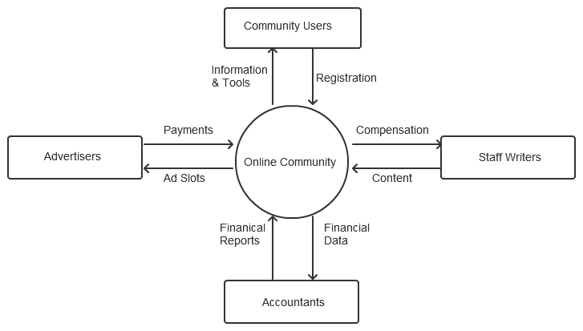
Introduction
Data Flow Diagrams are representations of flow through a process or a system.
It illustrates how data is processed by a system in terms of inputs and outputs.
We created a UI-based
system which can
convert a hand
drawn sketch
automatically
into a proper
Data Flow
Diagram.

Slide 4
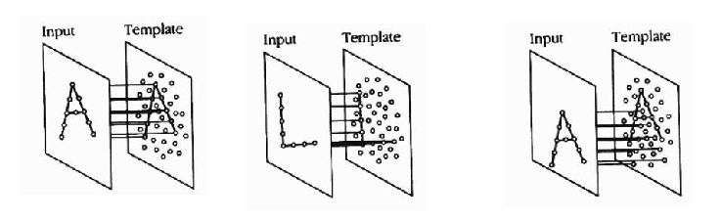
Basic Terminology
Data Flow Diagram : Visualization of information flow within a system.
Template Matching : It is a measure of finding similarity between a known and an unknown pattern.
Circles represent a
process in a DFD
Rectangles represent
modules in a system
Arrows represent
the flow of data

Slide 5
Motivation
Creating a Data Flow Diagram is a time consuming process.
A draft needs to be created which is transformed into a formal diagram using various tools like powerpoints or various similar softwares.
It would be easier if user can directly convert sketch into a DFD.
We implemented a simple interface which directly converts rough user sketch into a formal DFD.
User effort decreases as now a sketch can simultaneously be converted into a flow diagram.

Slide 6
Prior Works and Novelty
Previously, softwares have been created which allow user to select pre-defined shapes and combine them to form flow diagrams.
Similar work has been done on analysis and creation of flow charts.
Work has been done on recognition of hand drawn flowcharts using machine learning models [1].
We have implemented sketch recognition based model which takes strokes as input and replaces each stroke with related regular shape.
Template Matching is used along with simple transformations and manipulations.

Slide 7
Methodology
Approach :
Strokes are taken as input from user interface.
Recognition is performed using $1 template matching [2]. (Unistroke)
The strokes are replaced by transformed templates.
$1 Template Matching :
Given a set of candidate points and pre defined templates.
4 main steps are performed on templates and input strokes :-
(i) resampling : strokes are resampled
(ii) rotation : best alignment is calculated
(iii) scaling : scaled according to a reference square
(iv) translation : centroid is translated to origin
Transformed templates and strokes are matched using euclidean distance.
The best fit template is returned.

Slide 8
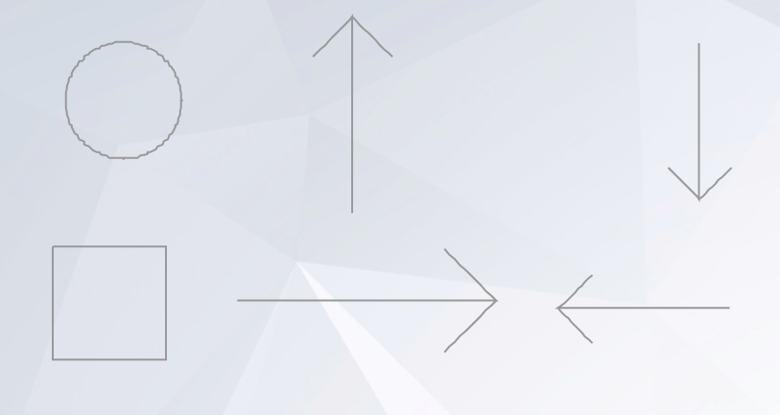
Template Creation
We created formal templates by specifying coordinates and using simple
for loops according to our requirements.

Slide 9
Methodology (Implementation)
Algorithm :
Strokes are taken as input from the interface (unistroke implementation).
On mouse up, recognition is performed using $1 template matching algorithm.
$1 algorithm returns the points for best matching template.
Centroid is calculated for resultant template and input stroke.
Maximum distance between each centroid and its respective pixels is calculated.
This distance is used to calculate the scaling factor for template.
The template is translated to origin and scaled to match the size of input stroke.
Once scaling is done, it is translated to the centroid of input stroke.
These immediate replacements are performed for each input stroke and the final output is a transformed data flow diagram.

Slide 10
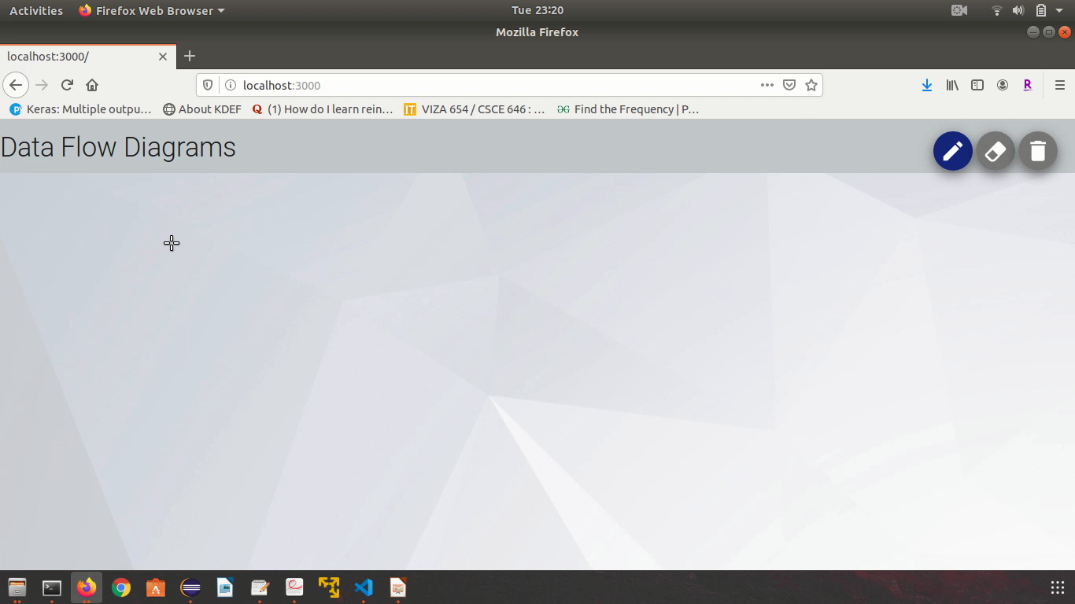
Observation and results (Demo)

Slide 11
Conclusion
We successfully replaced input strokes with correct shapes using template matching.
This project can be extended by implementing multi stroke template matching using $P algorithm.
Flow diagrams can be complex depending on their level of implementation. Various new shapes and recognition techniques can be integrated for recognition of complex flow diagrams.
Handwriting recognition can be integrated with shape recognition.

Slide 12
References
[1] Szwoch W., Mucha M. (2013) Recognition of Hand Drawn Flowcharts. In: Choraś R. (eds) Image Processing and Communications Challenges 4. Advances in Intelligent Systems and Computing, vol 184. Springer, Berlin, Heidelberg.
[2] Wobbrock, J.O., Wilson, A.D. and Li, Y. (2007). Gestures without libraries, toolkits or training: A $1 recognizer for user interface prototypes. Proceedings of the ACM Symposium on User Interface Software and Technology (UIST '07). Newport, Rhode Island (October 7-10, 2007). New York: ACM Press, pp. 159-168.

