Slide 1

2020 TAMIDS DATA SCIENCE COMPETITION
Team Data Hungry

Slide 2




TEAM
ROLINE STAPNY SALDANHA
VIPUL TIWARI
DEVI SANDEEP ENDLURI
MANSEERAT BATRA

Slide 3
INTRODUCTION
01
DATA CLEANING
02
DATA MODELING
DATA ANALYSIS
TABLE OF CONTENTS
04
03
SUMMARY
05
REFERENCES
06
Put forward the problem statement and describe the dataset.
Discussion of data cleaning techniques employed.
Model Building, experiments and results.
Exploratory data analysis through tables, graphs and charts.
Short summary and additional information.
What inspired us? Check these references.

Slide 4
01
INTRODUCTION

Slide 5
Problem Statement
Flight Scheduling issues because of flight delays
Airport Management problems
Bad customer satisfaction
Sudden changes in airfare
Solution
Flight Delay Prediction

Slide 6
DATA
The U.S. Bureau of Transportation Statistics tracks the on-time performance of domestic flights operated by large air carriers. The data for the years 2018 and for the Quarters 1 and 2 for the year 2019 is provided.
Following are the details of the data provided:
FlightDelays.csv: 10,915,495 flight logs for 2018 and the first half of 2019
Airports.csv: Airport locations and codes for 362 passenger airports in the United States
Routes.csv: Distance for 6,684 airport routes with origins and destinations in the U.S.
Airfares.csv: The average airfares between cities for 2018 and the first half of 2019.

Slide 7
02
DATA CLEANING

Slide 8
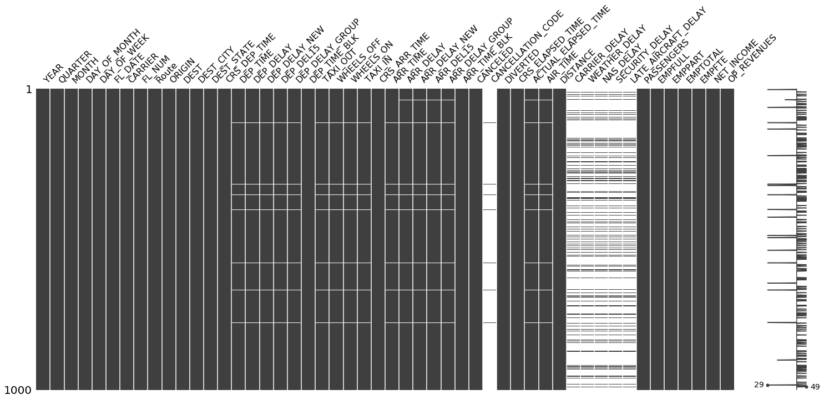
DATA CLEANING
Missing data is analyzed using missingno python package.
All the 5 categories of delays (carrier, weather, security, NAS and Late Aircraft) are mostly empty. Chose not to drop these features and imputed the missing values with 0.
Removed the cancelled flight information
Converted the time stamp format for the Arrival, Departure times. Used these values to fill other missing entries.
Removed all the dependent features based on correlation heatmap

Slide 9
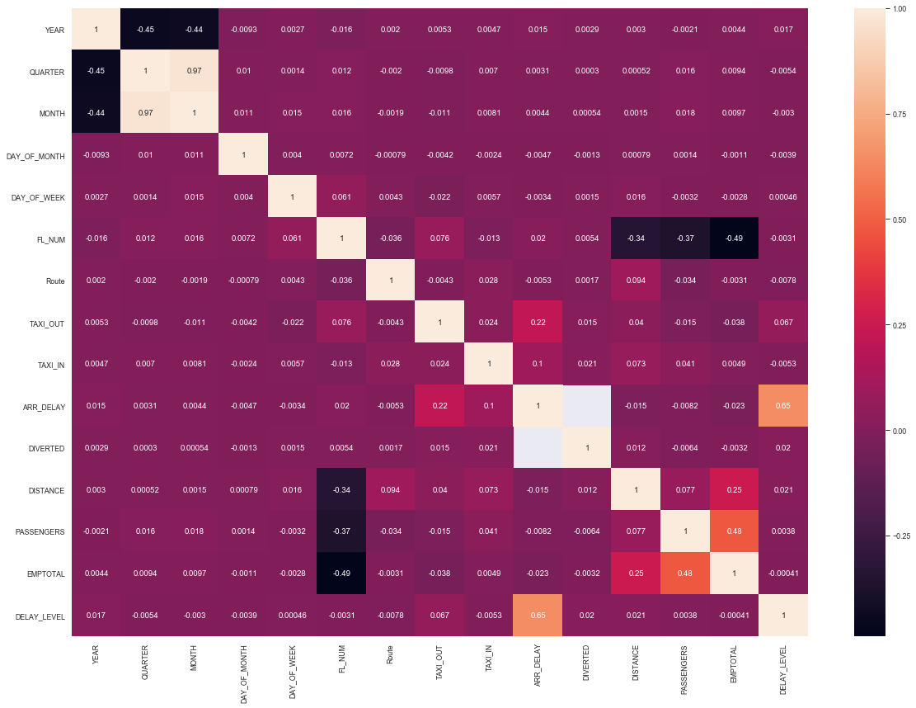
DATA CLEANING
CORRELATION MATRIX
Here is the final correlation matrix and we are down to 16 features from the initial 50 features!!
Observation: Arrival delays are dependent on departure delays.
Analysis: Departure delay at Origin airport will subsequently cause Arrival delay at destination airport.
Implication: we have removed all the features related to departure delays and set to build prediction model for arrival flight delays.

Slide 10
03
DATA ANALYSIS

Slide 11
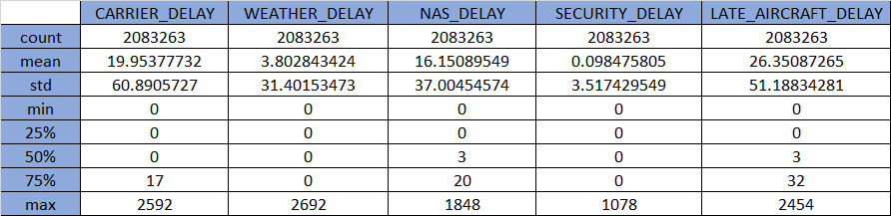
DATA ANALYSIS
Security delay is the least significant of all these with very low mean and variance
Weather delay, even though has very less mean value, has high variance.
Carrier and Late aircraft delays are the most significant ones.

Slide 12
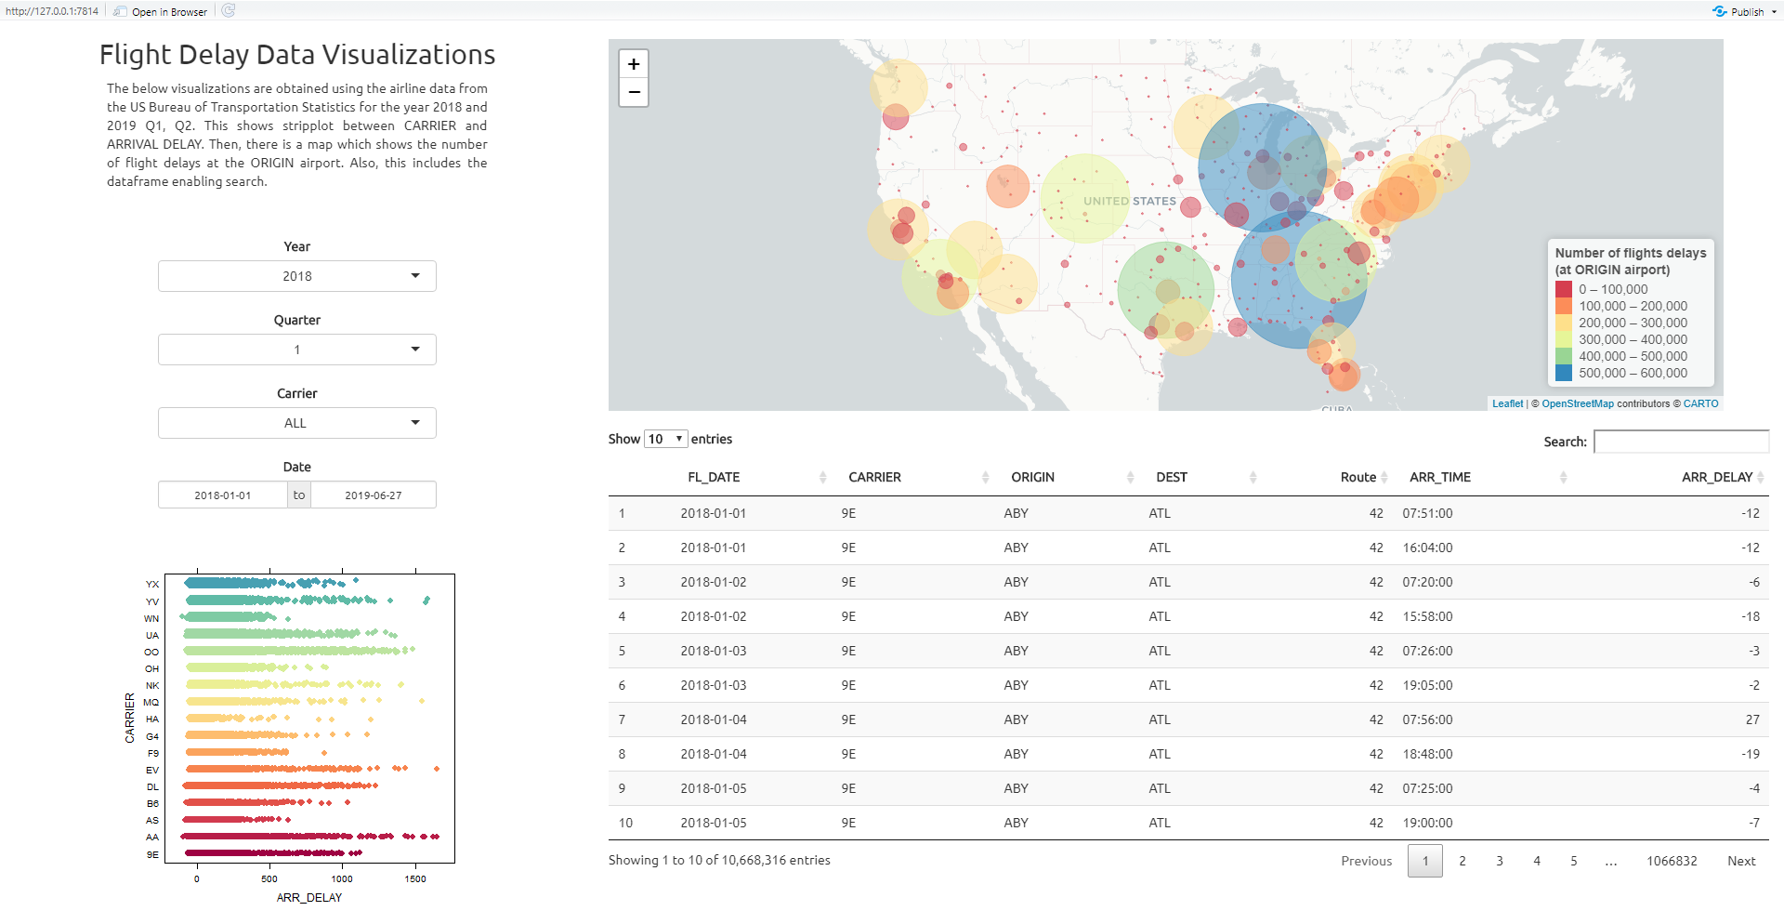
VISUALIZATION DASHBOARD

Slide 13
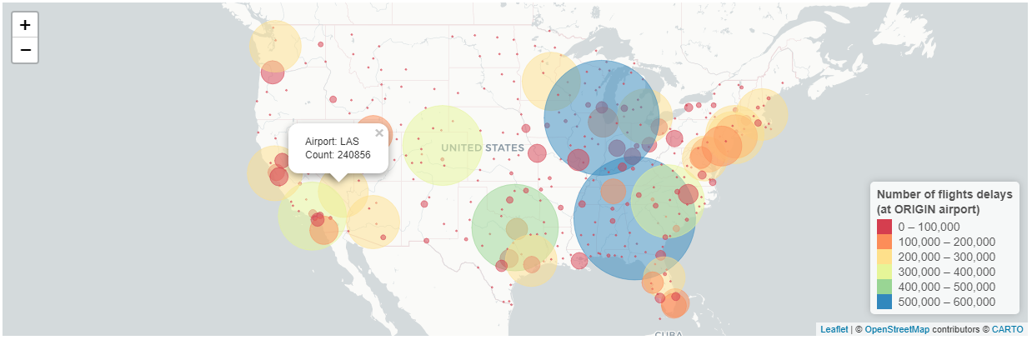
DATA VISUALIZATION
Visualization of total number of delays at origin airport

Slide 14
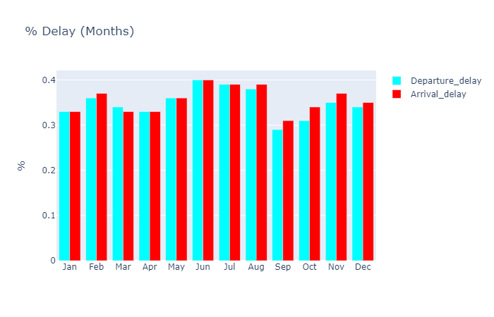
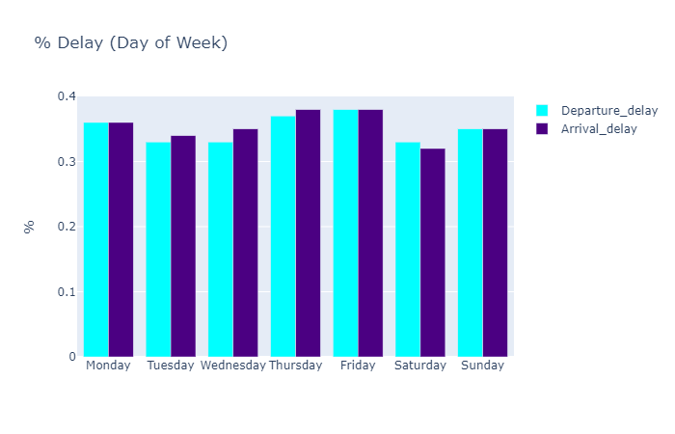
DATA VISUALIZATION

Slide 15
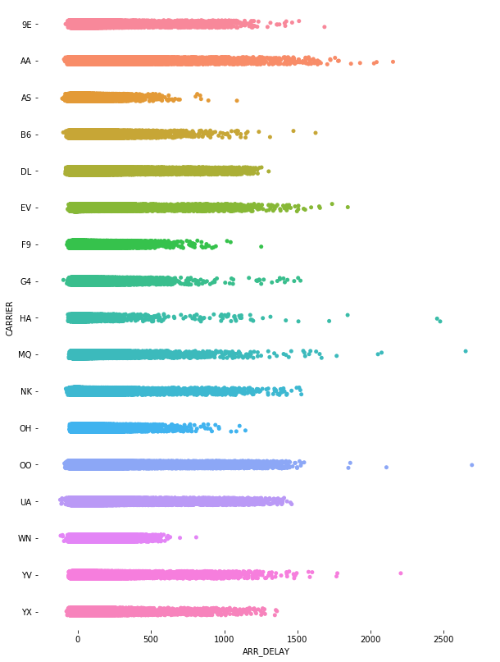
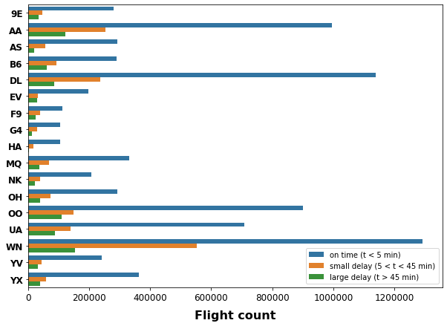
DATA VISUALIZATION

Slide 16
04
DATA MODELING

Slide 17
DATA MODELING
Total of 16 features which includes carrier, Day of the week, Origin Airport, Destination Airport, distance, delay categories etc. are considered to train various regression models.
Used Linear Regression, Lasso, Ridge and Bagging regressor models to train the data. Bagging regressor model took significantly more training time than the others.
The Extreme delays (> 300 minutes or < -100 minutes ) present in the dataset were removed because they were marginal (a few %) and were inducing bias in the analysis.
Experimented by removing the other features and keeping only the 5 categories of delays. Just with these delay features, we were able to achieve an RMSE of 9.97.
We further experimented by including carrier and distance and could see only slight improvements.
We could finally achieve an RMSE of 9.592!!

Slide 18
MODEL RESULTS
Model Name | Mean Absolute Error | Mean Squared Error | Root Mean Squared Error | R2 Score
Linear Regression | 7.56 | 92.016 | 9.592 | 0.939
Lasso | 7.96 | 99.576 | 9.978 | 0.934
Ridge | 7.56 | 92.016 | 9.592 | 0.939
Bagged Linear | 7.560 | 92.016 | 9.5925 | 0.9397

Slide 19
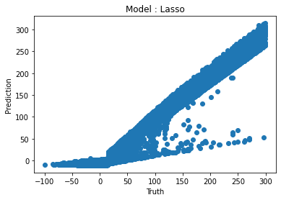
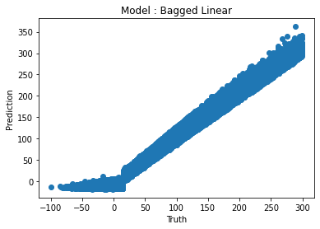

DATA MODELING
Model constructed using 16 features.

Slide 20
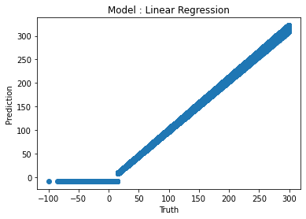
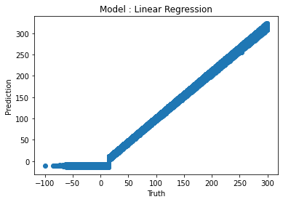
DATA MODELING
Model constructed using 5 delay features
Model constructed using 5 delay features + Carrier + distance
Mean Absolute Error: 7.877
Mean Squared Error: 99.449
Root Mean Squared Error: 9.972
R2 : 0.9349
Mean Absolute Error: 7.891
Mean Squared Error: 99.211
Root Mean Squared Error: 9.9605
R2 : 0.935

Slide 21
05
SUMMARY

Slide 22
SUMMARY
We see that the regression models do a decent job in fitting the airline data and can be effectively used in predicting the airline arrival delays.
We achieved an RMSE of 9.592, and have scope of further reducing the RMSE by considering more complicated models and further fine-tuning.

Slide 23
06
REFERENCES

Slide 24
LIBRARIES USED
Data cleaning:
Missingno (For missing data visualizations)
Data Analysis/Visualizations:
Basemap (For visualizations involving map)
Pyproj
Leaflet, shiny for R (for development of visualization platform)
Plotly (visualization graphs)
seaborn
Data Modeling:
Scikit-learn (model building and tuning)

Slide 25
REFERENCES
Additional data:
https://openflights.org/data.html
References:
N. Xu, L. Sherry, and K. B. Laskey, “Multifactor model for predicting delays at U.S. airports,” Transportation Research Record, no. 2052, pp. 62–71, 2008.
https://www.bts.gov/topics/airlines-and-airports/understanding-reporting-causes-flight-delays-and-cancellations
Bilogur, (2018). Missingno: a missing data visualization suite. Journal of Open Source Software, 3(22), 547, https://joss.theoj.org/papers/10.21105/joss.00547
Leaflet for R - Introduction [Internet]. Leaflet for R - Introduction. [cited 2017Apr9]. Available from https://rstudio.github.io/leaflet/
Most of the visualizations are inspired from: https://www.kaggle.com/fabiendaniel/predicting-flight-delays-tutorial
Model feature analysis and model building is further inspired from this Kaggle tutorial: https://www.kaggle.com/abhishek211119/2015-flight-delays-and cancellation-prediction

Slide 26
THANKS
Does anyone have any data questions?

