Slide 1
FASHIONWAVE
Retail Store Sales Analysis
Business Intelligence Report | Power BI Dashboard
Total Sales
Total Profit
Profit Margin
Units Sold
AOV
₹40.14M
₹12.77M
31.82%
30K
₹4.01K
Prepared from the FashionWave Power BI dashboard and sales dataset

Slide 2
1. Business Scenario & Objectives
Retail chain with 50 stores across India | Focus: sales, profitability, weekends and discounting
Business Scenario
• FashionWave is experiencing weaker weekend sales compared with weekdays.
• Management needs to understand category, product, store and city performance.
• Discounting must be evaluated for its effect on profit margins.
• The analysis uses the available FashionWave transaction dataset only.
Business Objectives
• Increase weekend sales by 15% in the next quarter.
• Identify high- and low-performing product categories and products.
• Improve product-level profitability.
• Develop data-driven discount strategies.
• Track performance by store, city and time period.
FashionWave | Retail Store Sales Analysis
2

Slide 3
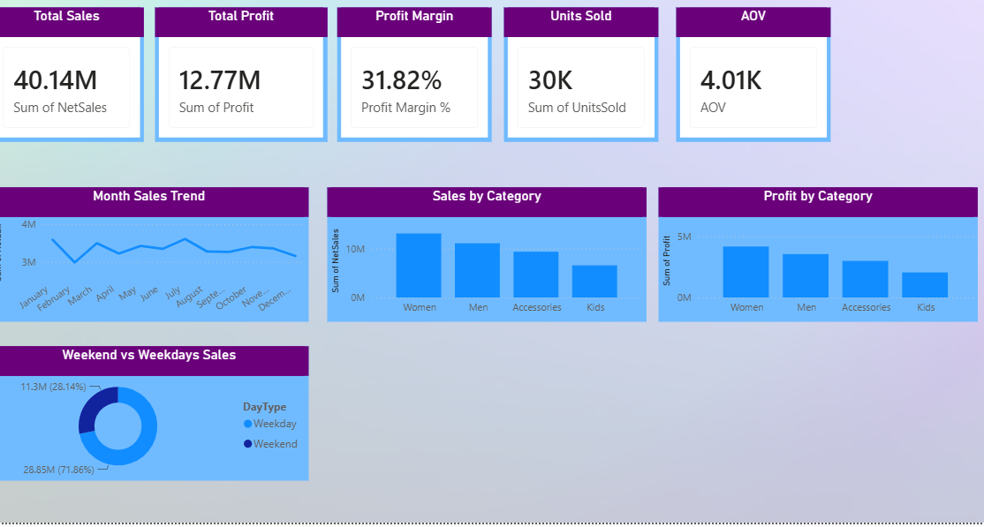
2. Executive Dashboard — KPI Summary
The values below match the user's Power BI dashboard.
Total Sales
Total Profit
Profit Margin
Units Sold
AOV
₹40.14M
₹12.77M
31.82%
30K
₹4.01K
Net sales
Profit generated
Profit / Net Sales
Units sold
Average order value
FashionWave | Retail Store Sales Analysis
3

Slide 4
3. Category & Product Performance
Sales and profit concentration by category, with product-level profitability
Dashboard Insights
• Women leads sales at ₹13.10M.
• Women also leads category profit at ₹4.17M.
• Kids has the lowest category sales at ₹6.58M.
• Jeans is the highest-profit product at ₹2.20M.
FashionWave | Retail Store Sales Analysis
4

Slide 5
4. Time Trend & Weekend vs Weekday Analysis
Weekend performance is a central business challenge in the case study.
Weekday Sales
Weekend Sales
₹28.85M
₹11.30M
Dashboard KPI
Dashboard KPI
Weekend / Weekday
Weekend Profit
0.39
₹3.57M
Sales ratio
Weekend profit
Key Takeaways
• Weekend sales are 0.39× weekday sales.
• The dashboard shows a clear opportunity to improve weekend revenue.
• Monthly sales fluctuate across the year.
FashionWave | Retail Store Sales Analysis
5

Slide 6
5. Store & City Performance
Use store-level and city-level views to identify performance gaps.
Top 5 Stores by Sales
Store | Net Sales
Store_15 | ₹1.02M
Store_48 | ₹0.94M
Store_13 | ₹0.92M
Store_17 | ₹0.92M
Store_14 | ₹0.91M
Bottom 5 Stores by Sales
Management View
• Store_15 is the highest-sales store at ₹1.02M.
• Store_11 is the lowest-sales store at ₹0.55M.
• Bhopal leads the city view at ₹1.78M.
• Use store gaps to guide targeted local promotions and assortment reviews.
Store | Net Sales
Store_11 | ₹0.55M
Store_25 | ₹0.64M
Store_12 | ₹0.65M
Store_43 | ₹0.65M
Store_35 | ₹0.69M
FashionWave | Retail Store Sales Analysis
6

Slide 7
6. Discount Impact on Profitability
The dashboard indicates that heavier discounting is associated with weaker profit margins.
Gross Sales
Total Discount
Total Profit
Average Discount
₹44.80M
₹4.65M
₹12.77M
10.43%
Before discounts
Discount value
Profit generated
Average discount rate
Key Interpretation
• Margin falls from 39.0% with no discount to 13.9% at 26–30% discount.
• Use targeted discounts rather than broad high-percentage promotions to protect profitability.
FashionWave | Retail Store Sales Analysis
7

Slide 8
7. Key Insights from the Power BI Dashboard
Concise findings that can be used directly in the report/presentation.
Overall Performance
₹40.14M sales with ₹12.77M profit and 31.82% margin.
Category Leader
Women leads sales at ₹13.10M and profit at ₹4.17M.
Weekend Gap
Weekend sales are ₹11.30M vs ₹28.85M weekdays; ratio = 0.39.
Product Opportunity
Jeans is the highest-profit product at ₹2.20M.
Discount Effect
Average discount is 10.43%; higher discount tiers show lower margins.
Store Opportunity
Store sales range from about ₹0.55M to ₹1.02M.
FashionWave | Retail Store Sales Analysis
8

Slide 9
8. Recommendations & Action Plan
Recommendations are based only on trends visible in the FashionWave dashboard.
Quick Wins
• Run targeted weekend campaigns around high-demand products and categories.
• Use Women and high-profit products such as Jeans as traffic-driving anchors.
• Review Kids category performance and test focused bundles or assortment changes.
• Prioritize the lowest-performing stores for local marketing and assortment review.
Long-Term Strategy
• Create a store-level performance monitoring routine in Power BI.
• Adopt discount guardrails and avoid unnecessarily deep discounts.
• Use category and product profitability—not sales alone—to guide promotions.
• Compare weekend performance regularly to track progress toward the 15% growth objective.
Management focus: Grow weekend sales while protecting the 31.82% overall profit margin.
FashionWave | Retail Store Sales Analysis
9

