Slide 1

AgroBot: The Universal AI-Based Agricultural Assistant
A Smart Conversational System designed to empower farmers by providing instant agricultural guidance, crop management support, and plant disease analysis using Artificial Intelligence (AI), Natural Language Processing (NLP), and Computer Vision (CV) technologies.

Slide 2
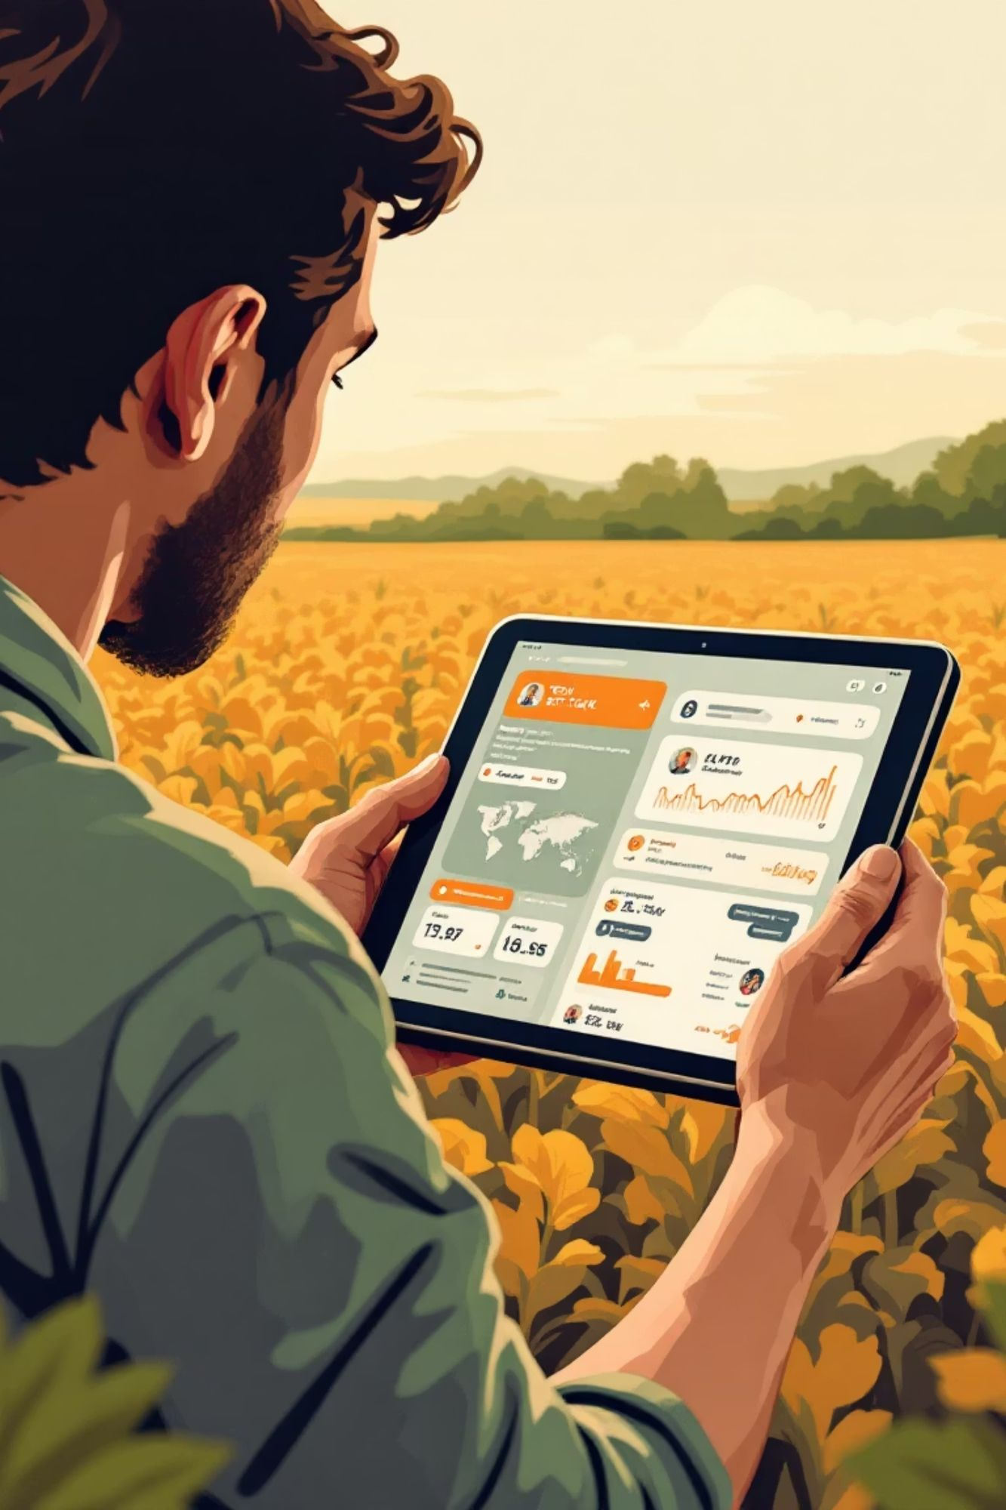
The Power Behind the Assistant
AgroBot-Universal: A Smart Web-Based Assistant
Instant Answers & Multilingual Support
Instantly answers questions about crops, pests, soil, irrigation, and fertilizers. Reads queries in English, Hindi, Tamil, with easy scalability for additional regional languages.
Real-Time Plant Analysis
Features real-time plant/leaf image analysis for immediate detection of health issues, stress, or disease, offering quick intervention strategies.
Seamless Connectivity
Works effectively offline using an integrated knowledge base, with an automatic OpenAI fallback for complex or new queries when online.
Administrative Management
Includes user login, a comprehensive admin dashboard, and CSV/JSON knowledge base import for easy content updates and system maintenance.

Slide 3

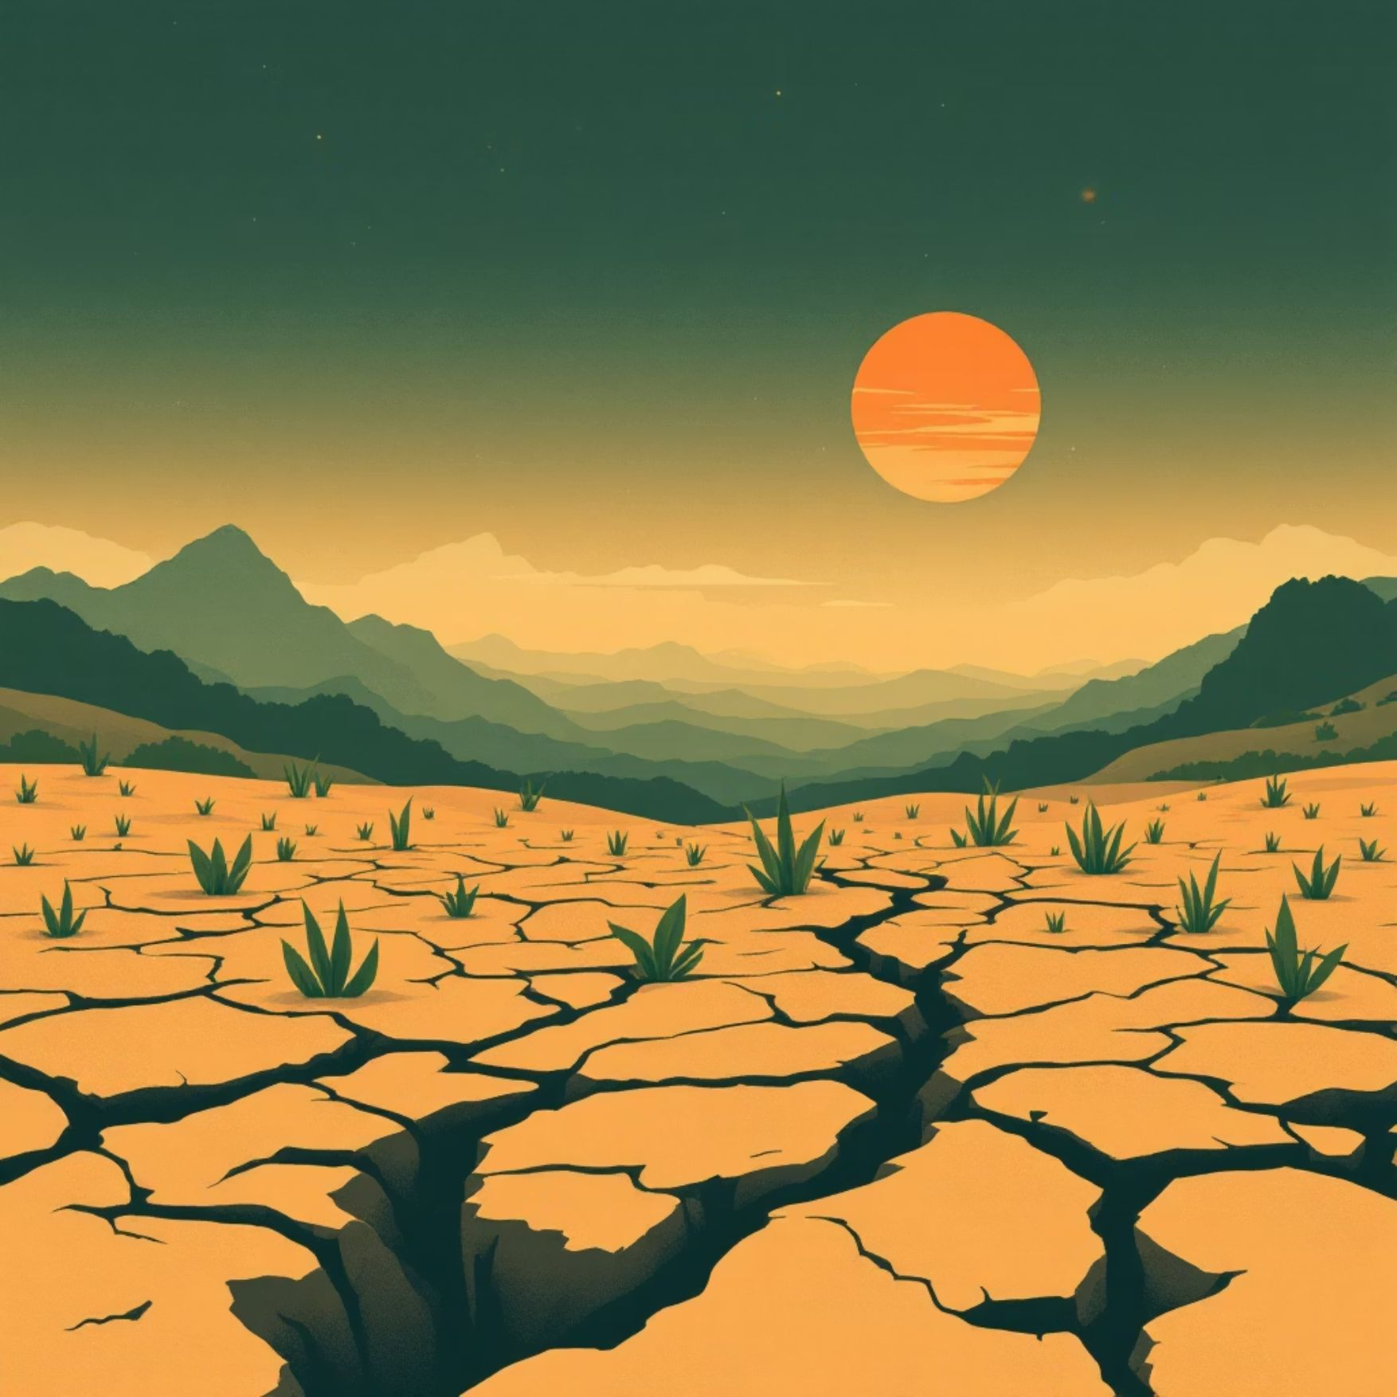
The Farming Challenge Today: Why AI is Essential
Surging Food Demand
Climate & Resource Scarcity
The global population is projected to reach 9 billion by 2050, requiring a massive surge in food production capacity worldwide.
Climate change, combined with increasing resource scarcity, threatens crop yields and agricultural stability across the globe.
Traditional farming methods are often labor-intensive, costly, and lack the precision needed to meet modern challenges efficiently.

Slide 4
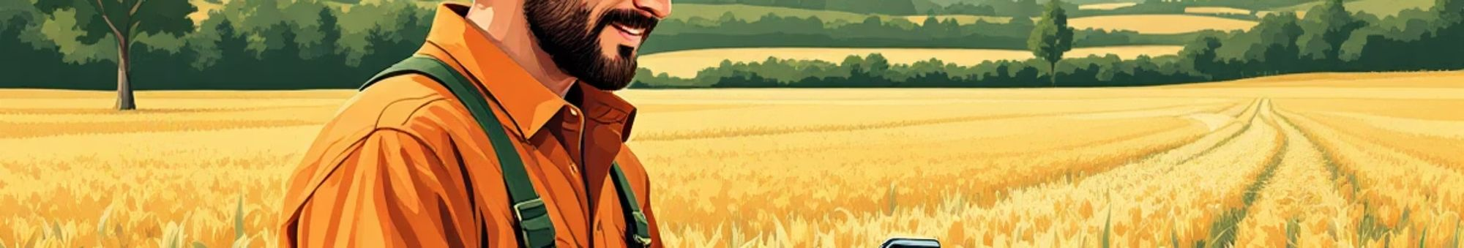

Enter AgroBot: AI Meets Agriculture
1
2
3
AI-Powered Chatbot
Integrated Technology
24/7 Real-Time Support
A specialized assistant tailored precisely for the immediate, practical needs of farmers.
N-atural language understanding with powerful computer vision capabilities.
Available instantly on mobile devices, providing real-time, personalized, and actionable guidance anytime, anywhere.
The system bridges the gap between complex agricultural science and practical field application.

Slide 5

Core Capabilities: Key Features of AgroBot
Plant Identifier
Disease Diagnosis
Snap a photo to instantly identify your crop or weed species with high accuracy.
Upload plant images and receive AI-driven detection of diseases, along with specific, effective treatment advice.
Farming Tips
Agriculture News
Tailored guidance on crucial tasks: optimized irrigation schedules, precision fertilization, and integrated pest control strategies.
Stay current with the latest global farming developments and localized agricultural news curated specifically for your region and crops.

Slide 6
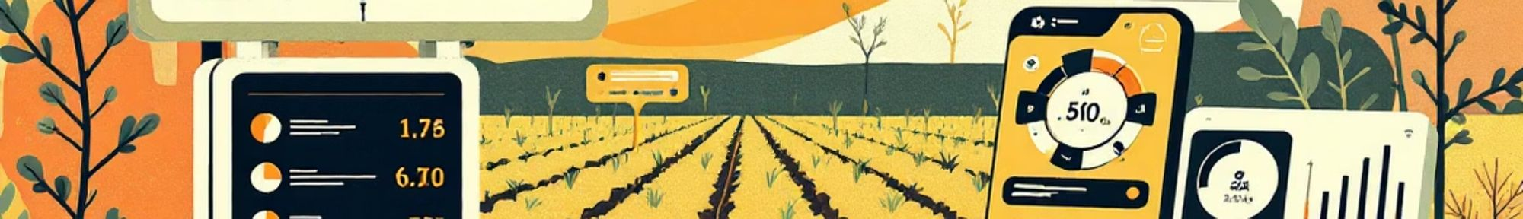
Precision and Personalization in Farming
Soil and Crop Optimization
Analyzes crucial soil parameters—like pH, nutrient levels, and moisture—to provide precise, targeted crop recommendations and management plans.
Breaking Communication Barriers
Understands and responds in regional languages and local dialects, ensuring all farmers, regardless of literacy level, can access expert advice.
Sustainable Practices
Promotes eco-friendly and sustainable farming techniques, helping farmers reduce their environmental impact while maintaining profitability.

Slide 7
Real-World Impact: Empowering Farmers
—
—
—
Reduction in Crop Loss
Improved Yield
Input Cost Savings
Instant access to expert diagnosis and advice significantly minimizes losses from pests and diseases.
Targeted interventions enabled by precision farming recommendations lead to higher, more consistent yields.
Optimized use of fertilizers, water, and pesticides based on real-time data reduces unnecessary expenditure.
AgroBot supports smallholder farmers by providing accessible, cutting-edge technology, effectively leveling the agricultural playing field globally.

Slide 8

Technology Stack
Python
Core programming language providing flexibility and extensive libraries for AI integration
OpenAI API
Advanced language model delivering intelligent, context-aware responses for complex queries
JSON Knowledge Base
Structured agricultural data enabling fast, accurate retrieval of farming information
Flask
Lightweight web framework enabling responsive backend services and API management
Google Trans
Automatic translation service breaking language barriers across farming communities
RESTful APIs
Seamless integration architecture connecting frontend, backend, and AI services

Slide 9

A Cycle of Continuous Improvement
Data Input
AI Analysis
Feedback Collection
Field Action
This dynamic feedback loop ensures the AI model constantly learns from real-world outcomes, improving its accuracy and relevance with every interaction.

Slide 10






How the Chatbot Works
Natural Language Processing
User Input
Advanced NLP algorithms process and understand the farmer's question or concern
Farmers submit queries through text or voice in their preferred language
Multi-language Output
Knowledge Base Search
Response is translated and delivered in the farmer's preferred language
System searches through structured agricultural database for relevant information
Response Generation
AI Analysis
Tailored advice and recommendations are generated based on the specific query
OpenAI API provides intelligent analysis and contextual understanding

Slide 11
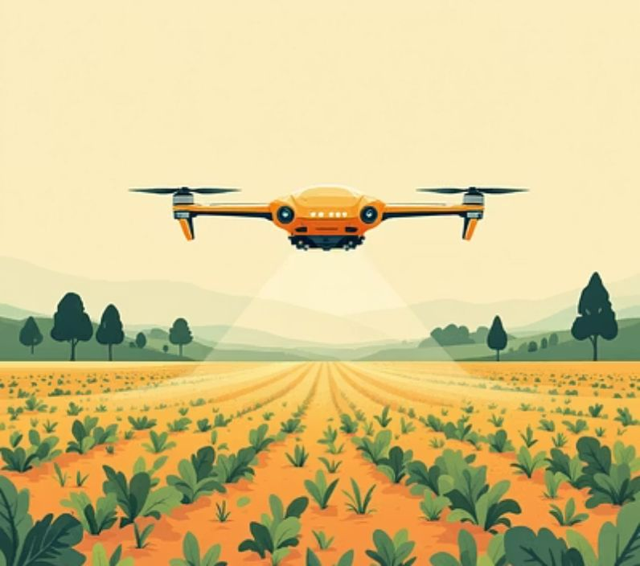
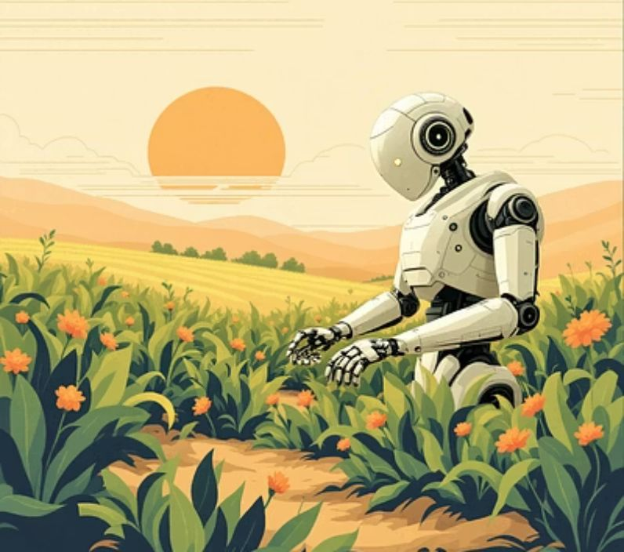
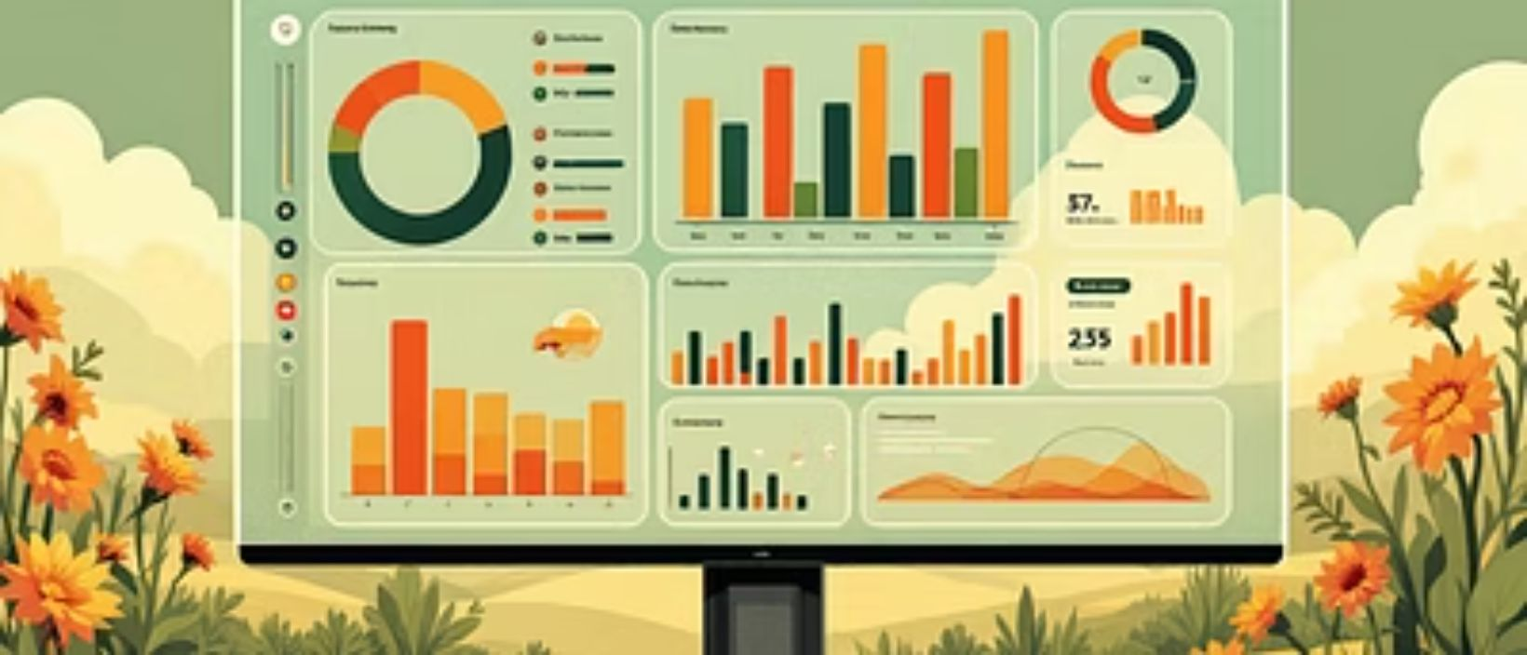
The Future of Farming with AgroBot
Adaptable AI: Our continuous learning AI framework adapts rapidly to emerging crops, novel diseases, and innovative farming methods.
Automation Potential: Future integration capabilities with autonomous farm robots, drones, and IoT sensors promise a pathway toward fully automated, hyper-efficient farming operations.
Sustainability Driver: By promoting resource efficiency and smart interventions, AgroBot is actively driving sustainable agriculture to feed a growing world while safeguarding the planet's ecosystems.

Slide 12
AgroBot's Roadmap: Future Enhancements for Efficiency
IoT Integration
ML Enhancement
Connects with smart sensors and weather stations for real-time data to enable proactive decision-making.
Continuously evolving algorithms improve accuracy in predictions and recommendations through advanced learning.
Mobile App Development
Drone Integration
Dedicated native iOS and Android applications for seamless on-the-go access and enhanced user experience.
High-resolution aerial imagery and data for comprehensive crop health assessment and detailed field mapping.
Blockchain Implementation
Advanced Computer Vision
Ensures verifiable, transparent tracking of produce from farm to table, building trust and efficiency.
Next-gen visual analytics for earlier, more precise identification of plant diseases and pests.

Slide 13
Conclusion
AI Revolution
Comprehensive Features
Robust Technology
Transforming agriculture with intelligent, accessible AI solutions for every farmer.
From instant plant identification to disease diagnosis and multilingual support, all in one app.
Built on Python, OpenAI, and a powerful knowledge base for reliable, real-time insights.
Real-World Impact
Promising Future
Proven to boost yields, reduce losses, and significantly lower operational costs for farmers.
Continuous innovation with IoT, advanced ML, and drone integration for hyper-efficiency.
AgroBot stands as a beacon of innovation, empowering farmers worldwide to cultivate a more productive, efficient, and sustainable future for global food security.

Slide 14

Cultivating Tomorrow
AgroBot Universal is more than an assistant—it's the future of agriculture, combining human expertise with artificial intelligence to ensure food security and sustainability for generations to come. Join us in cultivating a smarter, greener tomorrow.

Slide 15
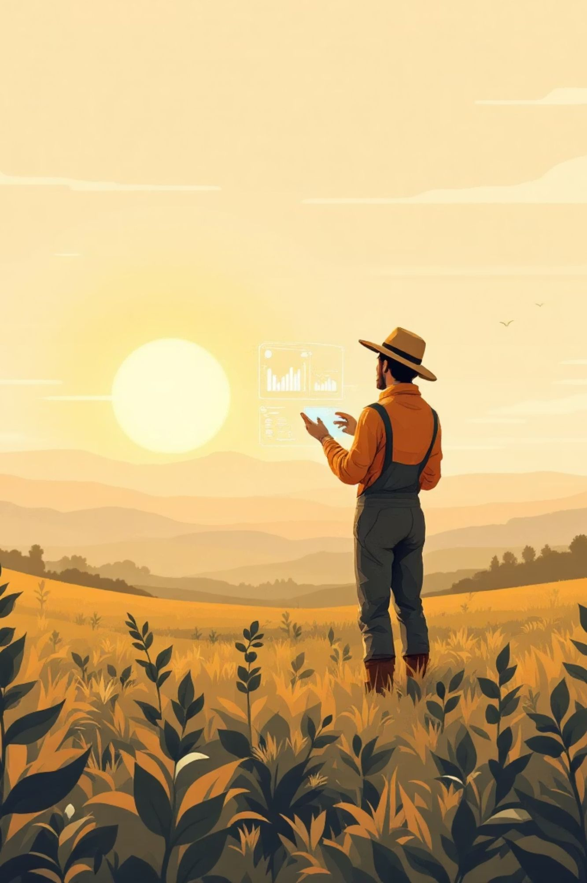
Thank You!
We sincerely appreciate your time and attention today.

