Slide 1
Library Resource
Management System
Fundamentals of Data Science — Portfolio Assessment
Presented by: Manshi Sah · Sumant Sah · Aman Mahato

Slide 2
Project Objectives
Data Storage
Books, members, loans, and passwords stored in four plain text files.
Librarian role
Add / remove books, update member records, generate an overdue report.
Student role
Search the catalogue, view personal loans, update profile.
Object-oriented design
A shared User class with Librarian and Student subclasses.
Error handling
Try/except throughout so bad input never crashes the program.

Slide 3
System Design
Data Storage
Class Hierarchy (OOP)
books.txt isbn, title, author, available
User
members.txt username, full_name, role
loans.txt isbn, username, borrow_date, due_date, returned
Librarian
Student
add/remove book, reports
search, loans, profile
passwords.txt username, password
Both subclasses inherit username, full_name, and role from User, and add their own methods.

Slide 4
Program Flow
START
Login: enter username
& password
Show error,
allow retry
(max 3 tries)
Credentials
valid?
No
Role?
Librarian
Librarian Menu
Student Menu
1 Add book
2 Remove book
3 Update member
4 Overdue report
5 Logout
1 Search books
2 View my loans
3 Update profile
4 Logout
Perform action via
data_io.py (read/write .txt)
Choose
Logout?
END

Slide 5
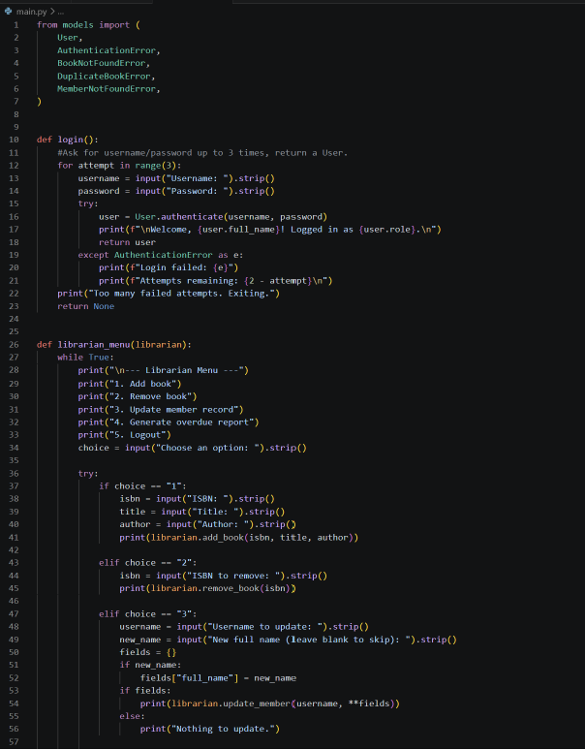
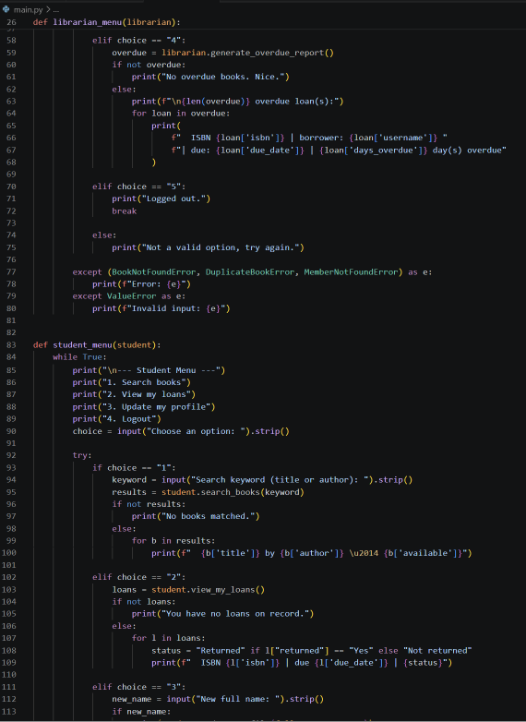
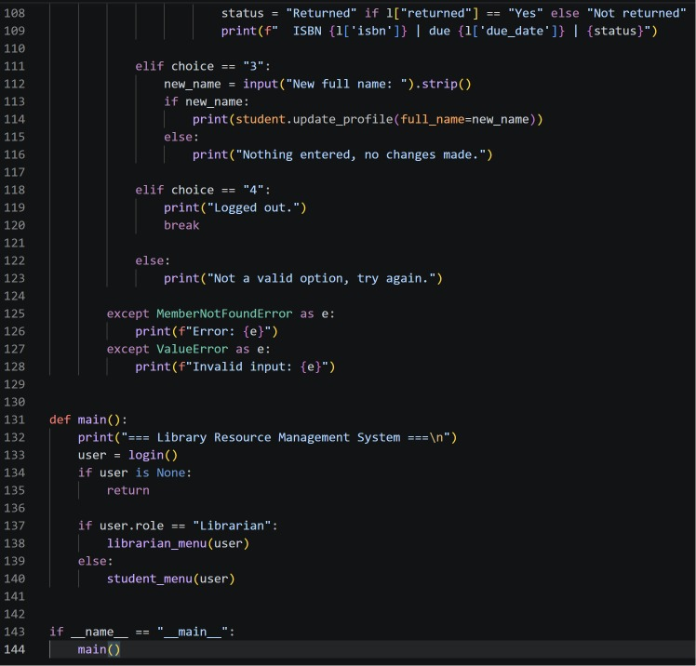
User Interface — main.py
Handles user login with authentication, directs users to the appropriate Librarian or Student menu based on their role, manages menu navigation, validates user input, and handles exceptions to ensure the program runs smoothly.

Slide 6
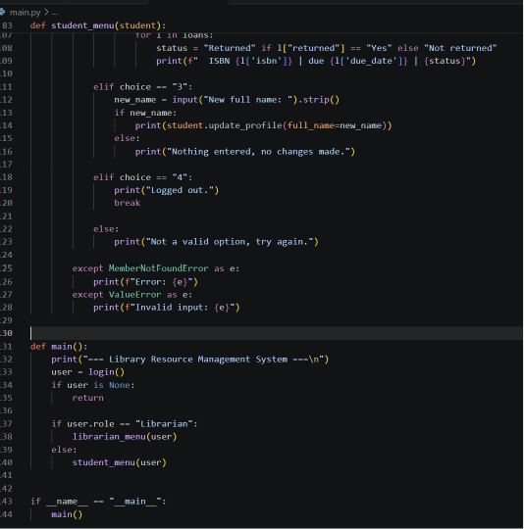
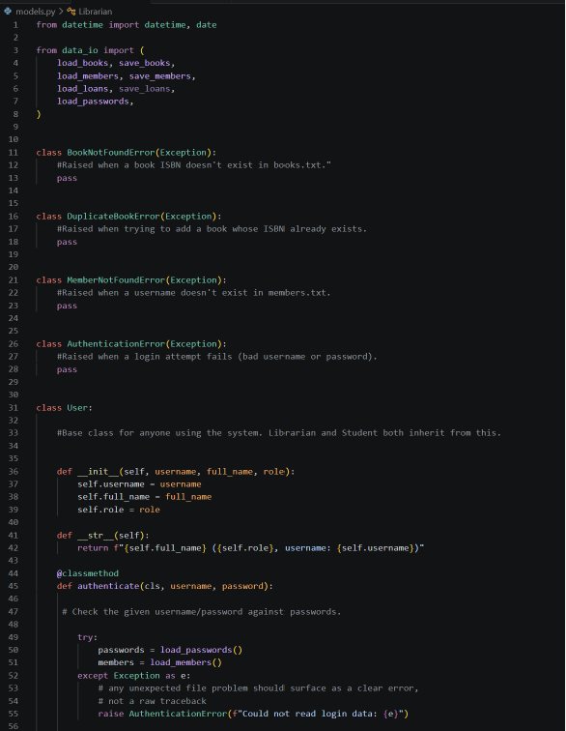
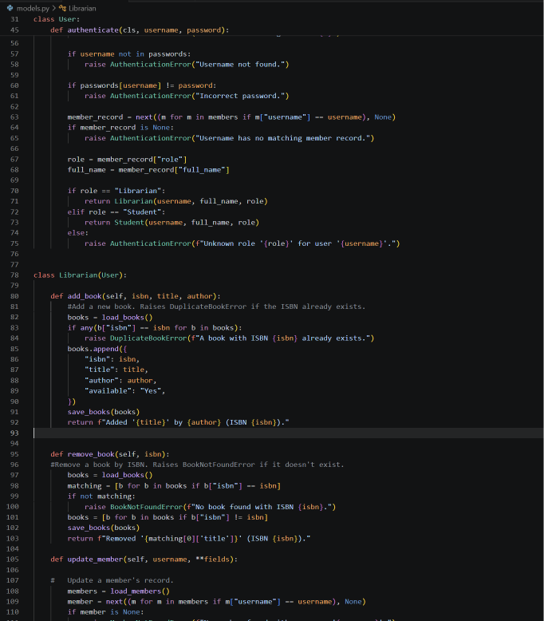
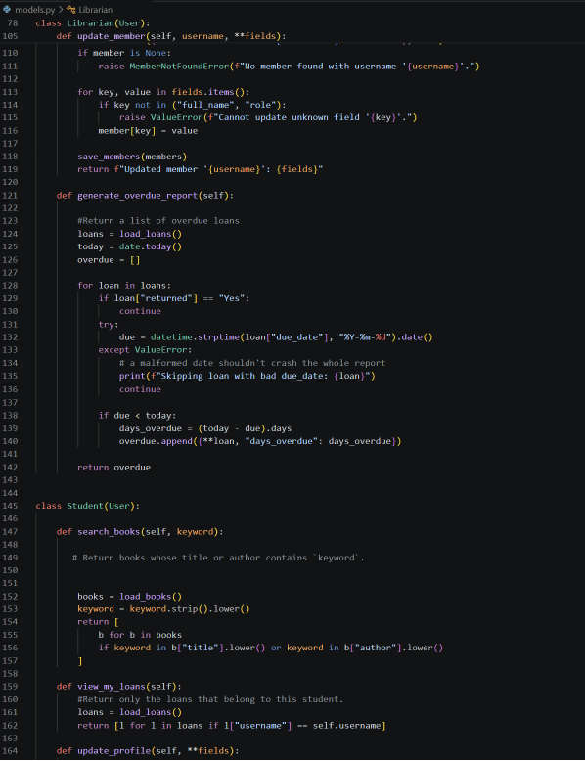
Class Structure — models.py
Defines the User base class plus the Librarian and Student subclasses. Custom exceptions (AuthenticationError, BookNotFoundError, DuplicateBookError, MemberNotFoundError) give clear, specific error handling.

Slide 7
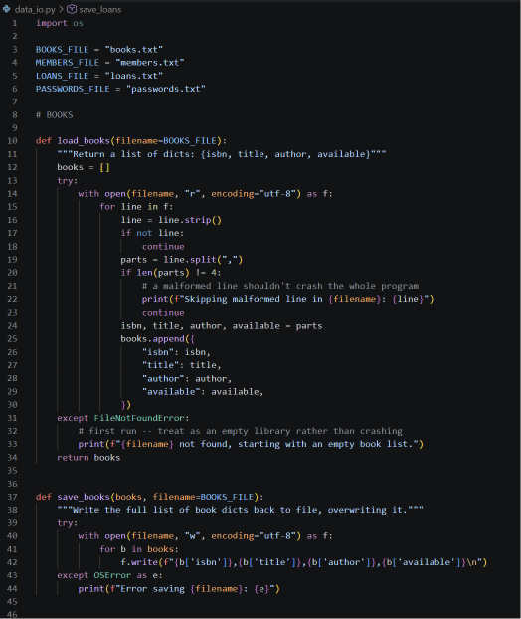
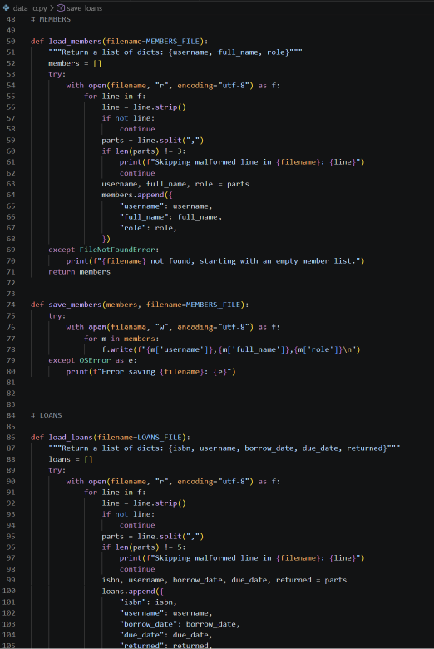
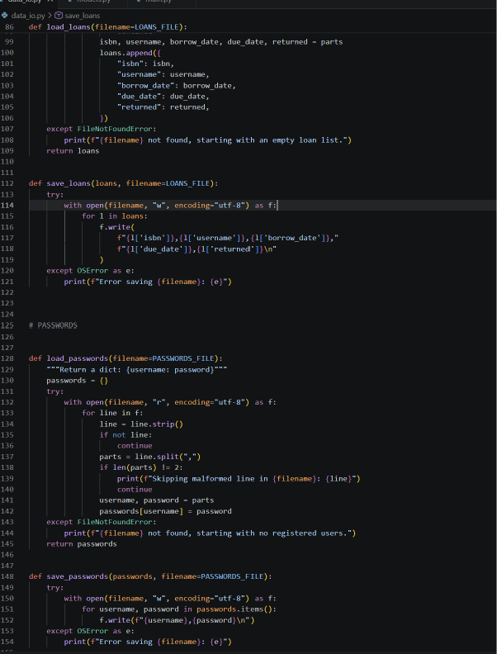
Data Layer — data_io.py
Every load/save function for the four text files lives here. Each load function wraps file access in try/except, so a missing file starts the program with an empty list instead of crashing.

Slide 8
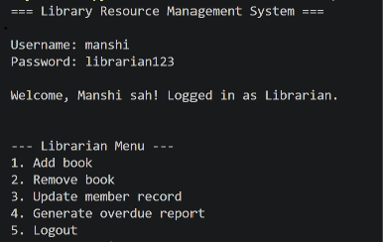
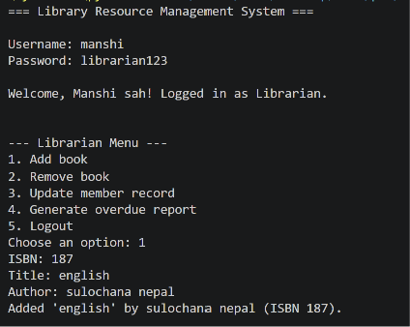
Testing — Librarian Login
Login as manshi / librarian123 correctly routes to the Librarian menu.

Slide 9
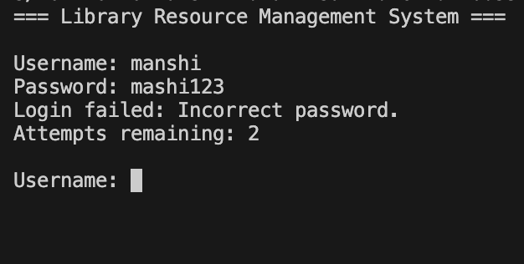
Testing — Failed Login Handling
An incorrect password is caught and reported without crashing the program, with retries remaining shown.

Slide 10
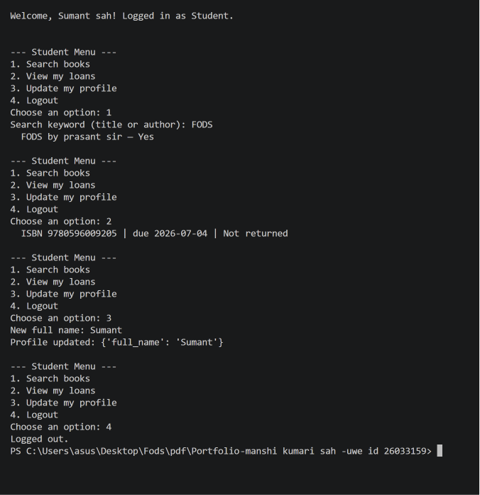
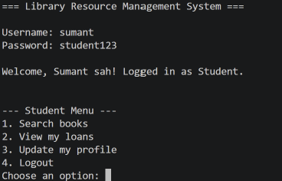
Testing — Student Session
Search, view loans, update profile, and logout all working correctly for the sumant account.

Slide 11
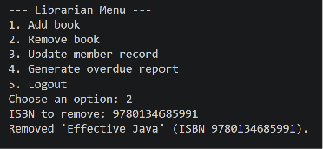
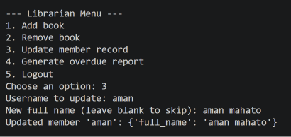
Testing — Librarian
Adding book, removing book and updating member record

Slide 12
Conclusion
All four data files implemented with full read/write persistence.
Librarian and Student roles fully functional and tested end to end.
OOP design (User base class + Librarian/Student subclasses) avoids duplicated logic.
Exception handling prevents crashes on invalid input or missing data.
Thank you

