Slide 1
FRAUD DETECTION
PRESENTED BY : MANSI SHARMA

Slide 2

FRAUD
DETECTION
This project aims to enhance the accuracy of detecting fraud in mobile financial transactions. By leveraging machine learning, the project seeks to predict fraudulent transactions with high precision. The goal is to develop a robust machine learning model to accurately identify fraudulent transactions in real-time , enabling the company to improve security, reduce financial losses, and gain insights into factors contributing to transaction fraud.

Slide 3
DATA COLLECTION
EXPLORATORY
DATA ANALYSIS
FEATURE ENGINEERING
MODEL IMPLEMENTATION
MODEL SELECTION
01
02
03
04
05

Slide 4

OBJECTIVE OF THE PROJECT
Protecting Consumers :
Preventing Unauthorized transaction
Detecting account takeovers
Protecting Financial Institutions:
Reducing financial losses
Improving customer experience
Protecting Businesses :
Reducing chargebacks
Protecting brand reputation
Enhancing customer loyalty

Slide 5




DATA COLLECTION
In this specific dataset the fraudulent behavior of the agents aims to profit by taking control of customers accounts and try to empty the funds by transferring to another account and then cashing out of the system.
We have a data of 11142 transactions.
We have based our data on 10 parameters
Aim of this project is to predict the fraudulent transactions

Slide 6
Column name | description
step | maps a unit of time in the real world. In this case 1 step is 1 hour of time.
type | CASH-IN, CASH-OUT, DEBIT, PAYMENT and TRANSFER
amount | amount of the transaction in local currency.
nameOrig | customer who started the transaction
oldbalanceOrg | initial balance before the transaction
newbalanceOrig | new balance after the transaction.
nameDest | customer who is the recipient of the transaction
oldbalanceDest | initial balance recipient before the transaction. Note that there is not information for customers that start with M (Merchants).
newbalanceDest | new balance recipient after the transaction. Note that there is not information for customers that start with M (Merchants).
isFraud | This is the transactions made by the fraudulent agents inside the simulation
**Column Value Information for type **
CASH-IN: Refers to depositing cash into an account, typically adding funds.
CASH-OUT: Refers to withdrawing cash from an account, usually removing funds.
DEBIT: This can have two meanings:
It can refer to a decrease in the balance of a financial account due to a withdrawal or an expense.
In accounting, it represents an entry that reduces assets or increases liabilities.
PAYMENT: Refers to the transfer of money from one party (payer) to another (payee) in exchange for goods, services, or as settlement of a debt.
TRANSFER: Refers to moving money from one account to another, often between accounts held by the same person or entity.

Slide 7

EXPLORATORY DATA ANALYSIS
Exploratory Data Analysis (EDA) helped us understand the data structure, find patterns, identify trends, and gain valuable insights from the dataset

Slide 8
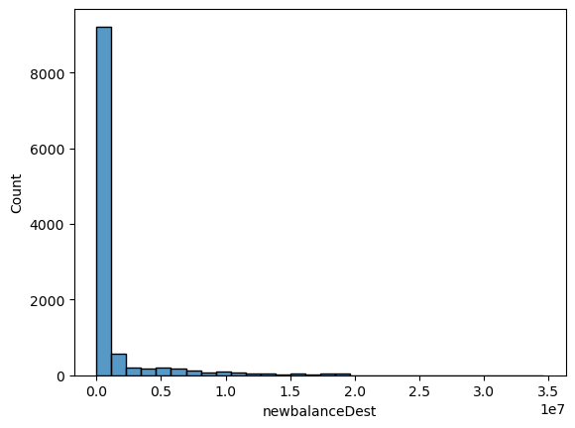
Here we visualize different parameters given in our data like newbalanceOrig, oldbalanceOrg, newbalanceDest, oldbalanceDest .
As we can see in this graph newbalanceDest is right skewed .
Similarly oldbalanceOrg, newbalanceDest, oldbalanceDest , amount all are right skewed .
We do not see any missing or NULL values in any of the given parameters.
We also found that the target variable isFraud is very imbalanced, this information will be useful while selecting and implementing ML models.
There are some outliers in the data in later section we see what we do with these outliers.

Slide 9
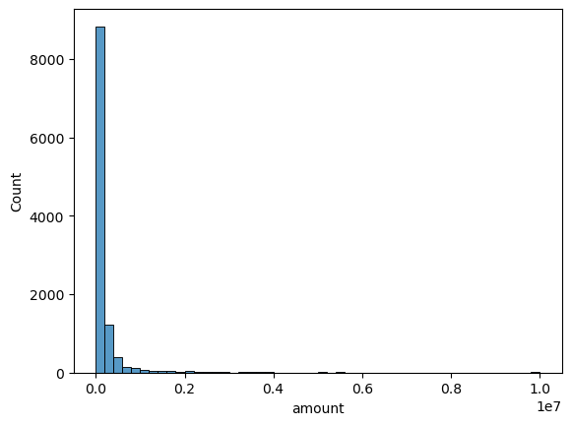
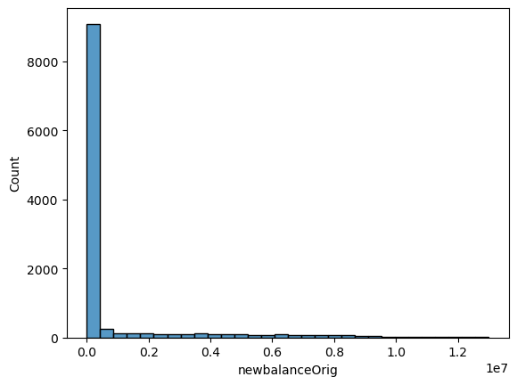
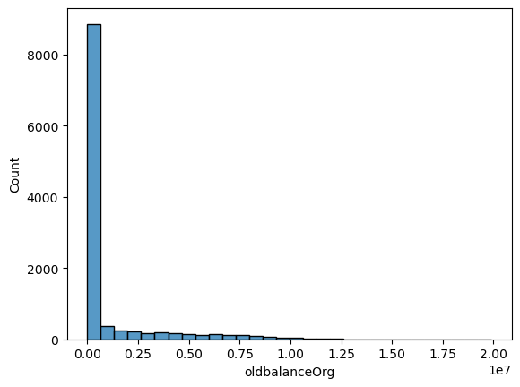
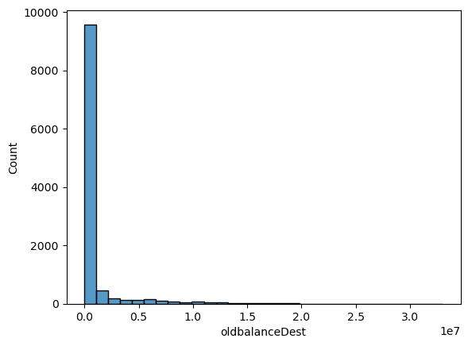
All these parameters need to be normally distributed especially if we are using Logistic Regression Algorithm .
We will convert them into Normal distribution. However, if we use any other algorithm, we need not to convert them into Normal distributed.

Slide 10
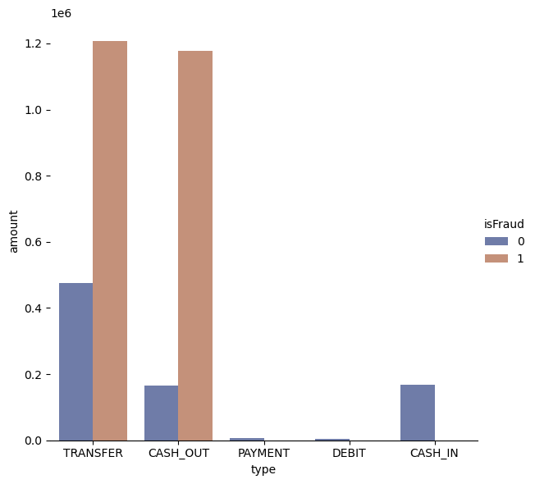
Distribution of categorical variable
In this graph we plot categorical variable ‘type’ based on the ‘amount’ segregated based on ‘isFraud’.
We see that the highest amount of transactions is in TRANSFER and CASH_OUT categories .
Also TRANSFER and CASH_OUT are the categories where there are fraud transactions and amount of transactions is significantly high.
PAYMENT and DEBIT categories have the minimum amount of transactions.
We see overall that the amount of fraud transaction is higher than the amount of normal transactions.

Slide 11
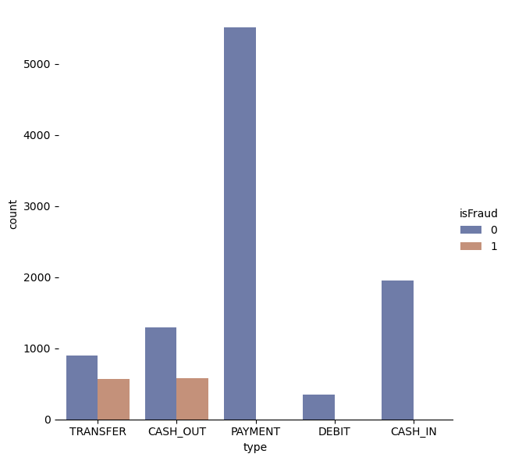
Categorical VARIABLE vs TARGET
In this graph we plot ‘type’ categorical variable segregated by the target variable ‘isFraud’.
We see that PAYMENT category has highest number of transactions.
Fraud transactions are only present in TRANSFER and CASH_OUT categories and their number is lower than the normal transactions.
DEBIT has the lowest number of transactions.
Overall, we see that the number of normal transaction is higher than the fraud transactions

Slide 12
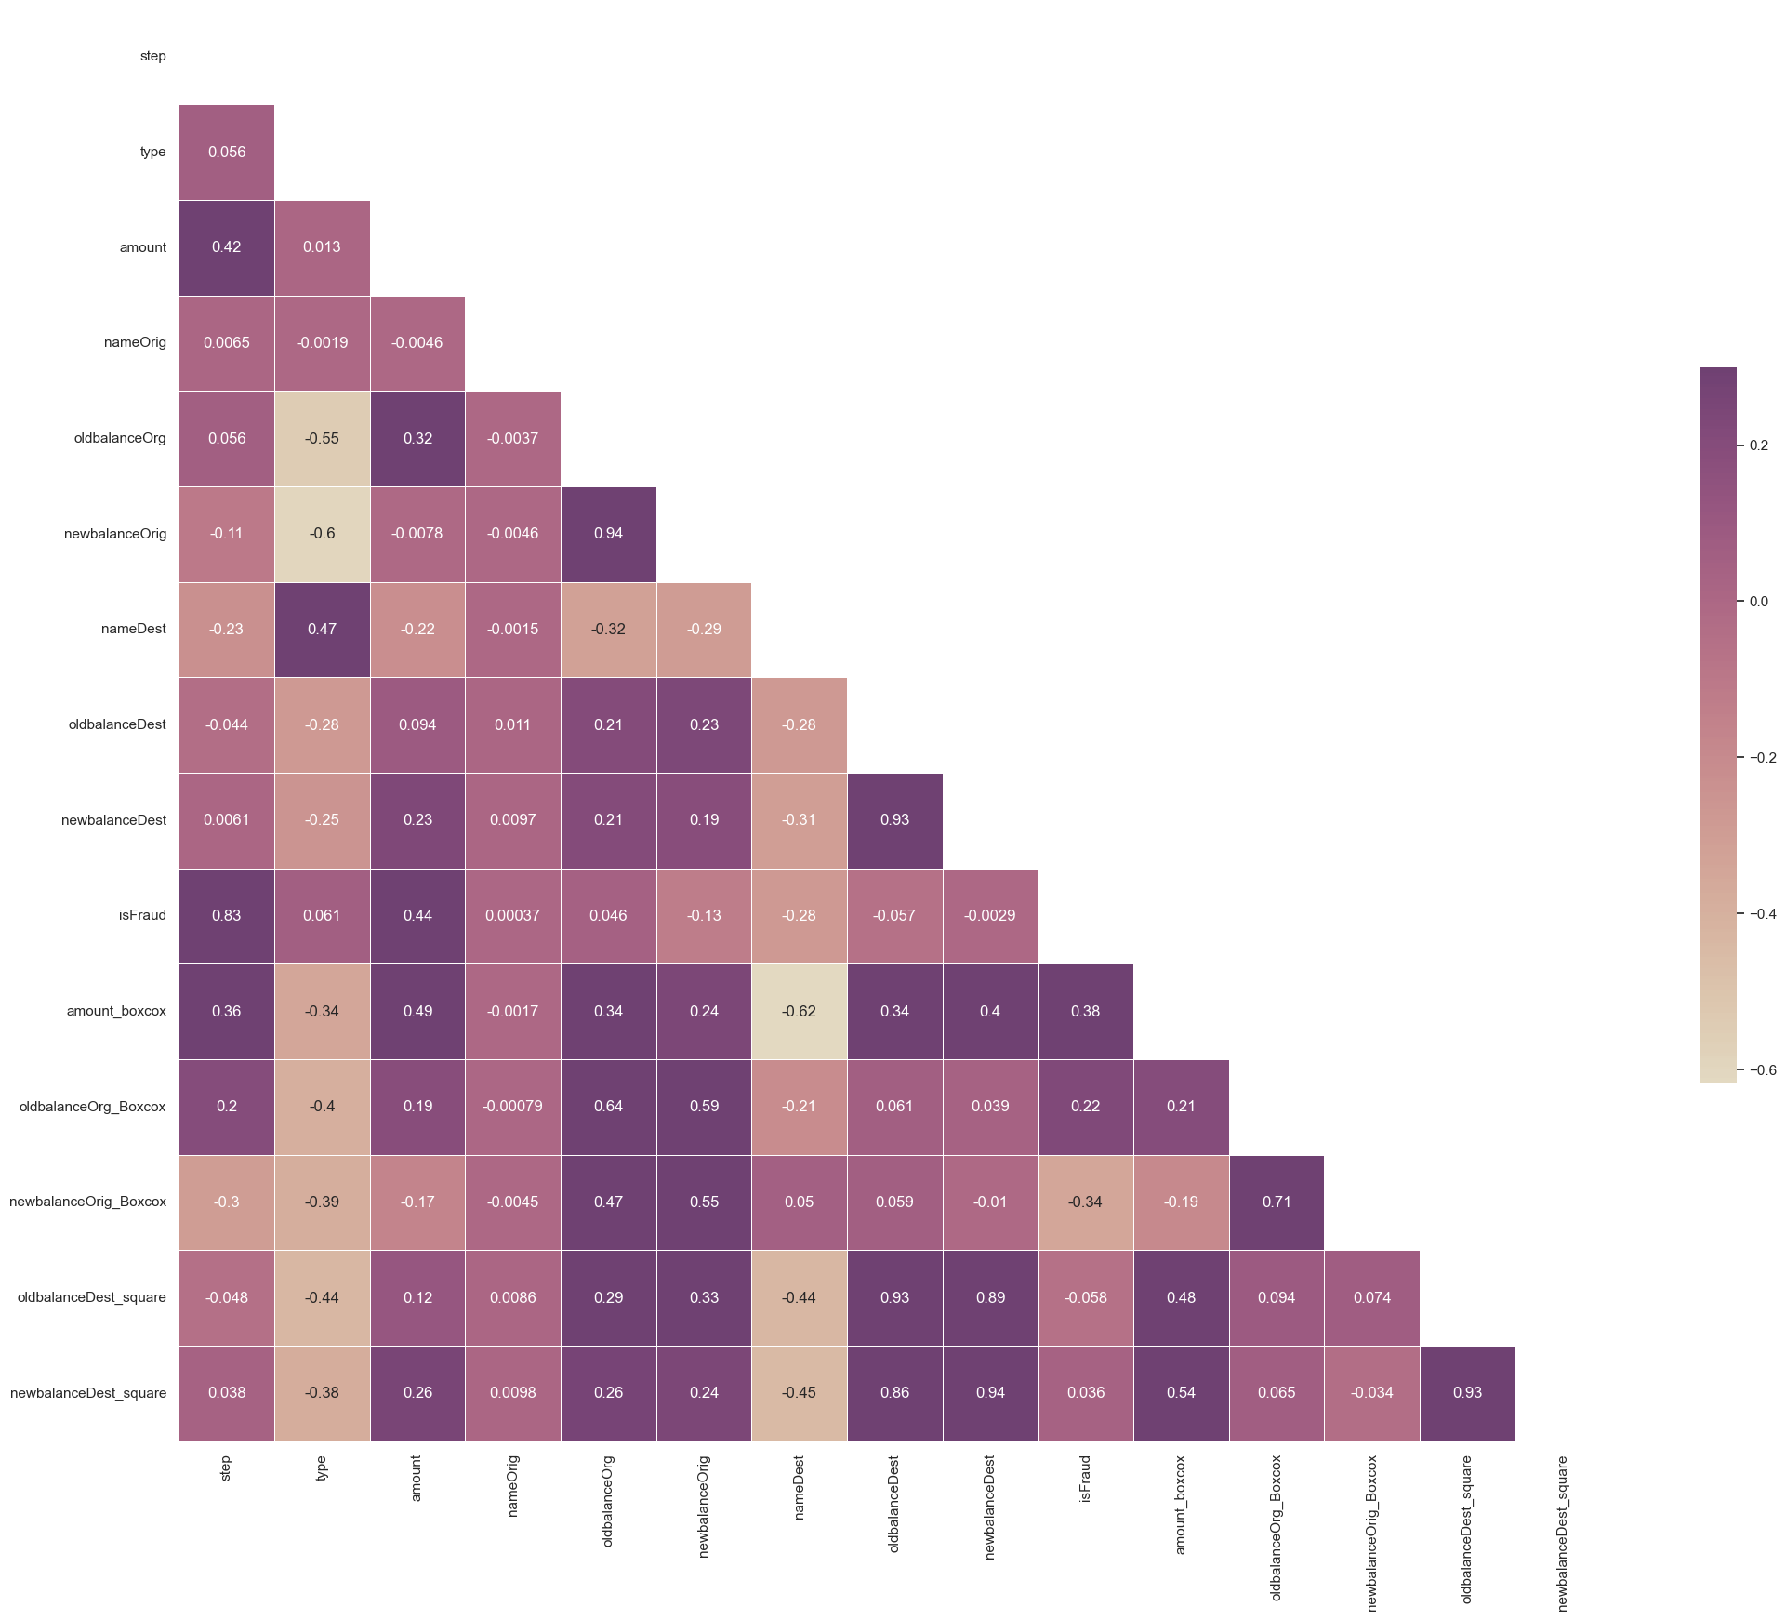
Correlation heatmap
In this correlation heatmap we can see that ‘step’ and ‘amount’ and highly correlated to target variable.
The variable ‘nameDest’ and ‘newbalanceOrig’ is highly negatively correlated to the target variable.
While ‘type’ and ‘oldbalanceOrg’ are moderately correlated with target variable.
While variables ‘nameOrig’, ‘oldbalanceDest’, ‘newbalanceDest’ are minimally correlated with target variable.

Slide 13

FEATURE ENGINEERING
Feature Engineering transforms raw data into meaningful features that significantly improve model performance, accuracy, and interpretability
|||||||||||||||||||
By selecting, creating, and transforming features, we can make models more efficient, less prone to overfitting, and better at capturing underlying patterns.

Slide 14
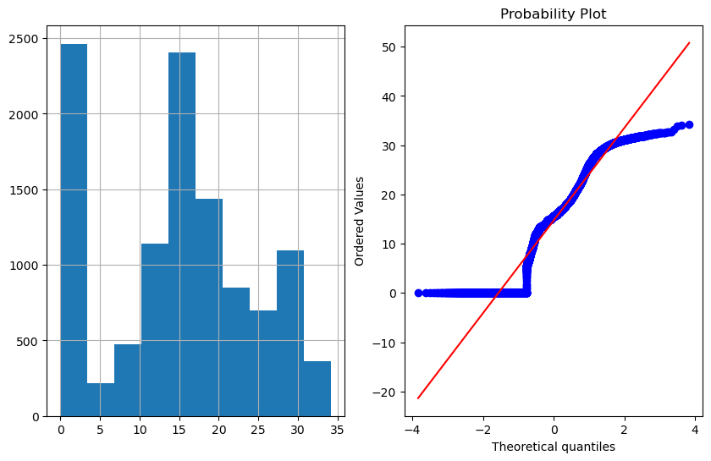
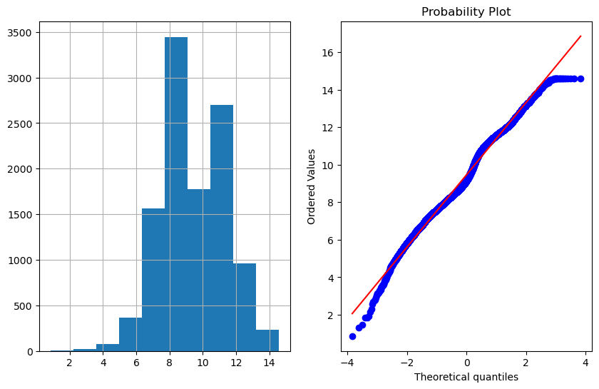
There were no missing or NULL values in the dataset .
We saw that amount, oldbalanceOrg, newbalanceOrig, oldbalanceDest, newbalanceDest are not normally distribute. Although there are algorithms that do not need normally distributed data but Logistic Regression Algorithm requires normal data.
We convert these variable into normally distributed data using a concept called boxcox and square root methods.
We also know that our target variable is highly imbalanced so in order to treat imbalanced data for Logistic Regression we use SMOTETomek method
Similarily for Decision tree there is a parameter class_weight in the algorithm and for XGBoost there is a parameter scale_pos_weight in the algorithm to deal with imbalanced dataset.

Slide 15
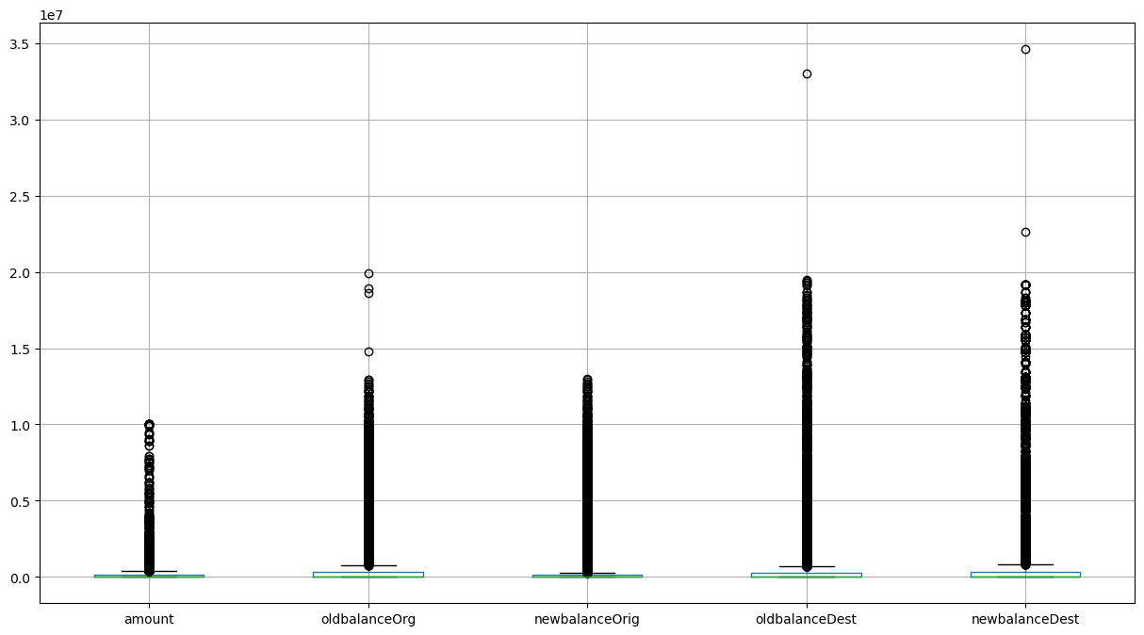
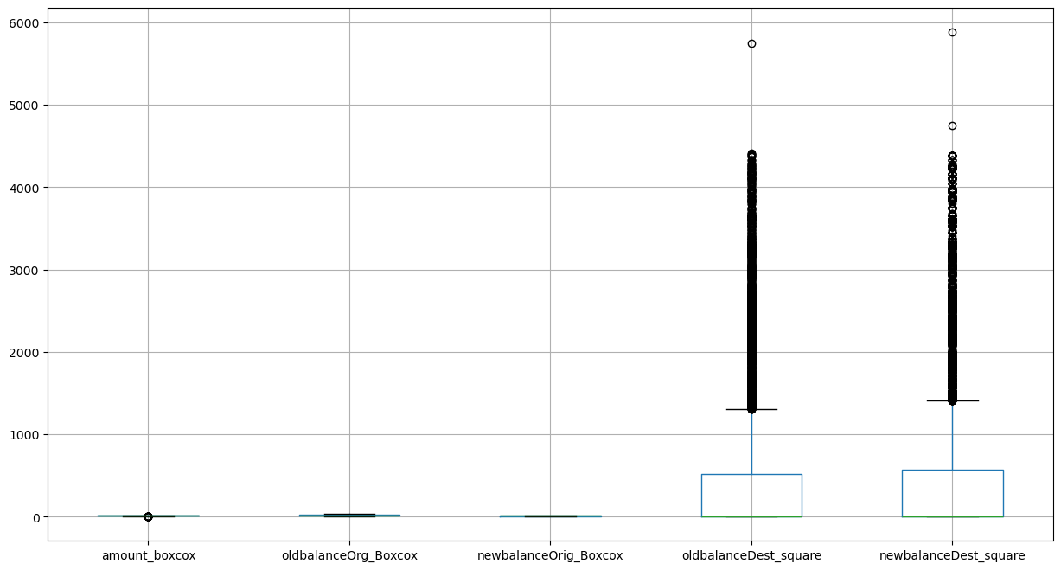
We see that there are many outliers but we do not straight up remove outliers as for our problem statement there can be crucial information in outlier data as well. We see that in graphs above the outliers have reduced to some extent because we used Boxcox method to make data normally distributed.
There is a categorical variable ‘type’ in the dataset, we use LabelEncoder to encode this categorical data .

Slide 16
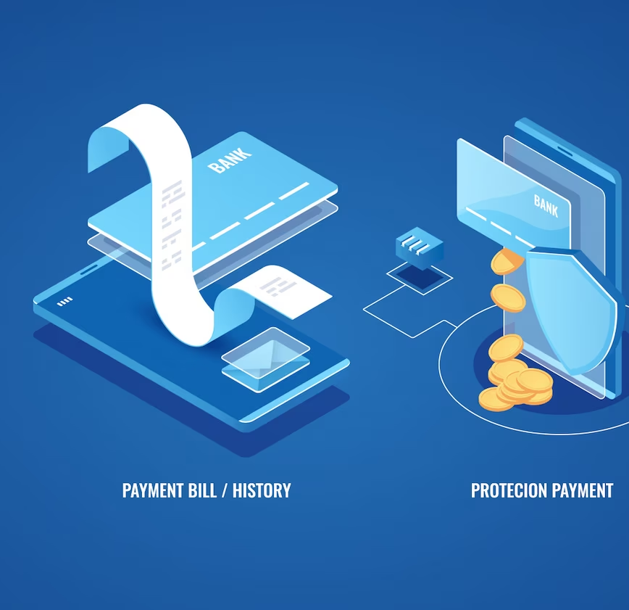
MODEL IMPLEMENTATION
We distributed data into training(70%) and test(30%) sets .
We also divide data into X and Y where X is independent variable(features) and Y is dependent variable(target variable)
We use GridSearchCV to implement different models and compare based on accuracy score and confusion matrix
We then compare all the models using different metrics and select the one which gives us the best solution to our problem statement

Slide 17
We have implemented following models :
Logistic Regression : Here we implement the algorithm with new parameters created that are normally distributed i.e. ‘amount_boxcox’, ‘oldbalanceOrg_Boxcox’, ‘newbalanceOrig_Boxcox’, ‘oldbalanceDest_square’, ‘newbalanceDest_square’. The algorithm gives us a 97.16% accuracy.
Decision Tree Algorithm: Here we implement algorithm using the columns without normal distribution i.e. ‘amount’, ‘oldbalanceOrg’, ‘newbalanceOrig’, ‘oldbalanceDest’, ‘newbalanceDest’. There is a parameter called class_weight which we use for handling imbalanced data.
Random Forest : In this algorithm also we use the same parameters as Decision Tree. There is a parameter called class_weight which we use for handling imbalanced data. This algorithm gives us a 99.16% accuracy.
XGBoost Classifier : In this algorithm also we use the same parameters as Decision Tree. There is a parameter called scale_pos_weight which we use for handling imbalanced data. This algorithm gives us a 99.16% accuracy.

Slide 18
MODEL SELECTION
In this problem statement we want that False negative should be low or Recall must be high which means that fraudulent transactions(1) should not be classified as non fraudulent transactions(0).
We not only have to consider just the accuracy but also consider the value of Recall. As we can see that XGBoost Classifier has highest Recall.
I will recommend that XGBoost Classifier should be used in this problem as it will reduce false negatives and will predict most of the fraudulent behaviour.
random_forest
precision recall f1-score support
0 1.00 1.00 1.00 3018
1 1.00 0.98 0.99 325
xgb_classifier
precision recall f1-score support
0 1.00 1.00 1.00 3018
1 0.98 1.00 0.99 325
decision_tree
precision recall f1-score support
0 1.00 1.00 1.00 3018
1 1.00 0.99 1.00 325

Slide 19
Thank You!

