Slide 1
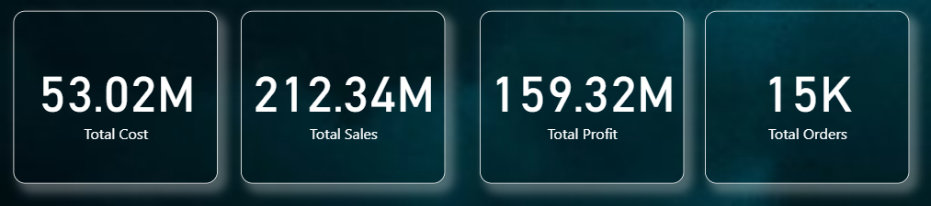
Product categories 3
FashionWave
Retail Sales Analysis
Total transactions 15,000
Stores analyzed 50
Turning transaction data into clearer decisions on sales, margin, stores and customer behavior.
Net sales 192.98M
Dataset: fashionwave_sales
Total profit 159.32M
November 2023 – November 2025
Overall profit margin 72.52%
SALES • PROFIT • GROWTH
FASHIONWAVE • RETAIL SALES ANALYSIS

Slide 2



Project Objectives
Increase weekend sales
Improve Profitability
Optimizing Discount
Achieve +15% growth in weekend
revenue by Q2 2025 through targeted
campaigns, events, and loyalty programs.
Identify and address unperforming product lines across 50 stores. Target Clothing margin uplift from 63 % to 75%.
Transactions with discounts above 25% deliver a 64.6% profit margin, compared with 75.4% for transactions without discounts. Review high-discount offers and use targeted promotions to protect profitability.
Overview
Categories
Weekend
Discounts
Stores
Customer
Actions
FASHIONWAVE • RETAIL SALES ANALYSIS • DASHBOARD-BASED
07/08

Slide 3
Accessories lead sales and profit
Accessories is the strongest category, contributing approximately 42.8% of total net sales and generating the highest profit margin. Clothing has the lowest revenue and weakest margin, despite having the most transactions.
Total Sales by Category
Total Profit by Category
91M
74M
71M
54M
50M
31M
Accessories
Shoes
Clothing
Accessories
Shoes
Clothing
Maintain product availability for Accessories, review pricing and costs in Clothing, and investigate which clothing products are selling with low margins.
Overview
Categories
Weekend
Discounts
Stores
Customers
Actions
FASHIONWAVE • RETAIL SALES ANALYSIS

Slide 4

Weekend is the growth opportunity
Weekdays generate more total sales because there are more weekday dates. However, average daily sales are approximately 31.2% higher on weekends, and average sales per transaction are approximately 27.2% higher.
Weekday vs Weekend Sales by Category
60M
Recommendation
47M
31M
33M
Test weekend-focused bundles, premium product displays and targeted promotions. Compare results by individual weekday and weekend day before expanding the strategy.
24M
17M
Accessories
Shoes
Clothing
Target: +15% next quarter
WEEKEND
WEEKDAY
Overview
Categories
Weekend
Discounts
Stores
Customers
Actions
FASHIONWAVE • RETAIL SALES ANALYSIS

Slide 5

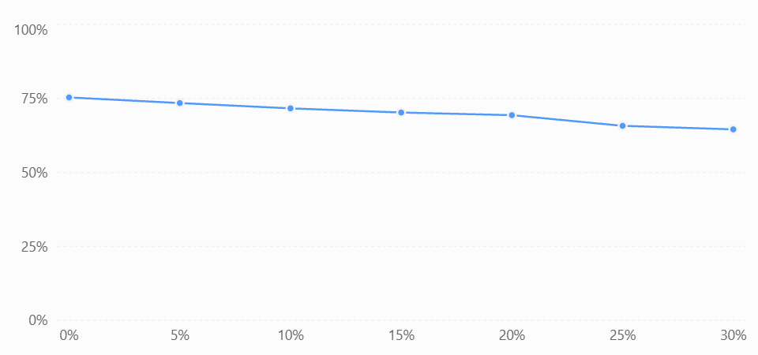
Measure margin impact before changing offers
Profit margin declines consistently as discounts increase. Transactions with a 30% discount have a 64.6% margin, compared with 75.4% for transactions without a discount — a difference of 10.8 percentage points.
Profit Margin by Discount Group
Recommendation
Introduce discount thresholds, prioritize offers on products with sufficient margins, and measure incremental sales and profit before extending promotions.
Impact = discounted margin − no-discount margin
Overview
Categories
Weekend
Discounts
Stores
Customers
Actions
FASHIONWAVE • RETAIL SALES ANALYSIS

Slide 6

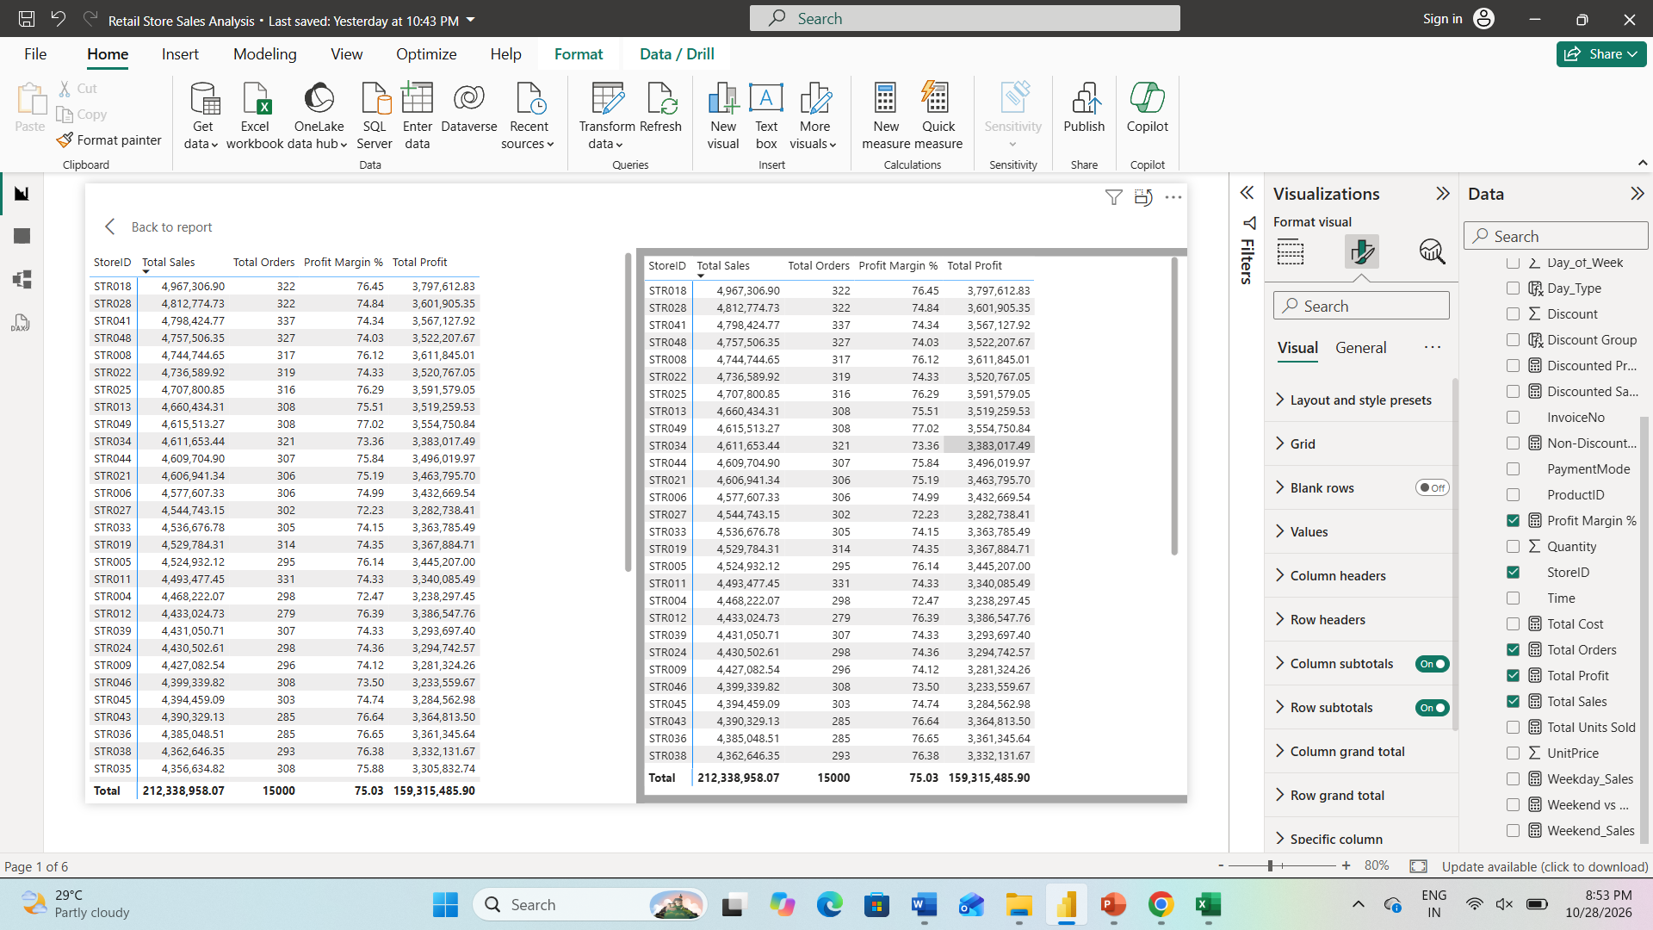
Improvement opportunities for underperforming stores
STR037 and STR023 have the weakest total sales, while STR027 and STR001 have the weakest margins. This distinction matters: low sales may reflect fewer or smaller purchases, while low margins suggest a profitability issue.
Top Stores by Total Sales (approx.)
Possible causes to investigate
Lower average transaction values or weaker product mix.
Greater reliance on discounted products.
Higher unit costs for products sold.
Different customer or category mixes across stores.
Overview
Categories
Weekend
Discounts
Stores
Customers
Actions
FASHIONWAVE • RETAIL SALES ANALYSIS

Slide 7

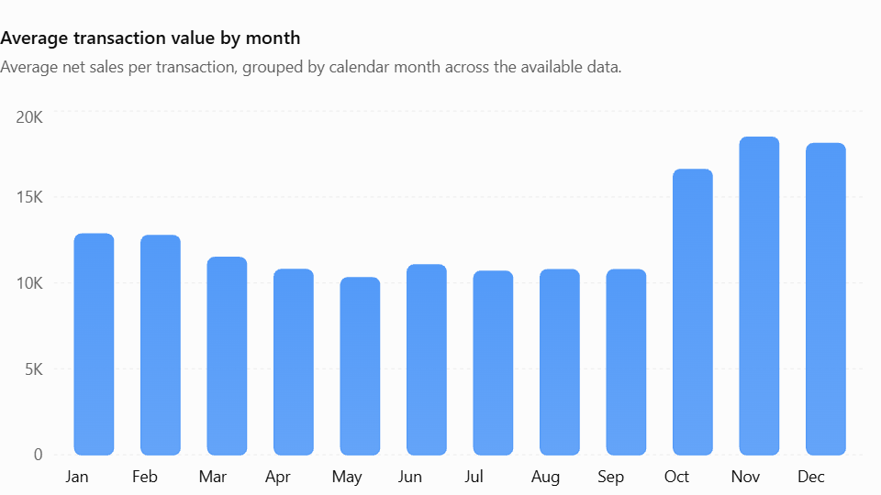
Trends, patterns and anomalies
The dataset shows relatively high average transaction values in November and December. This may be consistent with seasonal shopping or holiday promotions, but the dataset does not identify festivals or explain why sales rise.
Average transaction value by month
Insights
November has the highest average transaction value, followed by December and October.
Recommendation: Plan inventory and promotional campaigns ahead of the October–December period. Compare the same months across years before concluding that the pattern repeats consistently.
Overview
Categories
Weekend
Discounts
Stores
Customers
Actions
FASHIONWAVE • RETAIL SALES ANALYSIS • DASHBOARD-BASED
07/08

Slide 8
Quick wins versus long-term strategies
Quick wins — next 30 days
Long-term strategies — next 3–6 months
Review 25% and 30% discounts and test smaller offers where margins are under pressure.
Test weekend bundles and promotions, tracking both net sales and profit.
Investigate STR037 and STR023 for low sales, and STR027 for low margin.
Launch targeted retention offers for returning customers and second-purchase incentives for new customers.
Prioritize Accessories availability and investigate the low margin in Clothing.
Build a seasonal forecasting process using comparable monthly periods.
Introduce a unique customer ID to enable repeat-purchase, retention and RFM analysis.
Develop store-level benchmarks for net sales, margin and average transaction value.
Evaluate promotions using incremental profit, not revenue alone.
Create a Power BI monitoring page with category, store, discount and customer-type filters.
Overview
Categories
Weekend
Discounts
Stores
Customers
Actions
FASHIONWAVE • RETAIL SALES ANALYSIS • DASHBOARD-BASED
08/08

