Slide 1
TOYJOY
SEASONAL INVENTORY
MANAGEMENT ANALYSIS
Business case study | Power BI dashboard insights
Analysis period: January 2023 – September 2025
Prepared by: Junior Analytic Team
INVENTORY • DEMAND • SEASONALITY

Slide 2
01 | MANAGEMENT OVERVIEW
Executive summary
A demand-led inventory plan can protect availability while reducing avoidable stock investment.
TOTAL REVENUE
UNITS SOLD
STOCKOUT RATE
PRODUCTS / RECORDS
4.29M
185,124
1.56%
12 / 9,360
Revenue represented in dashboard context
Across the selected analysis period
Definition and denominator need validation
Five store IDs available in slicer
WHAT THE DATA SAYS
WHAT MANAGEMENT SHOULD DO
Holiday and Summer Vacation account for about 61% of unit demand. Several products show less than one week of supply.
Protect high-volume products, prepare before seasonal peaks, and validate stockout / excess-stock measures before major buying or liquidation decisions.
TOYJOY | INVENTORY MANAGEMENT
02

Slide 3
02 | BUSINESS CONTEXT
Business problem & decision questions
Inventory imbalance creates two opposing risks: cash tied up in stock and lost sales from stockouts.
EXCESS INVENTORY
STOCKOUTS
SEASONALITY
Capital tied up
Lost opportunity
Demand swings
Consumes warehouse capacity and working capital.
Can cause missed sales and customer dissatisfaction.
Requires forward planning for holidays and school breaks.
Key questions addressed
• Which products show the weakest stock coverage or stockout observations?
• Which categories and seasons contribute most to sales?
• What replenishment, transfer and forecasting actions should be prioritized?
TOYJOY | INVENTORY MANAGEMENT
03

Slide 4
03 | DATA & METHOD
Dataset & analytical approach
Descriptive analysis of product, store, date, inventory and sales measures.
RECORDS
PRODUCTS
STORES
DATE RANGE
9,360
12
5
~33 months
Rows in toyjoy_inventory
Distinct products shown
ST001–ST005
Jan 2023–Sep 2025
Analysis workflow
Profile
Compare
Segment
Recommend
01
02
03
04
Units, revenue, inventory and category totals
Product sales velocity and weeks of supply
Season, month, year and store
Replenishment, transfers and forecast controls
Important checks: confirm row grain; standardize labels; validate dates, keys, missing values and the definitions of stockout rate and excess inventory.
TOYJOY | INVENTORY MANAGEMENT
04

Slide 5
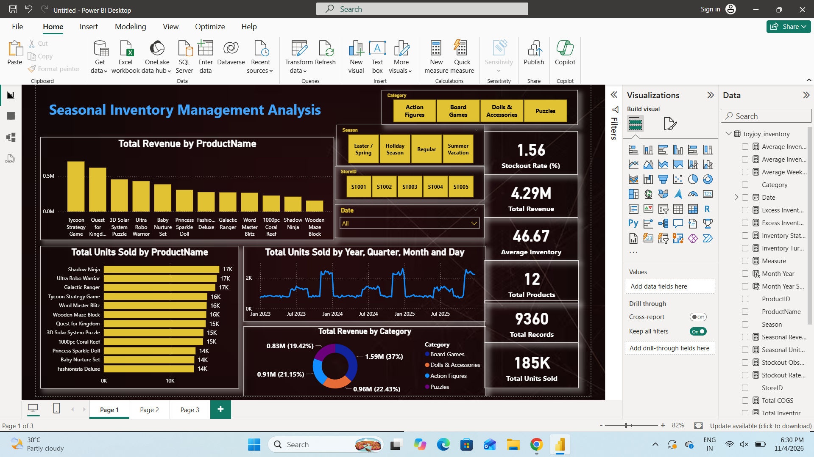
04 | COMMERCIAL PERFORMANCE
Revenue performance by category
Board Games contribute the largest share of reported revenue.
TOP CATEGORY
37.0%
Board Games | 1.59M revenue
INVENTORY IMPLICATION
Protect the Board Games revenue base while monitoring stock efficiency and demand in the other three categories.
Category shares: Dolls & Accessories 22.43% • Action Figures 21.15% • Puzzles 19.42%
TOYJOY | INVENTORY MANAGEMENT
05

Slide 6
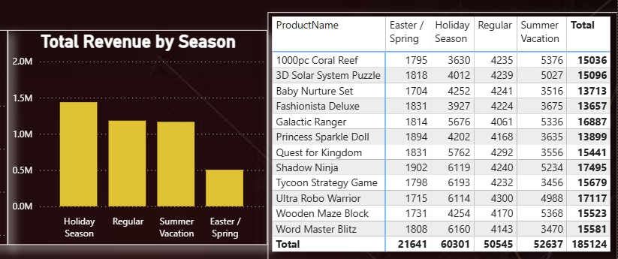
05 | SEASONALITY
Seasonal demand patterns
Holiday Season and Summer Vacation together account for approximately 61% of units sold.
HOLIDAY SEASON
60,301 units
32.6% of total units
SUMMER VACATION
52,637 units
28.4% of total units
Planning implication: begin supplier, warehouse-capacity and buying-calendar reviews before these demand windows.
TOYJOY | INVENTORY MANAGEMENT
06

Slide 7
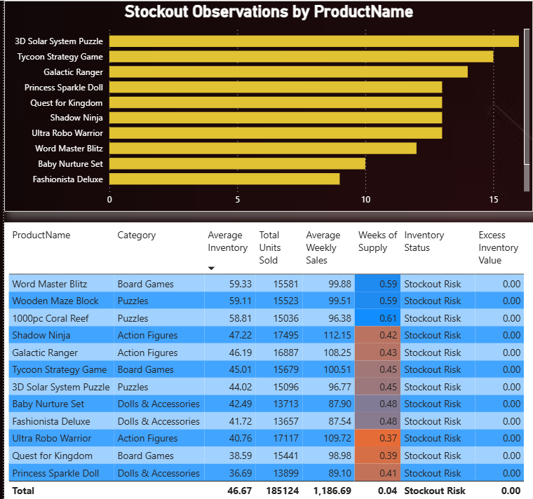
06 | INVENTORY RISK
Product-level stock coverage
All listed products are marked as “Stock out Risk”; coverage ranges from 0.37
to 0.61 weeks.
LOWEST COVERAGE
Ultra Robo Warrior: 0.37 weeks
Quest for Kingdom: 0.39 weeks
Princess Sparkle Doll: 0.41 weeks
RELATIVELY BETTER COVERAGE
1000pc Coral Reef: 0.61 weeks
Wooden Maze Block and Word Master Blitz: 0.59 weeks each
Even the relatively better-covered products remain below one week of supply
TOYJOY | INVENTORY MANAGEMENT
07

Slide 8
07 | AVAILABILITY
Stockout observations: where to investigate
The data highlights 3D Solar System Puzzle and Tycoon Strategy Game among the highest displayed counts.
HIGHER OBSERVATIONS
HIGHER OBSERVATIONS
LOWER OBSERVATIONS
3D Solar System Puzzle
Tycoon Strategy Game
Fashionista Deluxe / Baby Nurture Set
Among the highest shown in the stockout chart
Among the highest shown in the stockout chart
Among the lowest shown
Root-cause checks
• Check whether events relate to forecast error, delayed replenishment or uneven store allocation.
• Compare stockout events with weekly sales, on-hand stock, committed stock and in-transit quantities.
TOYJOY | INVENTORY MANAGEMENT
08

Slide 9
08 | DATA QUALITY & LIMITATIONS
Overstock assessment: validate before reducing stock
WHAT THE DATA SHOWS
Visible excess-inventory value is zero for all products in the detailed table. Weeks of supply is low across the displayed list.
Before making stock-reduction decisions, validate:
• Excess-inventory calculation and target-stock threshold
• Stockout-rate numerator, denominator and eligible observations
• Inventory units, weekly sales units and filter context used in weeks-of-supply
• On-hand, committed, in-transit stock, lead times and unit costs
TOYJOY | INVENTORY MANAGEMENT
09

Slide 10
09 | ACTION PLAN
Recommended actions
Prioritize availability now; strengthen forecasting and inventory controls over time.
NEXT 2–4 WEEKS
NEXT 1–2 QUARTERS
1. Review lowest-coverage products first.
2. Check on-hand, committed, in-transit and safety stock.
3. Transfer stock between stores where feasible.
4. Investigate stockout dates and affected stores for top observed products.
5. Avoid liquidation based only on low unit sales.
1. Build a pre-season buying calendar for Holiday and Summer.
2. Forecast demand by product and store.
3. Set service levels by product class.
4. Apply seasonal uplift only where product-level history supports it.
5. Introduce ABC/XYZ segmentation and monitor forecast bias.
Guiding principle: make product- and store-specific decisions rather than applying one blanket stock increase or reduction.
TOYJOY | INVENTORY MANAGEMENT
10

Slide 11
10 | REPLENISHMENT DESIGN
Optimize reorder points & quantities
Use lead-time demand plus safety stock to trigger replenishment, while respecting capacity and pack sizes.
REORDER POINT
ORDER-UP-TO QUANTITY
Expected demand during replenishment lead time + safety stock
Target stock level − (on-hand + on-order − backorders)
Operating controls
• Estimate safety stock from demand variability and supplier lead-time variability.
• Apply tighter, weekly coverage reviews to high-volume / high-risk A-items.
• Use smaller, more frequent replenishment for slower movers where supplier economics allow.
• Respect warehouse-capacity ceilings, supplier minimum order quantities and pack-size constraints.
TOYJOY | INVENTORY MANAGEMENT
11

Slide 12
11 | WRAP-UP
Conclusion & assumptions
ToyJoy should move toward demand-led replenishment and evidence-based seasonal readiness.
REVENUE
UNITS
PEAK SEASONS
COVERAGE
4.29M
185,124
~61%
< 1 week
Reported dashboard total
Total units sold
Holiday + Summer unit share
Across displayed products
Key assumptions & limitations
• Dashboard totals and visible product-table values are treated as the source of truth and rounded as displayed.
• Date coverage is approximately Jan 2023–Sep 2025; confirm exact model boundaries.
• Season labels are treated as business-defined demand periods.
• Missing product-level revenue, costs, lead times, stockout definitions and forecast accuracy are not invented.
FINAL TAKEAWAY | Protect high-volume availability, prepare early for seasonal peaks, and validate inventory measures before major stock decisions.
TOYJOY | INVENTORY MANAGEMENT
12

