Slide 1
TASTYBITES
Product Profitability
& Pricing Strategy
Business analysis presentation
Analysis period | 01 Jan 2024 – 31 Dec 2025
Prepared by Data Analyst

Slide 2
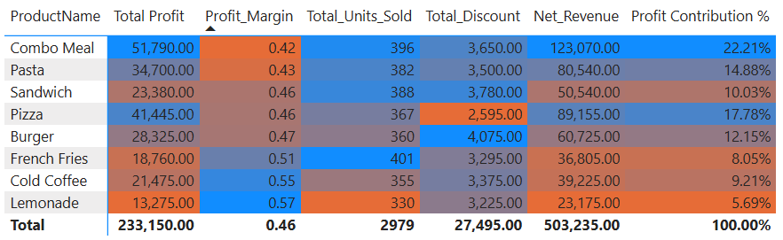
01 / BUSINESS PERFORMANCE
TastyBites is a food delivery app operating across multiple cities. Management has observed that some products can generate substantial sales without delivering equivalent profit, while other products contribute strongly to the bottom line. The business needs to optimize product pricing and promotions while protecting customer demand.
UNIQUE ORDERS
UNITS SOLD
AVERAGE ORDER VALUE
1,000
2,979
₹503
Two-year period
Across 8 products
Net revenue ÷ unique orders
NET REVENUE
TOTAL PROFIT
Combo Meal leads revenue and absolute profit.
₹503,235
₹233,150
Lemonade has the highest margin but the lowest total profit.
After discounts
46.33% margin
French Fries sells the most units but contributes only 8.05% of profit.
TASTYBITES • 02

Slide 3
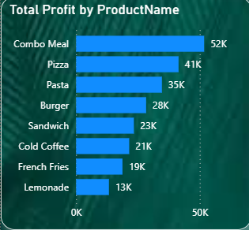
02 / BUSINESS OBJECTIVE
What management needs to solve
Objective: optimize product pricing and promotions to improve profitability while protecting customer demand.
Identify high- and low-profit products and categories.
Understand how discounts relate to profit margins.
Find high-volume products with modest profit contribution.
Identify candidates for small, controlled price tests.
Recommend promotions and bundles that protect contribution.
TASTYBITES • 03

Slide 4
03 / METHODOLOGY
Scope, assumptions & data readiness
ANALYSIS WINDOW
ORDER LINES
PRODUCTS
MISSING DISCOUNTS
2 years
1,000
8
25.9%
2024–2025
1,000 unique orders
4 standardized categories
259 rows need validation
Profit = net revenue after discount − product cost; delivery costs excluded.
Discount rate assumed as discount amount ÷ unit price; policy cap is 25%.
Proposed price tests start at 3–5% and stay below the 10% sensitivity threshold.
Category labels standardized: Meal → Meals; Snack → Snacks; Drinks → Beverages.
No city, campaign, customer ID or control-group fields are available.
Discount status | Rows | Discount | Net revenue | Profit | Margin
Discounted | 609 | ₹27,495 | ₹295,615 | ₹131,140 | 44.36%
No Discount | 132 | ₹0 | ₹69,060 | ₹33,990 | 49.22%
Missing | 259 | ₹0 | ₹138,560 | ₹68,020 | 49.09%
TASTYBITES • 04

Slide 5
04 / EDA FRAMEWORK
How profitability was measured
GROSS REVENUE
DISCOUNT AMOUNT
Quantity × unit price
Quantity × discount per unit
NET REVENUE
PRODUCT COST
Gross revenue − discount amount
Quantity × cost per unit
PROFIT
PROFIT MARGIN
Net revenue − total product cost
Profit ÷ net revenue × 100
Missing discounts are treated as zero only for headline revenue/profit calculations; they remain a separate group in discount comparisons.
TASTYBITES • 05

Slide 6
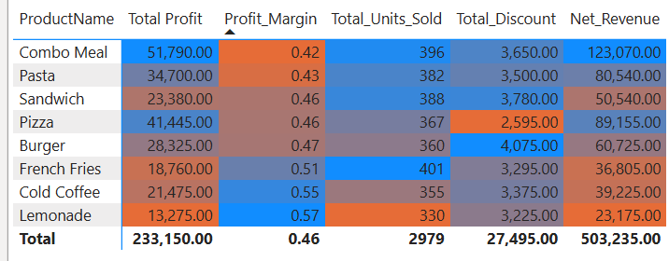
05 / FINANCIAL OVERVIEW
From gross sales to profit
OVERALL MARGIN
46.33%
Profit ÷ net revenue
AVERAGE ORDER VALUE
₹503
Across 1,000 orders
₹233,150 profit generated from ₹503,235 net revenue.
TASTYBITES • 06

Slide 7
06 / PRODUCT ANALYSIS
Product performance: leaders & watch-outs
TOP PROFIT PRODUCT
HIGHEST MARGIN
HIGHEST UNIT VOLUME
Combo Meal
Lemonade
French Fries
₹51,790 | 22.21% of total profit
57.28% | profit ₹13,275
401 units | 8.05% of profit
Combo Meal leads net revenue (₹123,070) and total profit; review cost and discount structure.
Lemonade has a strong margin, but low volume limits total profit. Grow through visibility and add-ons.
French Fries leads unit volume, but contributes modest profit dollars; focus on attach rate and unit economics.
Cold Coffee and Lemonade have the two strongest product margins.
Discount status | Rows | Discount | Net revenue | Profit | Margin
Discounted | 609 | ₹27,495 | ₹295,615 | ₹131,140 | 44.36%
No Discount | 132 | ₹0 | ₹69,060 | ₹33,990 | 49.22%
Missing | 259 | ₹0 | ₹138,560 | ₹68,020 | 49.09%
TASTYBITES • 07

Slide 8
07 / CATEGORY ANALYSIS
Category performance
LARGEST CATEGORY
HIGHEST CATEGORY PROFIT
HIGHEST CATEGORY MARGIN
Meals
Meals
Beverages
₹230,420 net revenue
₹104,470 | 44.81% of profit
55.69%
Meals is the leading category in both net revenue and profit.
Beverages retains the strongest category margin and is suited to carefully designed add-ons.
Combos has the lowest category margin (42.08%) and should be prioritized for cost and discount review.
Exact category totals are highlighted only where stated in the source report.
TASTYBITES • 08

Slide 9
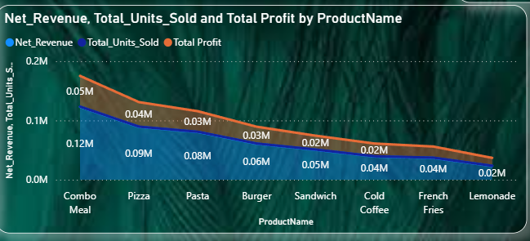
08 / PRODUCT OPPORTUNITY
High volume does not always mean high profit
FRENCH FRIES
LEMONADE
French Fries is the clearest high-volume / modest-profit example. Its margin is not the lowest; the opportunity is to improve profit dollars per order.
401 units
57.28% margin
₹18,760 profit | 8.05% share
Lowest total profit: ₹13,275
French Fries: prioritize checkout add-ons and review unit economics.
Lemonade: avoid blanket price increases; improve visibility and meal attachment.
Do not judge performance on sales volume or revenue alone—consider margin and profit contribution.
TASTYBITES • 09

Slide 10
09 / DISCOUNT ANALYSIS
Discounts and margin: what the data shows
DISCOUNTED ROWS
609
₹27,495 total discount
NO-DISCOUNT MARGIN
49.22%
132 explicit zero-discount rows
MISSING DISCOUNT
25.9%
259 rows; validate capture
Discounted margin is 4.86 percentage points below explicit zero-discount margin.
TASTYBITES • 10

Slide 11
10 / DISCOUNT CONTROLS
Discount pressure & policy compliance
POLICY EXCEPTIONS
13 rows
All are Lemonade records
IMPLIED DISCOUNT
31.25%
₹25 off ₹80 price
If Discount is a per-unit currency amount, the 25% cap on an ₹80 item equals ₹20.
TASTYBITES • 11

Slide 12
12 / GROWTH OPPORTUNITIES
Promotions that protect contribution
Meal + beverage
Offer Cold Coffee or Lemonade with a meal at a modest bundle saving.
Fries checkout add-on
Show French Fries as an optional add-on; measure attach rate and incremental profit.
Combo substitution
Test a lower-cost side or beverage substitution instead of discounting the full combo.
Targeted offers
Use customer segments or low-demand periods once customer-level data becomes available.
Margin floor
Require every promotion to meet a minimum contribution margin after discount and product cost.
TASTYBITES • 12

Slide 13
13 / EXECUTION ROADMAP
30-day action plan
Priority | Action | Success measure
Immediate | Validate 259 missing discount values and investigate 13 apparent >25% records. | Completeness; exceptions resolved
Immediate | Review Combo Meal / Combos cost and discount structure. | Margin and profit per order
30 days | Pilot 3–5% price tests with a control group. | Units, conversion, revenue and profit vs control
30 days | Test beverage add-ons and fries cross-sell. | Attach rate; incremental profit per order
Ongoing | Refresh product/category dashboard monthly. | Revenue, profit, margin, discounts and units
TASTYBITES • 13

Slide 14
TASTYBITES | KEY TAKEAWAY
Grow profit by protecting margin—not by chasing sales alone.
Protect Combo Meal profit contribution while reviewing its cost and discount structure.
Use beverage add-ons and fries cross-sell to grow incremental profit.
Fix discount data and validate policy exceptions before changing promotion rules.
Run controlled 3–5% price tests; keep changes below the 10% sensitivity threshold.
Limitations: delivery/platform/packaging costs excluded; no customer, city, campaign or controlled experiment fields.
Thank you

