Slide 1
Collabora.AI
A TNC Customiser For GEM Portal
Team Name: Cyber_Punks
Ministry Category: Ministry of Women and Child Development
Problem Code: AS39

Slide 2
Problem Statement
In GeM Portal, we are looking for provision of customization of terms and conditions for Annual Maintenance Contract of services as per the need of the services required by the organisation may be created. It could be a module which would:
(1) Provide facility to review terms and conditions of services between concerned people.
(2) Facility to add comment against/add/remove a particular point.

Slide 3
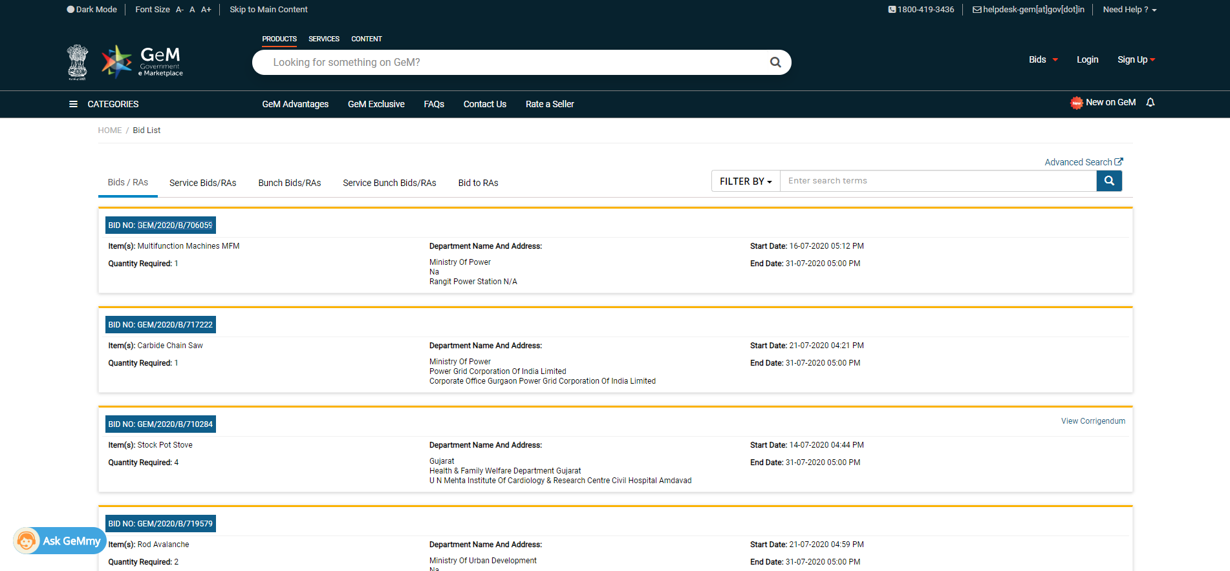
CURRENT BIDDING METHODS

Slide 4
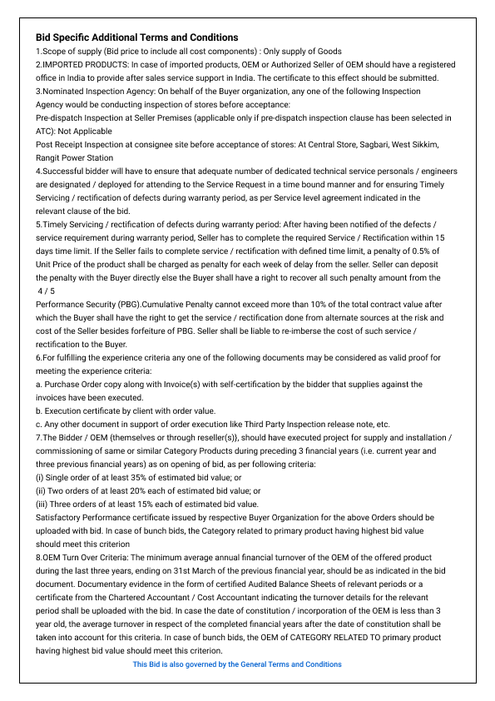
CURRENT TnC
RIGID STRUCTURE
INAPPROPRIATE REVIEW SYSTEM
LACK OF NEGOTIATION

Slide 5
ABOUT
THE PROJECT
We are designing a web platform for the GeM portal where the customization of terms and conditions for Annual Maintenance Contract of services as per need will be created.
Real-Time Team collaboration is the top feature priority.

Slide 6
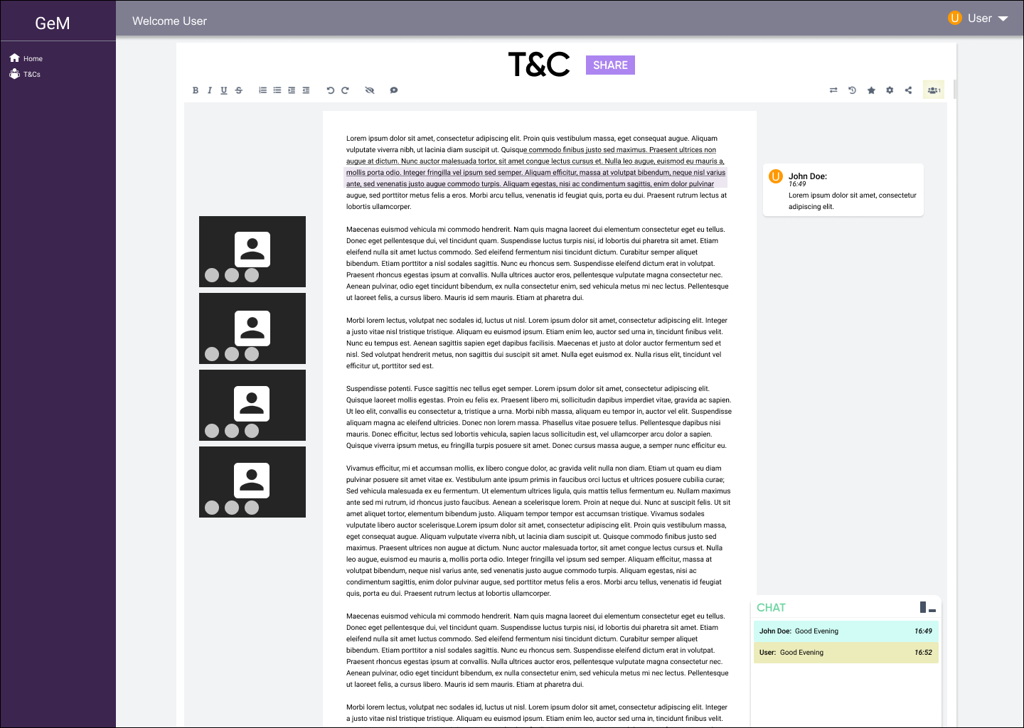
LOW FIDELITY WIREFRAME
User Panel
Video Chat
Comments
Editor Board
Editor panel
Chat

Slide 7
KEY FEATURES
01
05
Real time
Revision History
02
06
Comments
Integrated API calls
03
07
Chat Feature
Super Admin access of Owner
04
08
Video Chat
Import/Export
Collaborative system to ease the terms and conditions agreement
A timeline to view the series of edits done to the document
Making easy to highlight the part which needs discussion
To integrate the Real-time video chat to our project.
To communicate real time for better agreement
Any number of members of the portal that has all the rights.
For a better exchange of information between buyer and seller to interpret body language and facial
expressions
Of the documents made easy for discussing on an existing document or to finalise a document

Slide 8
WHAT WE ARE WORKING ON
SECURE
INTEGRABLE
FAST AND RELIABLE
The security measures include authentication, authorisation to the terms and conditions document.
Real time collaborative system easily integrable with the existing GEM portal.
The application is tested through google insights and is extremely fast and mobile compatible.

Slide 9




MAJOR REQUIREMENTS
PHP
NODE.jS
LARAVEL
MySQL
General-purpose scripting language that is especially suited to web development.
Open-source, cross-platform, JavaScript runtime environment that executes JavaScript code outside a web browser.
PHP web framework intended for the development of web applications following the model–view–controller architectural pattern and based on Symfony.
MySQL is an open-source relational database management system.

Slide 10
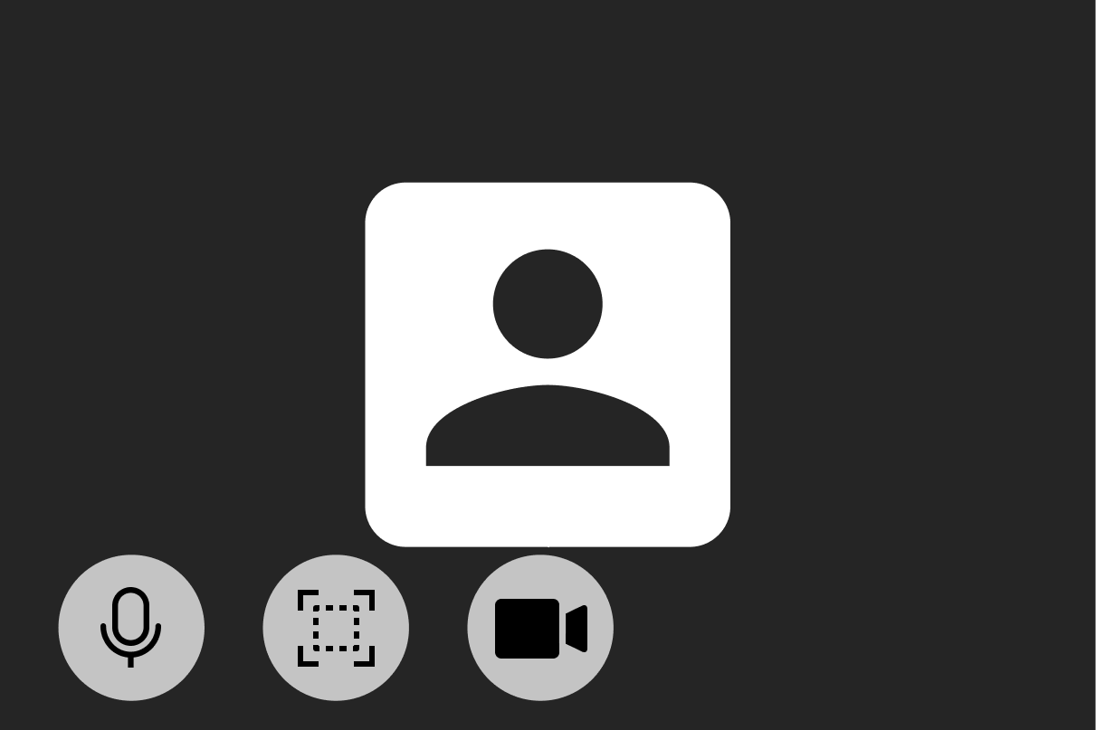
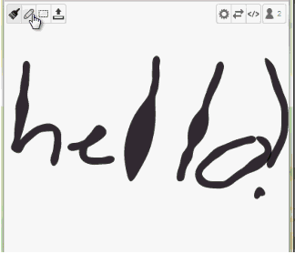
To Do: Suggestions by the Evaluators
Internal Hackathon
Video chat
Mathboard

Slide 11
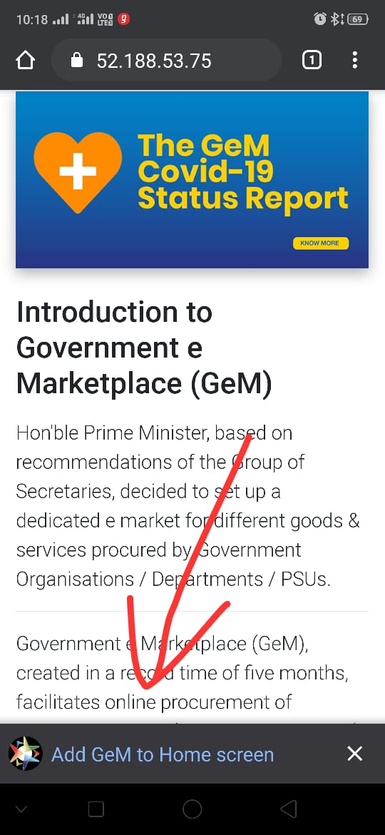
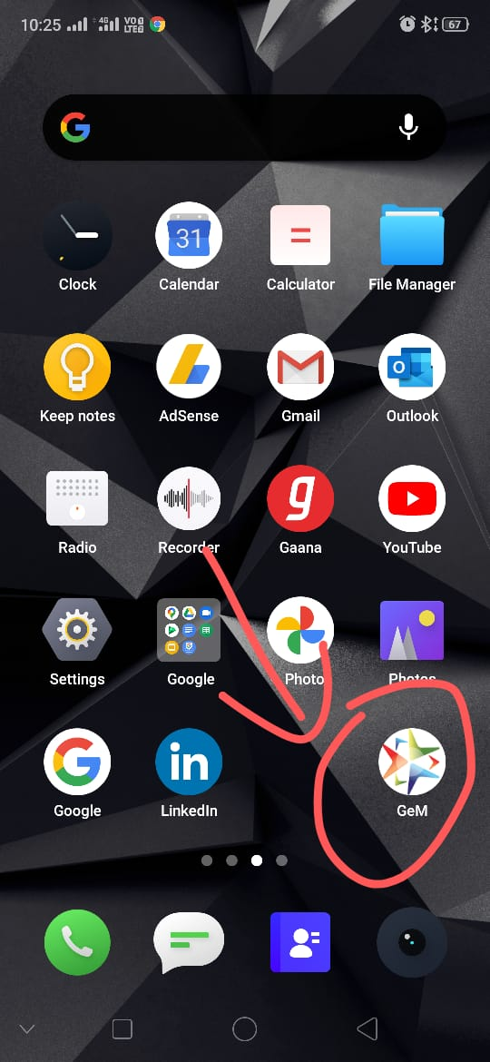
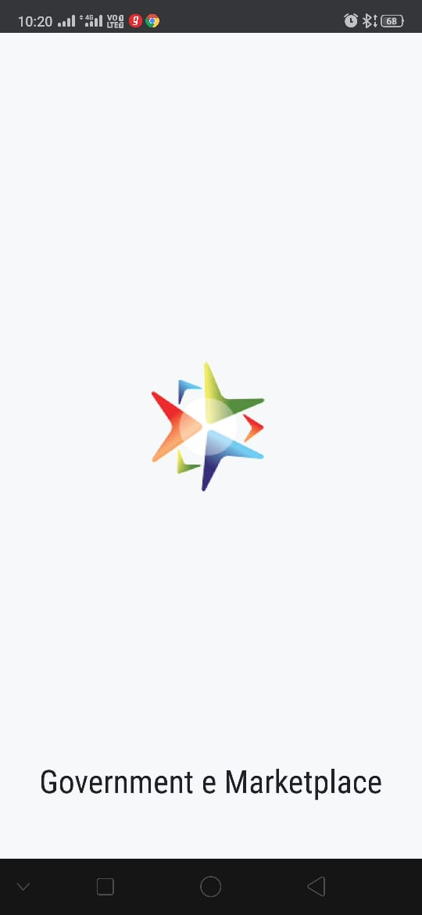
PWA

