Slide 1
LISFLOOD HYDROLOGICAL MODEL
Cold Start & Warm Start — Execution, Outputs & Analysis
A comprehensive walkthrough of simulation setup, Docker execution, state-file transitions, output datasets, and discharge hydrograph comparison.
Watershed Area: 781.836 km² • Daily Timestep (86 400 s) • Channel Sub-Step: 3 600 s • UTM Zone 43 / WGS 84 • Docker: jrce1/lisflood

Slide 2
UNDERSTANDING THE TWO SIMULATION MODES
❄ COLD START (Spin-Up Run)
🔥 WARM START (Operational Run)
▸ What it is:
The simulation starts from scratch — all internal water stores are empty or set to bogus placeholder values (0 or −9999).
▸ Purpose:
Run a multi-year spin-up period so that soil moisture, groundwater zones, channel flows, snow cover and frost indices build up to physically realistic levels.
▸ Key Point:
Outputs from the early portion of the run are unreliable and typically discarded; only the end-of-run state maps (.end.nc) matter — they become the 'memory' of the watershed.
▸ InitLisflood:
Set to 1 (ON) — tells the model this is an initialization run.
▸ Config File:
cold.xml
▸ What it is:
The simulation loads pre-stabilized state files (*.end.nc) produced at the end of the Cold Start, bypassing the spin-up.
▸ Purpose:
Immediately generate physically accurate discharge and water-balance outputs — ideal for real-time flood forecasting with daily weather feeds.
▸ Key Point:
Model outputs are trustworthy from timestep 1 because the 'memory' of the watershed is already baked into the initial states.
▸ InitLisflood:
Set to 0 (OFF) — this is a real simulation, not initialization.
▸ Config File:
warm_start.xml

Slide 3
COLD START — SIMULATION CONFIGURATION
01/01/2024
30/11/2024
~336 Days
~47 seconds
Simulation Start (StepStart)
Simulation End (StepEnd)
Total Timesteps
Run Time
DOCKER COMMAND
docker run --rm -v "$(pwd):/input" jrce1/lisflood /input/cold.xml
INITIAL STATE VALUES (no prior knowledge)
OUTPUTS ENABLED
Variable | Init Value | Description
LZInitValue | −9999 | Lower groundwater zone (steady-state)
UZInitValue | 0 | Upper groundwater zone storage
ThetaInit 1/2/3 | −9999 | Soil moisture layers (field capacity)
ChanCrossSectionInit | −9999 | Channel cross-section (½ bankfull)
SnowCover A/B/C | 0 | Snow cover in elevation zones
FrostIndexInitValue | 0 | Ground frost / freeze-thaw index
CumIntInitValue | 0 | Cumulative rainfall interception
DSLRInitValue | 1 | Days since last rain
✅ repEndMaps = 1
End-of-run state maps
✅ repStateMaps = 1
State maps at report steps
✅ repDischargeTs = 1
Discharge time series (.tss)
✅ repDischargeMaps = 1
Discharge spatial maps (.nc)
✅ InitLisflood = 1
Cold initialization mode ON

Slide 4
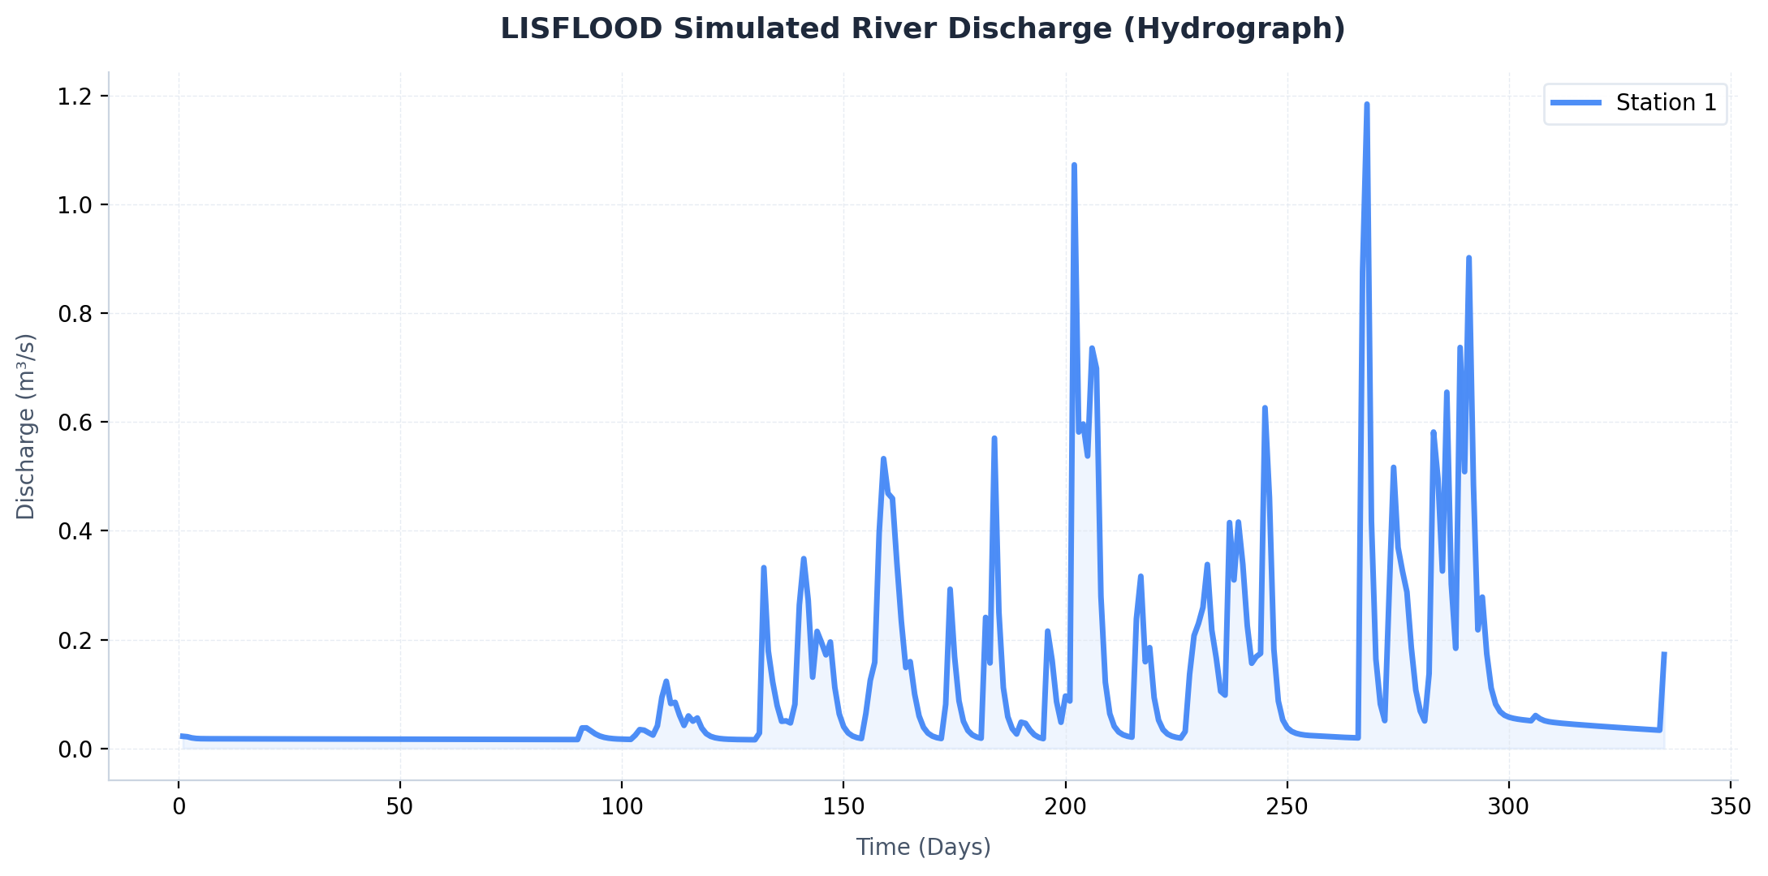
COLD START — DISCHARGE HYDROGRAPH
Simulated river discharge (m³/s) at the reporting station over ~336 daily timesteps • 01/01/2024 → 30/11/2024
▸ Notice the initial flat period (~0 m³/s) — the spin-up phase where internal stores are still filling up from empty.

Slide 5
WARM START — SIMULATION CONFIGURATION
01/12/2024
31/12/2024
~31 Days
~34 seconds
Simulation Start (StepStart)
Simulation End (StepEnd)
Total Timesteps (Dec 2024)
Run Time (est.)
DOCKER COMMAND
docker run --rm -v "$(pwd):/input" jrce1/lisflood /input/warm_start.xml
INITIAL STATES LOADED FROM COLD START (*.end.nc files)
File | Variable | Description
frost.end.nc | FrostIndexInitValue | Ground frost / freeze-thaw index
cumi.end.nc | CumIntInitValue | Cumulative rainfall interception
dslr.end.nc | DSLRInitValue | Days since last rain event
cumf.end.nc | CumIntForestInitValue | Cumulative interception (forest)
dslf.end.nc | DSLRForestInitValue | Days since last rain (forest)
dsli.end.nc | DSLRIrrigationInitValue | Days since last rain (irrigated)
cseal.end.nc | CumIntSealedInitValue | Cumulative interception (sealed)
PathInit = /input/output_dataset/out (reads cold start's output) PathOut = /input/output_dataset/out_warm (writes to a separate directory)

Slide 6
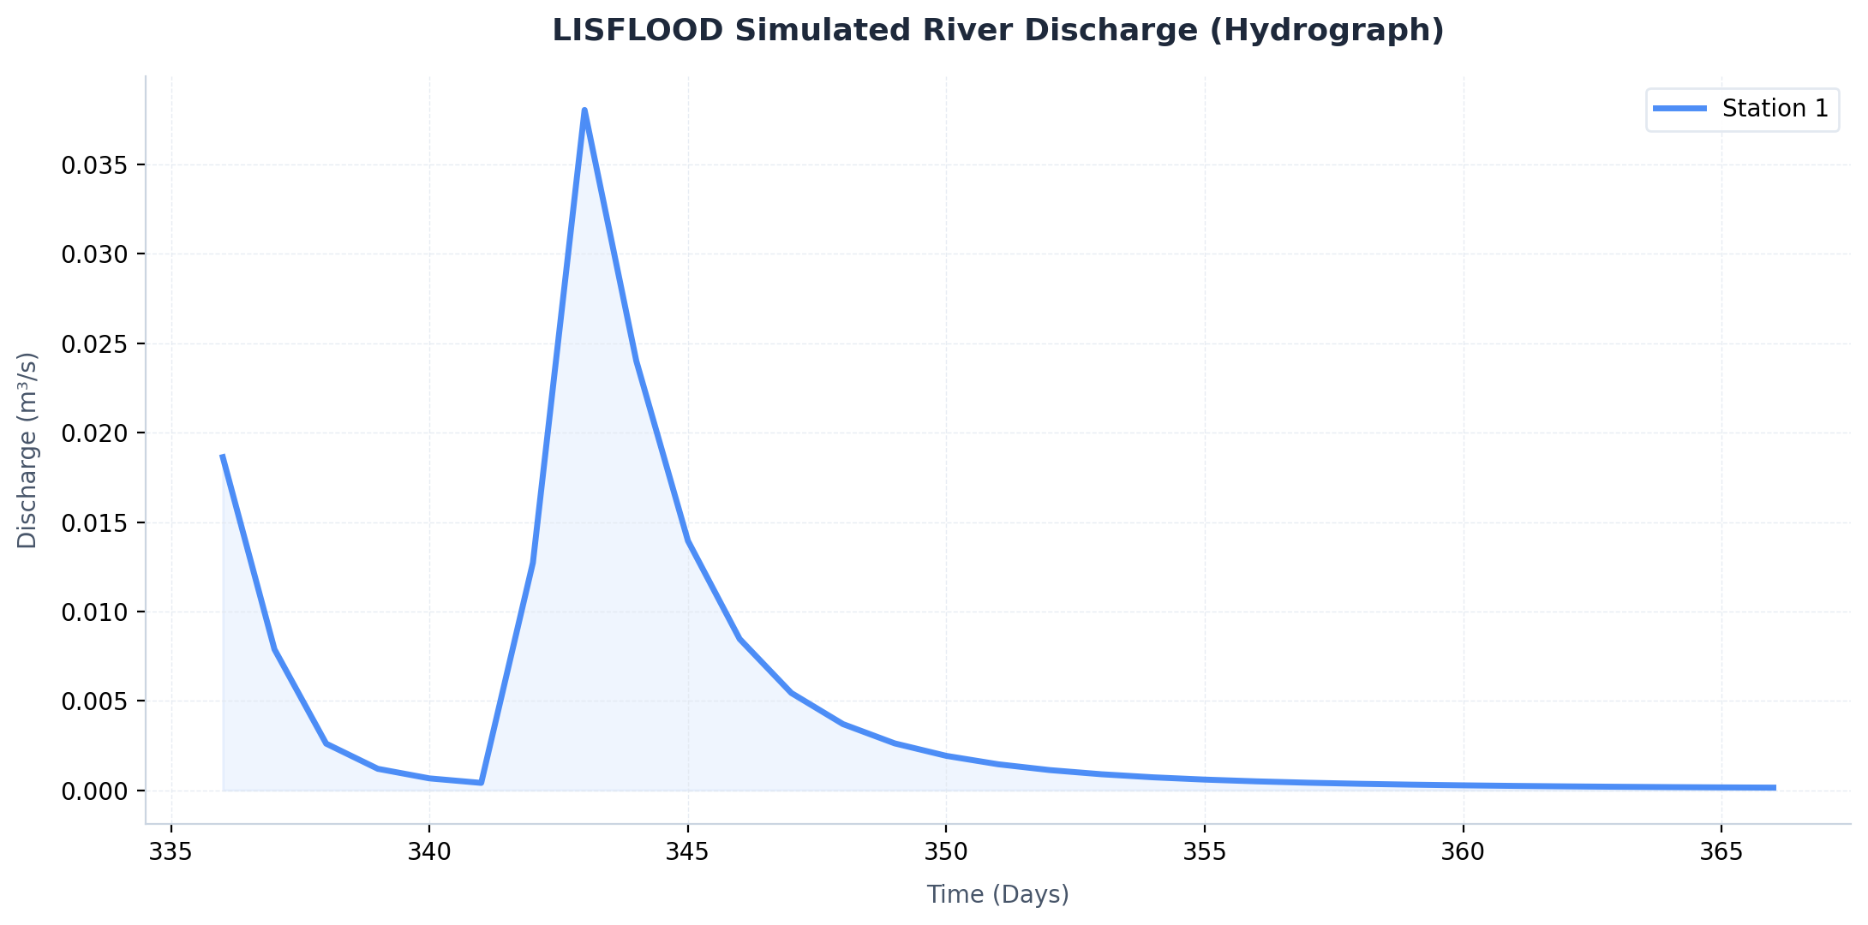
WARM START — DISCHARGE HYDROGRAPH
Simulated river discharge (m³/s) at the reporting station over ~31 daily timesteps • 01/12/2024 → 31/12/2024
▸ The warm start produces realistic discharge immediately — notice the rainfall-driven peak around day 342-343 (~0.038 m³/s), consistent with a real storm event.

Slide 7
OUTPUT FILES — SUMMARY & DESCRIPTION
END-OF-RUN STATE MAPS (.end.nc)
TIME SERIES & SPATIAL OUTPUTS
NetCDF snapshots of every grid cell at the final timestep. Cold start produces 30 .end.nc files — the watershed's 'memory' for warm-start initialization.
Time Series (.tss files)
File | Source | Description
dis.tss | Both | Discharge at gauge (m³/s)
chanqWin.tss | Both | Channel Q last sub-step
rainUps.tss | Warm | Upstream rainfall
tAvgUps.tss | Warm | Upstream avg temperature
etUps.tss | Warm | Upstream evapotranspiration
snowUps.tss | Warm | Upstream snowmelt
Category | Files | Description
Channel | chanq, chcro .end.nc | Discharge & cross-section
Snow | scova/b/c .end.nc | Snow cover per elevation zone
Soil Moisture | tha/b/c .end.nc | Soil moisture layers a/b/c
Groundwater | lz, uz, uzf, uzi .end.nc | Lower/upper zone storage
Interception | cumi, cumf, cseal .end.nc | Rainfall interception
Days Since Rain | dslr, dslf, dsli .end.nc | General / forest / irrigated
Frost | frost .end.nc | Ground frost index
Overland Flow | ofdir, offor, ofoth .end.nc | Direct / forest / other
Spatial Maps (.nc)
File | Size | Description
dis.nc | 5.65 MB | Spatially-distributed discharge
chanq.nc, chcro.nc | 20-31 KB | Channel state maps
tha/b/c.nc | ~76 KB | Soil moisture maps
lz.nc, uz.nc | 76-80 KB | Groundwater zone maps

Slide 8
COLD START vs WARM START — AT A GLANCE
Parameter | Cold Start | Warm Start
Config File | cold.xml | warm_start.xml
Simulation Period | 01/01/2024 → 30/11/2024 | 01/12/2024 → 31/12/2024
Duration | ~336 days (~11 months) | ~31 days (December 2024)
Approx. Run Time | ~50 seconds | ~10 seconds
Initial States | All set to 0 or −9999 (empty watershed) | 7 × .end.nc files loaded from cold run
InitLisflood | 1 (initialization mode ON) | 0 (operational mode)
Spin-Up Required | Yes — early output unreliable | No — accurate from timestep 1
Output Directory | /output_dataset/out | /output_dataset/out_warm
Key Outputs | 30 .end.nc state maps + dis.tss | 33 .end.nc + 8 .tss + 25 spatial .nc
Docker Image | jrce1/lisflood | jrce1/lisflood
Use Case | Build initial states / calibrate | Real-time operational forecasting

Slide 9
COLD → WARM START WORKFLOW
STEP 1 — COLD START
STEP 2 — WARM START
RESULTS
▸ Run cold.xml for ~336 days
▸ All states start at 0 / −9999
▸ Watershed fills up over time
▸ End-of-run: 30 state maps saved
as *.end.nc in /out/
▸ Output: dis.tss + dis.nc
(discharge data for analysis)
▸ Total storage: ~130 MB
▸ Run warm_start.xml for 31 days
▸ 7 key states loaded from .end.nc
▸ Remaining states use defaults
▸ Physically realistic from day 1
▸ Outputs written to /out_warm/
▸ 8 .tss files + 25 spatial .nc
+ 33 new .end.nc maps
▸ Ready for next warm cycle!
Cold Run
30 .end.nc + 5 .tss + dis.nc (5.65 MB)
Warm Run
33 .end.nc + 8 .tss + 25 spatial .nc maps
Peak Q (Cold)
~1.19 m³/s around day 275
Peak Q (Warm)
~0.038 m³/s around day 342
Run Time ↓
48 s + 34 s
→
7 × .end.nc files transfer

Slide 10
Thank You
LISFLOOD • Cold Start & Warm Start Analysis
For questions or further discussion, please reach out.

