Slide 1
Dr. Akhilesh Das Gupta Institute of Technology and Management
Information Technology
Major Presentation
COLLECTION AND VERIFICATION OF DRUG ADVERSE EFFECTS
Aniket Singh Bhadouria –00715603115
Chirag Sehra– 01615603115
Mansi Kukreti--03215603115

Slide 2
Table of Contents
Project Objective
Overview
Existing Problems
Our Solution
Technologies used

Slide 3
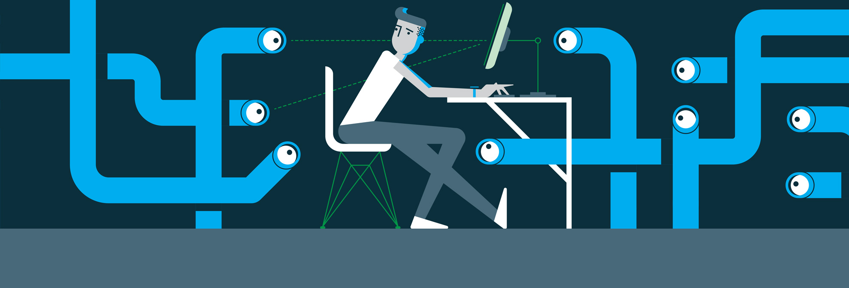

Project Objective
Make user information private
Allow the access to all the genuine users to vote according to the actual events successfully deliver this accurate data to the concerned authorities
Reasonable actions can be taken for the reported events.

Slide 4
Overview
Mansi

Slide 5
Existing Problems
Mansi: some data in points. Not more than 3 points

Slide 6
Our Solution
Chirag will put some info and screenshots of the dapp here.

Slide 7
chirag

Slide 8
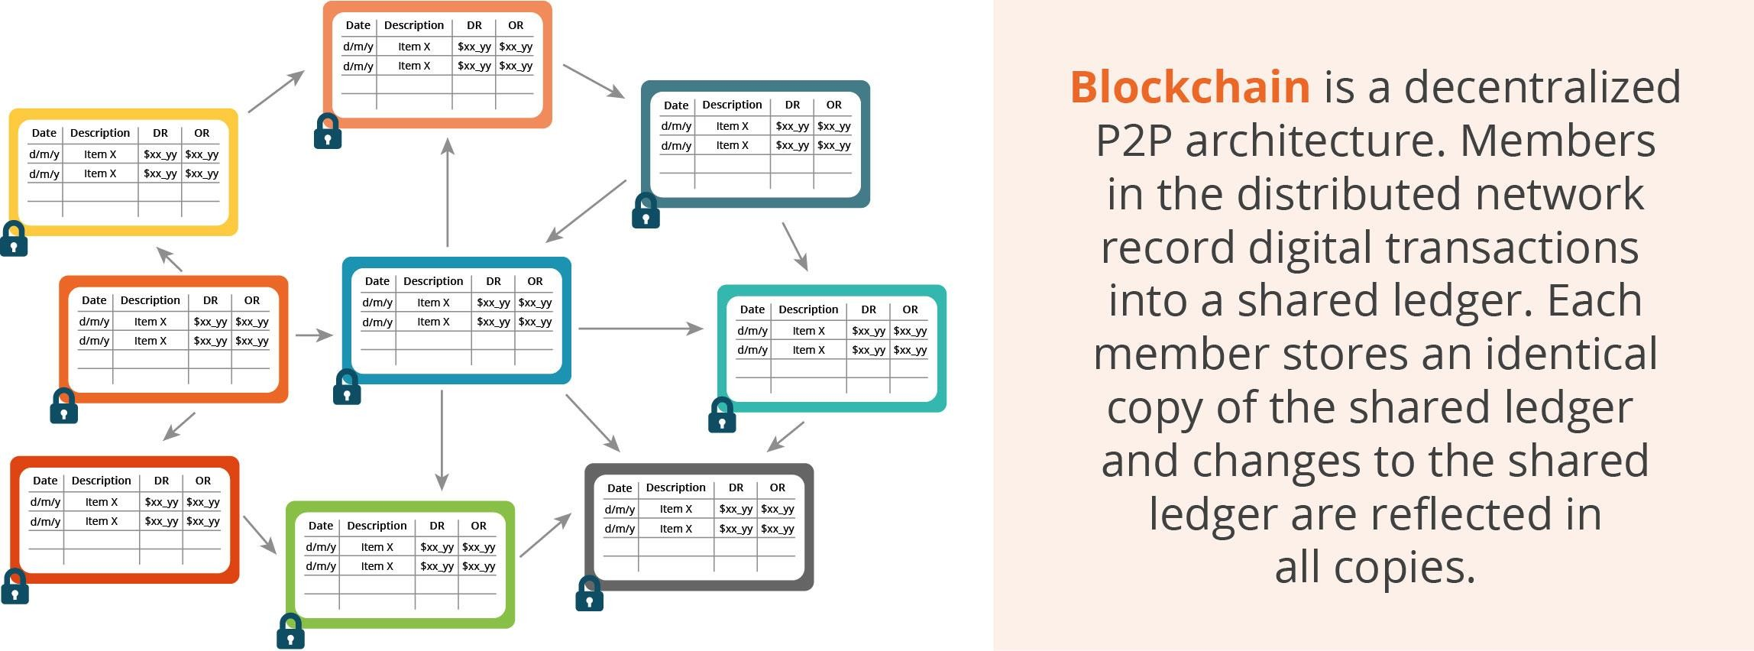
Technologies Used
Blockchain Technology

Slide 9
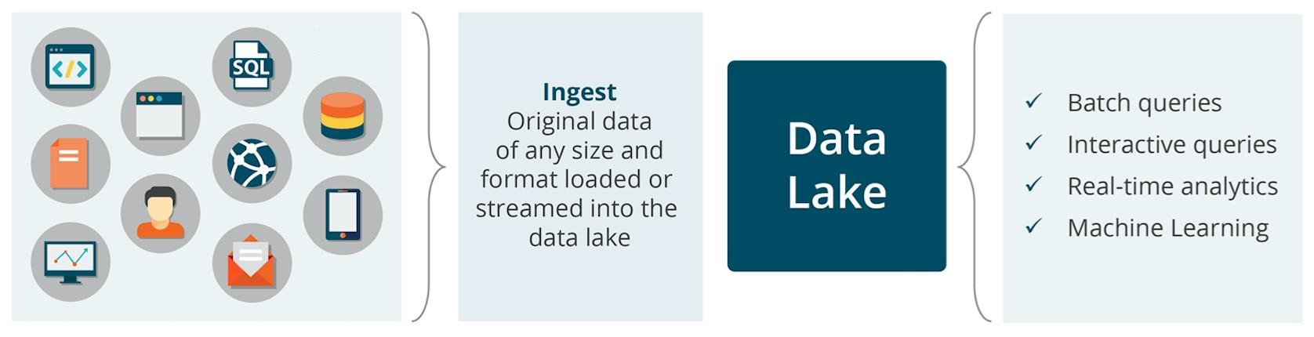
Data Lake

Slide 10









Web Platform
Aniket: a brief intro about tech of images

Slide 11
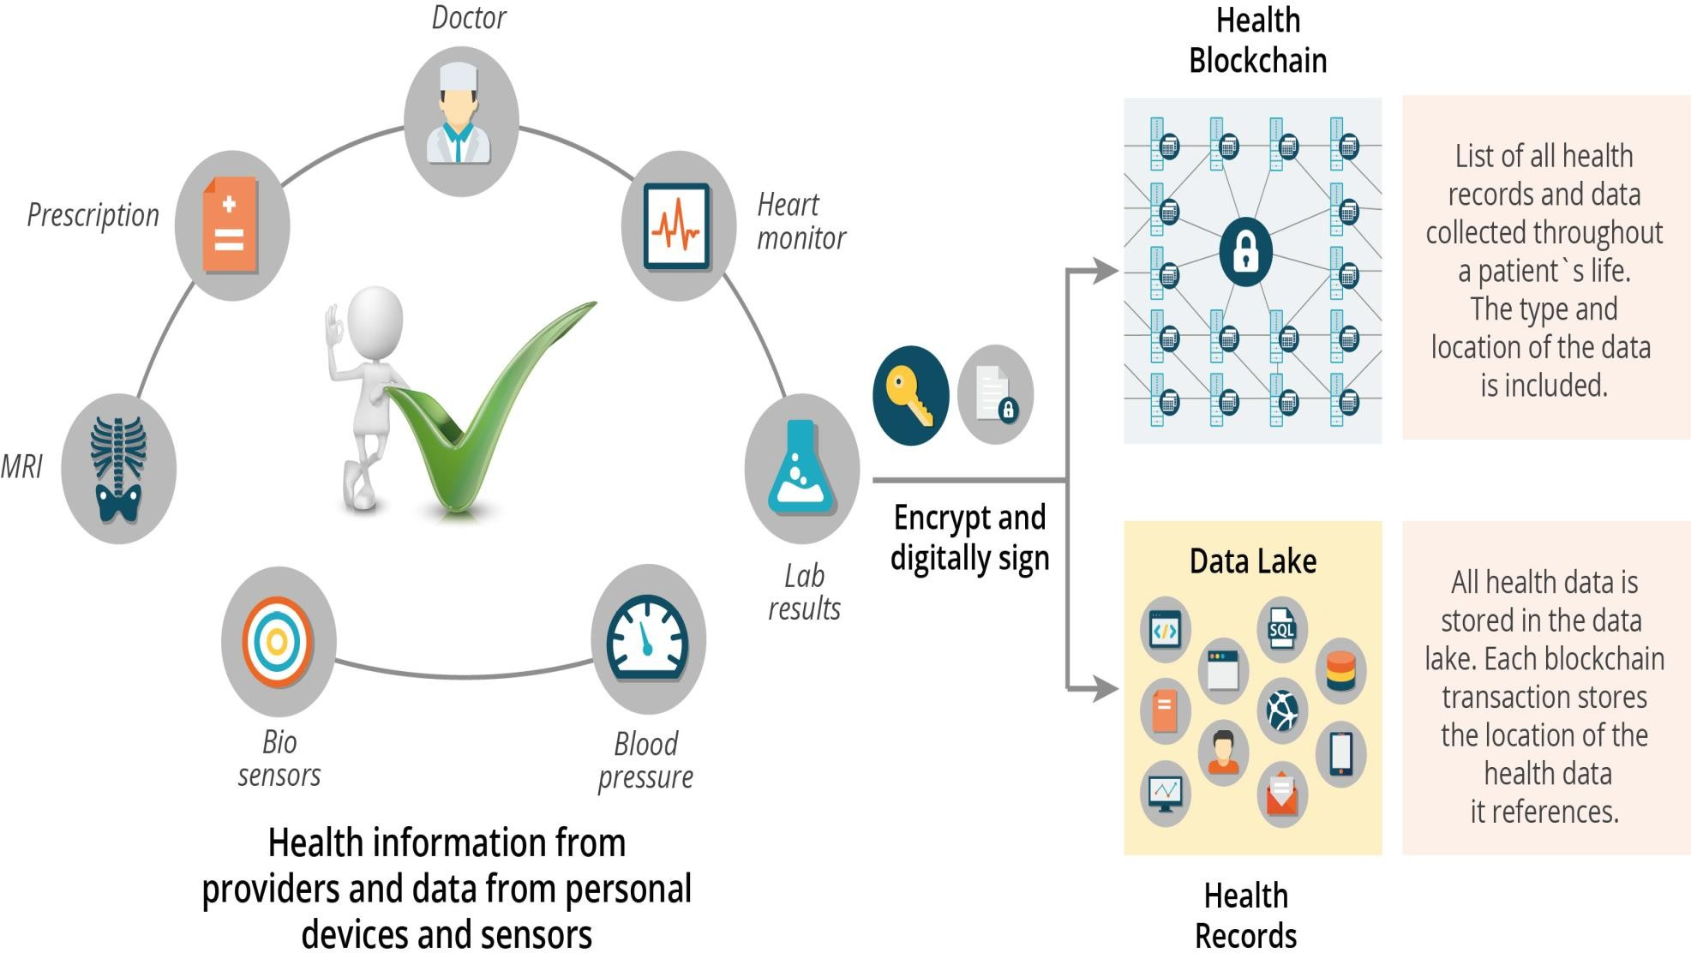
Collection Of Data

Slide 12
Chirag: MongoDB, sql and json database screenshots

Slide 13
Chirag: How dapp works right now includning proposals

