Slide 1
Title
Name of the presenter: Swata Swayam Dash
Email id: b522060@iiit-bh.ac.in

Slide 2



ABOUT THE PROJECT
DATA
MODEL
PRODUCT
The data used consists of openly available PDF/Books from various government and educational sites. The text extracted from these Books and PDFs and used to fine-tune a SLM (Small Language Model) for a QnA Tasks as per of our framework.
Our conversational-AI framework consists of 3 major parts : MOE (Mixture of Experts Fine tune LLMs), Conversational Managing LLMs and Translation/RAG.
We aim to design a product (FarmGenie) which helps the way the farmers gain up to-date knowledge regarding various agricultural and farming practices from the Internet. We aim to create an interface where farmers from a neighborhood can connect with each other and share their knowledge. The product ensures they get the right knowledge through our devised advance conversational-AI framework, community forms and our interactive web interface

Slide 3
PRODUCT/SOLUTION OVERVIEW
VALIDATION
INNOVATION
The validation process involved running the framework 5 times, with each trial consisting of queries in Hindi covering a range of complexities, from single-label queries (Soil, Irrigation, Plant diseases) to every possible permutation of these labels. For each query, the classified labels, generated sub-problems, and translated versions (Hindi-English and English-Hindi) were recorded, and the final output was evaluated based on these results.
At the core of our product lies a groundbreaking approach to agricultural knowledge dissemination and community engagement. By seamlessly integrating advanced language models, retrieval-augmented generation, and a user-friendly interface, we have created a truly innovative solution that empowers farmers to access the information they need, share their experiences, and collaborate with their peers. Our product's unique blend of cutting-edge technology and community-driven features sets it apart, positioning it as a transformative tool that can revolutionize the way farmers access knowledge and connect with one another, ultimately driving sustainable and impactful change in the agricultural sector.
SCALABILITY
The frontend is built with Next.js, which provides server-side rendering and performance optimizations. The backend is handled by Next.js and Express server, which communicates with a Redis queue to distribute load across multiple Node.js processes. This setup ensures that the ML backend does not get overwhelmed, allowing the application to scale to handle a large number of concurrent user requests without compromising performance. Additionally, the use of Docker containers for deployment and comprehensive monitoring and logging solutions further enhance the website's scalability and reliability.
SIMILAR PRODUCT
AgriAssist|Connecting Farmers with an On-Demand Workforce

Slide 4
PRODUCT/SOLUTION FEATURE - 1
Scalable and Secure Architecture
The website employs a scalable and secure architecture to handle a large number of concurrent user requests and protect user data. It has the frontend built using Next.js and the backend built using Next.js and Express server. The Express server communicates with a Redis queue to distribute the load across multiple Node.js processes, ensuring the ML backend does not get overwhelmed. Integration tests were employed to ensure the reliability and correctness of the system. The application is packaged and deployed using Docker containers, ensuring consistent and reliable deployment across different environments. Additionally, the website incorporates industry-standard security practices, such as SSL/TLS encryption, user authentication, and input validation, to protect user data and prevent unauthorized access. Monitoring is done using Grafana and Prometheus to track performance, errors, and user activity, enabling the team to quickly identify and resolve issues.

Slide 5
PRODUCT/SOLUTION FEATURE - 2
Intelligent Knowledge Retrieval and Sharing
The ML backend employs a Mixture of Experts (MoE) approach to provide farmers with up-to-date knowledge on various agricultural and farming practices. At the core of this framework are three fine-tuned Small Language Models (SLMs), each specializing in a different domain: the Soil SLM, trained on a dataset of agricultural soil reports and handbooks, provides in-depth knowledge on the types and characteristics of soils, factors affecting soil quality, and best practices for soil management; the Plant Diseases SLM, trained on a dataset of common plant disease reports and handbooks, equips it with expertise on the identification, prevention, and treatment of various plant diseases and pests; and the Irrigation SLM, trained on a dataset of agricultural irrigation reports and handbooks, gives it comprehensive knowledge on different irrigation techniques, water management strategies, and factors influencing irrigation efficiency. The Conversation Managing LLMs play a crucial role in the overall framework, responsible for classifying user queries, determining whether they are simple or complex, and then breaking down complex queries into a series of subproblems that can be addressed by the specialized SLMs. The Retrieval-Augmented Generation (RAG) module serves as the interface between the user and the SLMs, retrieving the most relevant information from the agricultural reports and handbooks database and seamlessly integrating it into the responses generated by the SLMs, ensuring that the farmers receive accurate, up-to-date, and informative answers to their queries. By leveraging this advanced conversational-AI framework, the ML backend aims to provide farmers, especially those new to the agricultural practices, with the right knowledge and resources to navigate their farming journey successfully.

Slide 6
PRODUCT/SOLUTION BENEFITS
For Geospatial Researchers:
For Community:
For Policy Makers:
Our platform tackles the information gap in agriculture by collecting real-time data straight from framers across various regions. It is a central hub where policymakers can directly access the challenges and needs faced by farmers on the ground. This empowers them to create data-driven policies that address specific needs within agricultural communities. By tracking trends in farming practices, crop yields , and market prices, policymakers can monitor the effectiveness of existing programs. In essence, our powerful data empowers policymakers to build a thriving and sustainable agricultural future.
The product offers significant advantages for geospatial researchers working in the agricultural sector. By connecting farmers and consolidating up-to-date knowledge on various farming practices, the platform serves as a valuable resource for researchers to gain a deeper understanding of the real-world challenges and opportunities faced by farmers. The researchers can leverage the platform to collect more accurate data, validate their findings, and conduct enhanced spatial analysis by integrating the platform's data with other geospatial datasets. The insights gained from farmer-to-farmer knowledge sharing and aggregated data can inform evidence-based policy development and decision-making processes, ensuring that research efforts align with the needs and realities of farmers on the ground. Moreover, the platform facilitates collaborative research opportunities, allowing geospatial researchers to engage with farmers possessing valuable local knowledge and collaborate on joint projects that combine their expertise with practical experience. Overall, this product has the potential to revolutionize the way geospatial researchers approach agricultural research, enabling them to develop more effective and sustainable solutions that address the specific needs of farmers in their local contexts.
By connecting farmers and aggregating up-to-date knowledge on various agricultural practices, the platform can serve as a valuable resource for community members to learn about sustainable farming techniques, access healthy local food, and engage in the food production process. The platform’s ability to promote agricultural education across different age groups, from primary schools to adult workshops, can foster a sense of community involvement and responsibility towards the land. Additionally by supporting local farms and businesses, the product can help keep food dollars in the local economy, create employment opportunities, and contribute to the overall economic development of the area. Furthermore, the platform’s focus on sustainable agriculture can help regulate the ecosystem, provide food and shelter for animals, and restore degraded areas, ultimately leading to a healthier and more vibrant community environment

Slide 7
MAJOR CHALLENGES/DRAWBACKS
1
2
3
- MoE is an extensive task when it comes to increasing the number of experts since it won’t be feasible without heavy compute and other resources, hence should be made into production with care.
- Translation should be done with the help of Translation APIs like the ones offered by Google or indic LLMs (like by AI4Bharat) instead of hard prompting the LLMs to do so as it may lead to unexpected error on larges ones when into production(we are yet to test this). We chose Gemini Pro because of its free tier services and appreciable translation abilities for our use-case.
- A ML model should be more appropriate approach to train and use it for Simplex/Complex query segregation to have better control and usability. However, hard prompting worked in our case.
High quality dataset, especially access to quality PDFs/Books for generation of QnA pairs and RAG. Since we couldn’t find many open and big pdf on the same nor the QnA pairs we had to make use paid services like OpenAI APIs to create the pairs.

Slide 8
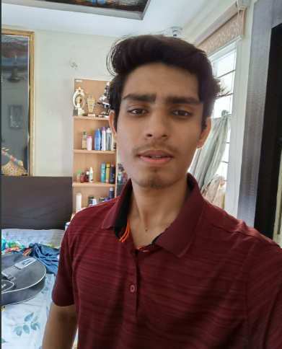
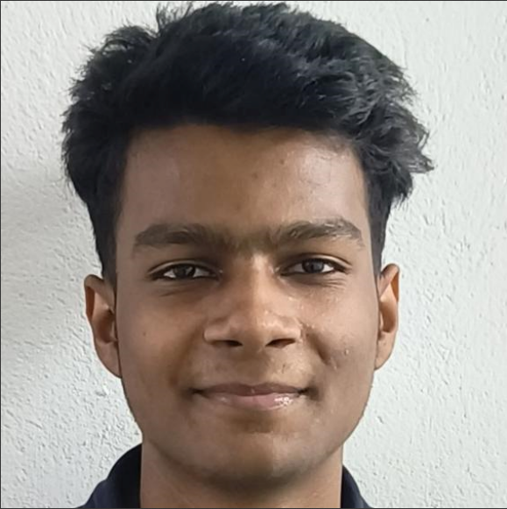
MEET THE FULL TEAM
SWATA SWAYAM DASH
YUVRAJ SINGH
Team Lead
Member

Slide 9
THANK YOU
Thank you for your interest in our product!
Our product (FarmGenie) aims to empower farmers, support sustainable agriculture, and drive positive change in the agricultural sector. We look forward to discussing how our solution can benefit your organization

