Slide 1


MedWays
-Where Care Meets Convenience
-By BitCoders

Slide 2

Problem Statement:
Many individuals face challenges in accessing timely and specialized healthcare services, especially when experiencing specific symptoms. Finding and scheduling appointments with appropriate healthcare professionals can also be cumbersome and time-consuming.

Slide 3
Proposed Solution:
Our solution is to create a user-friendly healthcare platform, “MedWays”, where users can input their symptoms, personal details, and preferences. The platform will match the symptoms with a database of medical conditions and recommend specialized doctors. Users can then schedule appointments with the recommended doctors conveniently through the platform.

Slide 4
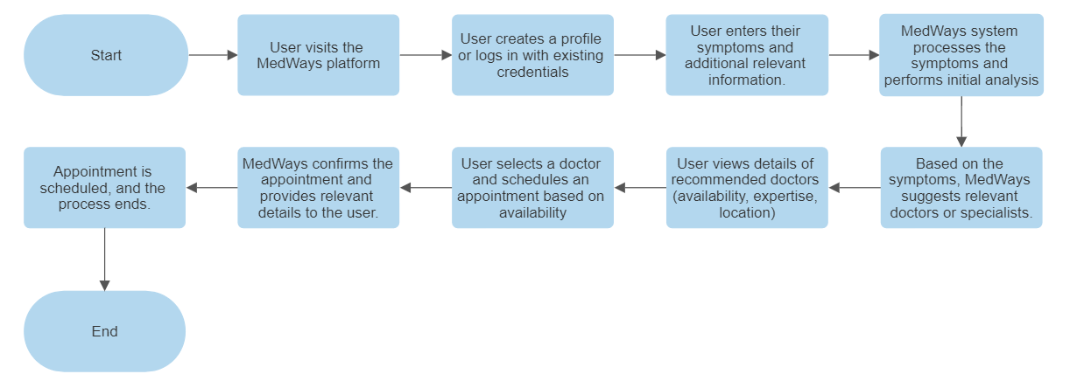
Workflow Diagram:

Slide 5
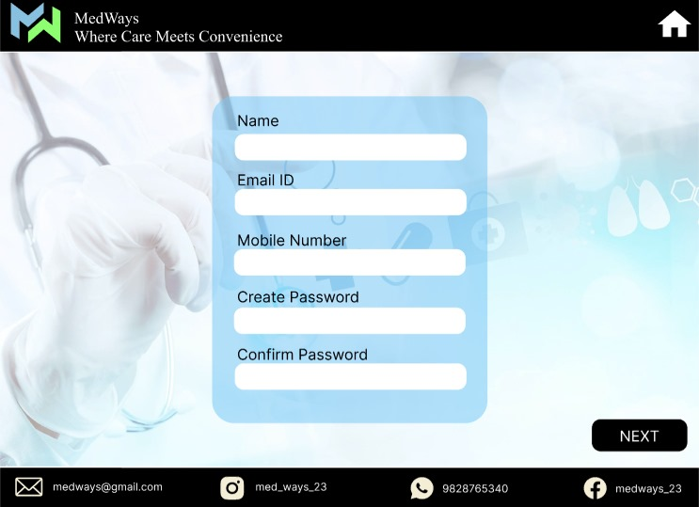

Slide 6
Business Model:
Basic and Premium Plans:
Basic Access (Free): Users can access symptom analysis and general doctor recommendations at no cost.
Premium Access (Subscription): Users can opt for a subscription-based model to unlock enhanced features such as priority appointment scheduling, extended symptom analysis, and access to specialist recommendations.
Partnerships and Collaborations :
Healthcare professionals and clinics can opt to feature their services on MedWays by paying a fee. This can include being listed at the top of relevant search results or highlighted in specific specialties.

Slide 7
Business Model:
Collaborations with pharmaceutical companies, insurance providers, or other healthcare-related organizations for mutual benefits, such as referral programs, data-sharing partnerships, or joint marketing initiatives.
Appointment Booking Commission:
MedWays can charge a small commission fee for each appointment booked through the platform. This fee can be a percentage of the appointment cost paid by the user or the doctor.

Slide 8
Future Scope:
Telemedicine Integration:
Implement a telemedicine feature to enable virtual consultations between users and healthcare professionals. Users can seek medical advice and consultations remotely, enhancing accessibility and healthcare delivery.
Integration with Health IoT:
Integrate with Internet of Things (IoT) devices focused on health, such as blood pressure monitors, glucose meters, or ECG machines. Users can connect their devices to MedWays for real-time data monitoring and analysis.

Slide 9
Future Scope:
AI-Powered Symptom Analysis:
Implement AI algorithms to enhance symptom analysis. AI can help improve accuracy in identifying potential health conditions based on symptoms provided by users.
Multilingual Support:
Offer multilingual support to cater to a diverse user base, ensuring that language is not a barrier to accessing healthcare services.
Community and Support Forums: Develop a platform for users to connect, share experiences, and support one another. Incorporate forums where users can seek advice or information from a community of peers.

Slide 10
THANK YOU

