Slide 1

Olist store Analysis

Slide 2
AGENDA
Introduction & Problem Statement
About Dataset
Business Objective
KPIS
Dashboard
Conclusion

Slide 3
About Dataset
Domain : E- commerce
Project Name: Olist store Analysis
Dataset Name: Olist customer, Olist geo location, Olist order, Olist order items, Olist order payment, Olist order Review, Olist product, Olist_seller, Olist product category
Dataset Type: Excel Data
Total No of orders:99224

Slide 4
BUSINESS OBJECTIVE
To analyze customer purchasing patterns and payment statistics on an e commerce platform, olist by using KPI.
To help Olist to improve their weekend sales and plan promotions.
To understand satisfaction rate of customer and encourage them to make repeat purchases.
To identify the areas, where delivery is taking more time than usual and what are the reasons behind that and how they can improve their delivery time and satisfy customer rate.
To identify high-value customers and creates targeted marketing campaigns.
To provide the delivery on time to make customer satisfaction levels and optimize their logistics and how to improve delivery time.

Slide 5
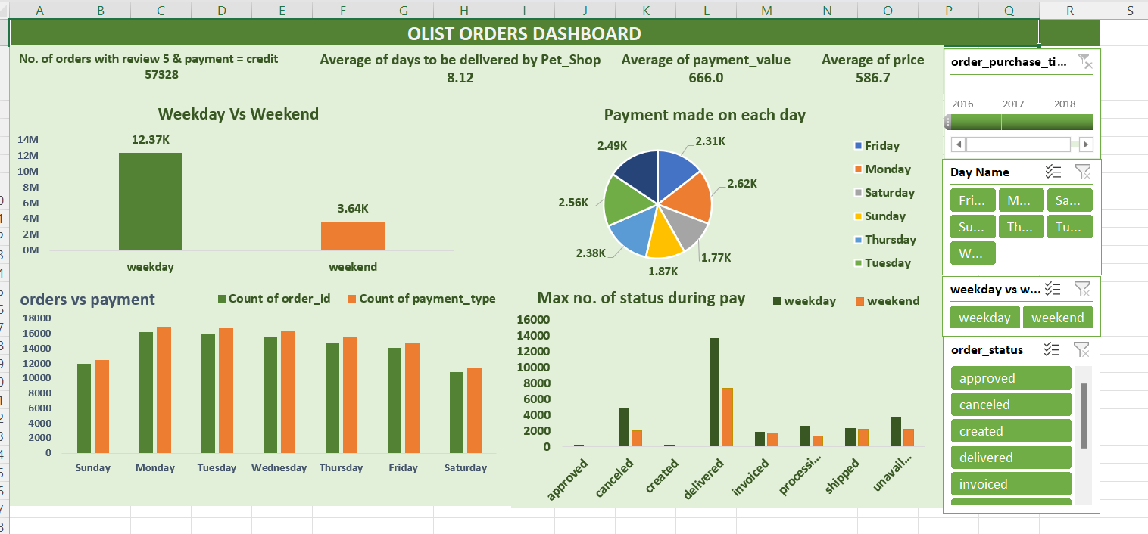
KPI 1:Weekday Vs Weekend (order_purchase_timestamp) Payment Statistics
It provides an understanding of the buying behavior of customers which day of the week has the highest sales and according to this, planning and execution has to be done like to attract more customers and engage more staffs accourding to the sales etc.The analysis of this KPI can help Olist to improve their weekend sales and plan promotions accordingly.

Slide 6
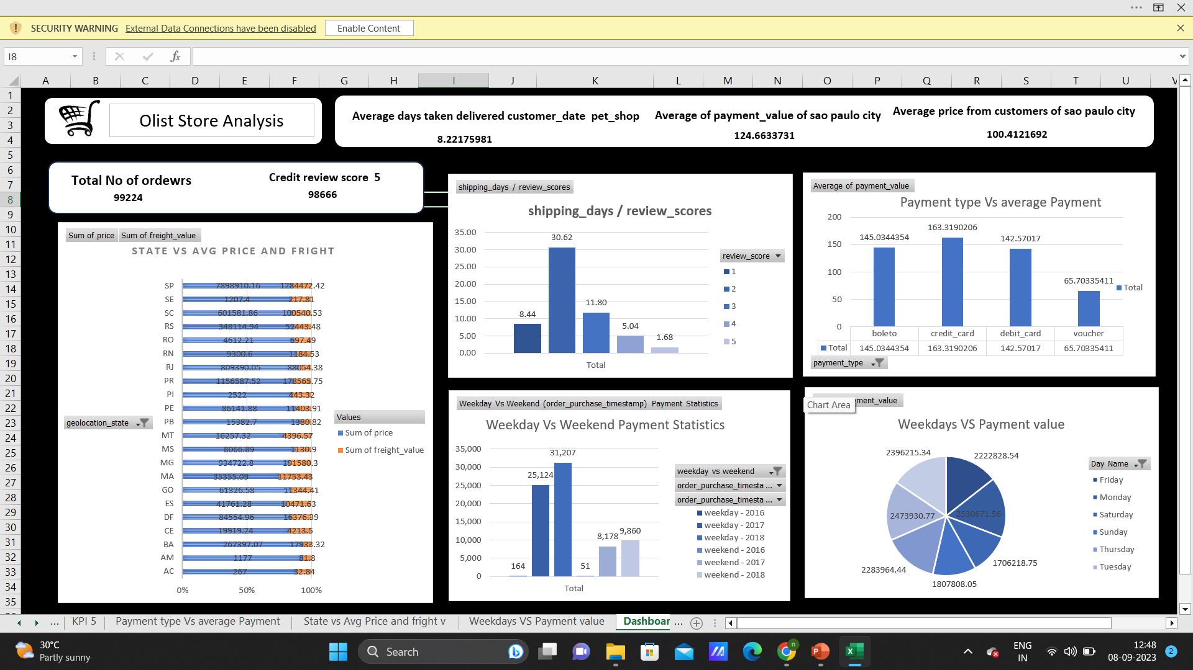
KPI 2:Number of Orders with review score 5 and payment type as credit card.
It helps in analysing that how many customers are satisfied and which mode of payment they preferred more. Olist can use this information to understand satisfaction rate of customer and encourage them to make repeat purchases.

Slide 7
KPI 3:Average number of days taken for order_delivered_customer_date for pet_shop
It helps to identify the areas, where delivery is taking more time than usual and what are the reasons behind that and how they can improve their delivery time and satisfy customer rate.

Slide 8
KPI 4:Average price and payment values from customers of sao paulo city
It helps in analyzing the how much they are spending in sao paulo city which not only helps in identifying high-value customers but also creates targeted marketing campaigns.

Slide 9
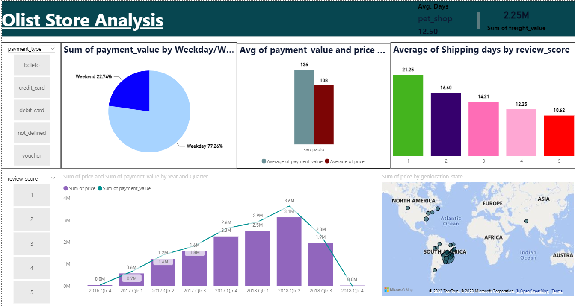
KPI 5:Relationship between shipping days (order_delivered_customer_date - order_purchase_timestamp) Vs review scores.
It helps in identifying that what positive impact has to be done when provides the delivery on time to make customer satisfaction levels and optimize their logistics and how to improve delivery time.

Slide 10
EXCEL Dashboard

Slide 11
Power BI Dashboard

Slide 12
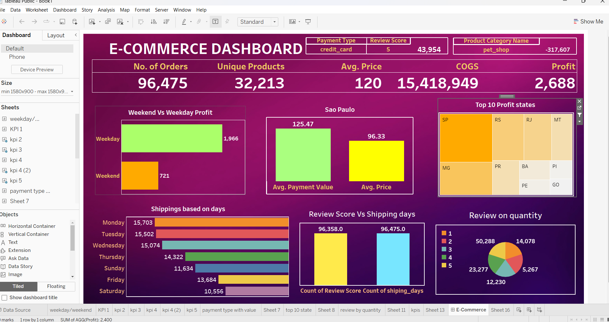
Tableau Dashboard

Slide 13
Conclusion
The Olist Store Analysis project provides valuable insights into customer behavior and payment statistics. The analysis of these KPIs helps Olist in identifying areas of improvement and creating targeted marketing campaigns. As a data analyst, I have used Excel and Power BI to clean and manipulate the dataset and create meaningful visualizations. This project serves as a great example of how data analysis can help businesses make informed decisions.

