Slide 1


Zomato analysis

Slide 2
AGENDA
ZOMATO
Introduction
About the project
ZOMATO
Objective
Kpi Implementation
ZOMATO
Dashboard
Conclusion

Slide 3
Introduction
Zomato is an India’s multinational restaurant aggregator and food delivery company.
Founded by “Deepinder Goyal” and “Pankaj Chaddah” in the year of 2008.
Services :- Online delivery and Table reservation
Initially named :- “Foodie Bay”
In November 2010 it was renamed as “ZOMATO”.
Parent Companies :- “Info Edge” and “Ant-Financial”.
Head-Quarters :- Gurugram,Haryana,India.
Revenue :- ₹7,079 crore (Feb23)

Slide 4
About Project
Zomato Restaurant Data Analysis Project :
This project involved analyzing Zomato restaurant data using advanced Excel functions and SQL queries, and creating interactive dashboards using Power BI and Tableau.
The project provided valuable insights into restaurant industry trends related to location, opening trends, ratings, and price ranges.
Project has the 15 Countries
City Count : 141
Restaurant's Count : 9551
Cuisines : 250
Data set : 2010 to 2018

Slide 5
OBJECTIVE
The objectives of the project were:
Building a data model using Excel sheets.
Building a country map table Building a calendar table using the column date key and adding columns such as year, month no, month full name, quarter(Q1,Q2,Q3,Q4), year_month (YYYY-MMM), weekday_no, weekday_name, financial month (April = FM1, May= FM2 … March = FM12), and financial quarter (quarters based on financial month). Finding the number of restaurants by city and country.
Converting the average cost for 2 column into USD Dollars
Analyzing number of restaurants opening trends by year, quarter, and month
Counting restaurants by average ratings
Creating buckets for average price ranges and finding out how many restaurants fall in each bucket
Calculating the percentage of restaurants with table booking.
Calculating the percentage of restaurants with online delivery.
Developing charts based on cuisines, city, ratings
Building dashboard for above Kip's.

Slide 6
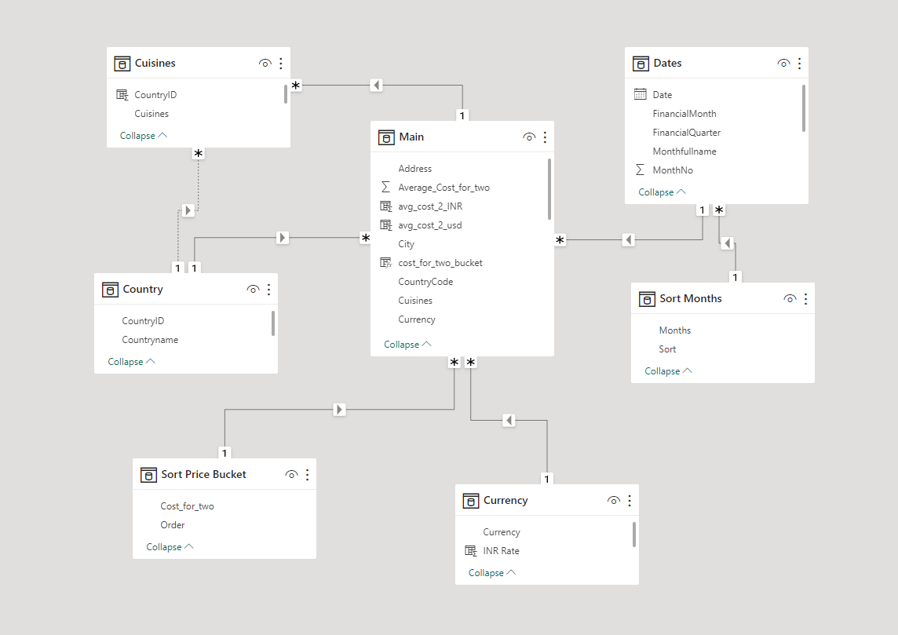
KPI 1 :-
Tables Provided :
Main
Country
Currency
Tables Generated :
Cuisines
Dates

Slide 7
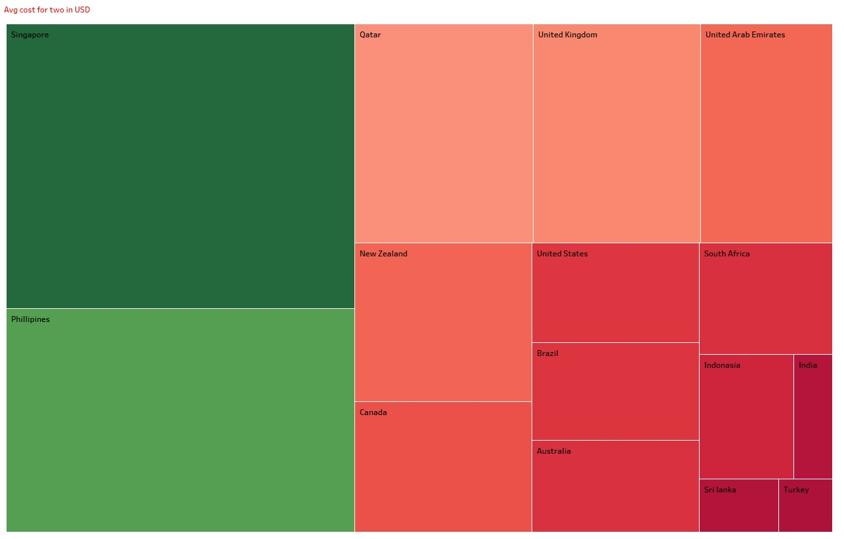
KPI 3 :-
Observation :-
Dining cost for 2 people is highest in Singapore with an avg of 156$, followed by Philippines with 117$.
we observed lowest dining cost for 2 people in India, Sri Lanka and Turkey with an average of 7$
Suggestion:-
Restaurants in Singapore and the Philippines could incorporate Indian cuisine from Indian restaurants to decrease overall expenses.

Slide 8
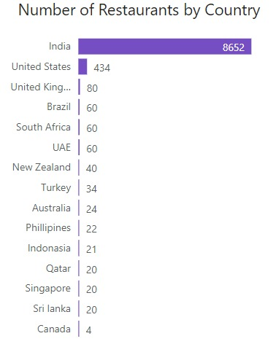
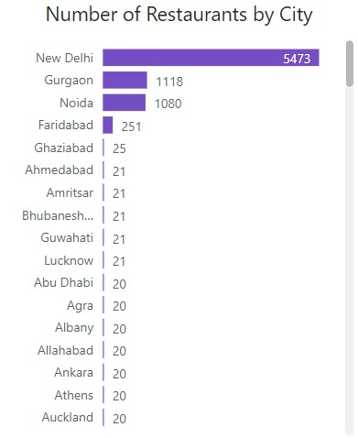
KPI 4 :
Observations :
In our restaurant data, we observed that India has the highest number of restaurants[8652] , indicating a strong and diverse food culture in the country.
New Delhi stands out as the city with the most restaurants [5473] , emphasizing its status as a vibrant culinary hub.
Suggestion :
This data highlights India's prominence in the global restaurant scene, with New Delhi leading the way among its cities, offering a wide range of dining options for both locals and visitors.

Slide 9
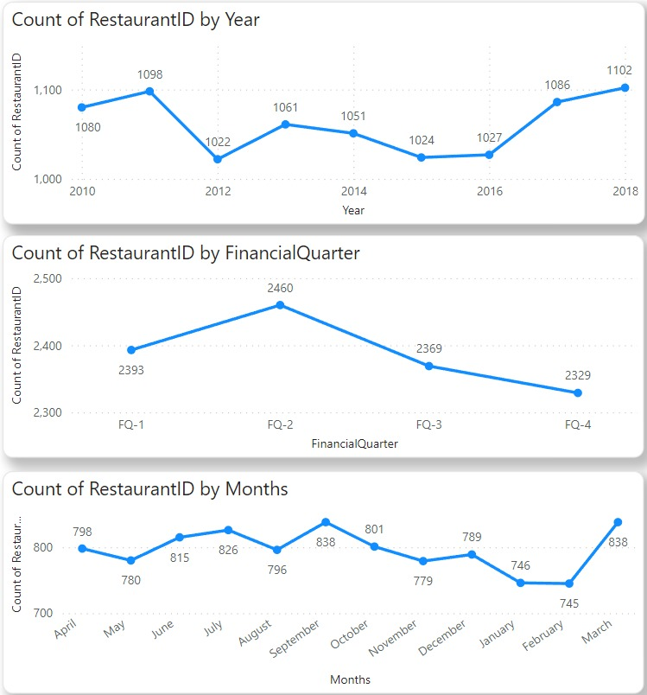
KPI 5 :-
Objervation :-
2018 witnessed the highest number of restaurant openings, while 2012 had the fewest.
Q2 consistently sees the most restaurant openings, whereas Q4 has the least.
In monthly terms, September and March experience the highest number of openings, while February is notably the slowest month.
Suggestion :
Our data underscores a significant growth in the restaurant industry by 2018, with a notable peak in Q2, especially during March and September. Conversely, Q4, especially February, appears to be less favorable for new restaurant ventures.

Slide 10
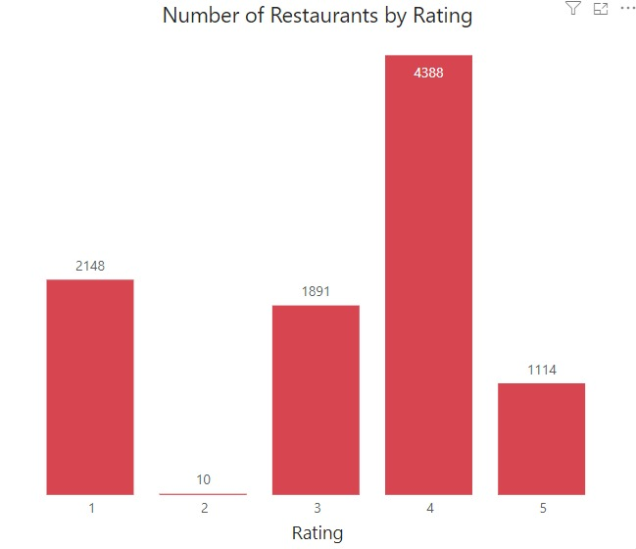
KPI 6:-
Observations
Restaurants with a rating of 4 are the most common, indicating a majority of establishments meet a high standard [4388] of quality and service.
On the other hand, A rating of 2 was the least common[10] among the restaurants, implying that poorly-rated restaurants are relatively rare in our dataset..
Conclusion:
The majority of restaurants in our dataset have achieved a good average rating of 4, indicating a general level of satisfaction among customers. On the other hand, restaurants with a rating of 2 are in the minority, suggesting that low-rated establishments are less common, which is a positive sign for the dining industry.

Slide 11
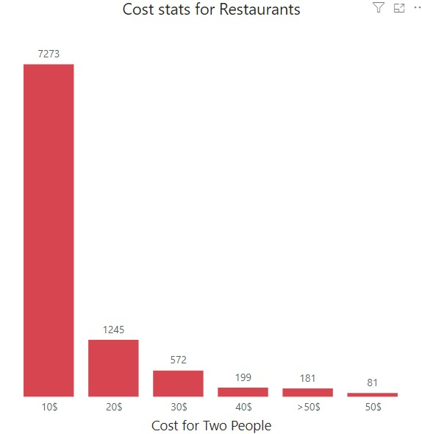
KPI 7 :-
Objervation :-
Almost 80% of restaurants offer food under $10.
Few people seem to prefer food price above $50.
Suggestion :-
To boost revenue and appeal, restaurants with dishes priced above $50 could also offer lower-cost menu options.

Slide 12
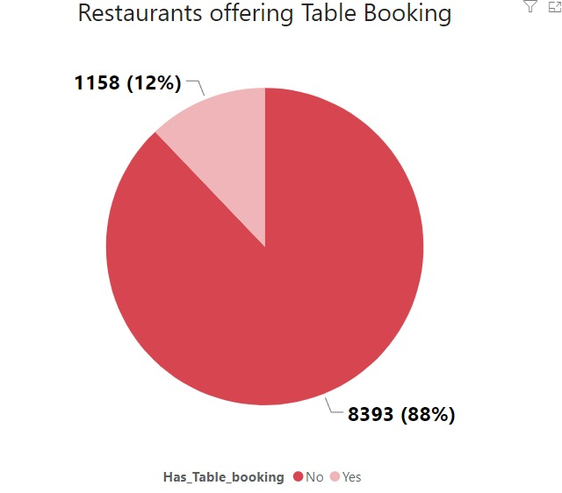
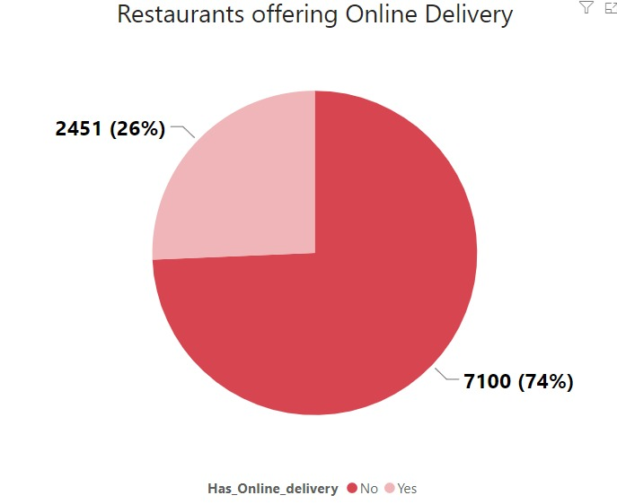
KPI 8 & 9 :-
Objervation:-
only 12% of restaurants have table booking 88% restaurants are not providing table booking
74% restaurants do not offer online delivery & Only 26% of restaurants have Online delivery.
Suggestion :-
Zomato has an online food delivery service in which we see a huge potential to boost revenue by incorporating as additional 74% restaurants into its network compare to table booking.

Slide 13
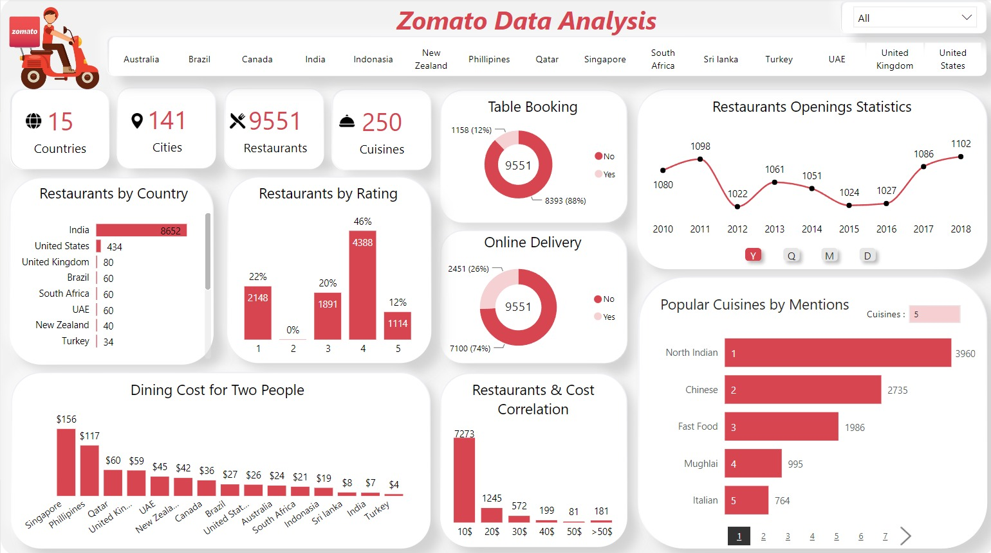

Slide 14
Conclusion
The Zomato Analysis project provides valuable insights into customer behavior and budget and cuisines preferences.
The analysis of these KPIs helps Zomato in identifying areas of improvement and creating targeted marketing campaigns throughout the countries.
As a data analyst, we have used Power Query to clean and Excel and Power BI to manipulate the dataset and create meaningful visualizations.
This project serves as a great example of how data analysis can help businesses make informed decisions.

Slide 15


