Slide 1
Deep Learning With Pytorch
Varun Raste
Data Scientist , IBM

Slide 2
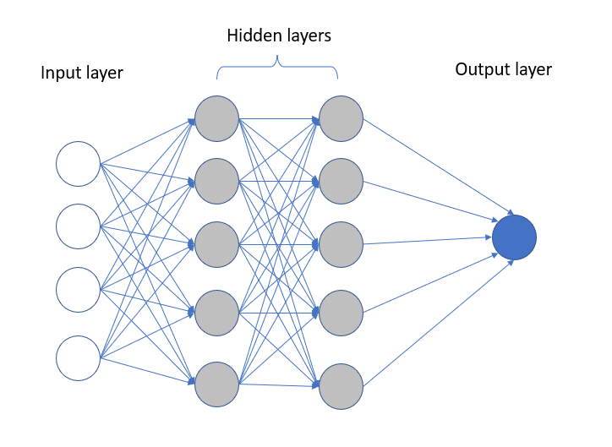
What are neural networks ?
Inspired by how biological neurons process signals
Made of layers: input → hidden → output
Learn patterns by adjusting weights
Powerful for non-linear problems
Backbone of modern Deep Learning
*All the images in PPT are taken from 3rd party sources , author doesn’t claim its rights

Slide 3
Perceptron
Simplest unit of a neural network
Takes inputs, applies weights, adds bias
Passes result through activation function
Outputs a single prediction
Can only solve linearly separable problems

Slide 4
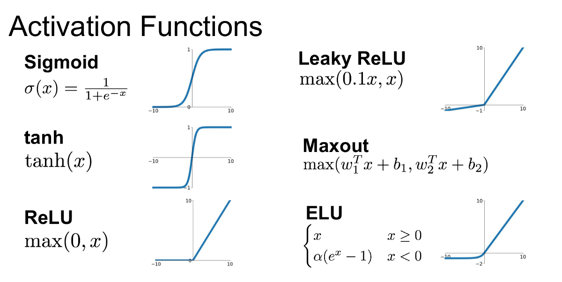
Activation Functions (Why Non-Linearity?)
Introduce non-linearity into the network
Decide whether a neuron “fires”
Help model complex relationships
Different activations suit different tasks
Without them → network becomes linear

Slide 5
Activation Functions (Comparison)
Activation Function | Pros | Cons | Common Usage
Sigmoid | Smooth output between 0–1Interpretable as probability | Vanishing gradientNot zero-centered | Binary classification (output layer)
Tanh | Zero-centered outputsStronger gradients than sigmoid | Vanishing gradient still exists | Hidden layers (shallow nets)
ReLU | Fast convergenceSparse activations | Dead neurons for negative inputs | Default for hidden layers
Leaky ReLU / ELU | Prevents dying ReLUBetter gradient flow | Slightly higher computation | Deep networks
Softmax | Outputs class probabilitiesGood multi-class separation | Sensitive to large logits | Multi-class output layer

Slide 6
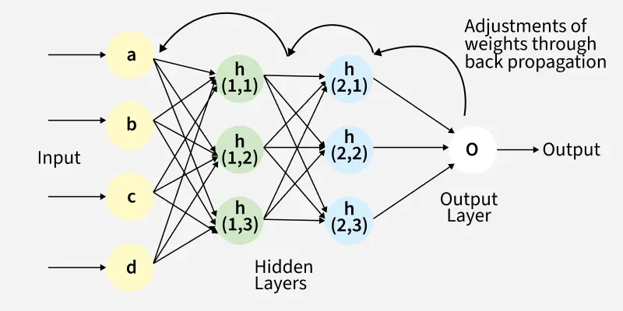
Back-Propagation
Core algorithm for training neural networks
Computes error at output layer
Propagates error backward through layers
Updates weights using gradients
Uses chain rule from calculus

Slide 7
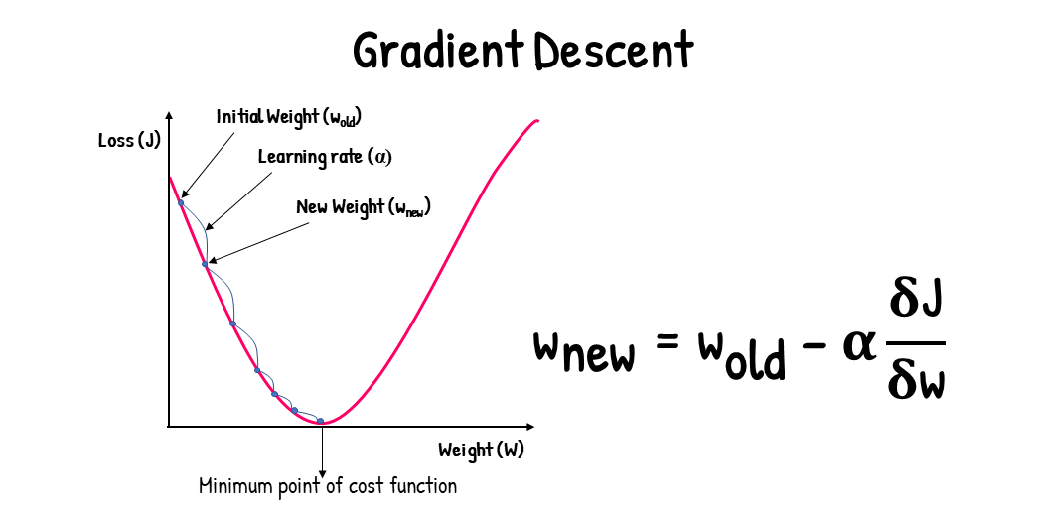
Back-Propagation (Math)
Loss function measures prediction error
Gradient = direction of steepest error increase
We move weights opposite to gradient
Learning rate controls step size
Small steps → stable learning

Slide 8
Back-Propagation (Math)
Given Values
Linear Combination
Sigmoid Output
Binary Cross Entropy Loss
Input (x) = 2
True label (y) = 1
Initial weight (w) = 0.5
Initial bias (b) = 0
Learning rate (η) = 0.1
L = − [ y log(ŷ) + (1 − y) log(1 − ŷ) ]
Since y = 1:
L = − log(0.731)
L ≈ 0.313
z = wx + b
z = (0.5 × 2) + 0
z = 1.0
ŷ = σ(z) = 1 / (1 + e^(−z))
ŷ = 1 / (1 + e^(−1))
ŷ ≈ 0.731
Weight Update
Gradient w.r.t Bias
Gradient w.r.t Weight
Gradient w.r.t z
w_new = w − η (∂L / ∂w)
w_new = 0.5 − 0.1 × (−0.538)
w_new = 0.5538
∂L / ∂b = ŷ − y
∂L / ∂b = −0.269
∂L / ∂w = (ŷ − y) × x
∂L / ∂w = −0.269 × 2
∂L / ∂w = −0.538
∂L / ∂z = ŷ − y
∂L / ∂z = 0.731 − 1
∂L / ∂z = −0.269
After One Gradient Step
Bias Update
Updated parameters:
w = 0.5538
b = 0.0269
Prediction moved closer to y = 1
Loss decreased ✔
b_new = b − η (∂L / ∂b)
b_new = 0 − 0.1 × (−0.269)
b_new = 0.0269

Slide 9
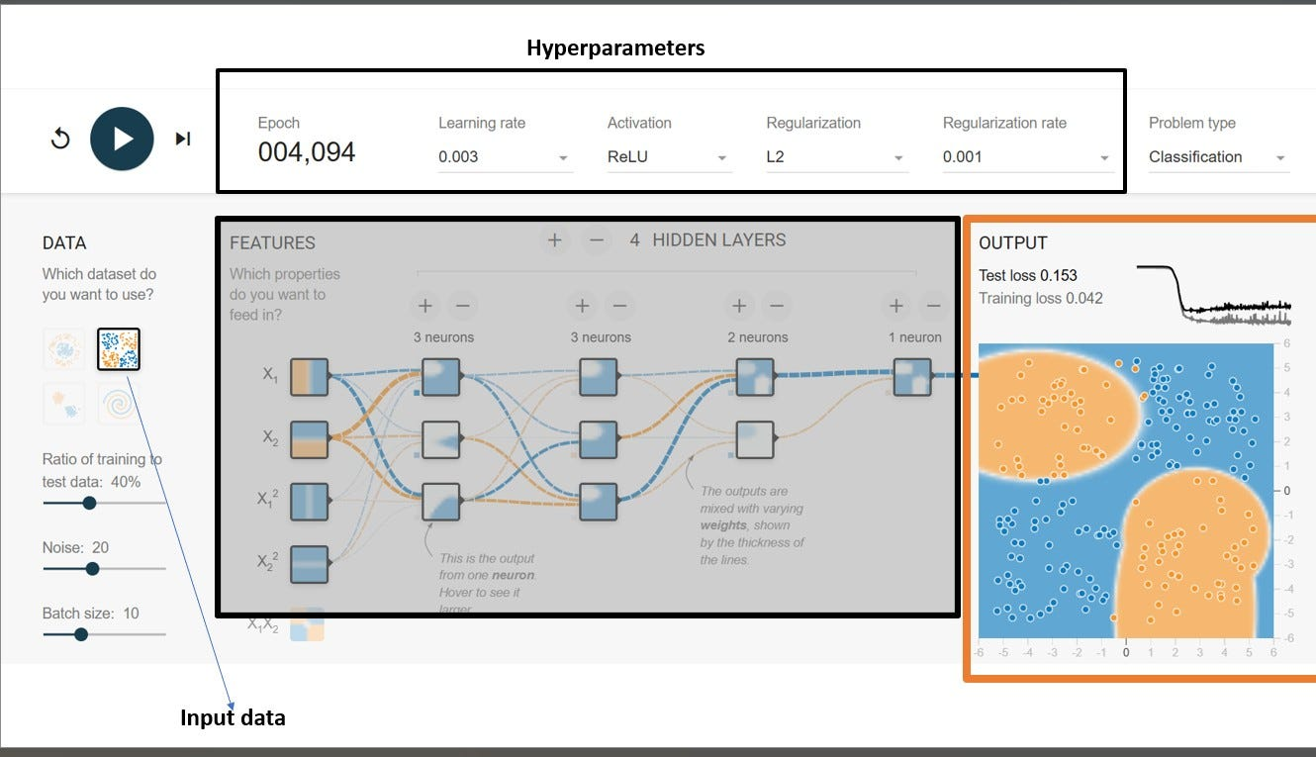
Neural Network (In a nutshell)
Input features are fed into the network
Inputs are multiplied by weights and added with bias
Result passes through an activation function
Forward pass produces final prediction
Loss is computed → backpropagation updates weights → repeat
Demo_Playground

Slide 10
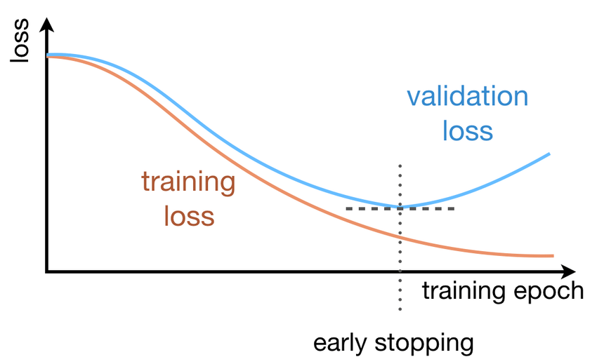
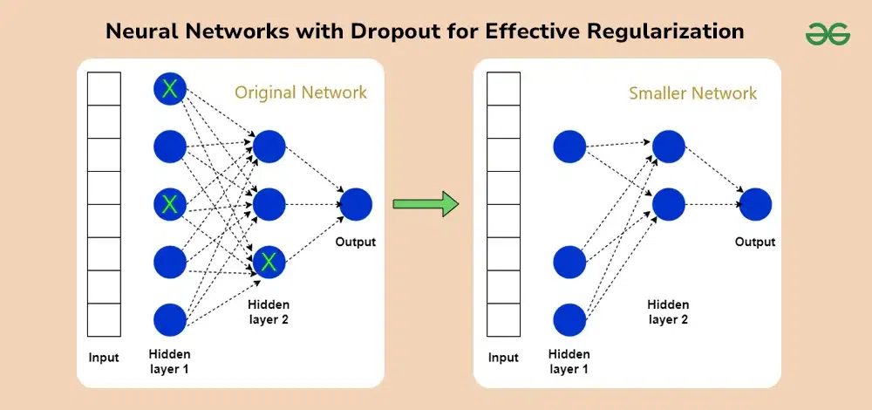
Dropouts & Early Stopping
Overfitting occurs when model memorizes training data
Dropout randomly disables neurons during training
Prevents dependency on specific neurons
Early stopping halts training when validation loss stops improving
Improves generalization on unseen data

Slide 11
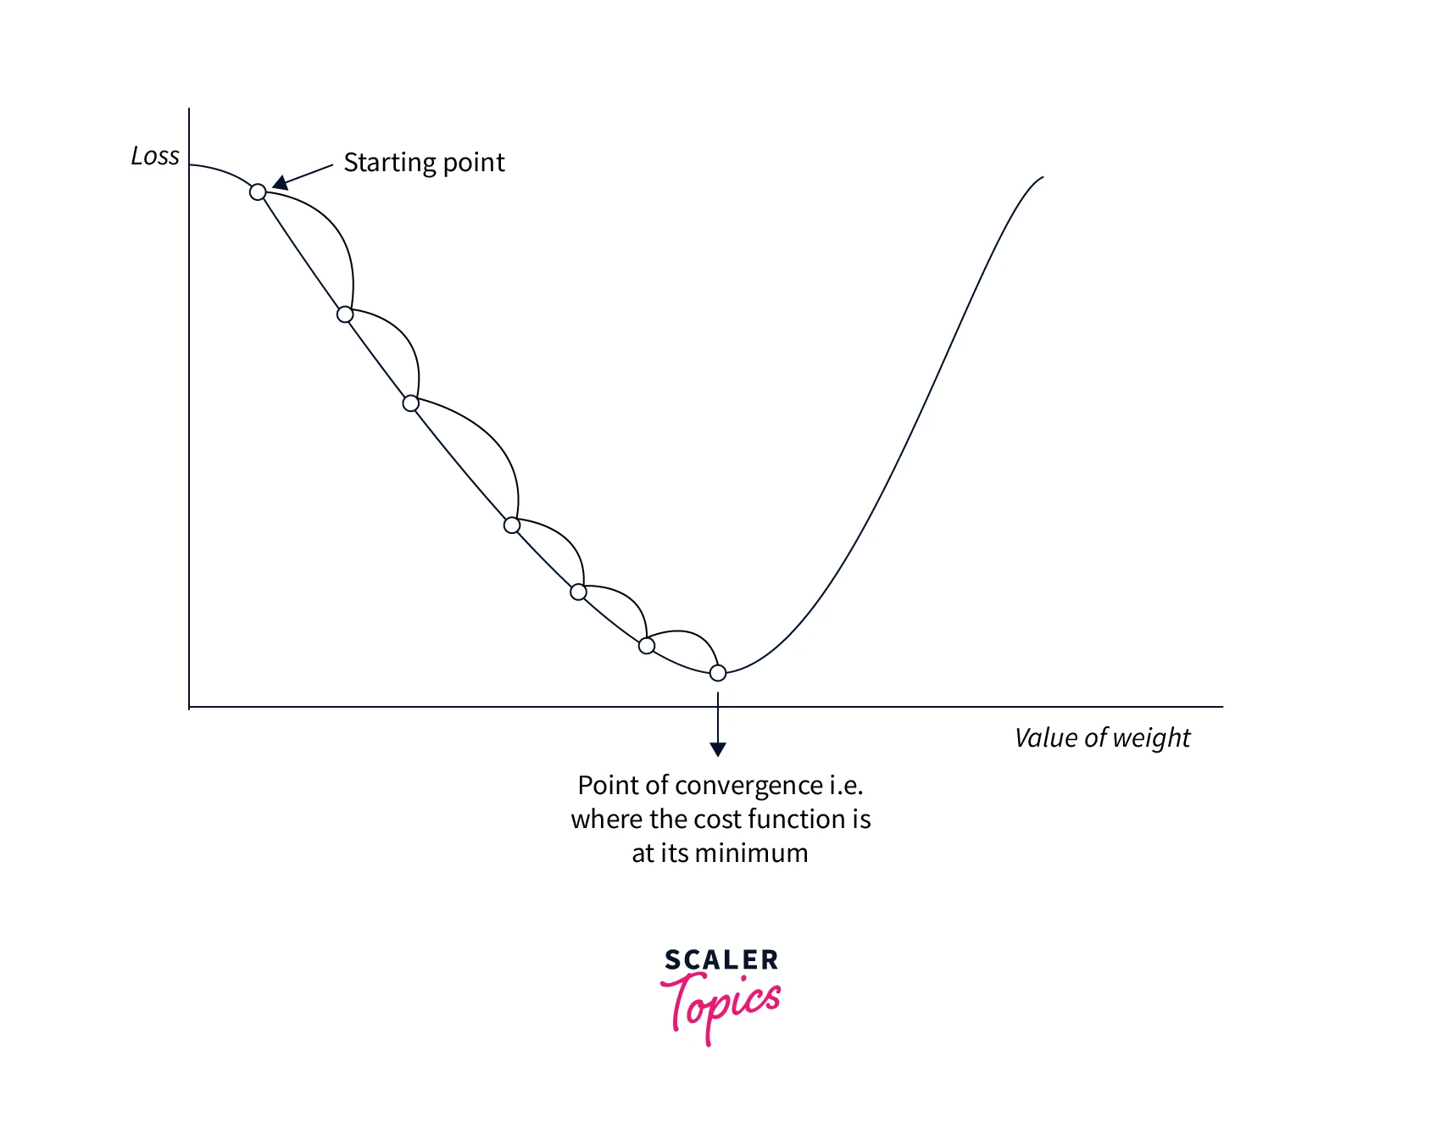
Optimizers
SGD family (SGD, Momentum, NAG) → stable learning, better generalization, slower convergence
Adaptive optimizers (Adagrad, RMSprop, Adam) → faster convergence, automatic learning rates
Improved Adam variants (AdamW, Nadam, AMSGrad) → better regularization & stability
Second-order methods (L-BFGS) → very fast on small datasets, high memory cost
Modern optimizers (Lion) → memory-efficient, designed for large-scale models

Slide 12
Comparison of Optimizers
Optimizer | How it Works | Pros | Cons | When to Use
SGD | Updates weights using raw gradients | Simple, stable, good generalization | Slow convergence, sensitive to LR | Small models, theory demos
SGD + Momentum | Adds velocity to gradient updates | Faster than SGD, smoother updates | Needs momentum tuning | CNNs, vision tasks
Adam | Adaptive LR using momentum + RMS | Fast convergence, low tuning | May generalize worse than SGD | Default choice, most DL tasks
RMSprop | Adaptive LR using moving avg of grads | Works well for non-stationary loss | LR still needs tuning | RNNs, sequence models
Adagrad | LR adapts per parameter | Good for sparse features | LR decays too fast | NLP, sparse data

Slide 13
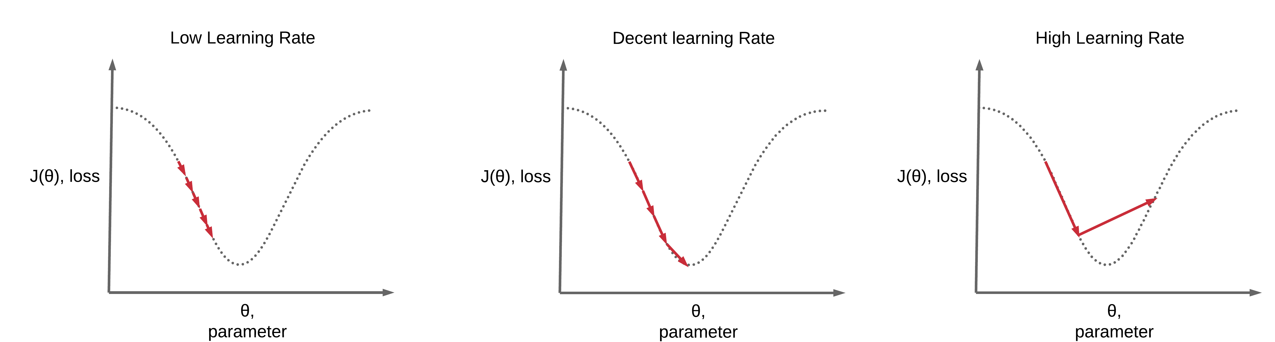
Learning Rate Scheduler
Learning rate shouldn’t stay constant
High LR → fast learning, unstable
Low LR → slow but stable
Schedulers reduce LR over time
Improve convergence and final accuracy

Slide 14
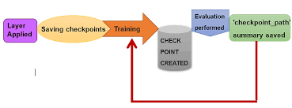
Checkpoints (Saving Your Sanity )
Save model state during training
Prevent loss from crashes
Enable resume training
Keep best performing model
Essential for long training runs

Slide 15
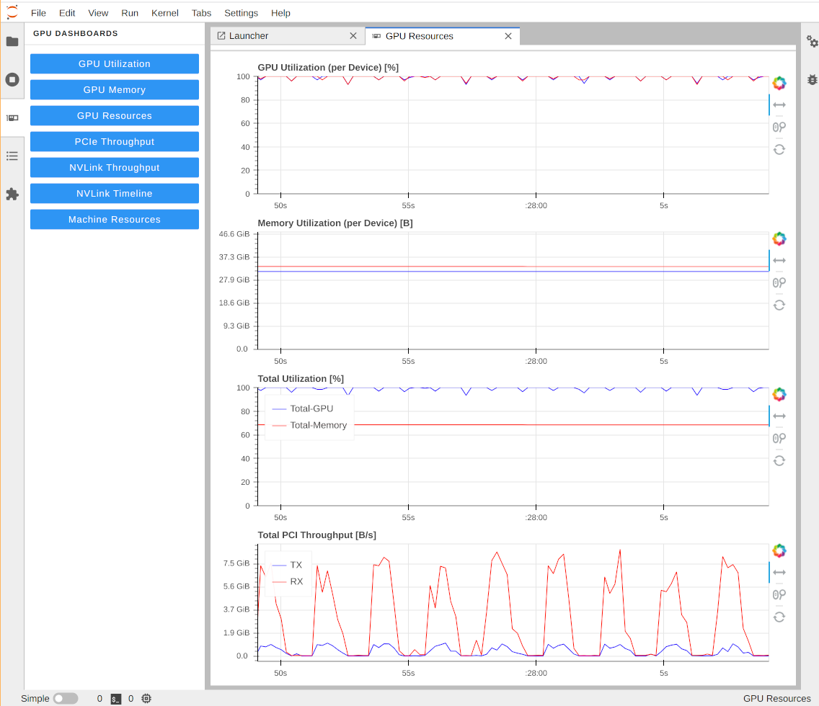
Profiling GPU Utilization
GPU may not always be fully used
Bottlenecks often in data loading
Profiling shows time & memory usage
Helps optimize training speed
Critical for large models

Slide 16
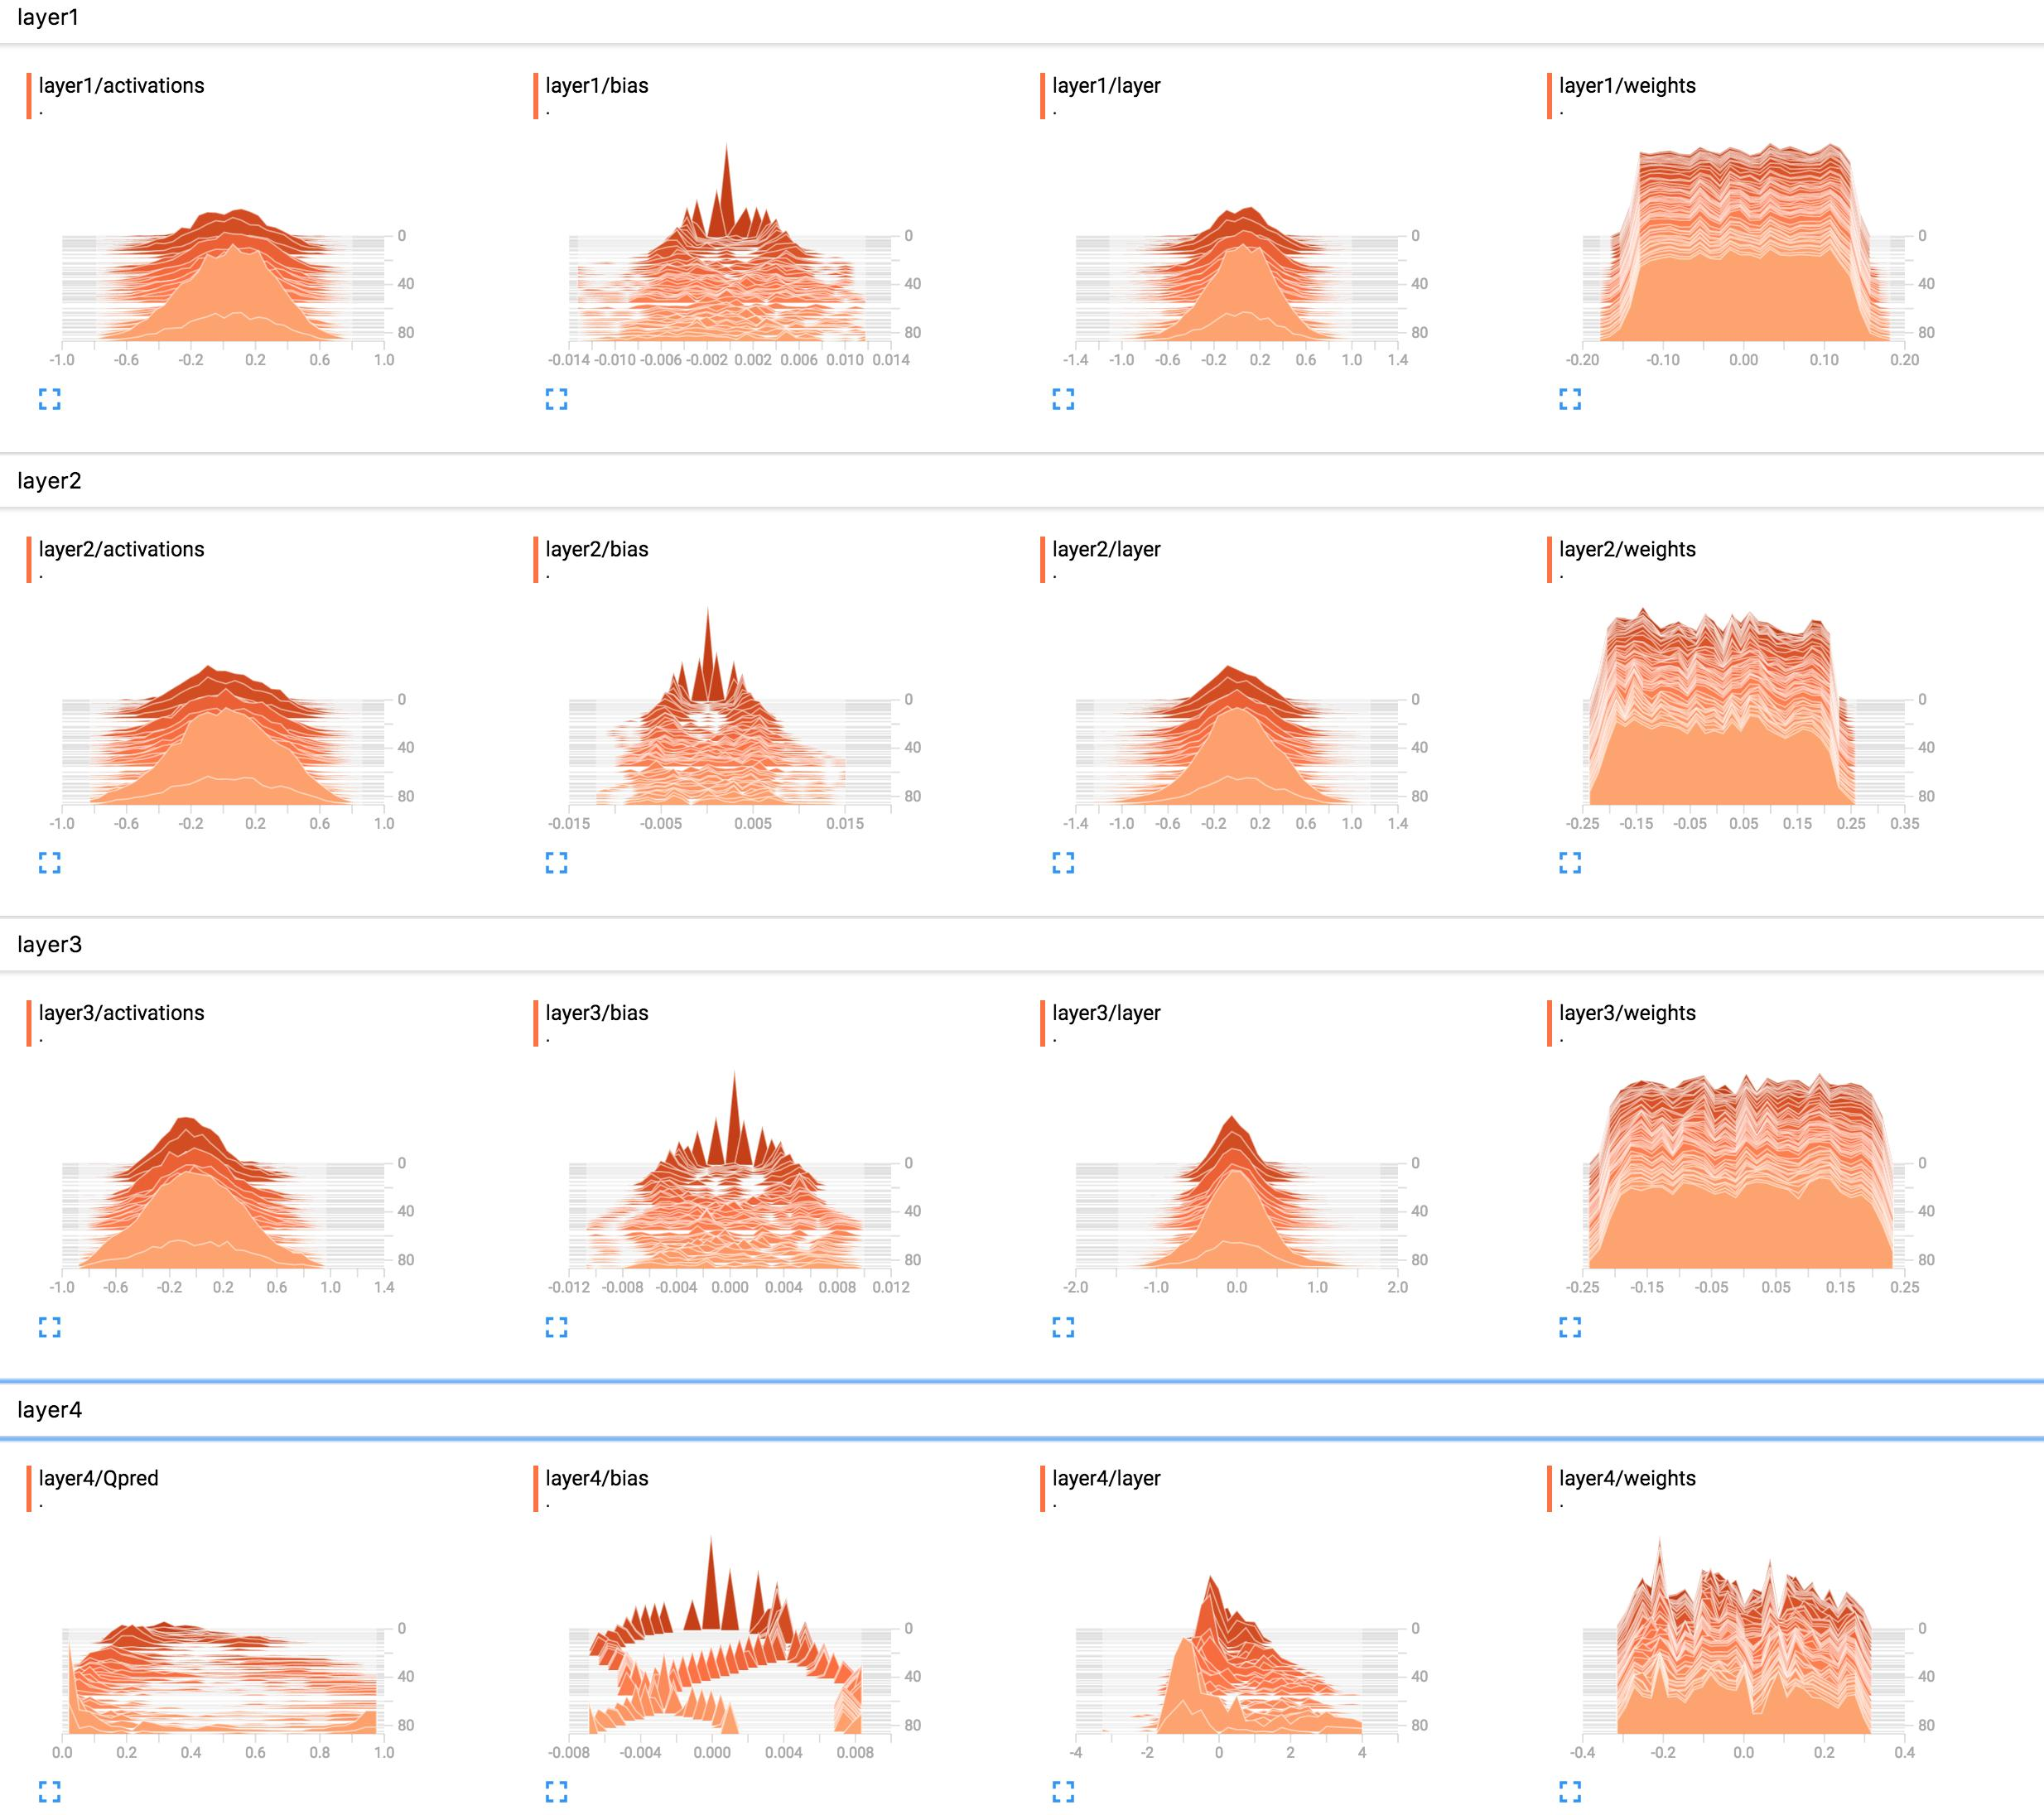
Weight Distribution (Model Health Check)
Show distribution of weights
Detect exploding or vanishing weights
Healthy models have balanced spread
Useful during training monitoring
Often visualized in TensorBoard

Slide 17
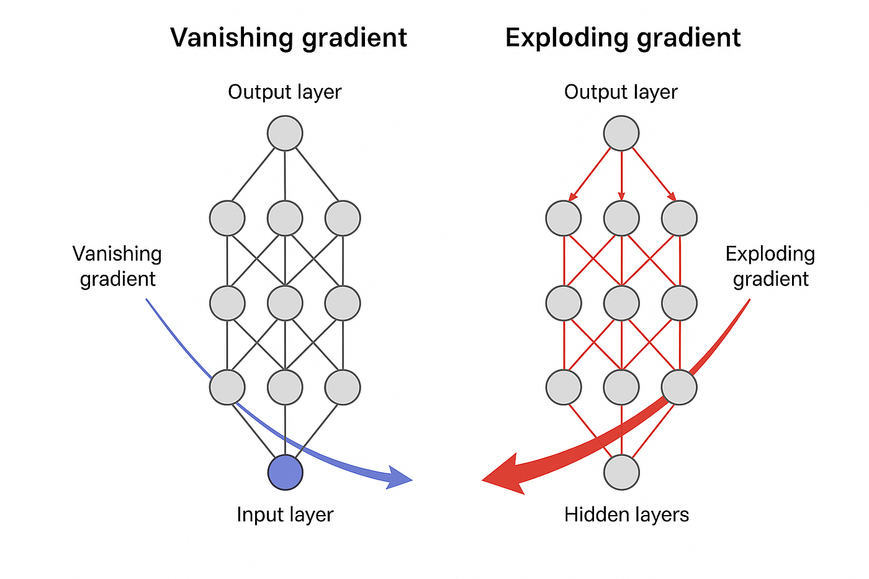
Gradient Anomalies (Silent Killers )
Vanishing gradients slow learning
Exploding gradients cause instability
Common in deep networks
Detected using gradient norms
Fixed via normalization & architecture

Slide 18

Pytorch
PyTorch uses dynamic computation graphs
nn.Module defines model structure
Layers are Python objects
Forward pass defines data flow
Autograd handles gradients automatically

Slide 19
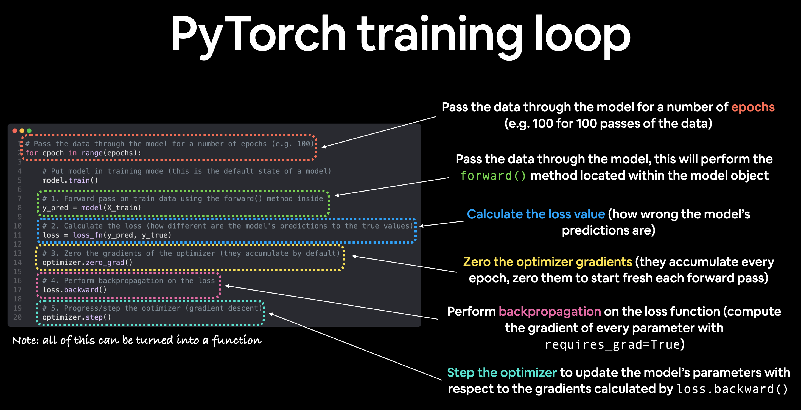
Pytorch Training Loop
Forward pass: compute predictions
Calculate loss
Backward pass: compute gradients
Update weights using optimizer
Repeat for multiple epochs

Slide 20
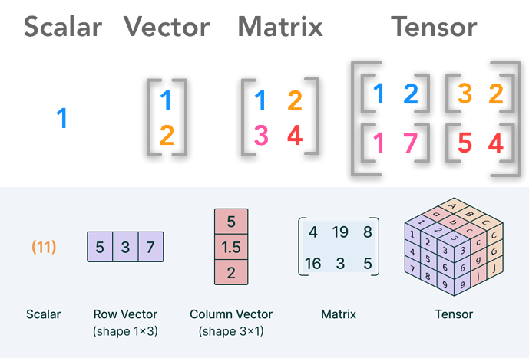
Tensor Operations (Why GPUs Love Them)
Tensors are multi-dimensional arrays
Support fast vectorized operations
Enable parallel computation on GPU
Replace slow Python loops
Core of performance optimization

Slide 21
