Slide 1
Designing a Personalized Instacart Homepage
A product analytics case study using customer purchase behavior to balance repeat shopping and discovery
• Historical market-basket data • SQL + Python analysis • Product strategy + Measurement plan
Instacart Personalized Homepage | 01

Slide 2
Executive Summary
From behavioral evidence to a personalized product strategy
58.97%
of product purchases are reorders
69.02%
reorder rate among high-frequency users
47.51%
reorder rate among medium-frequency users
7 days
strongest observed reorder cadence peak
Core finding
Repeat purchasing is substantial, but customers do not behave uniformly.
Purchase history becomes more reliable as customers mature, making
one-size-fits-all personalization inefficient.
Product recommendation
Create a behavior-based homepage with different prominence for Buy Again
and Discovery.
Prioritize friction reduction for established shoppers while preserving discovery
for users with limited history.
Instacart Personalized Homepage | 02

Slide 3
The Product Problem
Why redesign the homepage?
Observed problem
Customers repeatedly buy many of the same grocery products across shopping
sessions.
A generic homepage does not explicitly adapt to the strength of a customer's
purchase history.
The product opportunity is to reduce repeat-shopping effort without removing
opportunities for discovery.
Project objective
Analyze reorder behavior, purchase cadence, category patterns and customer
maturity.
Translate findings into a personalized homepage strategy.
Define how feature success would be measured and propose an experiment for
validation.
Core question: How can customer purchase behavior be used to create a more personalized and efficient shopping experience?
Instacart Personalized Homepage | 03

Slide 4
Data & Analytical Approach
The project moves from evidence → insight → product decision
1
Business questions
17 questions across reorder behavior, timing, basket composition and segmentation
2
SQL analysis
Joined order, product, aisle and department data to quantify behavioral patterns
3
Python + dashboards
Visualized distributions, category patterns, cadence and customer segments
4
Product strategy
Mapped findings to Buy Again, Discovery and future recommendation opportunities
5
Measurement
Defined feature-level success metrics and an experiment-ready measurement plan
Instacart Personalized Homepage | 04

Slide 5
Analytical Framework
The questions were selected to answer product decisions—not to produce isolated charts
Repeat behavior
How large is repeat purchasing, and which products/categories are strongest
candidates?
Cadence & timing
When do customers return, and when are they most likely to interact with the
homepage?
Customer maturity
How does behavior change as order history grows?
Basket behavior
How do exploration and repeat purchasing coexist?
Personalization fit
Which customer segments should receive which experience?
Instacart Personalized Homepage | 05

Slide 6
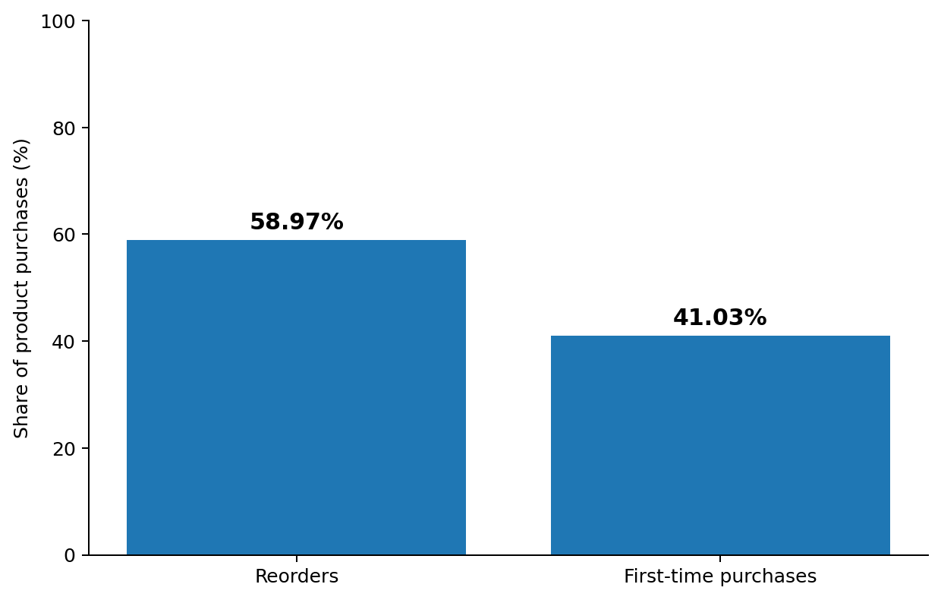
Insight 1 — Repeat Purchasing Is a Major Behavior
The first question: Is there enough repeat behavior to justify a dedicated reordering experience?
What the data says
58.97% of product purchases are reorders at the transaction level.
When every customer is weighted equally, the average repeat share is still
43.22%, showing the pattern is broader than only heavy users.
High-frequency customers contribute disproportionately to transaction
volume, so both transaction-level and customer-level views were considered.
Product implication: Build a visible Buy Again experience, but personalize its prominence rather than treating every customer identically.
Instacart Personalized Homepage | 06

Slide 7
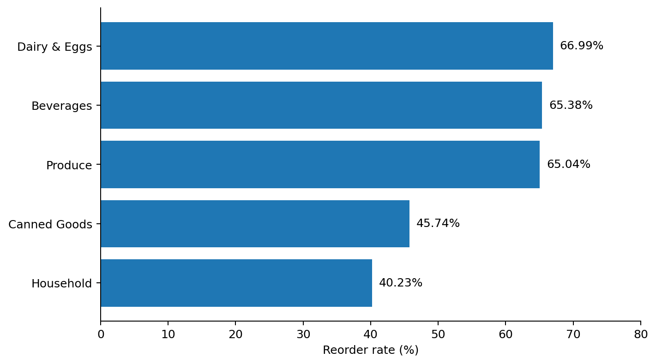
Insight 2 — Repeat Behavior Is Category-Specific
Not every product deserves equal homepage priority
What the pattern means
Dairy & Eggs, Beverages and Produce have the strongest department-level
reorder behavior.
At aisle level, Milk reaches 78.15% and Fresh Fruits 71.84% reorder rate.
High reorder rate alone is not enough: product volume should also be
considered to avoid over-prioritizing niche items with tiny samples.
Product implication: Rank Buy Again candidates using behavioral confidence signals such as prior purchases, reorder rate and sufficient historical volume.
Instacart Personalized Homepage | 07

Slide 8
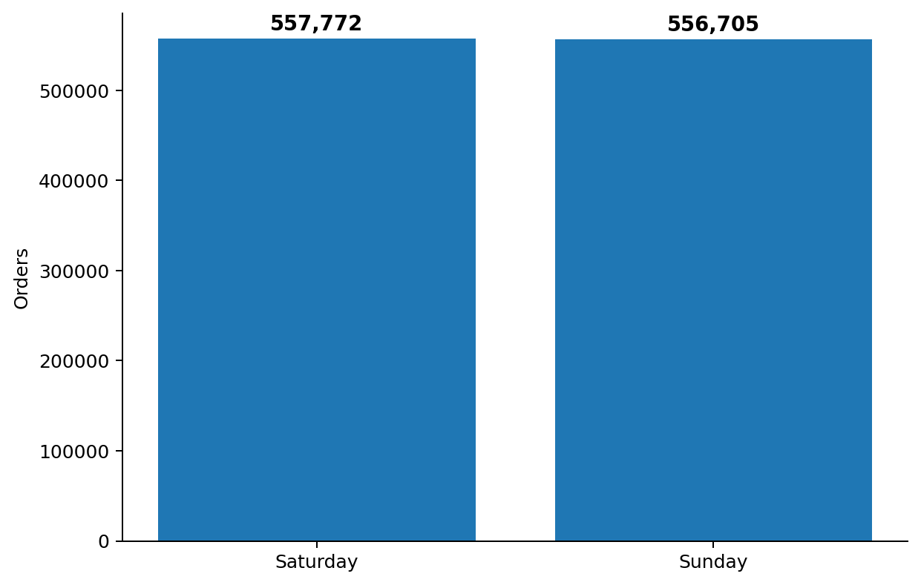
Insight 3 — Shopping Follows a Clear Rhythm
Cadence and timing can inform when personalized content is most useful
306,181
orders at the 7-day cadence peak
10 AM
highest observed hour: 271,885 orders
Interpretation
Order volume peaks on Saturday and Sunday, while daytime activity is
concentrated between 10 AM and 4 PM.
The strong 7-day peak suggests a meaningful weekly shopping rhythm.
Product implication: Cadence is a useful personalization signal. A future “Running Low” experience should be treated as a hypothesis to validate—not as something the historical data proves directly.
Instacart Personalized Homepage | 08

Slide 9
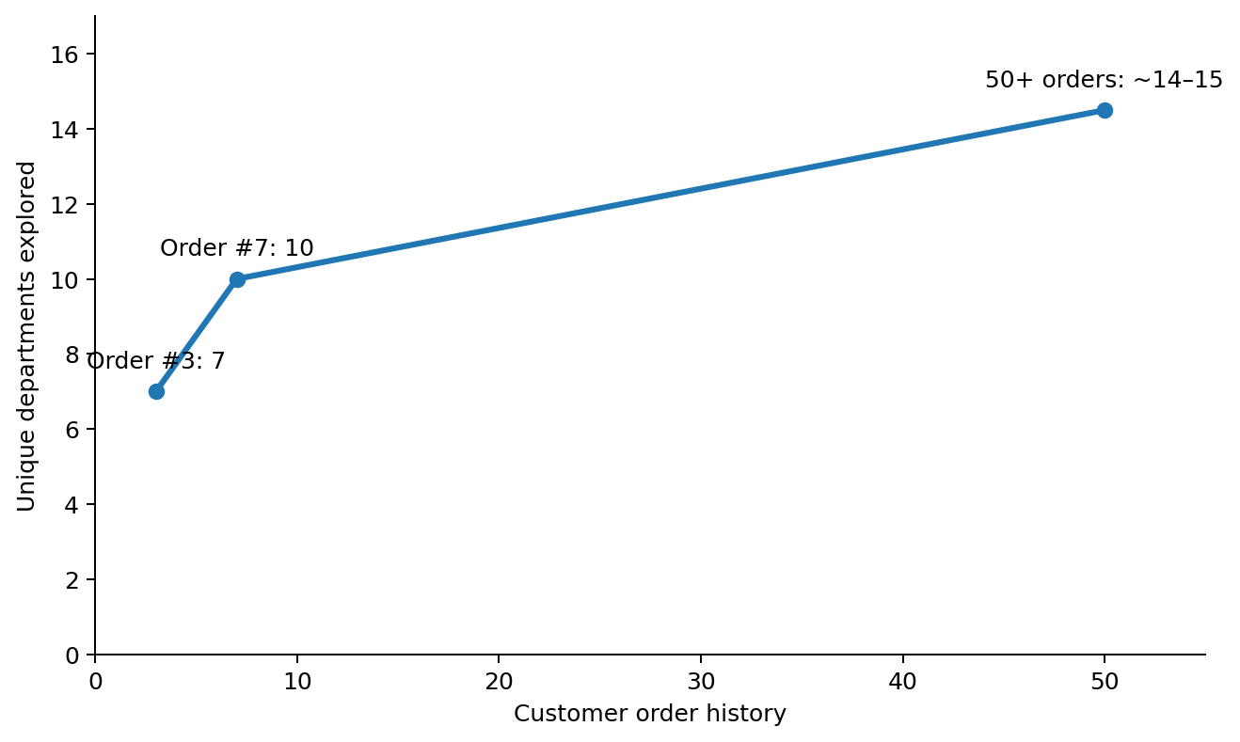
Insight 4 — Customer Maturity Changes What the Homepage Should Do
Exploration dominates early; repeat behavior becomes more reliable as history grows
Key observations
Customers expand across departments quickly early in their lifecycle, then
exploration plateaus around 14–15 departments.
Reorder behavior rises sharply during the first 5–6 orders, reaching 54.51%,
before growth slows.
This creates an evidence-backed reason to progressively increase
personalization instead of showing the same homepage from day one.
Product implication: Shift the homepage balance from Discovery → mixed experience → Buy Again as purchase history becomes more informative.
Instacart Personalized Homepage | 09

Slide 10
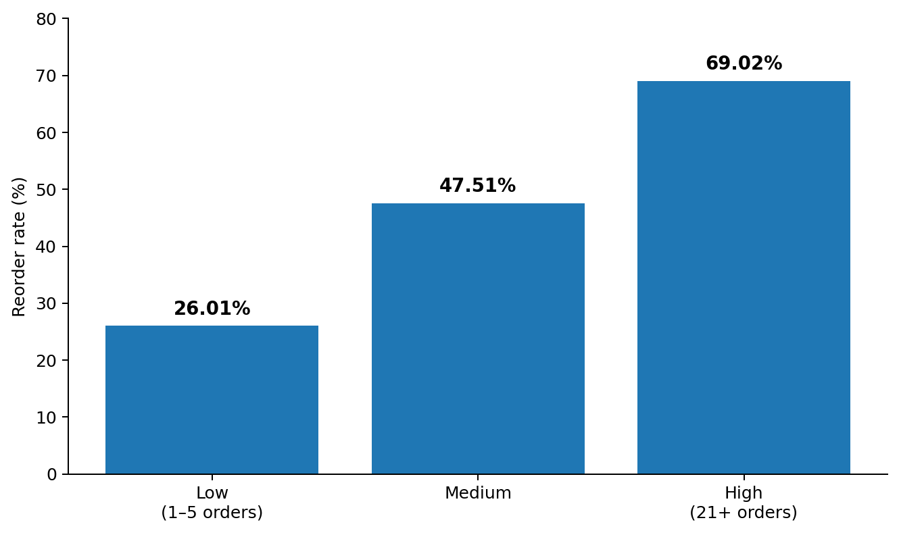
Insight 5 — Segmentation Is the Core Personalization Lever
Purchase frequency is a practical proxy for how much behavioral signal the product has
Segment strategy
Low frequency (1–5 orders): 26.01% reorder rate → discovery-heavy
experience.
Medium frequency: 47.51% reorder rate and 98,658 users → strongest
growth opportunity for a balanced experience.
High frequency (21+ orders): 69.02% reorder rate and 47,810 users →
strongest candidates for Buy Again.
Instacart Personalized Homepage | 10

Slide 11
The Product Recommendation — A Behavior-Based Homepage
Same platform. Different homepage emphasis based on customer maturity.
Low-frequency
Medium-frequency
High-frequency
Discovery-first
Balanced experience
Buy Again-first
More category and product exploration;
limited history means weaker repeat signals.
Buy Again alongside relevant Discovery; the exact allocation can be optimized through experimentation.
Prominent repeat shortcuts plus personalized recommendations based on established history.
Discovery
Discovery
Discovery
Buy Again
Buy Again
Buy Again
Recommendations
Recommendations
Recommendations
Instacart Personalized Homepage | 11

Slide 12
Feature Design — What Each Module Is Expected to Do
Buy Again and Discovery share a measurement structure but solve different user needs
Buy Again
Surfaces products the customer has purchased before.
Prioritizes reliable staples and frequently repeated products.
Primary value: reduce search and selection effort for repeat shopping.
Best fit: established customers with enough behavioral history.
Discovery
Surfaces relevant new products and categories.
Uses limited purchase history as a starting point rather than requiring deep
behavioral history.
Primary value: help customers explore and convert relevant new products.
Best fit: newer and lower-frequency customers, with a balanced role for
medium-frequency users.
Instacart Personalized Homepage | 12

Slide 13
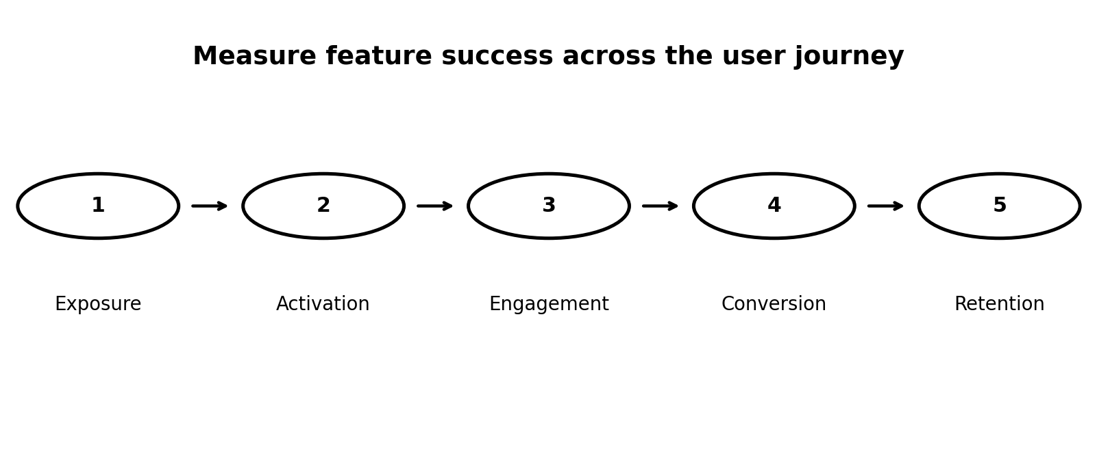
Measurement Framework
Metrics are defined around the user journey, not chosen because they are generic product metrics
Buy Again focus
Successful repurchase of previously purchased products, with shopping efficiency
as an additional outcome.
Discovery focus
Discovery and purchase of relevant new products; conversion is more important
than long-term feature retention.
Instacart Personalized Homepage | 13

Slide 14
Feature-Level Success Metrics
The same lifecycle stages apply to both modules, but the desired behavior differs
Metric stage
Buy Again — KPI question
Discovery — KPI question
Focus / North Star
Are users successfully using Buy Again to repurchase products they have previously purchased?
Are users discovering and purchasing relevant new products through Discovery?
Exposure
How many eligible homepage users see and interact with the module?
How many eligible homepage users see and enter the Discovery section?
Activation
How many users add a previously purchased product to cart after interacting?
How many users add a newly discovered product to cart after interacting?
Engagement
How frequently do activated users return to and interact with Buy Again?
How frequently do users explore and interact with Discovery recommendations?
Conversion / Outcome
How many users complete a purchase containing products selected through Buy Again?
How many users complete a purchase containing a product discovered through the feature?
Retention
After initial success, how many users return to use Buy Again within a defined period?
Optional supporting metric: do users return to Discovery in future sessions?
Instacart Personalized Homepage | 14

Slide 15
Validation Plan & Portfolio Takeaway
The analysis identifies an opportunity; experimentation is needed to establish causal impact
Proposed A/B test
Control: existing/generic homepage experience.
Treatment: behavior-based homepage with segment-specific prominence for
Buy Again and Discovery.
Primary evaluation: feature conversion/outcome metrics, supported by
engagement and shopping-efficiency signals.
Guardrails: overall purchase behavior and discovery should not deteriorate
while optimizing repeat purchases.
Limitations & next steps
Historical market-basket data does not contain homepage impressions, clicks or
experiment exposure.
The proposed product metrics are therefore a future measurement plan rather
than values calculable from this dataset.
Running Low and frequently-bought-together recommendations require
additional modeling/validation before implementation.
Next: finalize formulas, event instrumentation, experiment hypothesis and
success criteria.
Portfolio narrative: Business problem → behavioral evidence → segmentation → product strategy → success metrics → experiment plan.
Instacart Personalized Homepage | 15

