Slide 1
EVENT MANAGEMENT
FR
FABRIKAM RESIDENCES
-MANSI . S . KAPADIA

Slide 2
About Of Event Management :
The system has 3 sides of users which are the
1.Admin
2. Vendor and
3. User.
The Admin user is in charge of managing the Account, Manage Category, Manage User and Manage Vendors, It also search Event.
The Regular User will be the one who can Login view Multiple Event select particular Event and book event.
“Event Management” is web-based system which provides facility to manage wedding for couples, it allows Vendors to show their events on website and user can plan their wedding effectively.”

Slide 3
Technologies Used :
Software Configuration
Software | Visual Studio 2010, MS – SQLSERVER 2008
Front – End | CSS, JAVASCRIPT, AJAX, BOOTSTRAP
Back – End | MS – SQLSERVER
Other Tools | ASP.NET with VB.NET
Browsers | Google Chrome, Internet Explorer, Mozilla Firefox

Slide 4
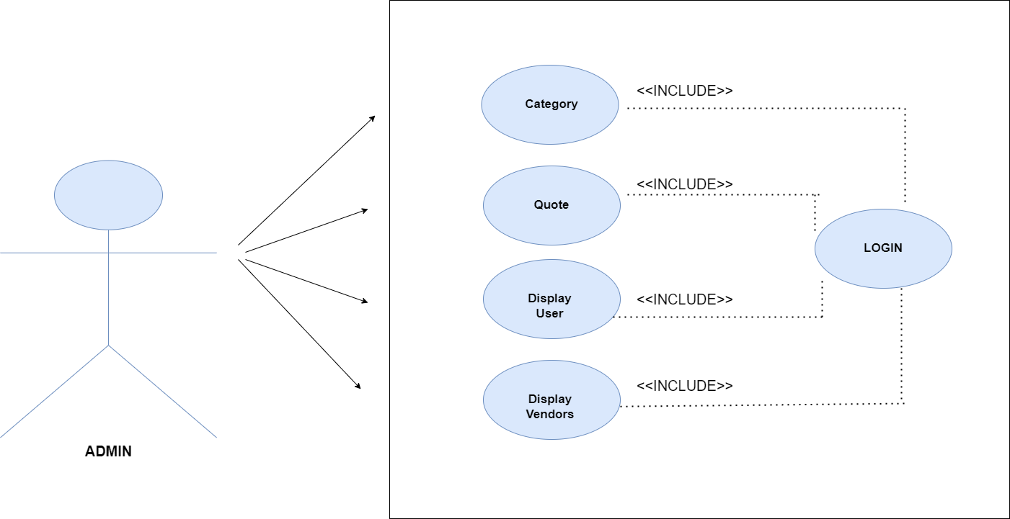
ADMIN MODULE AND FUNCTIONALITIES :
Admin can Signin.
Admin can manage own profile.
Admin can change password.
Admin can view/manage vendor
Admin can display user and vendor details.
MANSI KAPADIA

Slide 5
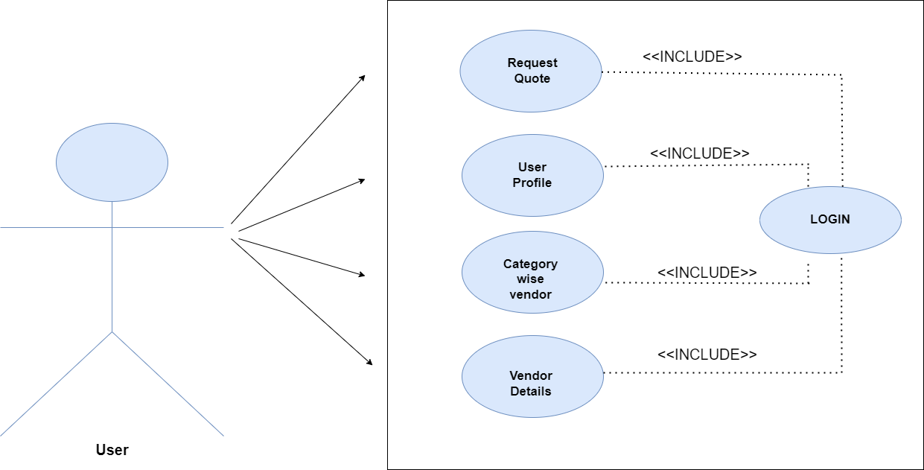
USER MODULE AND FUNCTIONALITIES :
User can create his/her own profile and register to website.
After get approved by Admin User can login to website.
User can manage own profile.
User can also add/edit own profile
User can request quote.
User can see category wise vendor.
User can see vendor details.
MANSI KAPADIA

Slide 6
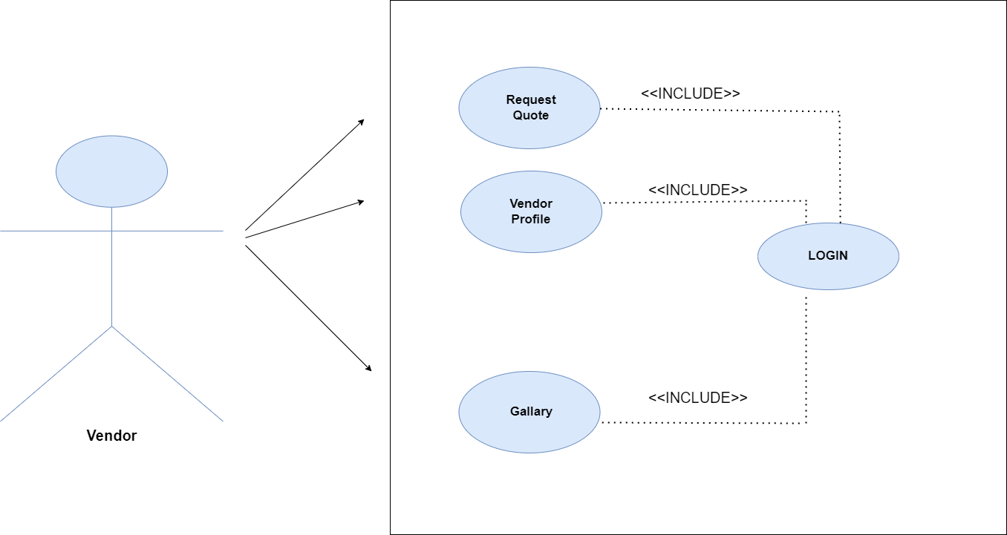
Vendor MODULE AND FUNCTIONALITIES :
Vendor can create own profile and register to website
After get approved by Admin Vendor can login to website.
Vendor can manage own profile.
MANSI KAPADIA

Slide 7
ENTITY RELATIONSHIP :
MANSI KAPADIA

Slide 8
THANK YOU
MANSI . S . KAPADIA
S.D.J.I.C

