Slide 1
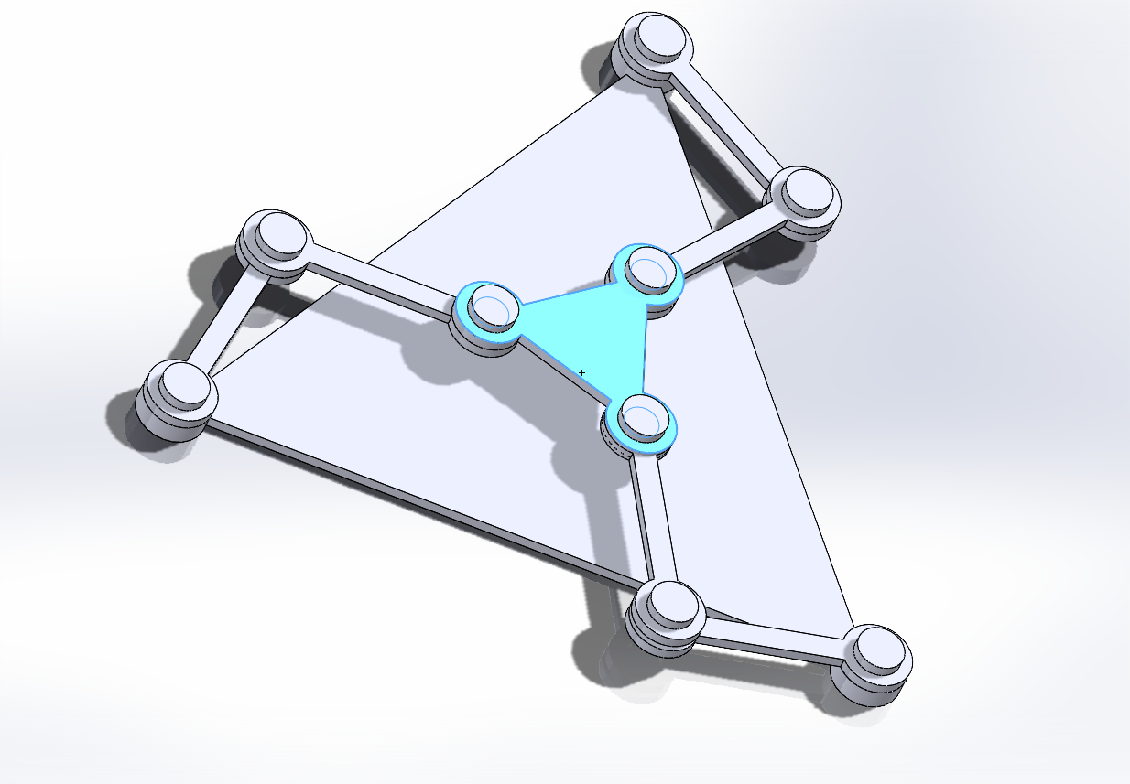
TERM PROJECT 2025
KINEMATICS OF MECHANISMS AND ROBOTS (2202)
KINEMATIC ANALYSIS OF 3-3R PLANAR PARALLEL MANIPULATOR

Slide 2
PROJECT BY :
DURGESH YADAV (2023MEB004)
MANSI MEHRA (2023MEB006)
ROHIT KUMAR (2023MEB008)
ANKITA KUMARI (2023MEB020)
AMAN DAULAT WANKHEDE (2023MEB062)

Slide 3
INTRODUCTION
The study of a planar parallel manipulator with a 3-3R configuration. The manipulator consists of equal-length links connecting a fixed base and a moving platform, both shaped as equilateral triangles. The project includes analysis of degrees of freedom, forward and inverse kinematics, animation of the manipulator, and identification of singular configurations. Link lengths are based on the average of the last digits of the group members' roll numbers.

Slide 4
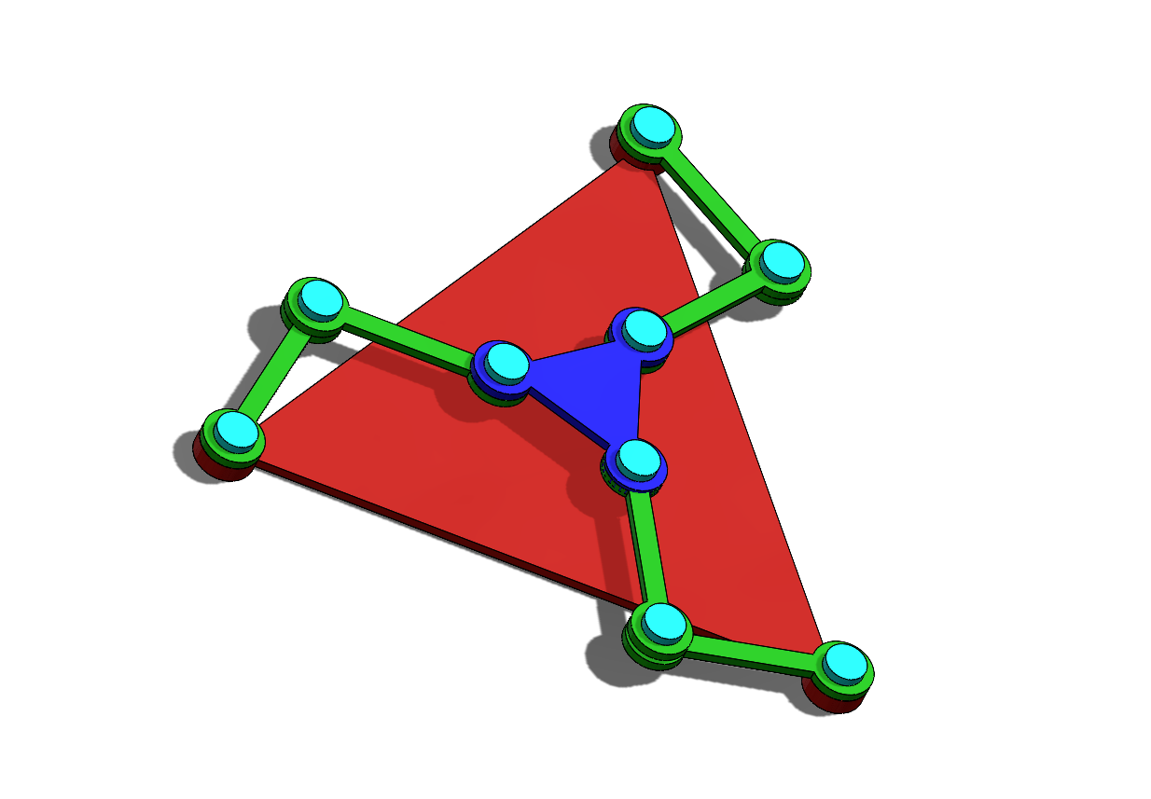
3-3R PLANAR PARALLEL MANIPULATOR MODEL :
LINKS
BASE
PLATFORM
ALL LINK LENGTS ARE EQUAL.
THE BASE AND MOVING PLATFORM ARE EQUILATERAL TRIANGLES

Slide 5
DEGREE OF FREEDOM (DOF)
DOF = 3(N-1) -3J + ∑ f
USING GRUBLER-KUTZBACH CRITERION FOR PLANAR MECHANISM
WHERE,
N = NO. OF LINKS
J = NO.OF JOINTS
F = DEGREE OF FREEDOM OF JOINTS

Slide 6
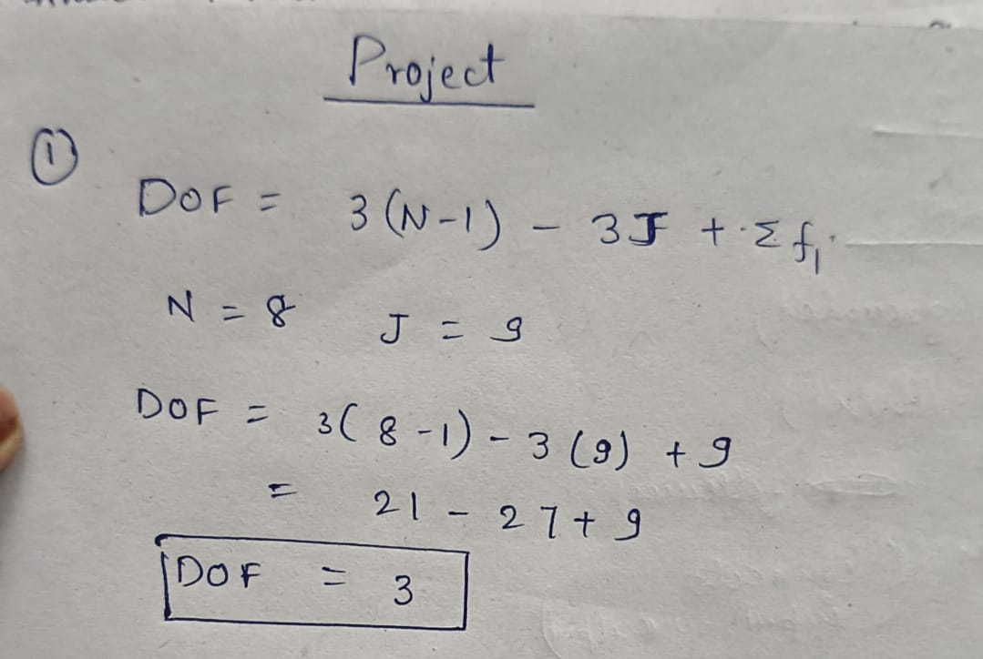
DEGREE OF FREEDOM (DOF)
HERE,
N = __
J = __
F = __

Slide 7
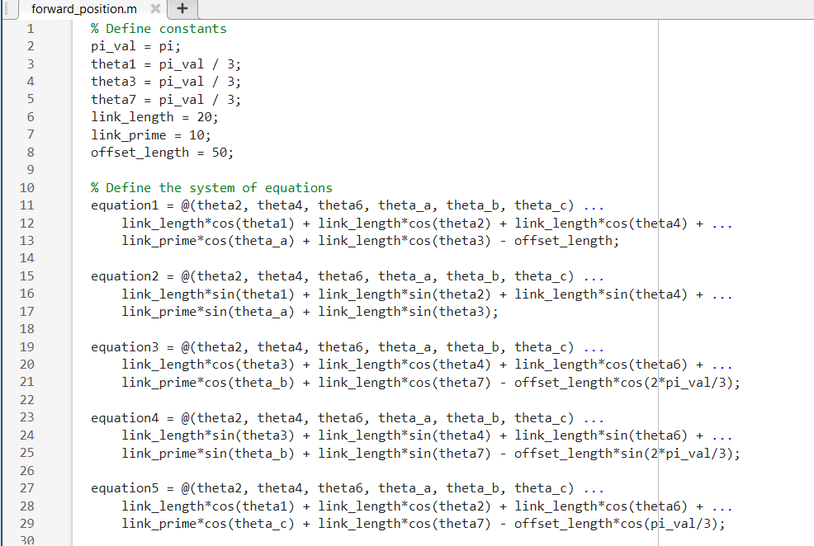
Forward position

Slide 8
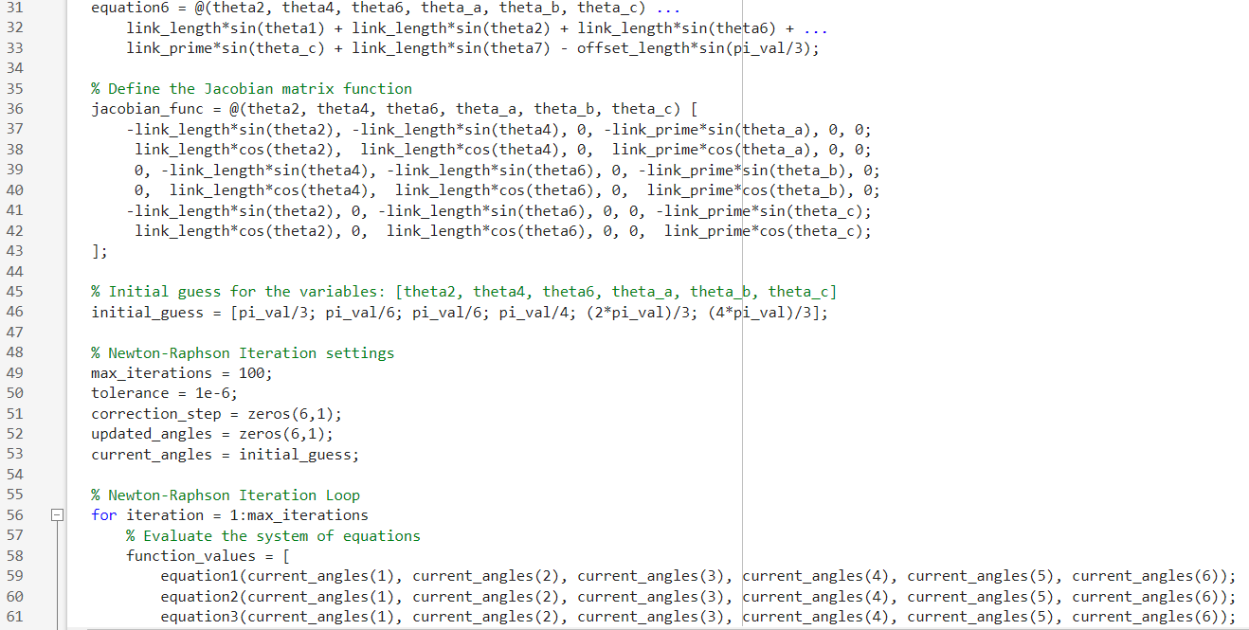

Slide 9
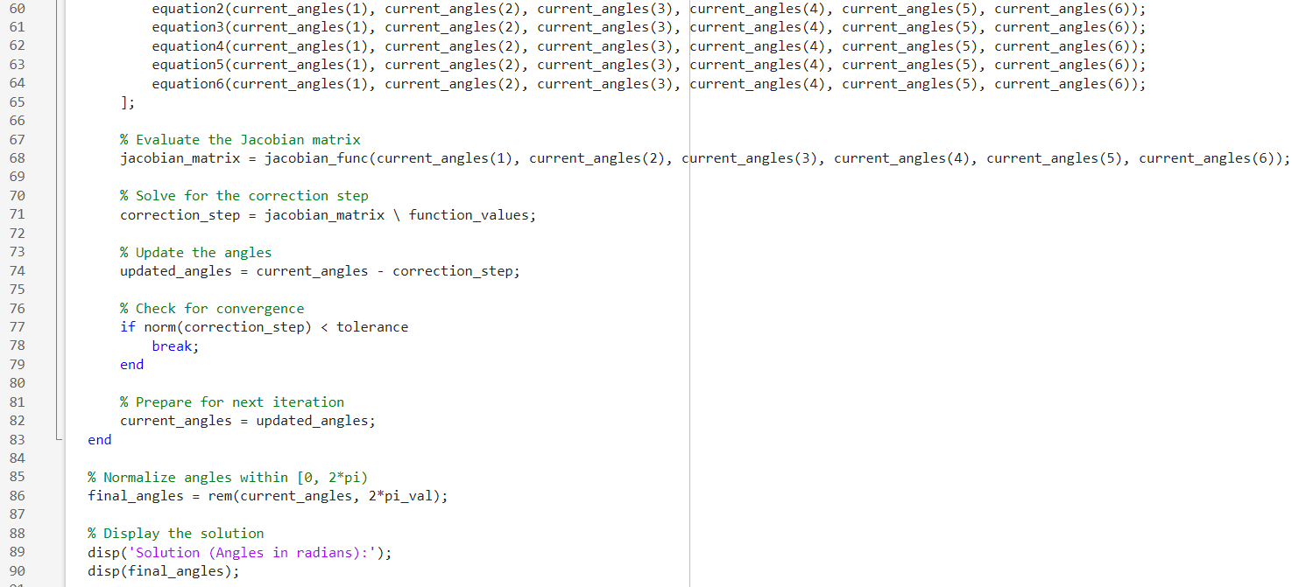

Slide 10
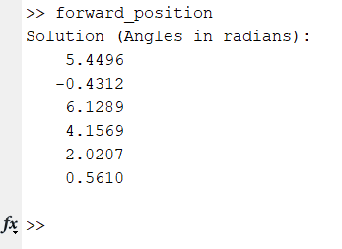
Forward position output

Slide 11
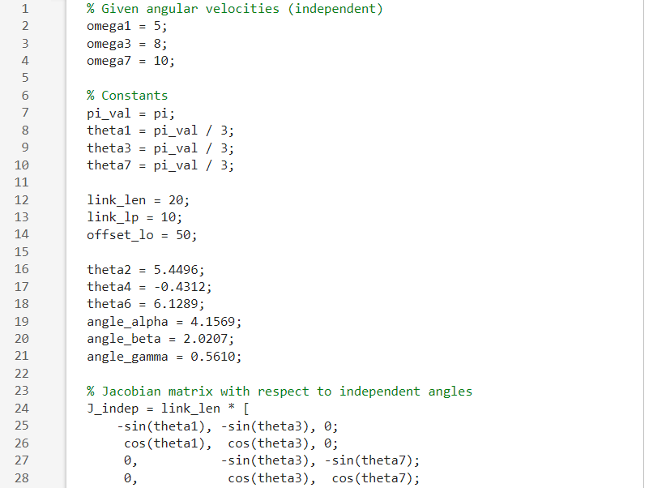
Forward Velocity

Slide 12
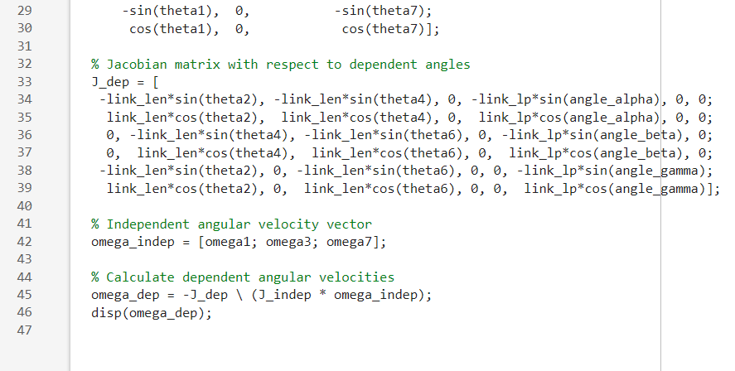

Slide 13
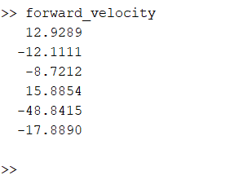
Forward Velocity output

Slide 14
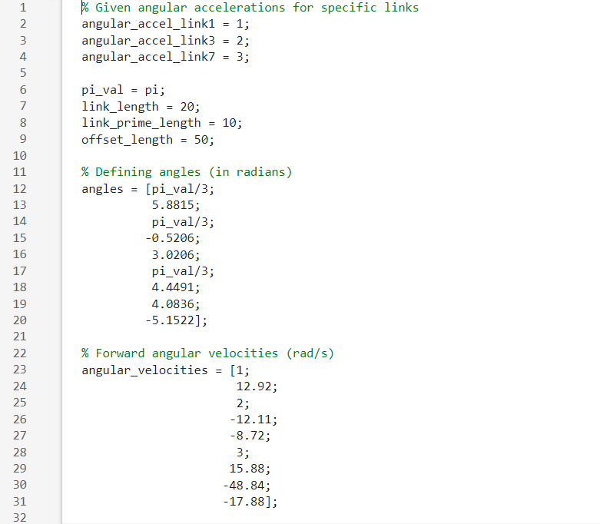
Forward Acceleration

Slide 15
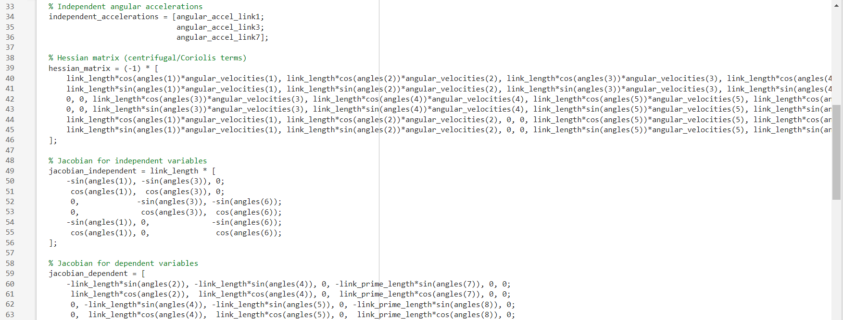

Slide 16
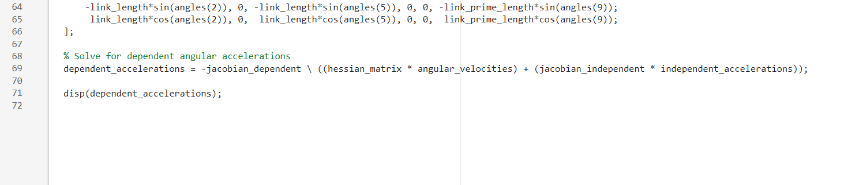

Slide 17
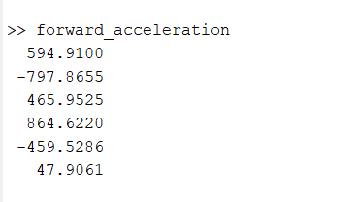
Forward Acceleration Output

Slide 18
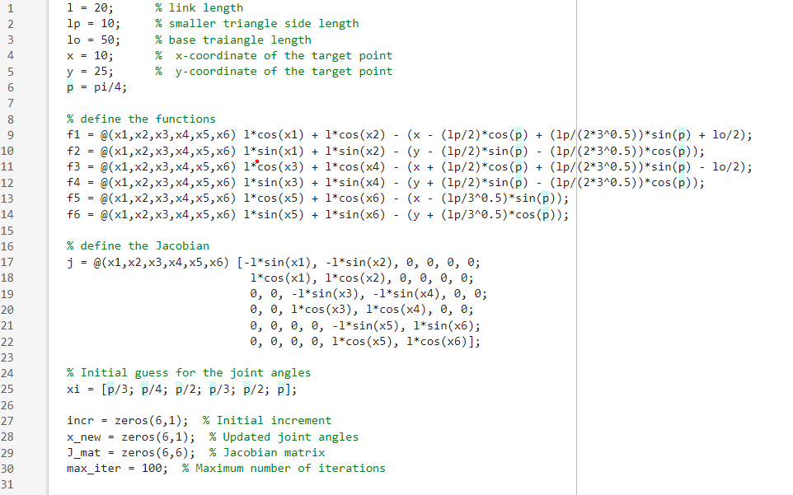
Inverse Position code

Slide 19
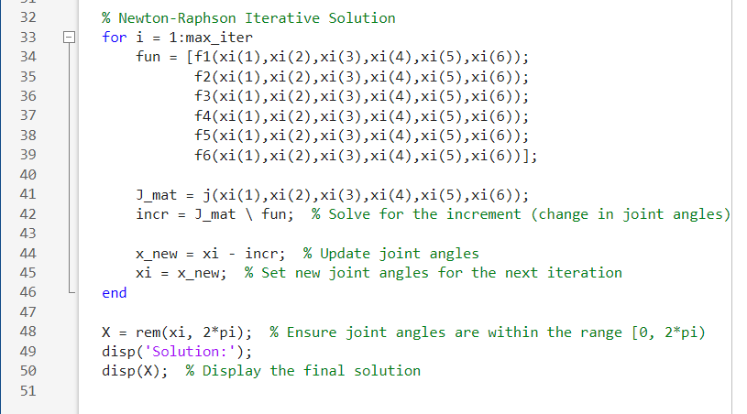
Inverse Position Code

Slide 20
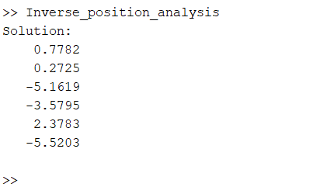
Inverse Position Output

Slide 21
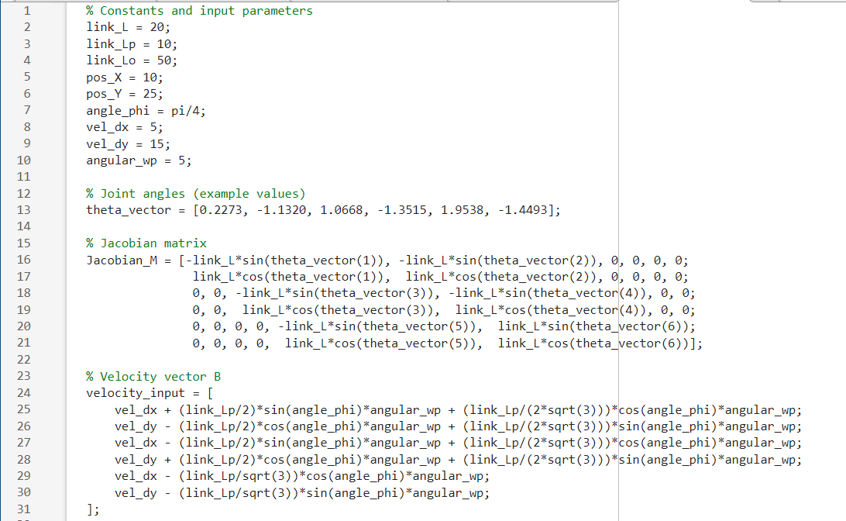
Inverse Velocity Code

Slide 22
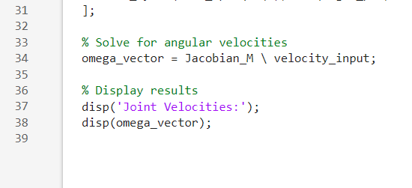
Inverse Velocity Code

Slide 23
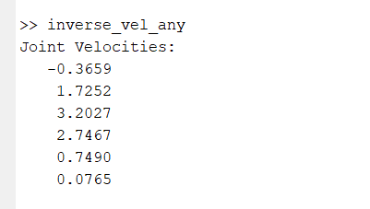
Inverse Velocity Output

Slide 24
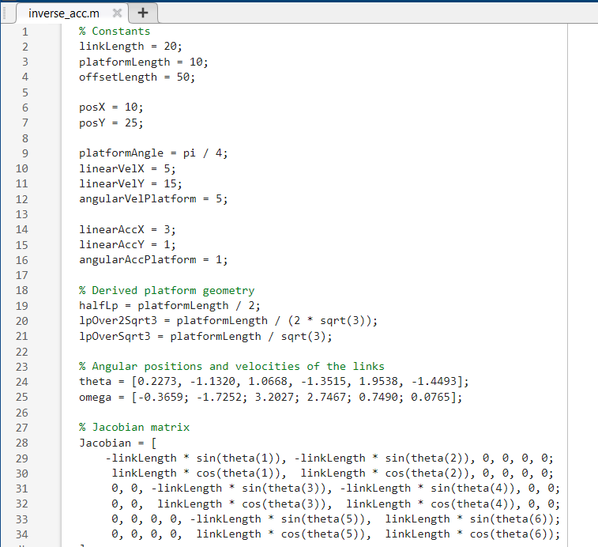
Inverse Acceleration Code

Slide 25
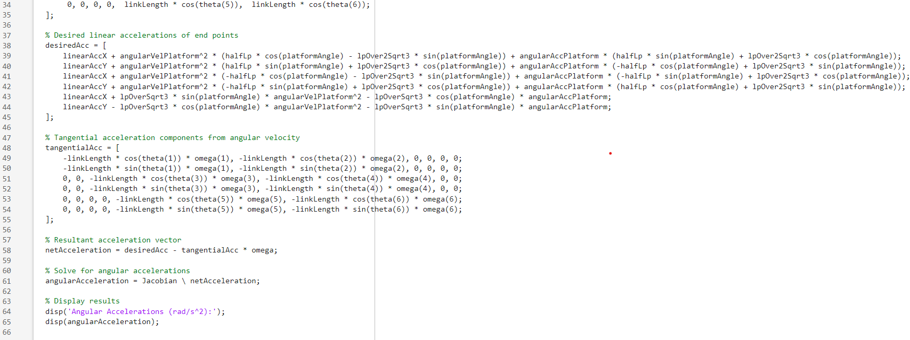

Slide 26
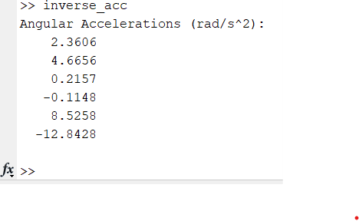
Inverse acceleration Output:

Slide 27
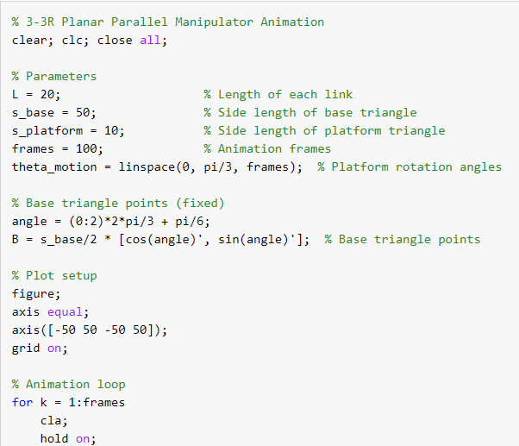
CODE FOR ANIMATION

Slide 28
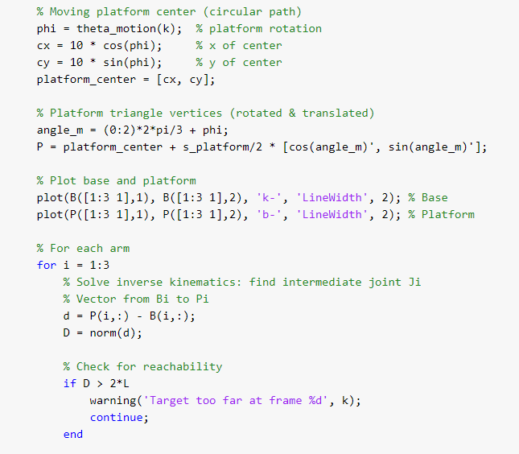
CODE FOR ANIMATION

Slide 29
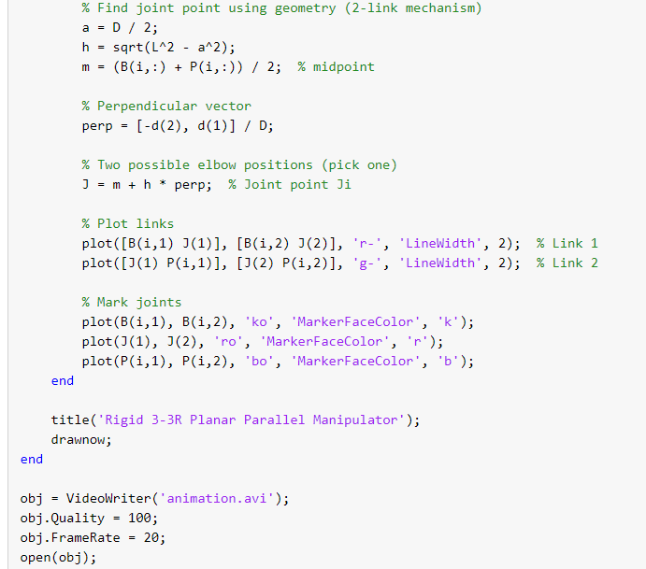
CODE FOR ANIMATION

Slide 30
ANIMATION

Slide 31
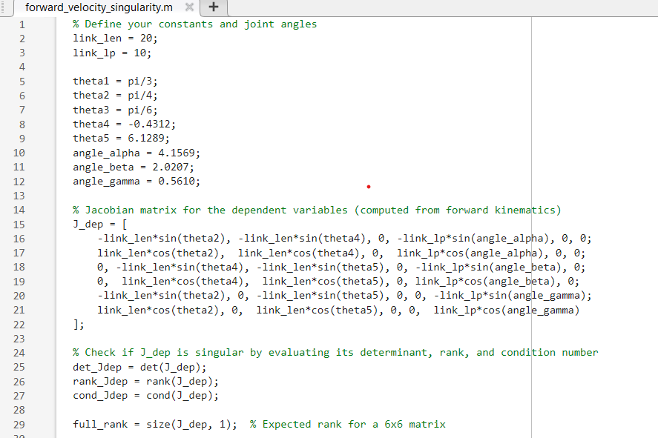
Singularity

Slide 32
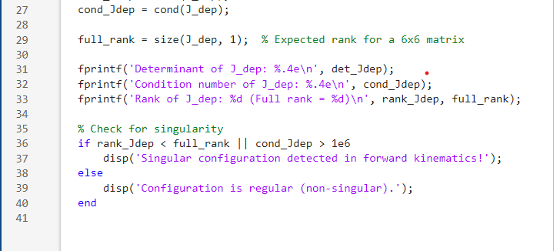

Slide 33
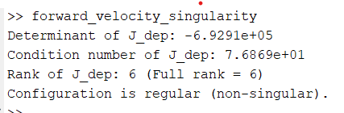
Output:

