Slide 1
NAME=Mansi Jagdish Mokashi ROLL.NO=87 ASSIGNMENT-1 HCI GOOD DESIGN AND BAD DESIGN

Slide 2
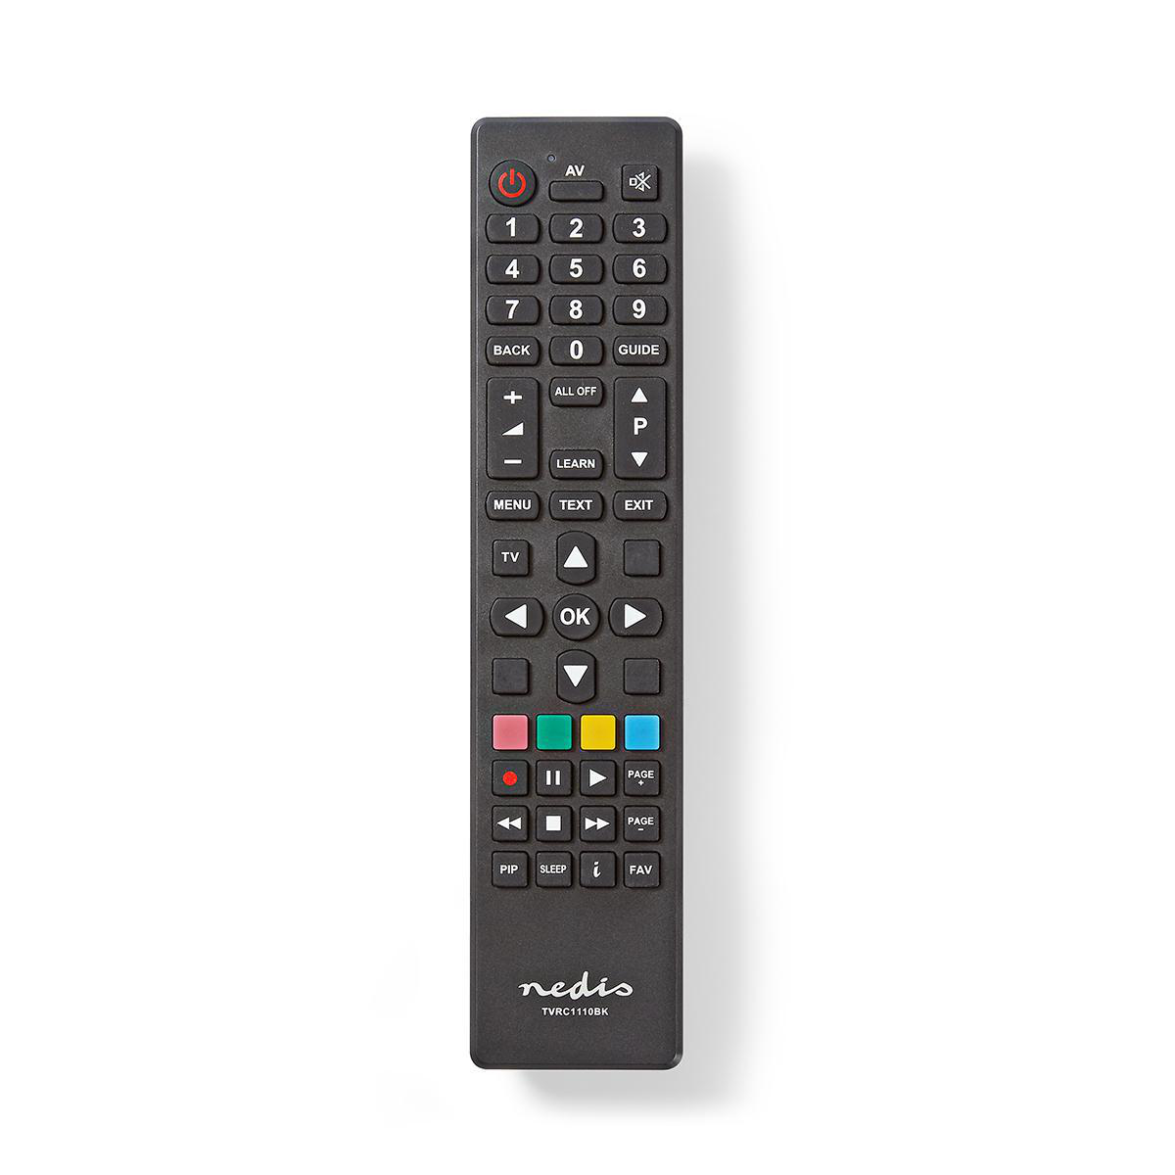
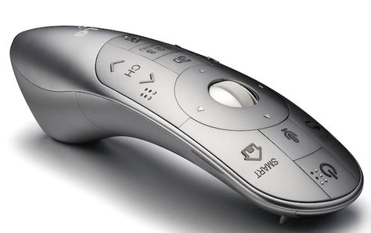
Bad design good design assignment
First photo is of bad design and
Second photo is of good design,in first photo
we can not hold remote correctly
But in second photo remote has
round shape so we can easily hold it
Sourse:home

Slide 3
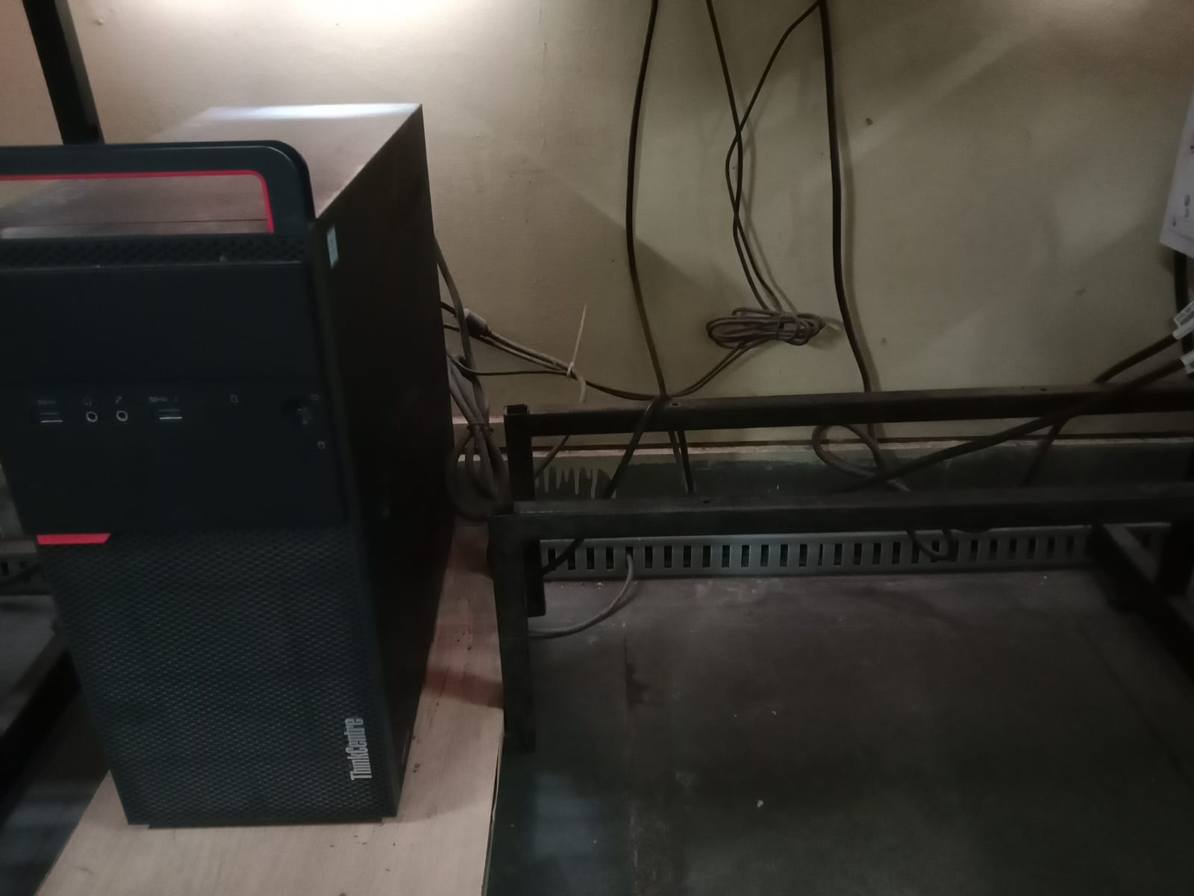
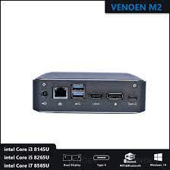
Sourse: college
First photo is of bad design second photo is
of good design.in first photo size of pc is big but in second photo
Size of pc is small,it occupies smaller space

Slide 4
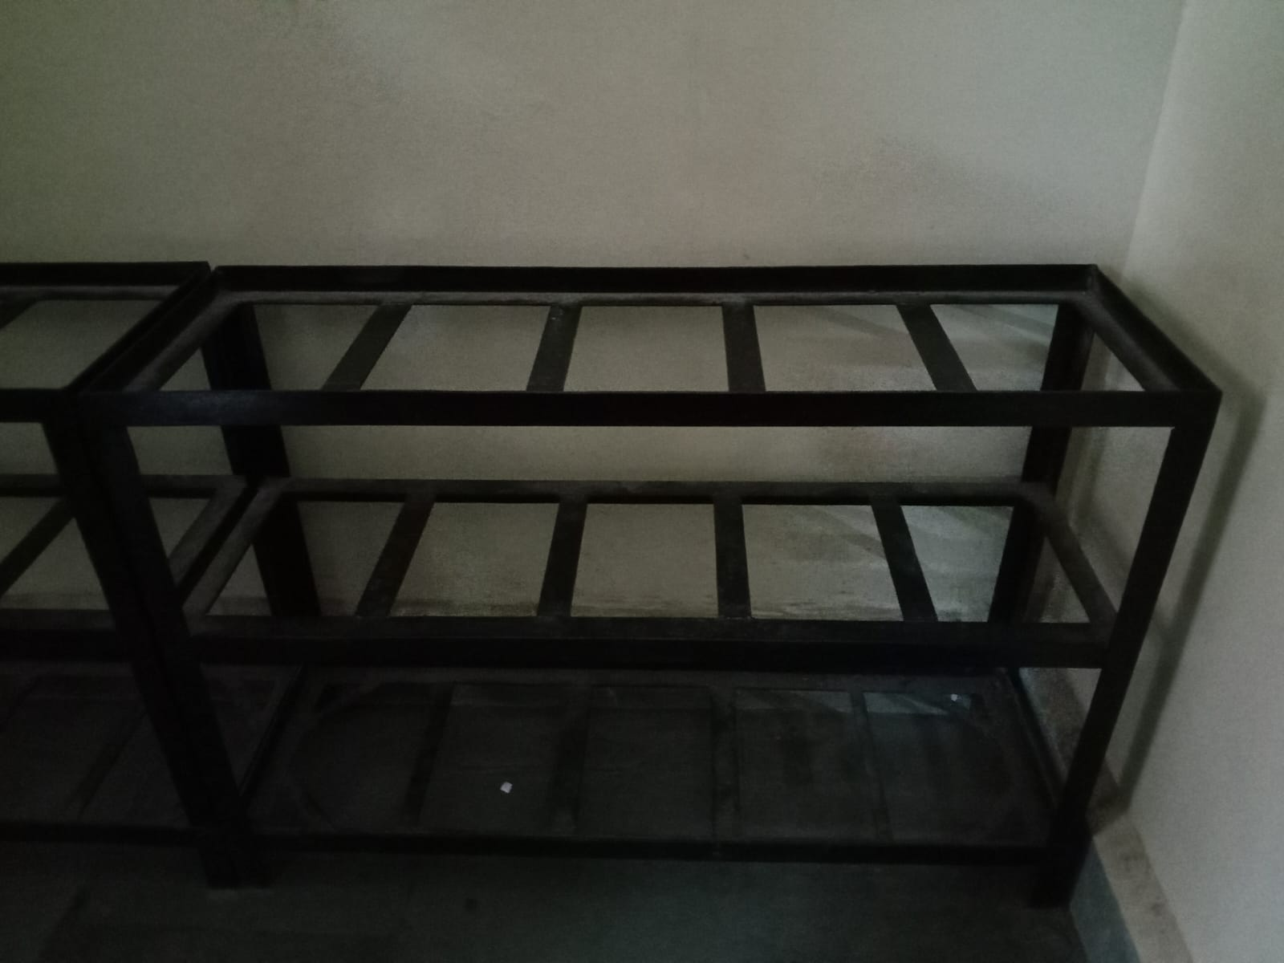
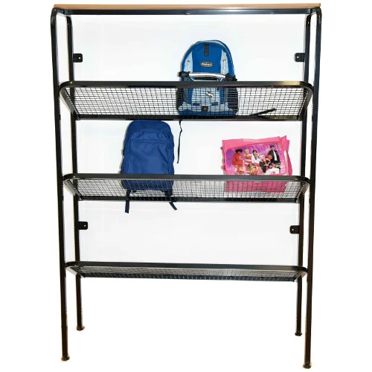
First is bad design and second one is good design.in fi
rst photo if you are putting bag,if
bag is of small size it may
Be fall.but in second photo stand has net so bag wont be fall.
Sourse:college

Slide 5
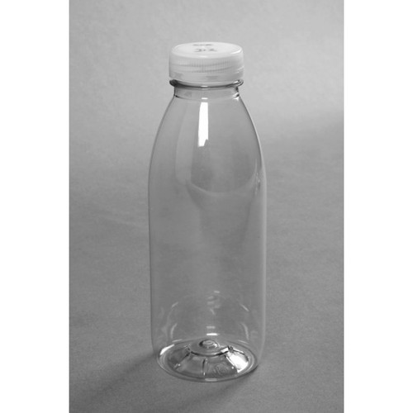
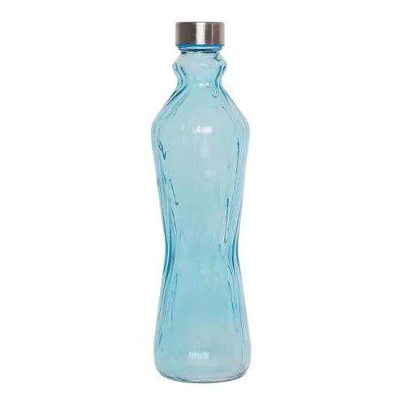
First photo is of bad design and second photo is
of good design.in first photo you can not easily hold water bottle
But in second photo you can easily hold
water bottle because of curve shape
Sourse:home

Slide 6
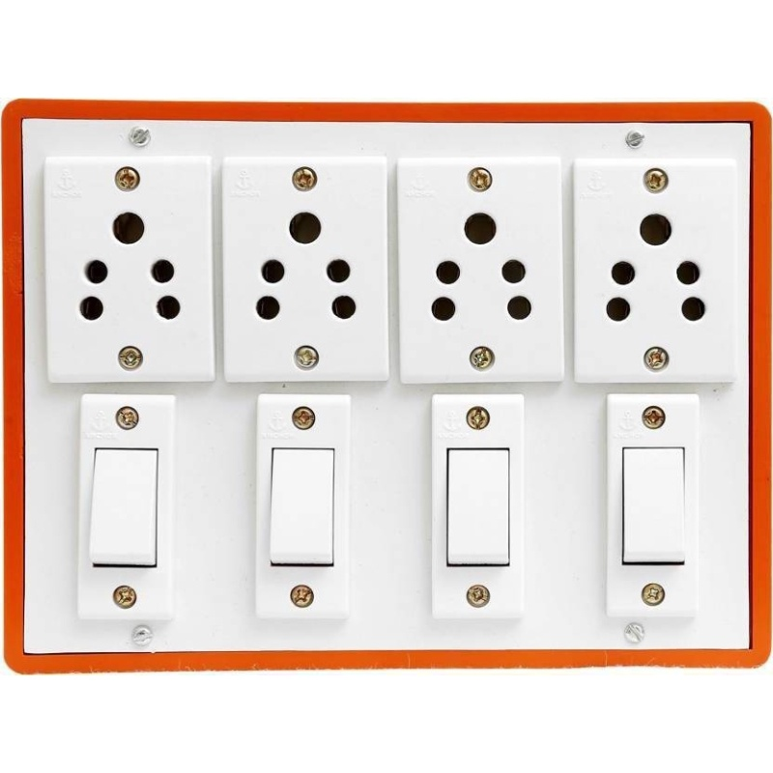
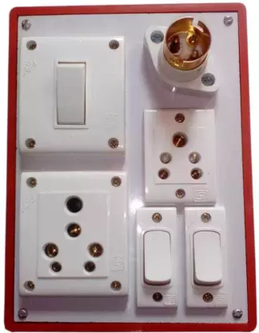
This is bad design of switch board ,user must
be confused in
buttons,but in second photo user can not be confused
Because it is designed very cleary.
Sourse:home

