Slide 1
NAME=Mansi Jagdish Mokashi ROLL.NO=87 ASSIGNMENT-2 HCI “THE JUGAAD”

Slide 2
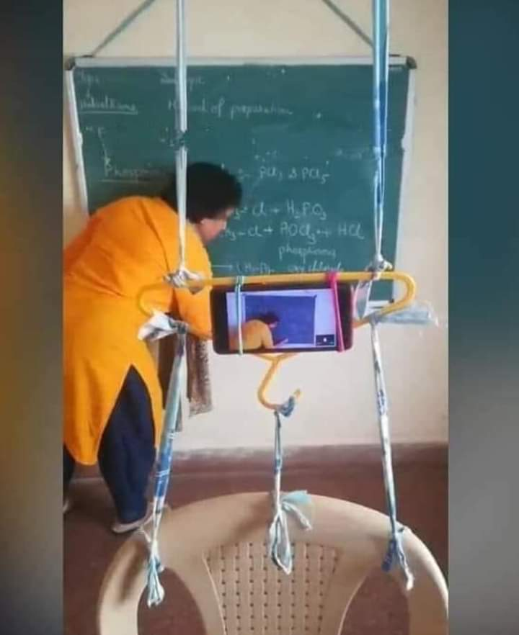
1)
This is jugad when lockdown is there
and teachers have to take online classes
And teachers doesnt have laptop .from
phone they have to took lectures like this

Slide 3
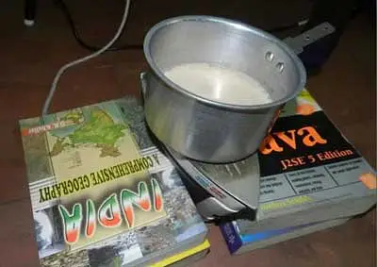
2)
If you are living in hostel and y
ou don’t have gas or kettle but you
want something hot to eat
or drink then this jugad is best
Sourse:hostel

Slide 4
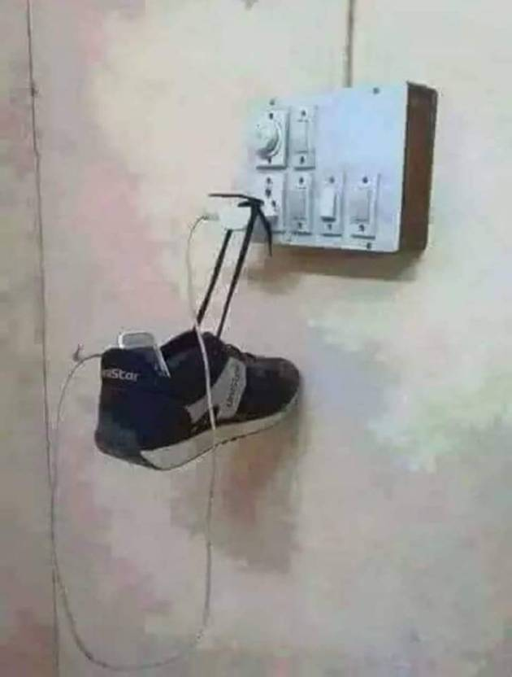
3)
In this jugad if you don’t have any table or
furniture ,you can do this
jugad by help of shoes
Sourse:hostel

Slide 5
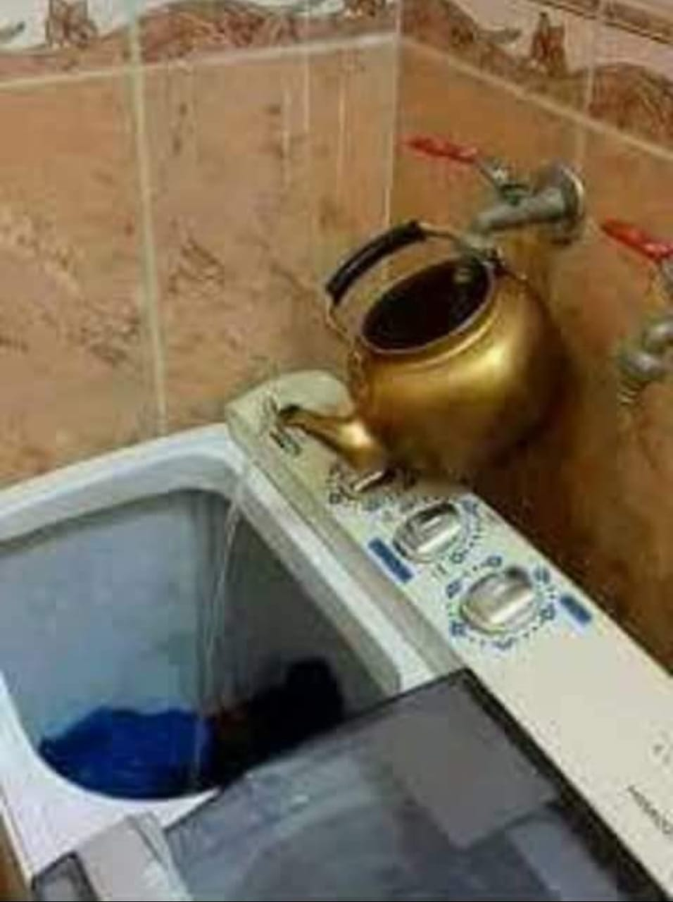
If You have to pour water and you don’t have pipe then
you can do this type of jugad by using pot
Sourse:home

Slide 6
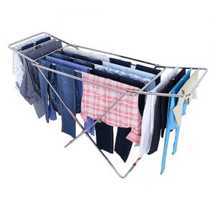
If you are living in hostel and you don’t have
balcony to dry your cloths you can do this jugad
Sourse:hostel

