Slide 1
NAME=Mansi Jagdish Mokashi Roll.no=87 TEIT ASSIGNMENT -3

Slide 2
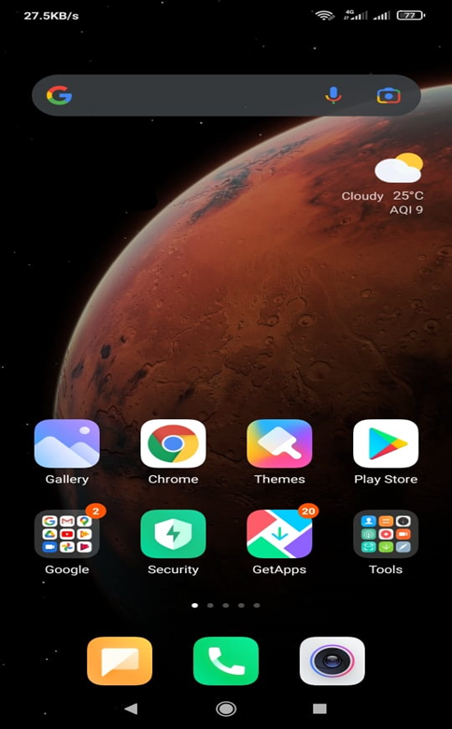
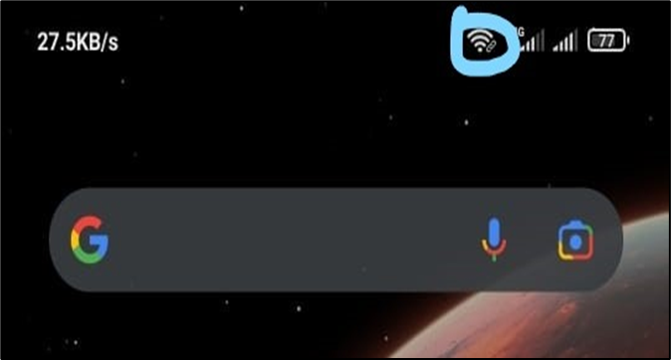
SYSTEM WITH FEEDBACK
As soon as we turn on hotspot ,mobile screen popped up the hotspot icon
Source: My Mobile Phone

Slide 3
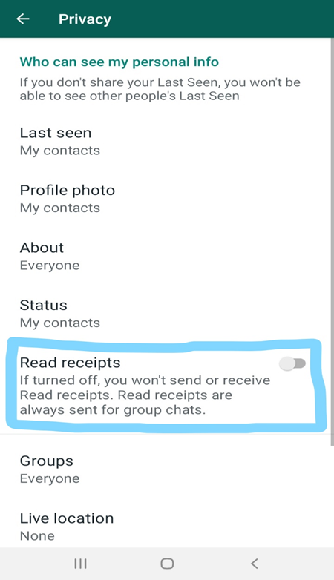
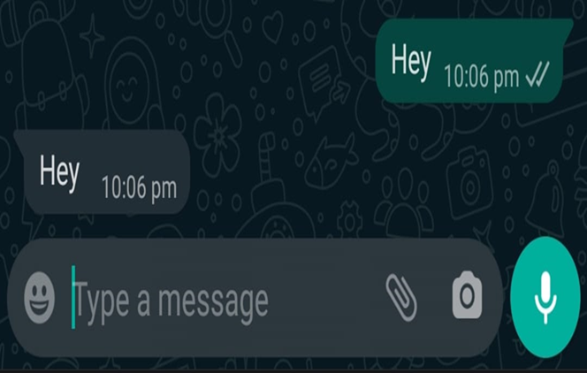
SYSTEM WITHOUT FEEDBACK
Users will see only two grey checkmarks instead of blue
Sender won’t be able to view the timestamp of instance when receiver read the message
Source: My Mobile Phone

Slide 4
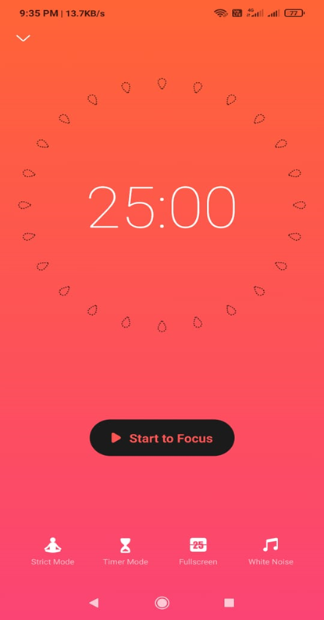
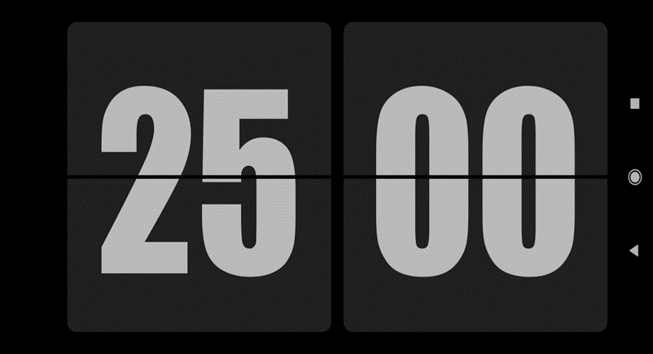
System with constraint
Pomodoro timer is the ultimate app for managing Tasks, Reminders, Lists, Calendar events, Grocery lists, checklist, helping you focus on work & study and tracking your working hours.
Source: Focus to do app

Slide 5
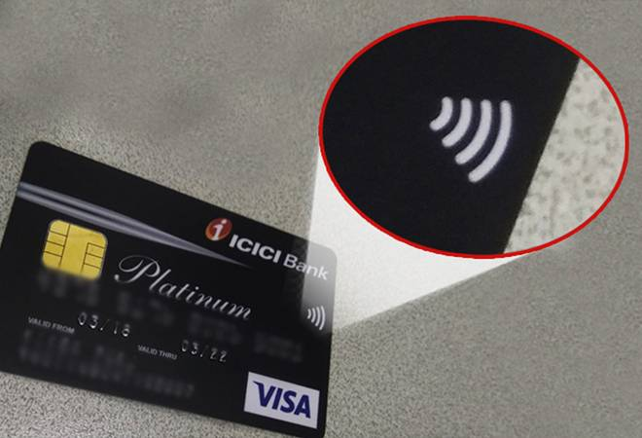
System without constraint
For transactions up to ₹5000, just tap
to pay using your contactless Visa card at a
contactless payment terminal and there is
no need for a PIN
Source: Google

Slide 6
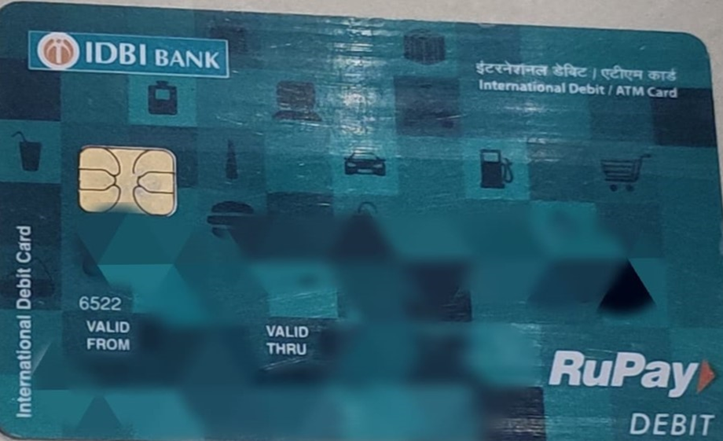
System with feedback and constraint
Permission constraint made transaction
impossible
After completing user will get
notified with message on registered number
Source: Debit Card

