Slide 1
HCI Assignment 4 - Wireframing and Prototyping
MANSI MOKASHI

Slide 2
Problem Statement
Design and implement a front end for online
flowers shopping, which will make it easier
for users to order and receive fresh
flowers sitting at home.

Slide 3
Introduction
● Our website is based on the concept of online fresh flower shopping.
● We have selected the topic in order to provide an online fresh flower buying
platform specially for the people who are in love with fresh flowers.
● User can choose from wide variety of items with
the user friendly interface of the website.

Slide 4
User Persona

Slide 5

This is anushka
“Want a website which will allow me
to buy flowers
staying at home!”
Name:Anushka
Age=21
Gender:Female
Marital Status:Unmarried
Occupation:SE Engineer at pune wipro
Location:Pune
ABOUT ANUSHKA:
Anushka is a hard-working engineer at wipro.
She has to work all day and has not time to go out and buy flowers to gift her friends.
She loves flowers a lot

Slide 6
1.Anushka navigates
to the website
2.Anushka
Watch all
Website pages
3. Anushka browses
through various
products available
4. Anushka confirms
the order.
Scenarios
5. Anushka proceeds
to payment
options.
6.She gets acquainted
with various features
of the website.
7.She is provided with
the options of free
Delivery,money back,
Secured payment
8.Anushka is offered with
a wide range of
flowers
available.
110
9.Anushka
Filled all details
For delivery
10.She clicks
On OKKK button
10.After that
She chooses
Payment
method
11.After that
She clicks on
Pay button
12.After payment thank
You message
Will display
13.After shopping she can give review of products
14.Or she can give suggestions or drawbacks by contactus form
15.Also she can check our extra offers

Slide 7
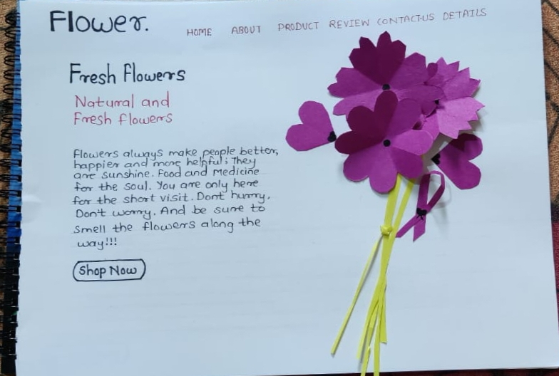
DESIGN

Slide 8
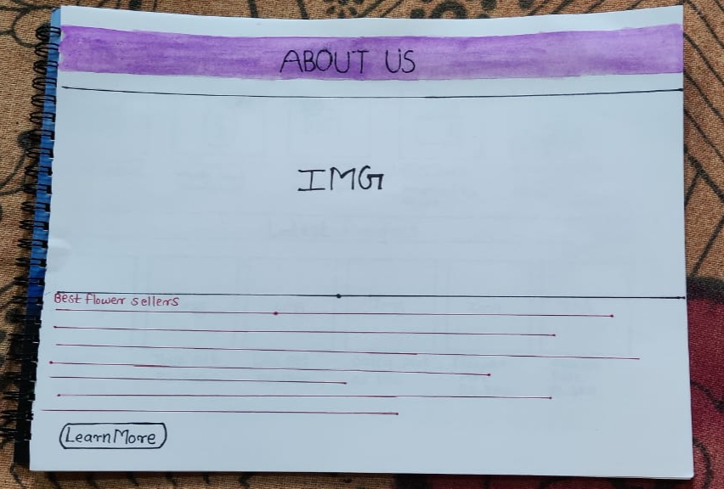

Slide 9
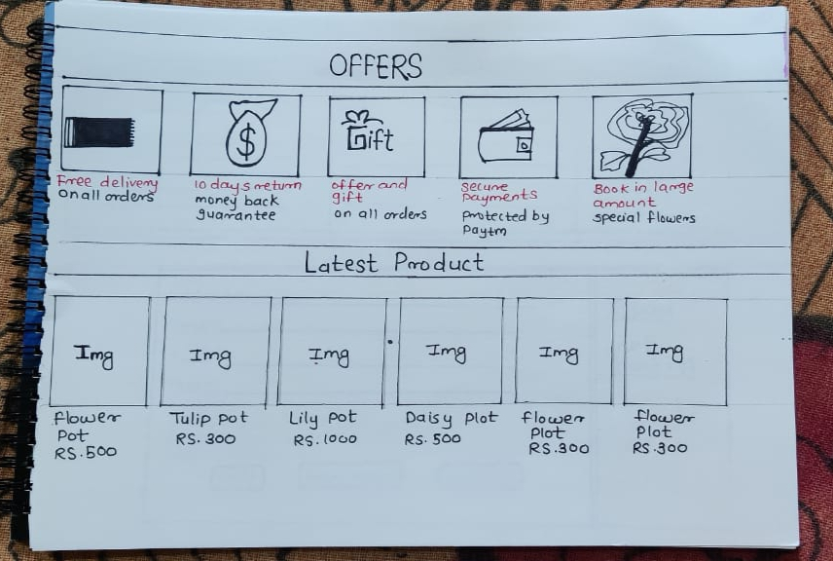

Slide 10
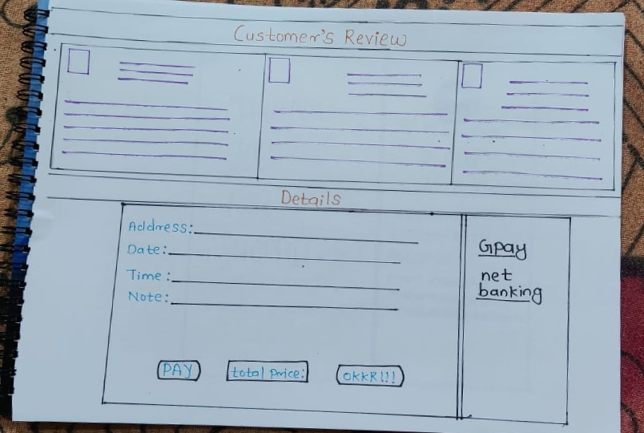

Slide 11
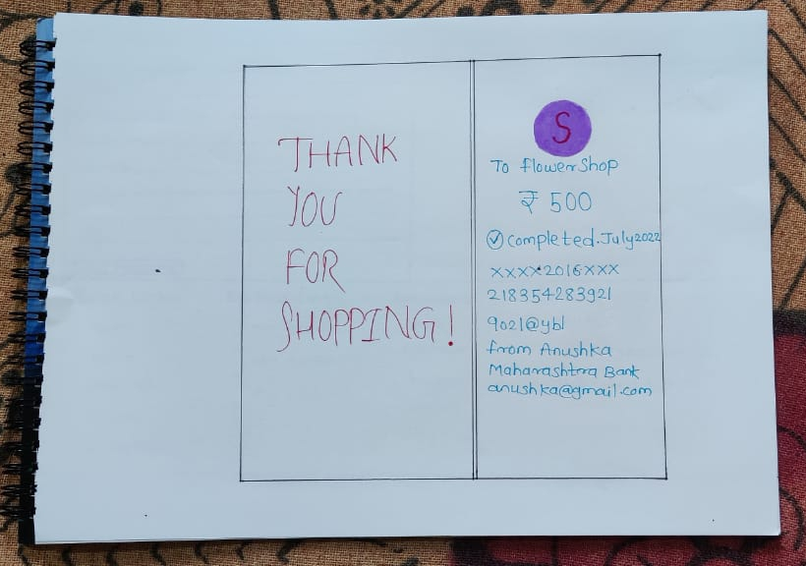

Slide 12
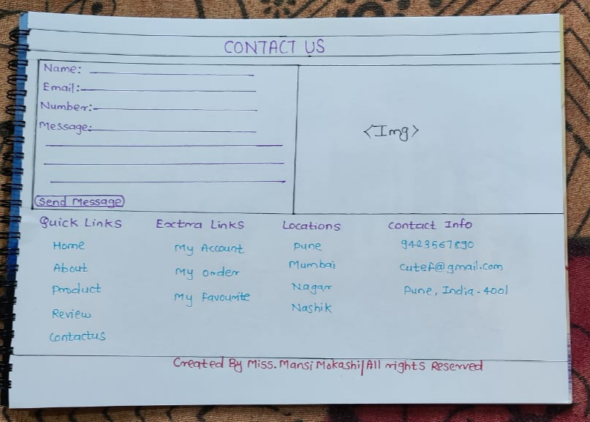

Slide 13
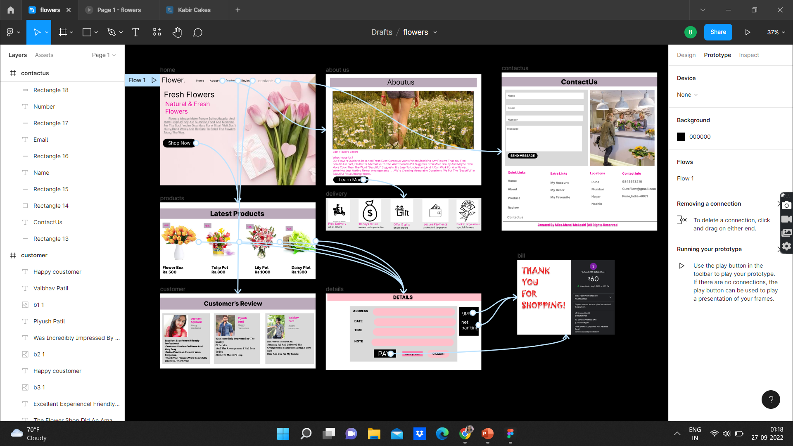
prototype

Slide 14
FIGMA LINK
https://www.figma.com/file/eK7F3MjF2a8fZ45Jmm5wYd/flowers

Slide 15
THANK YOU
-Mansi Mokashi

