Slide 1
BANkBOOsTX
EMPO ERING BANkING sUCCEss

Slide 2
AGENDA
01 02 03 04
OVERVIEW BANKBOOSTX
Objective & Predictions
07
Supervised Clustering
Summary & Features
08
CONCLUSION
05 06
hierarchical clustering ^{Unsupervised} Clustering

Slide 3



OBJECTIVE
Project Objective
Stakeholder Selection:
Data Exploration
Study aims to predict customer subscription to term deposits in
Portuguese bank's marketing campaigns. Dataset covers May 2008 to November
2010 with 41,188 examples and 20 variables.
BankBoostX, running the campaigns, seeks insights for better marketing strategies.
The study benefits marketers and
researchers in understanding customer
behavior and improving marketing tactics.
BankBoostX is the primary
stakeholder aiming to optimize the bank's marketing strategies.
Understanding customer decision
factors can boost engagement, order values, and resource allocation.
BankBoostX's collaboration highlights its dedication to marketing
effectiveness.
The study aligns with shared goals for success.
Explored dataset with 41,188
examples and 20 input variables. Investigated customer behavior and preferences.
Identified patterns influencing term deposit subscription.
Evaluated data to inform marketing strategies.

Slide 4

marital
job
education
housing
loan
month
day_of_week
campaign
FEATURES
pdays
previous
emp.var.rate
previous
poutcome
cons.price.idx
euribor3m
cons.conf.idx:
nr.employed
target

Slide 5
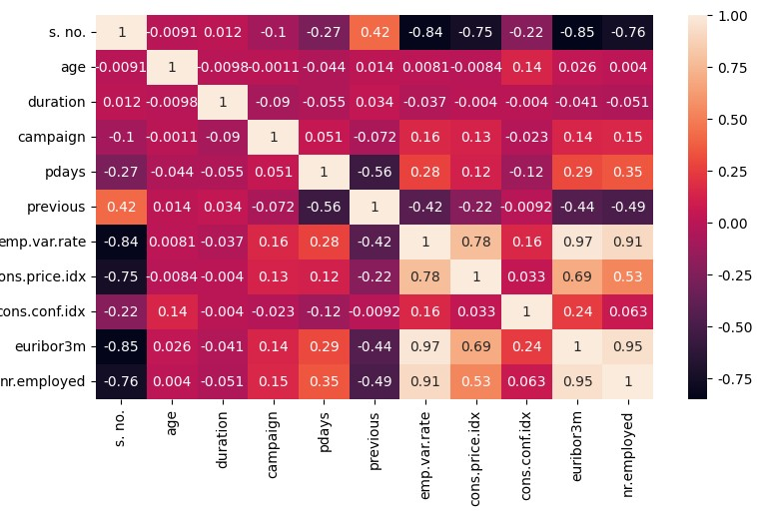
DATA EXPLORATION
Age positively correlates with consumer
confidence but negatively with employment variation, impacting older individuals more.
Previous campaign contacts negatively affect
current campaign contacts, reflecting changing engagement.
Employment variations correlate strongly with consumer prices, suggesting interdependence. Euribor 3-month rate and employee count are closely connected.
Employment variations link to consumer confidence via economic factors.

Slide 6






CLUSTERING
hierarchical clustering
Hierarchical clustering highlights distinct patterns within the dataset, aiding in the identification of underlying structures.
It assists in determining the optimal number of clusters, as
demonstrated by the dendrogram and agglomeration method's agreement on four clusters.
The relationships between features and clusters are unveiled, such as the influence of longer call durations on subscription choices.
Hierarchical clustering offers both manual and automated methods, providing flexibility in data analysis.
kNN Function
- The KNN model consistently predicts a class label of 1 for the given
data point. Thhis shows that the consumer subscribed to the program, data point is closest to instances in the dataset with a class label of 1.
- According to the KNN model, the given data point is more likely to be similar to dataset instances where users have paid for program
subscriptions. This suggests that the given data item demonstrates traits or features that are more important among clients whose
decision to sign up for the service. It's important to remember that the choice of k and the particular features of the dataset can affect how
accurate the predictions are. To get more accurate forecasts, the model may need to be further examined and adjusted.
K-means clustering
Individuals within the same cluster are considered similar based on the specified features (pdays, duration,
y_binary).
The clusters are created in such a way that individuals within a cluster are more similar to each other than to individuals in other clusters.

Slide 7


HIERARCHICAL CLUsTERING
Approach 1 (Built-in)
The built-in approach automatically merged data points into four distinct clusters based on their similarities. Each cluster contained similar data points, and the output displayed the
data points and their associated features for each cluster. This automated method streamlined the clustering process.
Approach 2 (Manual Approach)
This approach involved manually performing hierarchical
clustering using the agglomeration method without relying on built-in functions. It calculated distances between clusters,
progressively merging the closest ones to achieve the desired number of clusters. The result was a step-by-step approach
that matched the built-in method.

Slide 8

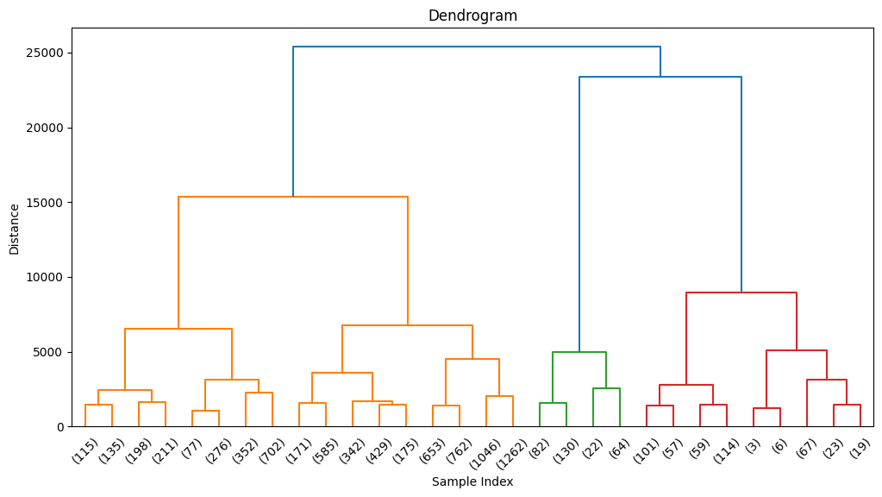
DENDROGRAM

Slide 9

K-MEANs CLUsTERING
Individuals in cluster 0 have relatively
higher values for 'duration' and 'y_binary' and have been contacted recently
(pdays is not 999).
Individuals in cluster 1 have higher values for 'pdays', indicating they have not been contacted recently.
Individuals in cluster 2 have lower 'duration' and 'pdays' values.
Individuals in cluster 3 have
moderate values for 'duration' and 'pdays'.

Slide 10

KNN FUNCTION
The K-Nearest Neighbors (KNN)
model consistently predicts a class label of 1 for different values of k for the provided data point.
This suggests that the data point
shares similarities with instances in the dataset where customers
subscribed to the program.
The choice of k can influence
prediction accuracy and should be selected based on dataset
characteristics and model performance.
Further model tuning and analysis are required to improve prediction accuracy and gain more insights
from the data.

Slide 11

SUMMARY
This project studies a bank's direct marketing campaigns with a dataset of 41,000 examples and 20 variables. It finds consistent K-Nearest Neighbors (KNN) predictions, insights from K-means and hierarchical clustering, which identify
four clusters using automated and manual methods. These insights help improve marketing strategies and engage
consumers better. Future refinements will require more model enhancements and analyses.

Slide 12
CONCLUSION
In this report, we've analyzed direct marketing campaigns, aiming to optimize strategies for success. Our research, driven by machine
learning, revealed that personalized approaches hold immense potential. Clustering and correlation analyses have provided
actionable insights to enhance customer engagement and refine marketing tactics. We recommend leveraging these findings to
fine-tune strategies, ensuring efficient resource allocation. This data-driven approach will be key to your future marketing
endeavors.

Slide 13

THANk YOU!

