Slide 1
amazon
case study
A Research Project By Mansi Narade
Top Ranked Data Science & Analytics Education Provider since 2007

Slide 2
Objective
Analyze the data to gain insights into Amazon's online clothing business.
Develop strategies based on data insights to maximize sales and revenue in the clothing category.
Set specific quarterly targets to increase sales and revenue based on data analysis and proposed strategies.

Slide 3
The dataset is large, with 19 columns and 128,970 rows, focusing on order and shipping details.
The dataset contains information related to the clothing category, encompassing order amount, shipping city, and shipping state, in addition to various other details.
The data is from the second quarter of 2022
It 128,970 unique orders originating from 7,297 cities across 26 states in India
Data set

Slide 4
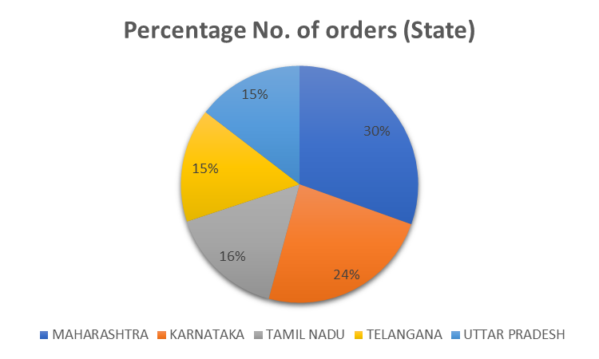
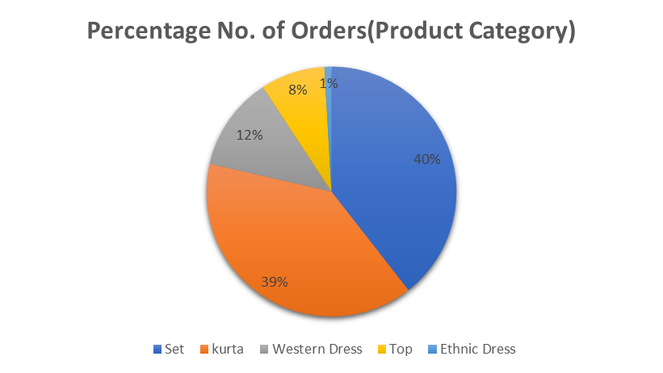
Preliminary Analysis
The chart highlights the top 5 states with the highest sales percentages, with Maharashtra leading the list.
The chart highlights the top 5 product categories with the highest sales percentages, with Set Category leading the list.

Slide 5
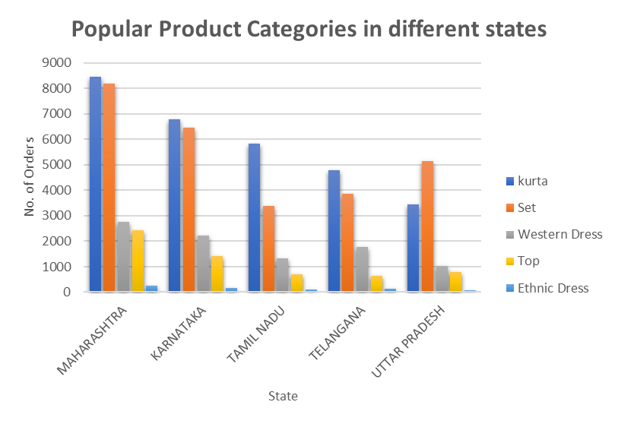
Preliminary Analysis
This graph illustrates the most popular product categories in states with the highest sales. "Kurta" emerges as the most favored product category across these states, followed closely by "Set."
The table shows that 99% of Amazon buyers are individuals, but businesses have the higher average order values at 1%.

Slide 6
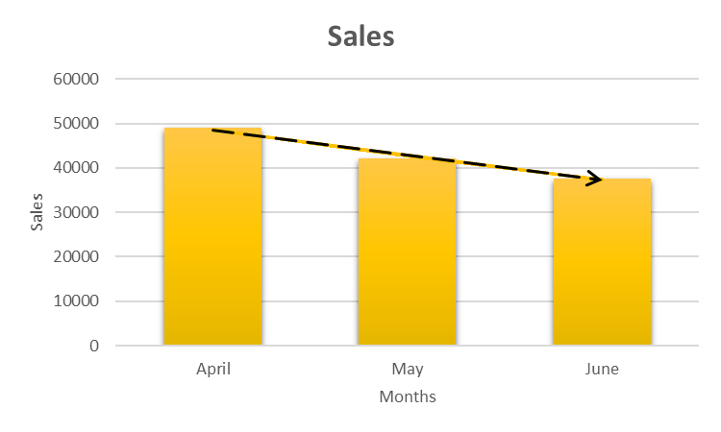
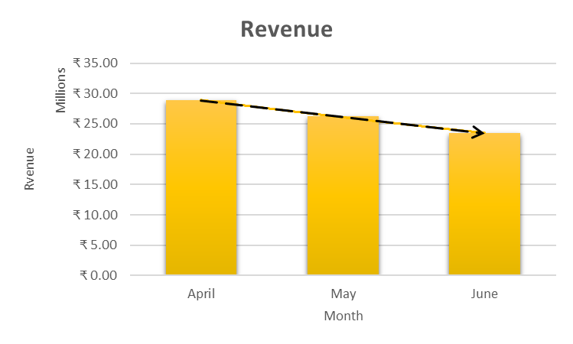
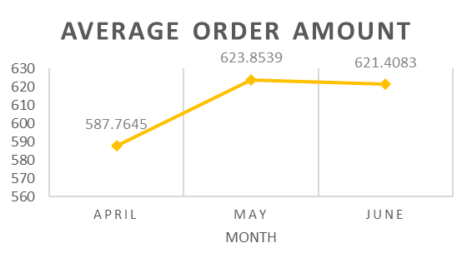
Preliminary Analysis
-14.32%
-9.06%
-10.68%
-10.33%
Over the course of the quarter, there was a noticeable decline in both sales and revenue, with reductions of 23.17% and 18.78%, respectively.
Interestingly, the average order value exhibited an increase during this time frame.

Slide 7
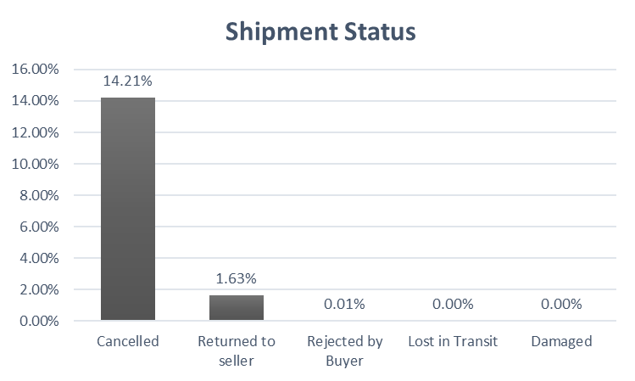
Order Cancellations
Additionally, about 2% of orders were returned to sellers, damaged, or lost in transit, and all of these orders were fulfilled by merchants.
In the analysis, I found that approximately 14% of orders were canceled. Of these cancellations, 63% were for orders fulfilled by Amazon, while the remaining orders were fulfilled by delivery partners or merchants.

Slide 8
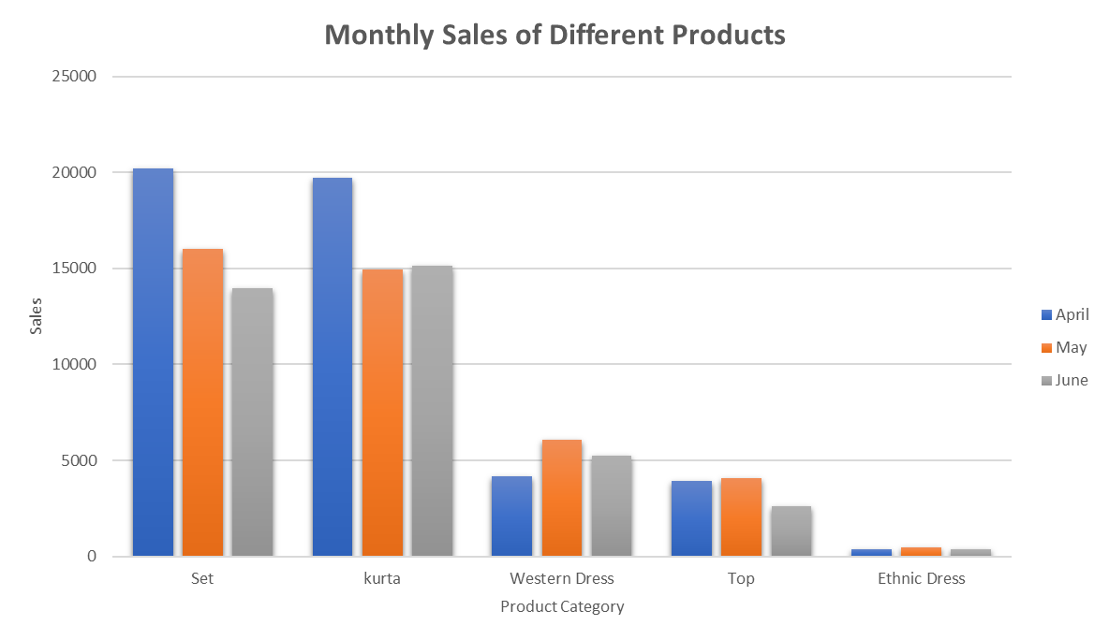
Sales and Revenue
Western dress sales have surged by 26.5%, while ethnic dress sales showed a more modest increase of 1.4% from the start to the end of the quarter.
45.50 %
-13.05%
28.49%
-21.06%

Slide 9
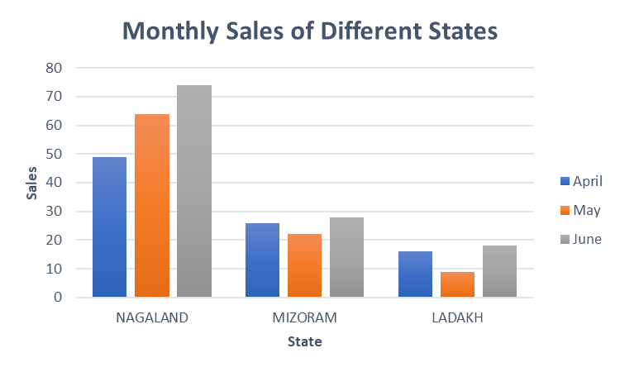
Sales and Revenue
Nagaland, Mizoram, and Ladakh demonstrated impressive sales growth during the quarter, with increases of 51%, 7.6%, and 12.5%, respectively, from the beginning to the end of the quarter.
15.63%
30.61%
27.27%
-15.38%
100%
-43.75%

Slide 10

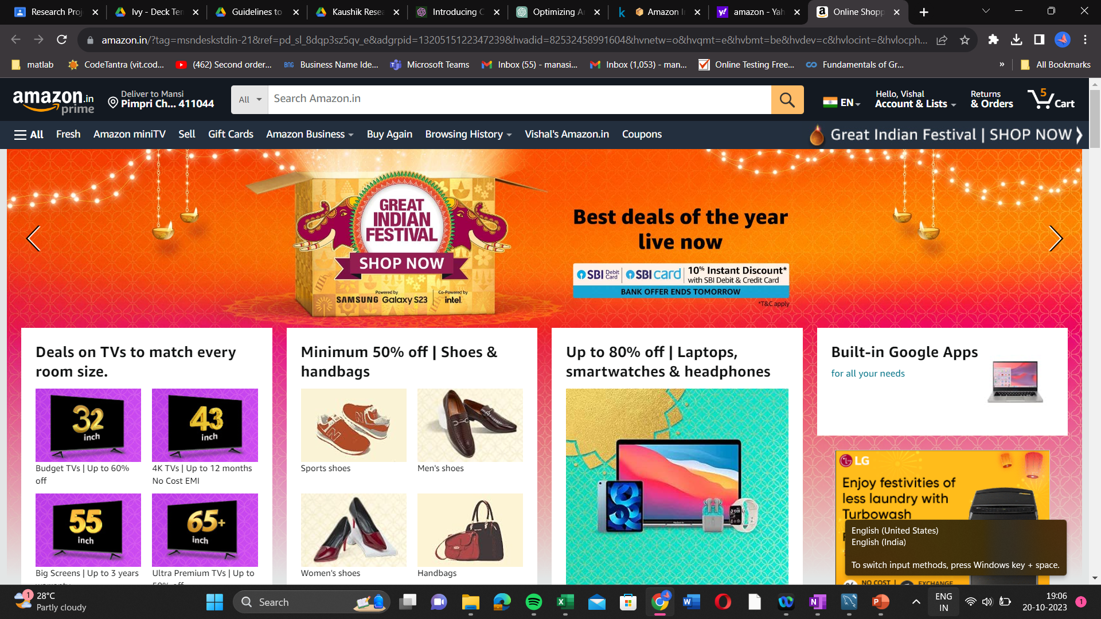

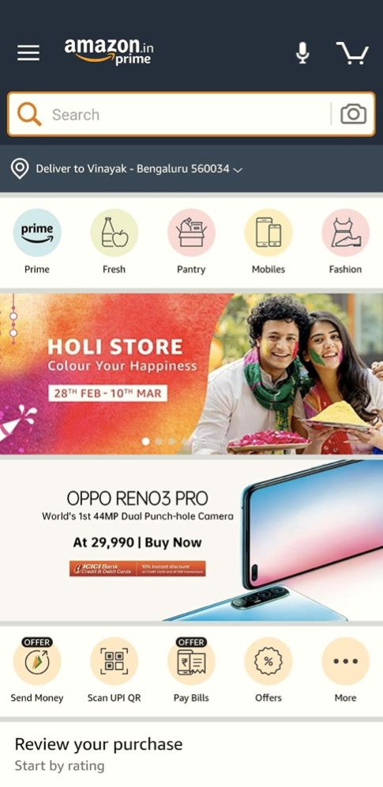
Sales Maximization Strategies
Product Expansion
2.Re-evaluate Fulfillment Partners
3.Strategic Advertising
4.Regional Promotion
Notes:
1. Product Expansion - Increase product offerings of high-sales and popular items in different states, such as "Set" and "Kurta," to drive revenue growth.
2. Re- evaluate fulfillment partners - Consider switching delivery partners or merchants since 100% of returned and rejected products were fulfilled by merchants.
3.Strategic Advertising - Increase product advertisements, especially for high-growth categories like Western and Ethnic dresses, to attract more buyers and boost revenue.
4. Regional Promotion - Launch promotional campaigns targeted at states that have demonstrated positive sales growth, with a particular focus on states like Nagaland, Ladakh, and Mizoram. Explore advertising opportunities in the North Eastern states of India.

Slide 11
thanks!

