Slide 1

BAN 675 - Text Mining Project :
Sentiment Analysis on Amazon Fine Food Reviews
Presented by -
Group 5 : Team Members
Student ID | First Name | Last Name | Email
PD7644 | Apoorva | Nerkar | anerkar@horizon.csueastbay.edu
WS2865 | Mansi Mrugen | Shah | mshah41@horizon.csueastbay.edu
MA7835 | Rohit | Nagpal | rnagpal@horizon.csueastbay.edu
EG7732 | Shruti | Bhalotiya | sbhalotiya@horizon.csueastbay.edu
TI6557 | Vibhuti | Vadje | vvadje@horizon.csueastbay.edu

Slide 2
AGENDA
Project Background
Data Description
Summary Statistics
Research Questions
Importance of Reviews & Review Analysis
Methodologies Required
Analysis Result Report & Explanation

Slide 3

PROJECT BACKGROUND

Slide 4
Project Background
Current Situation
90% of the Amazon customers check the reviews before purchasing the products
Objective
Project Plan
Sentiment analysis using several techniques
Benefits
Quick Summary of Product reviews
Perform text mining on product review data to gather useful information for Product owners
Extract key messages from the reviews
Significant phrases from word cloud
Influence of reviews on Sales

Slide 5

RESEARCH QUESTIONS

Slide 6
Research Questions
Sentiment Analysis
- To study whether product review is becoming better or worse during the life cycle of the product
Visualization
- Dwell into specifics about the overall sentiment of the product and determine what customer likes or dislikes
- Analyze how Sentiment Score interplays with Sales

Slide 7

IMPORTANCE OF REVIEW ANALYSIS

Slide 8
Importance of Reviews and Review Analysis
How reviews help customers and vendors :-
How review analysis helps vendors :-
Helps customers to decide the product/service
Shows whether vendor/seller is credible or not
Helps consumers feel more connected to the product/service
Evaluate product’s performance over the period of time
Understand customers concerns and needs
Impact on Sales and Purchase

Slide 9

DATA DESCRIPTION

Slide 10
Data Description (1/2)
DATA STATISTICS
Number of Reviews | 568,454
Number of Users | 256,059
Number of Products | 74,258
User with > 50 reviews | 260
Median no. of words per review | 56
Time span | Oct 1990 – Oct 2012
Obtained dataset from Kaggle
Dataset consists of reviews of fine foods from amazon
Key attributes used:
Product ID
Score
Time (in Unix seconds)
Text (Review of product)

Slide 11
Data Description – ETL (2/2)
Data Extraction
Data Preprocessing
Data Cleaning
Exploratory Data Analysis
Sentiment Analysis (Vader, Text Blob, Tf-Idf)
Accuracy
Word Cloud
Line Graph

Slide 12

SUMMARY

Slide 13
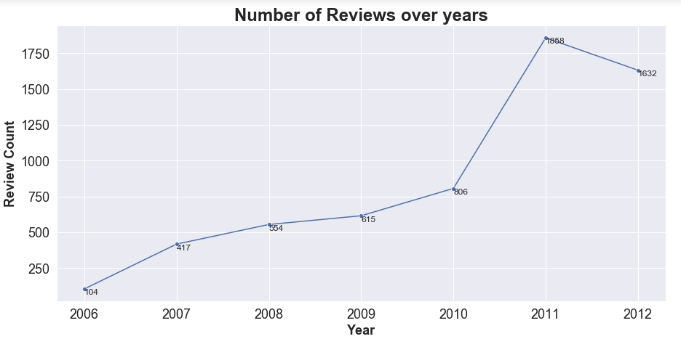
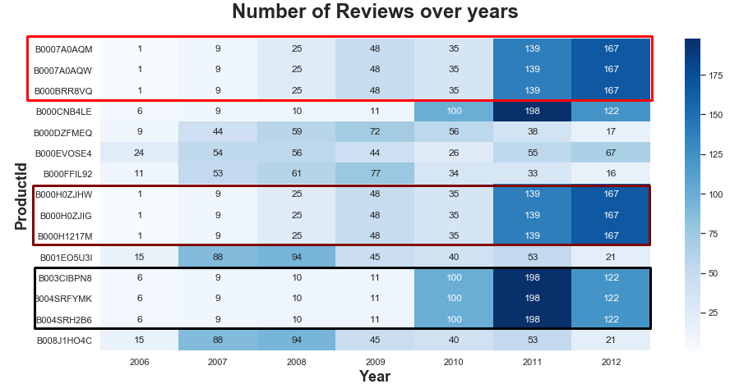
Summary (Exploratory Data Analysis) 1/3
Insights & Results:
Overall number of reviews increases over the period of time
Selected top 15 products based on maximum number of reviews with the time span of 6 years
For most of the products number of reviews gradually increased for year 2011 and 2012

Slide 14
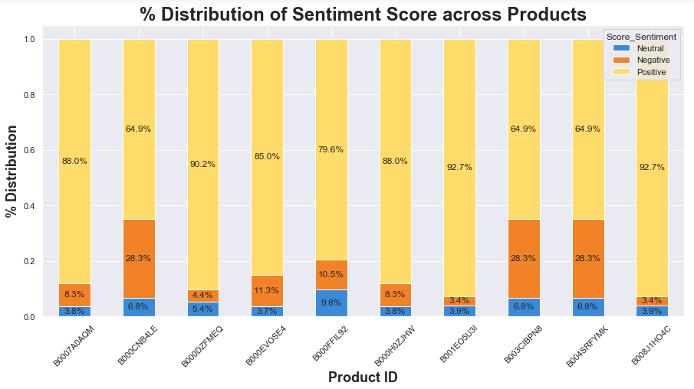
Summary (Exploratory Data Analysis) (2/3)
Insights & Results:
Percentage of positive reviews are significant based on sentiment score
7 out of 10 products show less than 20% of negative reviews

Slide 15
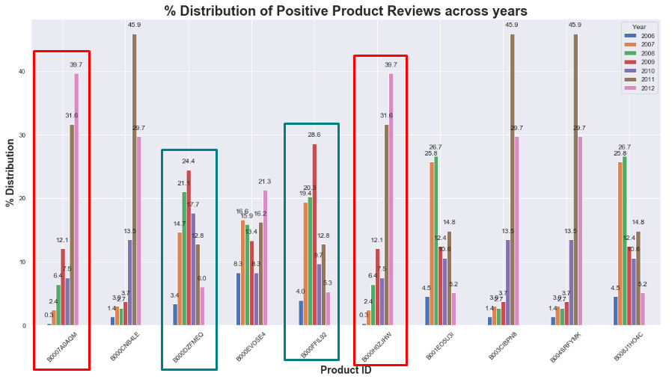
Summary (Exploratory Data Analysis) (3/3)
Product 1
Product 6
Product 5
Product 3
Insights & Results:
For product 1 and 6, percentage of positive reviews increased by ~30% from year 2006 to 2012
For product 3 and 5, percentage of positive reviews increased by ~20% and then decreased by ~15%

Slide 16

METHODOLOGIES REQUIRED

Slide 17
Methodologies Required
Method Name | Description | Predictor (Input Variables) | Predicted Variable | Logic | Accuracy
Text Blob | Trained based | Product Reviews Amazon Score Sentiment variable for comparison | Text Blob Sentiment Score | Positive - (*Pol >0 & *Sub > 0.5) Negative - (*Pol <= 0 & *Sub > 0.5) Neutral – (*Sub <= 0.5) | 57.69%
Lexicon | General purpose lexicon with TF-IDF |  | Lexicon Sentiment Score | TF-IDF - - Positive > 0.55 - Neutral > 0.45 - Negative <= 0.55 | 67.50%
Vader | Rule based |  | Vader Compound Sentiment Score | Compound- - Positive > 0.3 - Neutral = -0.3 to 0.3 - Negative < -0.3 | 79.96%
* Pol – Polarity , Sub - Subjectivity

Slide 18

ANALYSIS RESULT

Slide 19
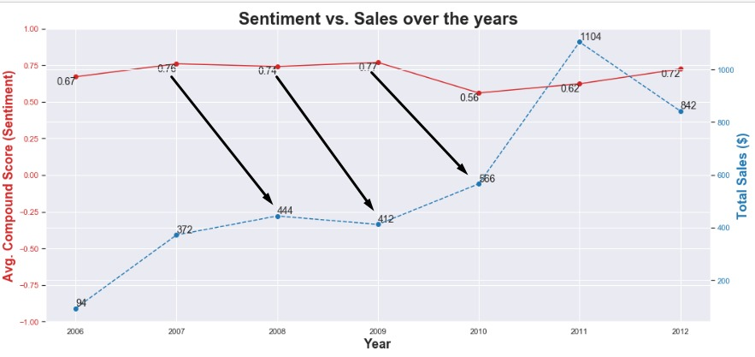
Analysis Result (1/3)
Insights & Results:
Sentiment Score of the prior year impacts the Sales of the next year
For e.g. Sentiment Score improves in 2007 which results in increment in Sales in 2008

Slide 20
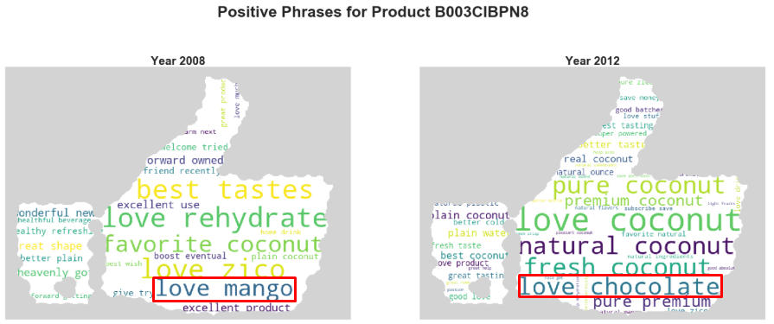
Analysis Result (2/3)
Insights & Results:
Number of positive phrases has increased from 2008 to 2012
Popular flavor has been changed from Mango to Chocolate from 2008 to 2012

Slide 21
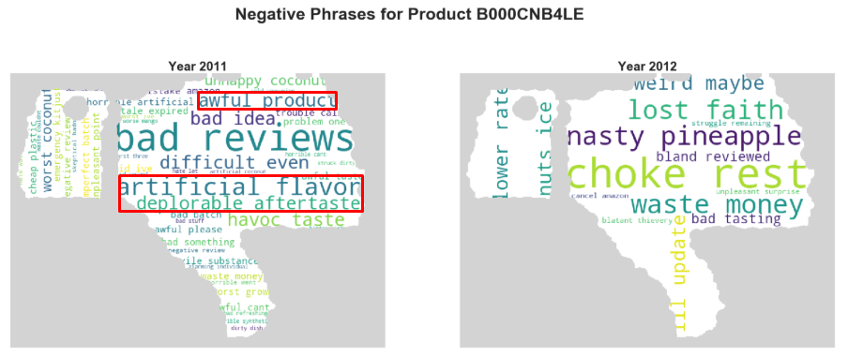
Analysis Result (3/3)
Insights & Results:
Number of negative phrases has decreased from 2011 to 2012
Negative keywords like deplorable, awful, artificial are not present in 2012

Slide 22
REFERENCE
https://matplotlib.org/3.1.0/gallery/subplots_axes_and_figures/secondary_axis.html
https://www.kaggle.com/aashita/word-clouds-of-various-shapes
https://amueller.github.io/word_cloud/auto_examples/masked.html

Slide 23

QUESTIONS???

Slide 24
THANK YOU!

