Slide 1
3. Importance of reviews and reviews analysis
How reviews helps customers and vendors:
Helps customers to decide the product/service
Shows whether vendor/seller is credible or not
Helps consumers feel more connected to the product/service
How reviews analysis helps vendors:
Evaluate product’s performance over the period of time
Understand customers concerns and needs
Impact on Sales and Purchase

Slide 2
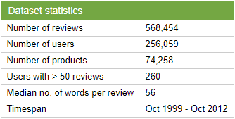
4. Data Description
Obtained dataset from Kaggle
Dataset consists of reviews of fine foods from amazon
Dataset statistics:
Key attributes used:
Product ID
Score
Time (in Unix seconds)
Text (Review of product)

